Slide 1
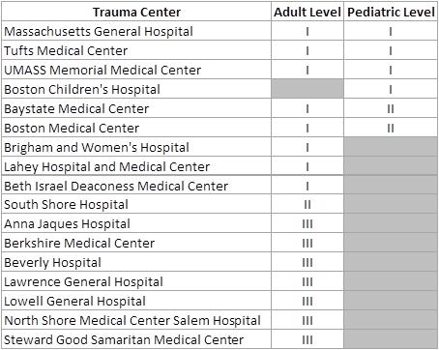
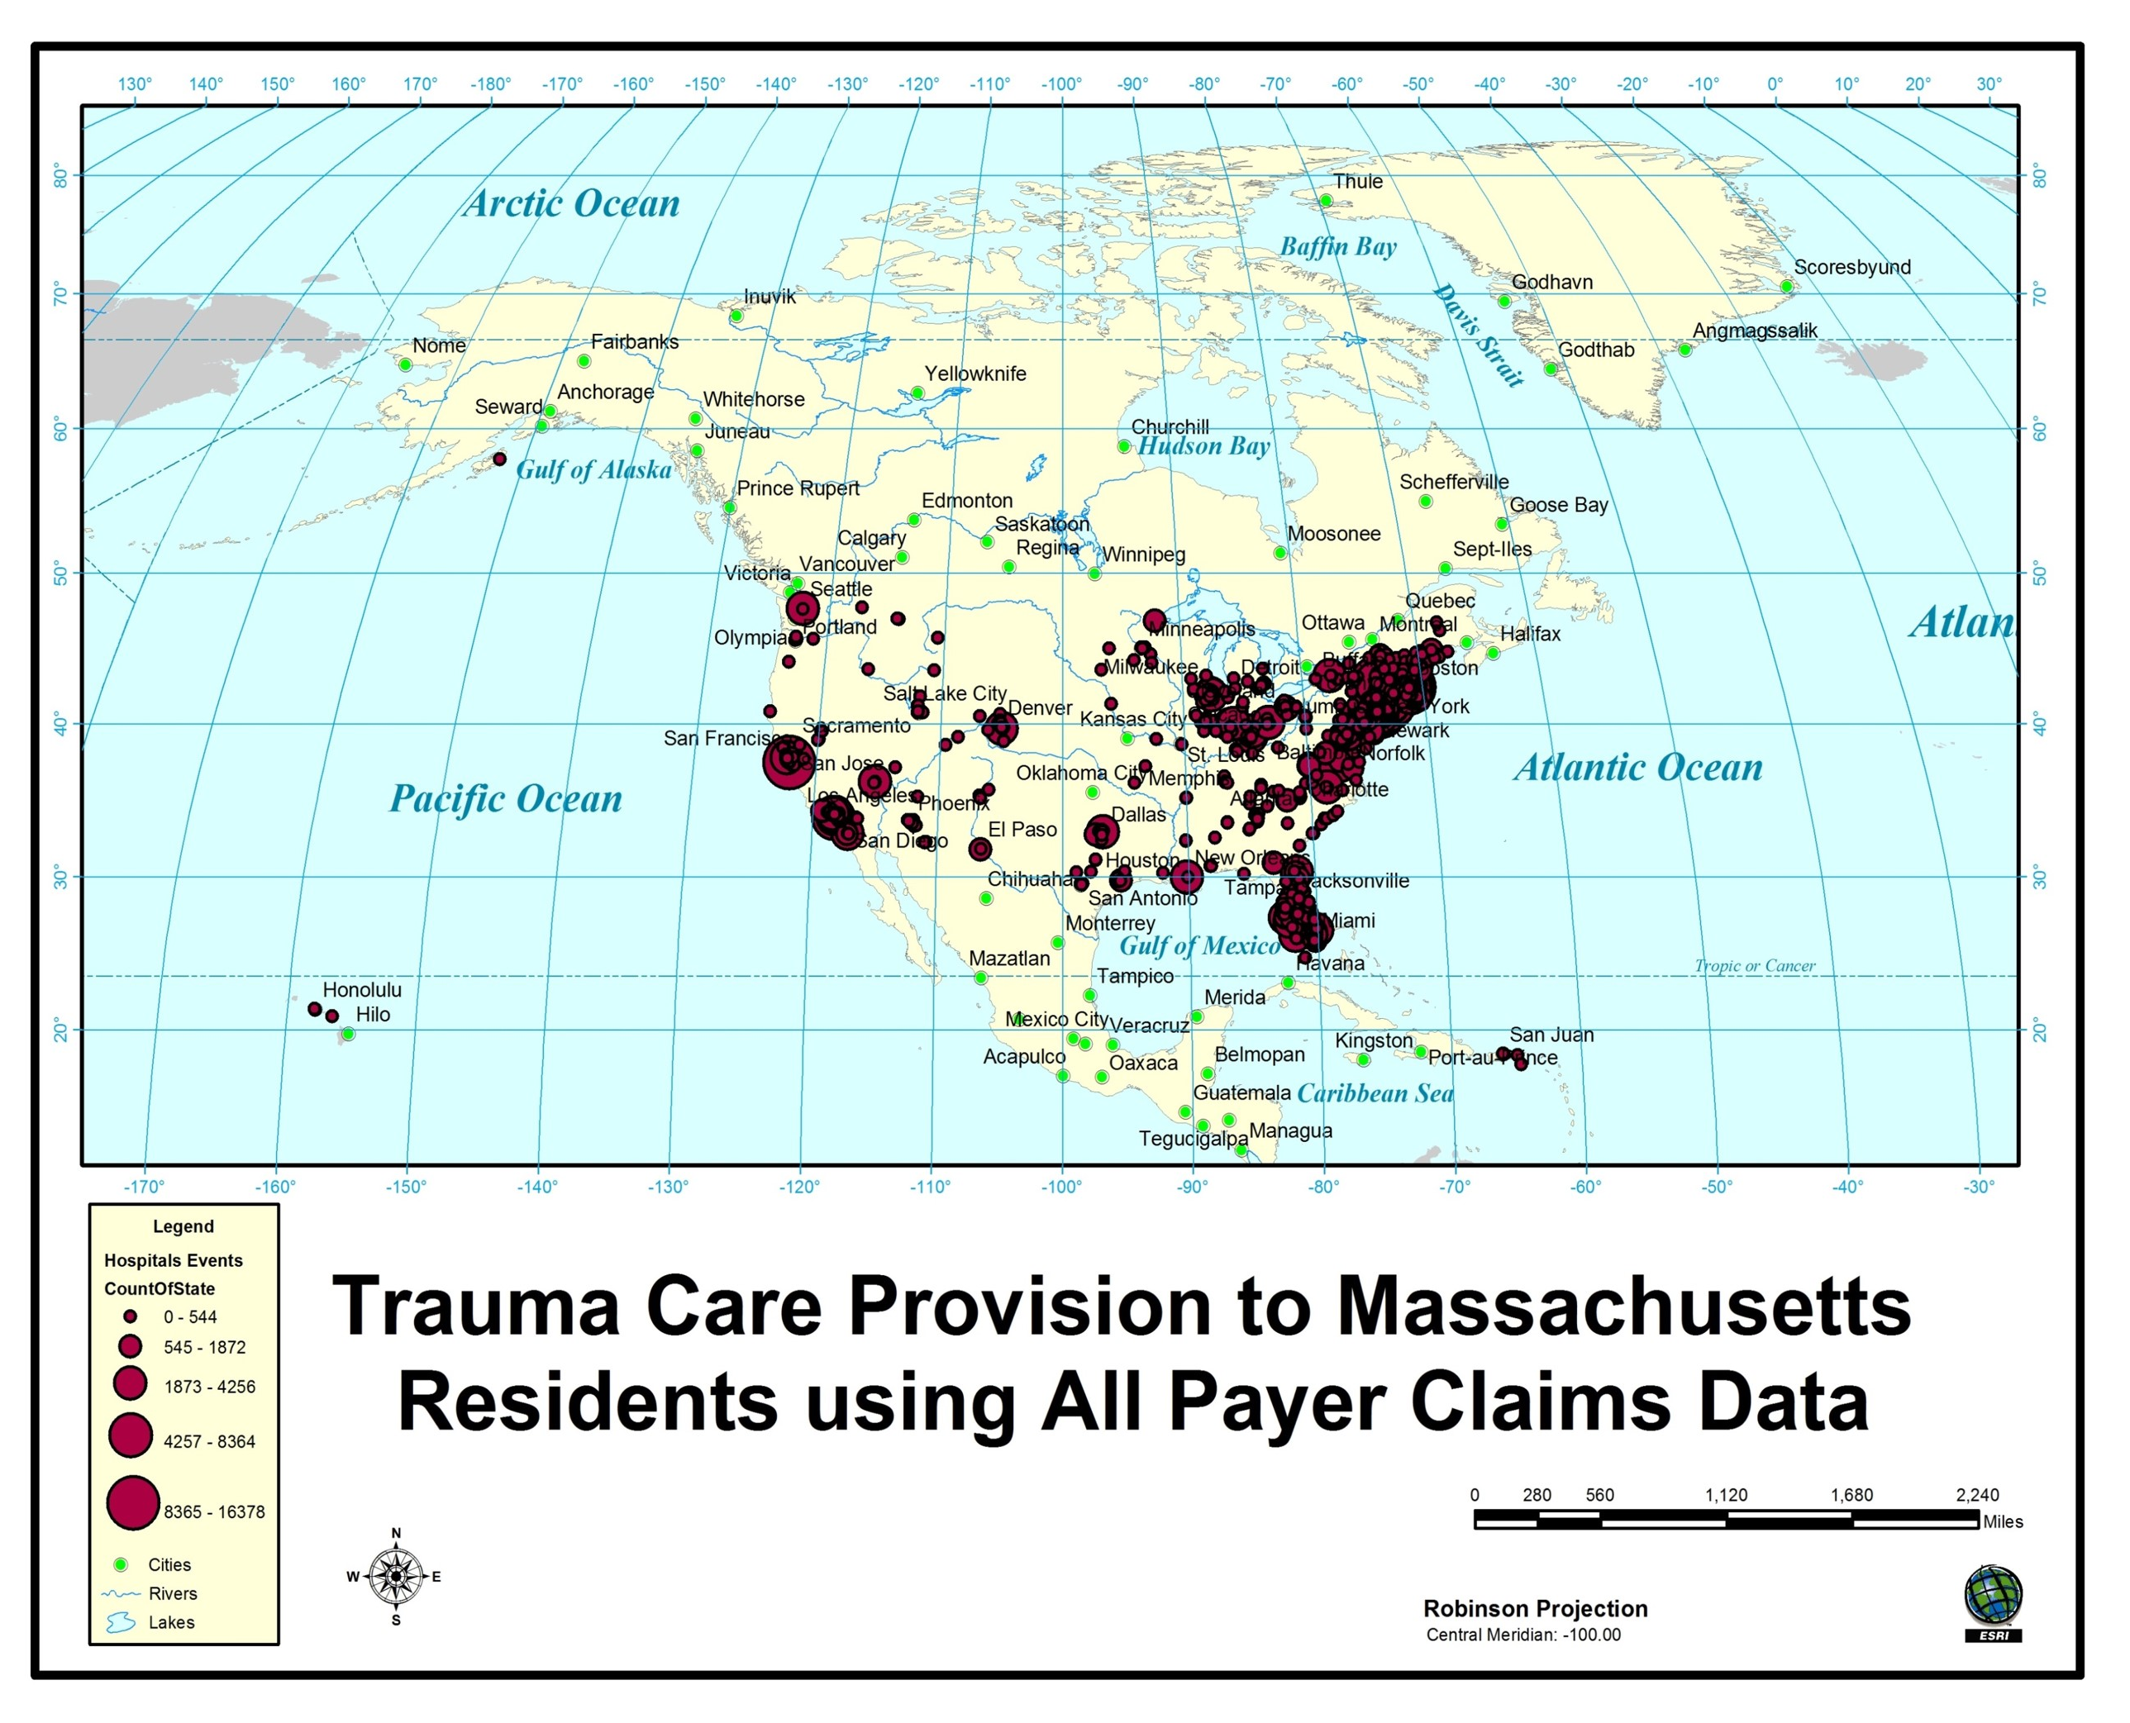
Question: The CHIA case mix data contains data from all the of the acute care hospitals
in Massachusetts. Do both the CHIA case mix data and MA APCD contain data from all
of the trauma centers verified by the American College of Surgeons?
TRAUMA CENTERS
Answer: Both the case mix data and MA APCD contain data from all Massachusetts trauma centers verified by the American College of Surgeons (ACS), see Table 1 below. However, the MA APCD contains data from trauma centers that extend beyond the Massachusetts political boundaries, see Figure 1 below. An initial release of the MA APCD was used by MDPH commercial health plan beneficiaries seeking trauma care over a 2-year period for 229,557 episodes of care needed by 91,477 MA residents analyzed for out of state inpatient trauma care seeking patterns. Investigators found that MA residents receiving care out of state constituted 9% of the patient sample with 50% of care provided in New England (NE) states bordering MA in order of the following MA patient volume ranking: RI, NH, CT, NY, ME, and VT. NE patients had increased odds of care destination through referral. Florida and Texas rank as the highest volume non-NE region sites of care. Clinically, NE patients had a higher rate of care sought for open fracture of base of skull with subarachnoid, subdural, and extradural hemorrhage, with loss of consciousness of unspecified duration than non-MA care seekers outside of the NE region.
Table 1. Massachusetts ACS Verified Trauma Centers (as of 5/25/2021)
Figure 1. Trauma Centers in the MA APCD extend beyond MA boundaries*

