Slide 1
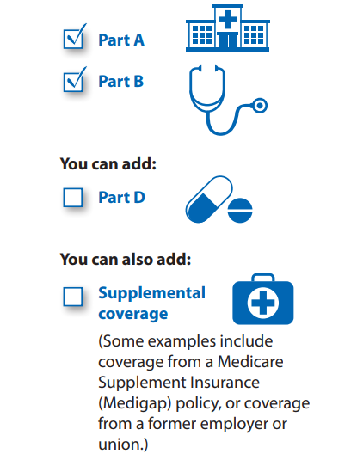
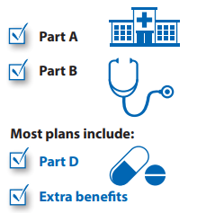
Question: MA APCD release 7.0 documentation indicates Medicare data is released only to government agencies. However, the MA APCD submission guides include product codes for Medicare. Is commercial carrier Medicare data available to non-government applicants? What type of Medicare products are included in the MA APCD and on how many beneficiaries?
MEDICARE
DATA
Answer: CHIA receives Medicare data (“Original Medicare”) from the Centers for Medicare & Medicaid Services (CMS) under a Data Use Agreement (DUA). Under terms of the DUA, CHIA only releases Original Medicare data to government* applicants. Original Medicare beneficiaries can obtain supplemental coverage through commercial carriers and have the option of receiving Medicare through commercial carrier “Medicare Advantage” plans which can include hospital, medical and pharmacy benefits. Claims data from commercial carrier supplemental coverage, pharmacy benefit managers, and Medicare Advantage plans submitted to the MA APCD are available to all applicants. According to CMS’s 2019 product guide **, the difference between Original Medicare and Medicare Advantage products is as follows:
Original Medicare
(separate extract available only to government* applicants)
Medicare Advantage
(included in the MA APCD available to all applicants)
Medicare Part A (Hospital Insurance)
Medicare Part B (Medical Insurance)
Beneficiaries can add Medicare Part D (Drug Coverage).
Beneficiaries can use any doctor or hospital that takes Medicare, anywhere in the U.S.
Medicare Advantage is an “all in one” alternative to Original Medicare. These “bundled” plans include Part A, Part B, and usually Part D.
In most cases, beneficiaries need to use doctors who are in the plan’s network.
Most plans offer extra benefits that Original Medicare doesn’t cover— like vision, hearing, dental, and more.
Note: Supplemental coverage submitted by commercial carriers directly to MA APCD is available to all applicants
Note: * Government agencies are limited Massachusetts state agencies and Federal agencies
** Understanding Medicare Advantage Plans, CMS Product No. 12026, Sept. 2019

Slide 2
Answer (continued): To gauge the number of beneficiaries who have any type of commercial Medicare products in the MA APCD as a proportion of the Massachusetts population, we assessed both medical coverage of the entire population as a proportion of the Census population and coverage for any Medicare product types as a proportion of the population 65 and older.
MEDICARE
DATA
In Table 1 below, MA census population* for 2013 to 2017 (first column) and all MA residents with medical coverage in the APCD (second column) show that data from 2013 to 2015 was close to population-based (over 95%) followed by a drop to 85% in 2016 (due to Gobeille). This drop was corroborated by comparing the Census American Community Survey estimate on insured population** under 65 years old (third column) to APCD beneficiaries under 65 with medical coverage (fourth column). In Table 2, census estimates for MA residents age 65 and over (first column) were compared to 65 and older age group in the APCD with different types of Medicare coverage (columns 2 through 7). Year 2017 showed increases for all products except Medicare Advantage, however the proportion of the population age 65 and over in the MA APCD with Medicare Advantage (26.86%) was closely aligned with CMS historical data on Massachusetts resident year 2017 Medicare Advantage enrollment (26.42%).****
Table 1. 5-Year Comparison of MA Census Population to MA APCD All Insured and Insured Under Age 65
Year | MA Census Population Estimate | MA Residents*** in APCD | MA Census Insured** Population Estimate (Under Age 65) | MA Residents*** APCD (Under Age 65)
2013 | 6,613,654 | 6,637,940 | 5,662,008 | 5,679,004
2014 | 6,668,348 | 6,687,425 | 5,691,319 | 5,676,655
2015 | 6,718,090 | 6,831,678 | 5,712,361 | 5,792,745
2016 | 6,736,017 | 5,694,862 | 5,699,946 | 4,734,582
2017 | 6,785,622 | 5,737,664 | 5,714,204 | 4,732,344
Table 2. 5-Year Comparison of MA Census Population Age 65 and Older to MA APCD
Massachusetts Residents Insured Age 65 and Older by Medicare Coverage Types
Year | MA Census Population Estimate (Age 65 and Older) | Medicare Advantage In MA APCD | Part A Only | Part B Only | Part A and B Only | Part C Only | Part D Only
2013 | 961,031 | 310,441 | 10,304 | 1,787 | 541,639 | 5,679 | 17,574
2014 | 990,097 | 337,182 | 8,579 | 1,784 | 553,741 | 5,234 | 93,269
2015 | 1,015,577 | 347,993 | 9,681 | 1,850 | 562,703 | 4,739 | 116,419
2016 | 1,044,226 | 369,268 | 6,873 | 2,227 | 517,769 | 4,203 | 134,010
2017 | 1,074,425 | 288,602 | 7,590 | 2,431 | 533,251 | 5,159 | 230,360
Notes: * Census American Community Survey Demographic Profile Data, ** Census American Community Survey Insured Population Estimate (Under Age 65) for civilian noninstitutionalized population, *** MA Residents Under 65 with Medical Coverage , **** Centers for Medicare & Medicaid Services, Office of Enterprise Data and Analytics, Data Warehouse

Slide 3

Question: What does the Medicare Code variable in the
Member Eligibility file mean and what values do its codes correspond to?
Answer: The Medicare Code variable (ME081) is used by the carrier
to report the value that defines if and what type of Medicare
coverage applies to the eligibility record using the codes shown
in the table to the right.
Part A is Inpatient/hospital coverage, Part B is outpatient/medical
coverage, Part C is Medicare coverage by private companies approved by Medicare, and Medicare Part D is prescription coverage.
MA APCD Release 8.0 Documentation Explanation of Medicare codes
ME081 Medicare Code
Value | Description
1 | Part A Only
2 | Part B Only
3 | Part A and B
4 | Part C Only
5 | Advantage
6 | Part D Only
9 | Not Applicable
0 | No Medicare Coverage
Term | Definition
Medicare Benefits (Part A & B) | Health insurance available under Medicare Part A and Part B through the traditional fee-for-service payment system. Part A is hospital insurance that helps cover inpatient care in hospitals, skilled nursing facility, hospice, and home health care. Part B helps cover medically-necessary services like doctors' services, outpatient care, durable medical equipment, home health services, and other medical services.
Medicare Advantage | A Medicare Advantage Plan (Part C) is a Medicare health plan choice offered by private companies approved by Medicare. The plan will provides all Part A (Hospital Insurance) and Part B (Medical Insurance) coverage and may offer extra coverage such as vision or dental coverage Medicare Benefits (Part A & B)
continued

Slide 4
Answer (continued): In looking at the frequency of Medicare Coding in MA APCD Release 8.0 by count of distinct MEIDs and by year for calendar years 2016 to 2019 for Massachusetts residents, while under 15% of records have a Medicare product, each year that percentage has been increasing as shown in the four charts below.
Frequency of Medicare Code (MEO81) for Massachusetts Residents by Distinct MEID Count
2019
2018
2017
2016

