Slide 1
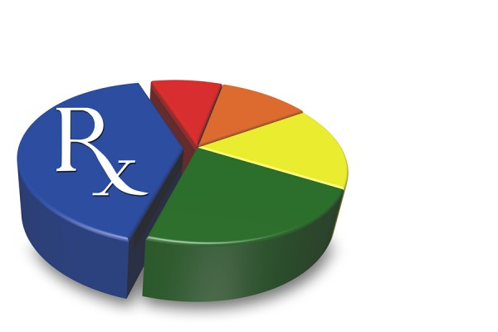
Question: I have a couple of questions regarding the pharmacy data. The Quantity dispensed field contains some very large numbers. What do they mean? What are the units? Is there any relationship between Drug units of Measure field and Quantity Dispensed field?
Answer: Yes, there is a relationship between Quantity Dispensed and Drug Units of Measure and also Days Supply. Different Drug Units of Measure and Days Supply impact the value of Quantity Dispensed. Quantity Dispensed is defined as the number of metric units of medication dispensed.
Days Supply are the number of days the prescription will last if taken as prescribed. Drug Units of Measure are the units of measure for drug dispensed using the following values:
    Code Description
    EA Each
    F2 International Units
    GM Grams
    ML Milliliters
    MG Milligram
    MEQ Milliequivalent
    MM Millimeter
    UG Microgram
    UU Unit
Quantity Dispensed, the Drug Units of Measure, and Days Supply can in combination be used to calculate dosage.
Dosage Calculation Example
If a 15-day supply consists of 30 pills at 200 mg per pill, then the daily dose would be 400 mg/day according to the following formula:
Daily Dose = (# Units Dispensed * Strength per Unit) / (Days Supplied)
QUANTITY DISPENSED EXAMPLES
QUANTITY DISPENSED of ‘ORALYTE ELECTROLYTE ‘ is 15,000 for 30 days, where DRUGUNITOFMEASURE= ‘ML’ (e.g. Liquid)
QUANTITY DISPENSED of ‘PREDNISONE‘ is 810 for 90 days, where DRUG UNIT OF MEASURE= ‘EA’ (e.g. Tablet)

Slide 2
Question: I have a couple of questions regarding the pharmacy data. The Quantity dispensed field contains some very large numbers. What do they mean? What are the units? Is there any relationship between Drug units of Measure field and Quantity Dispensed field? (continued)
Answer: For Drug Units of Measure, to illustrate the variation in metric units other than weight that measure drug properties, the Massachusetts Department of Public Health provides to pharmacists the following three examples:
Drug Units of Measure Examples
“Each” is used when referring to the following dosage forms: capsule, diaphragm, disc, patch, plaster, suppository, suture, tablet, troche, and wafer.
“ML” is used when referring to the following dosage forms: aerosol liquids (note: some formulations are powders, use “gm”), elixirs, emulsions, extracts, mouthwash, oils, shampoos, liquid soaps, solutions, sprays, suspensions, syrups, tinctures.
      For example: A pharmacist dispensed 1 package of 10 morphine sulfate syringes, each syringe containing 2 mL of 10 mg/mL morphine. The total volume dispensed is 20 mL and the Quantity Dispensed reported will be “20”.
“GM” is used when referring to the following dosage forms: aerosol powders (note: some formulations are liquids, use “mL”), creams, crystals, gels, jellies, granules, ointments, powders.

