Slide 1
Question: What fields in the MA APCD would I use to identify care provided in outpatient ambulatory surgery centers? Should I expect to see only ambulatory surgery centers in Massachusetts or also surrounding states? If I wanted to ensure that I had the location of all Massachusetts ambulatory surgery centers, would I need to include years prior 2016 drop in self-insured claims due to Gobeille v Liberty Mutual Insurance Company?
Ambulatory
Surgery
Centers
Answer: The medical claims file contains a field called service provider taxonomy field (MC032) in the release it is labeled “serviceproviderspecialty” where carriers report the standard taxonomy code for the provider associated with the service claim line. The CMS * provider taxonomy coding indicates the ambulatory surgery center is code '261QA1903X’.
In additional to code '261QA1903X’, there are a few instances where carriers have entered a code ‘49’ which is the CMS specialty code for ambulatory surgery center. These codes can be used to filter medical claims for care provided at ambulatory surgery centers. Provider numbers in the medical claims table include nine different fields. For those who request the provider table, the following six fields in the medical claims table can be linked to the provider table to obtain national provider identifiers and additional information on MC024 – the Service Provider, MC076 – the Billing Provider, MC112 – the Referring Provider, MC125 – the Attending Provider, MC134 – the Plan Rendering Provider, and MC135 – the Provider Location. For those who did not request the provider table, the medical claims limited data set table does contain dedicated National Provider Identifier (NPI) fields for three provider types that can be linked to the CMS registry to obtain the name of the ambulatory surgery center. Those three NPI fields in MA APCD medical claims limited data set are:
Taxonomy Code for Ambulatory Surgery Centers
261QA1903X
MC026 National Service Provider ID
MC077 National Billing Provider ID
MC242 Plan Rendering Nation Provider ID
*Source: National Uniform Claim Committee’s Health Care Provider Taxonomy
Code Set https://x12.org/codes/provider-taxonomy-codes
Continued

Slide 2
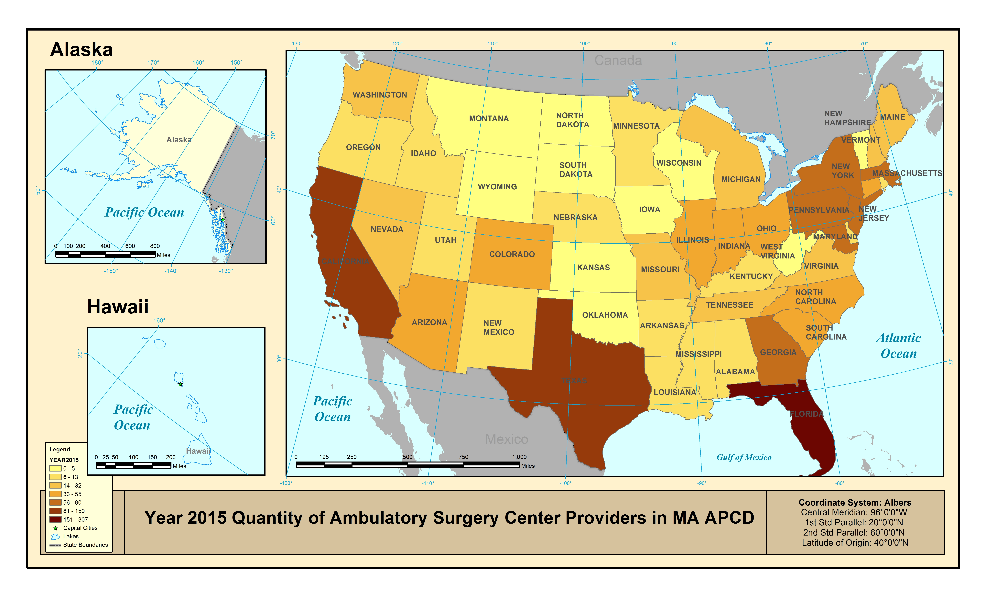
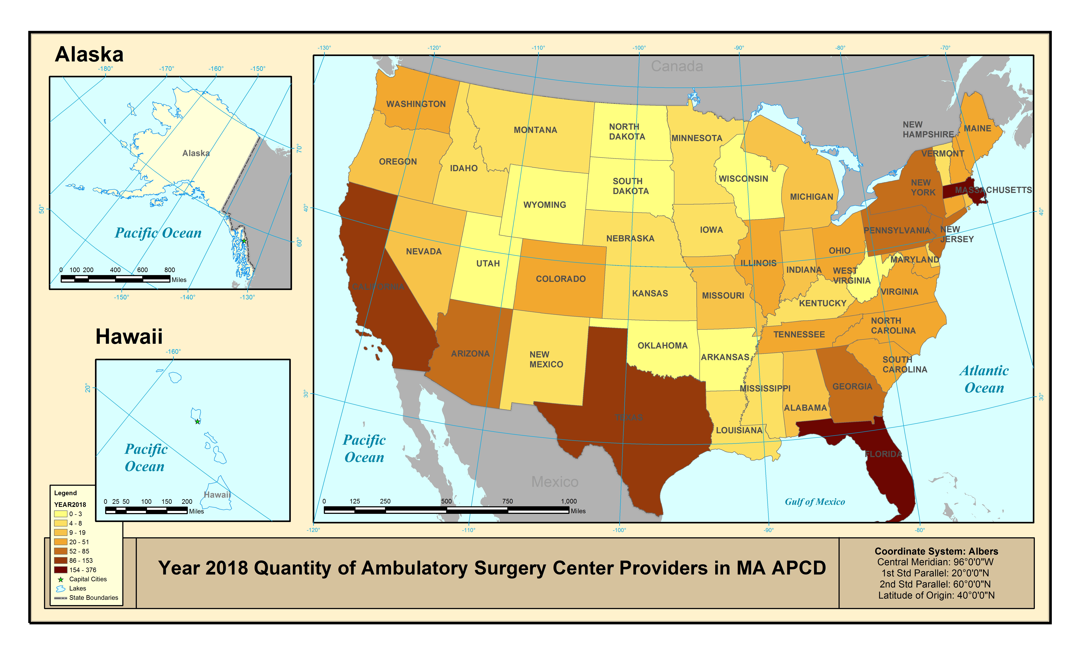
Answer (continued): While the highest volume of ambulatory surgery center medical
claims representing the largest number of people are from ambulatory surgery
centers located Massachusetts, the MA APCD nevertheless contains a certain number
of ambulatory surgery center medical claims
from every state in the U.S.
In 2015 and 2016, Florida, California, and Texas
each individually surpassed Massachusetts in
having a higher number of distinct providers with
an ambulator surgery center in the MA APCD
(defined by the taxonomy associated with unique
service provider NPIs). See Figure 1 (Year 2015).
Even though there was a reduction in medical
claims in 2016 due to Gobeille v Liberty Mutual,
in 2017 and 2018, the overall number of
ambulatory surgery center service providers in
the MA APCD increased. The number of
Massachusetts distinct NPIs with an ambulatory
surgery center taxonomy in the MA APCD
surpassed those of California and Texas in 2017,
and then surpassed Florida in 2018. The number
of ambulatory surgery center service providers in
Massachusetts more than doubled from
2015 to 2018. Compare Figure 1 (Year 2015) to
Figure 2 (Year 2018).
Ambulatory
Surgery
Centers
Figure 1. Year 2015 Ambulatory Surgery Centers in MA APCD
Figure 2. Year 2018 Ambulatory Surgery Centers in MA APCD

