Slide 1
Monthly MA APCD / Case Mix User Workgroup Webinar
May 26, 2015

Slide 2
Agenda
Announcement
Common Application Issues
Guest Presentation: Dr. Michael Barnett
Q&A

Slide 3
Announcement MA APCD Application Processing
CHIA will only be accepting applications for MA APCD from Massachusetts payers and providers that submit APCD and Case Mix data, as well as Massachusetts-based students and researchers.
Applications from all others will not be accepted until November 1, 2015
Applications submitted prior to May 13, 2015 will be processed
Case Mix is not impacted

Slide 4
Common Application Issues and Questions

Slide 5
Application Fees
Application Fee Remittance Form for non-government MA APCD and Case Mix requests: http://chiamass.gov/assets/Uploads/apcd-3-0/application-materials/Non-Government-APCD/1.-Fee-Remittance-or-Fee-Waiver-Request-Form.pdf
Reminders:
Submit this form with your check
Note CHIA’s address has changed to 501 Boylston
Online payment is not currently an option.

Slide 6
Application Revisions
Please remember to “lock” your application on IRBNet after you’ve finished making revisions to your application
Locking the application will send an automatic notification to CHIA staff letting them know that your revisions are complete and uploaded

Slide 7
Michael L. Barnett, M.D. Fellow in General Internal Medicine and Primary Care Harvard Medical School/Brigham and Women's Hospital

Slide 8
Master Patient and Provider Identifiers in the APCD
Michael Barnett, MD
Harvard Medical School & Brigham and Women’s Hospital

Slide 9
Overview
The Master Patient Index – Using the Enterprise ID
Using the Provider (PV) file for physician-level analysis

Slide 10
The Problem: Disparate Data Sources
APCD submitters have disparate identifiers for individuals
Full ME file for 2009-2012 has 37.2 million distinct ID combinations from submitters
Versus ~6.6 million residents in MA in 2010 Census
Why is this?
Submitters have their own unique system for identifying individuals
Not everyone has/can share more universal identifiers like SSN
Individuals move, change names, have erroneous data entry so can be hard to link individuals over time across plans

Slide 11
A Solution: The Master Patient Index
Master Patient Index (Derived-ME12, “Enterprise ID” or MEID) introduced in APCD v2.1
Present for ME and MC files for 2011-2012
See APCD User Workgroup from April, 2014 for detailed overview of creation of MEID
Uses probabilistic matching algorithm using available patient data to link people over time and across plans
Matching Confidence Level (Derived ME13, MCL):
2 = High Confidence Level
1 = Low Confidence Level
0 = Singleton, MEID only in one file type (= not useful for research)

Slide 12
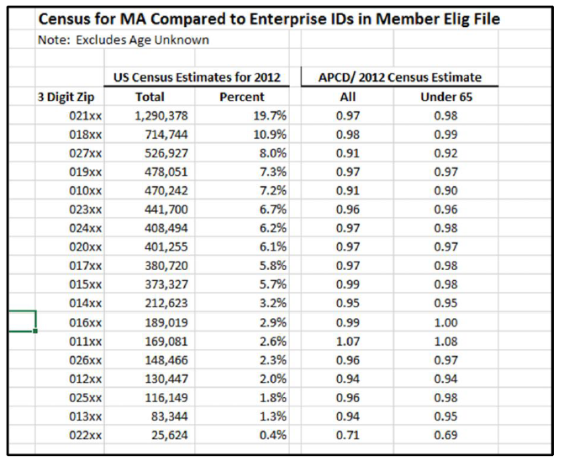
MEID Validation by Geography
Table from slide 14 in APCD User Workgroup Meeting 4-2014

Slide 13
Analysis: Persistence of MEID
Table 1: Assembling a cohort from APCD ME file
Major question: how long can we follow MEIDs over time?
Given universal health care in MA, at least 90% if not more residents should be continuously insured during the year
Moving from steps 5-7, lose 28% of MEIDs

Slide 14
Analysis: Persistence of MEID
Table 2: Number of insurers and coverage persistent for cohort from step 6 in Table 1

Slide 15
Analysis: Persistence of MEID
Despite lack of persistent with MEID, remaining cohort appears to reflect general non-elderly MA population
Population skews away from those most likely to change insurance
Fewer:
Young people
Healthier people (not shown)
MassHealth MCO
Table 3: Demographics for cohort from step 7 in Table 1

Slide 16
Overview
The Master Patient Index – Using the Enterprise ID
Using the Provider (PV) file for physician-level analysis

Slide 17
Using the Provider File: Master Provider Index
PV file: 42.2 million rows!
Enormous amounts of duplication, providers listed many times even within the same OrgID
Contains identifiers for all types of providers
Also has providers from across the country for some OrgIDs
A Master Provider Identifier exists: the NPI
But - many entries in PV file missing associated NPI
Difficult to do provider-level analysis without consistent NPI

Slide 18
Creating a Provider File Crosswalk
My strategy for creating a master provider index with NPI:
Step 1: Collect every OrgID plan provider ID (PV002, “submitter ID”) and NPI (PV039) combination
Take every combination in service (MC024, MC026) or billing provider (MC076, MC077) fields in entire MC file
Stack with all submitter IDs (PV002) and NPI (PV039) combinations in PV file
Ignoring second NPI field (PV040) for now
Keep unique combinations for complete crosswalk

Slide 19
Creating a Provider File Crosswalk
Step 2: Restrict crosswalk to providers in MA
Use PV file entries from largest OrgIDs (291, 300, 8647, 3156)
Use carrier specific lookup tables to keep only entities of interest using ProviderTypeCode (PV029, e.g. “MD” for physicians for one OrgID)
Restrict only to providers in “MA” using State Code (PV019) or Zipcode (PV021)
Can perform linkage to crosswalk from step 1 using submitter ID (PV002) or NPI depending on application
Step 3: Merge crosswalk to list of all submitter IDs providing any services in a single year
This step depends on your analytic question

Slide 20
Master Provider Index Validation
MMS Benchmark = Massachussets Medical Society Data from Physician Fact Book 2013 (http://www.massmed.org/News-and-Publications/Research-and-Studies/Physician-Fact-Book/#.VVyf4k_BzRY)

Slide 21
Master Provider Index Validation
Merging this master provider index to all professional medical claim lines with an E&M code:
13.0 million unique E&M service lines for 1.5 million continuously enrolled MA residents in 2011-2012
11.0 million (85%) could be merged to a physician NPI in my master provider index
National benchmark: ~15% of office visits with PA/NP only

Slide 22
Thank you!
Michael Barnett
mlb748@mail.harvard.edu
http://scholar.harvard.edu/mbarnett
@ml_barnett

Slide 23
Questions?
General questions about the APCD:
(CHIA-APCD@state.ma.us)
Questions related to APCD applications: (apcd.data@state.ma.us)
Questions related to Casemix: (casemix.data@state.ma.us)

Slide 24
Calendar
April 30 – April Data Release Committee Meeting
May 26 – May APCD / Case Mix User Workgroup
May 28 – May Data Release Committee Meeting

