Slide 1
Monthly MA APCD / Case Mix User Workgroup Webinar
April 28, 2015

Slide 2
Agenda
Announcements
Updates on MA APCD Release 3.0
Common Application Issues
Questions from Current APCD Users
Q&A

Slide 3
MA APCD Release 3.0
Now accepting applications!
Application forms for Release 3.0 have been posted to the CHIA website and IRBNet
  Available for both Government and Non-Government applicants
PLEASE READ – Important information for Non-Government applicants:
  http://chiamass.gov/assets/Uploads/apcd-3-0/Important-Info-Non-Govt-Data-Requests-2015.02.17.pdf
  Explains new process and minimum security requirements

Slide 4
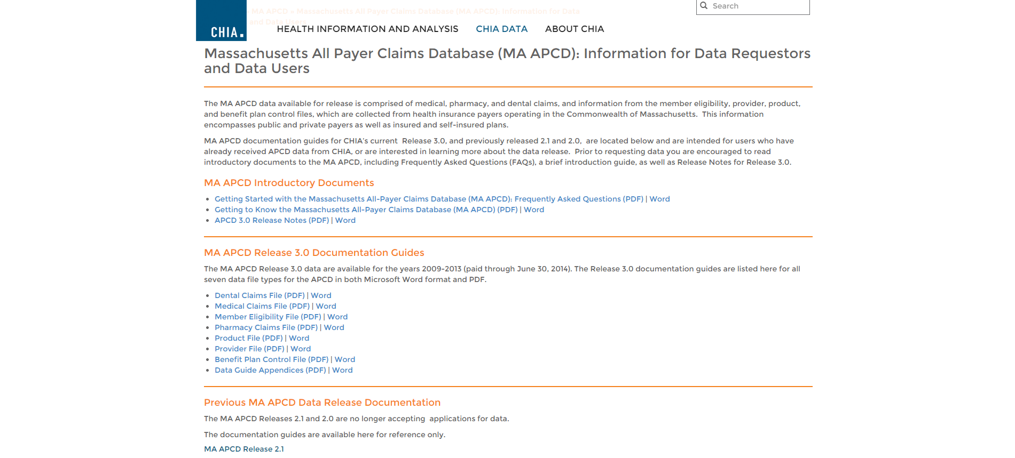
MA APCD Release 3.0
Now accepting applications!
MA APCD Release 3.0 Release Notes and Documentation Guides can be found here: http://chiamass.gov/ma-apcd-information-for-data-requestors-and-users/

Slide 5
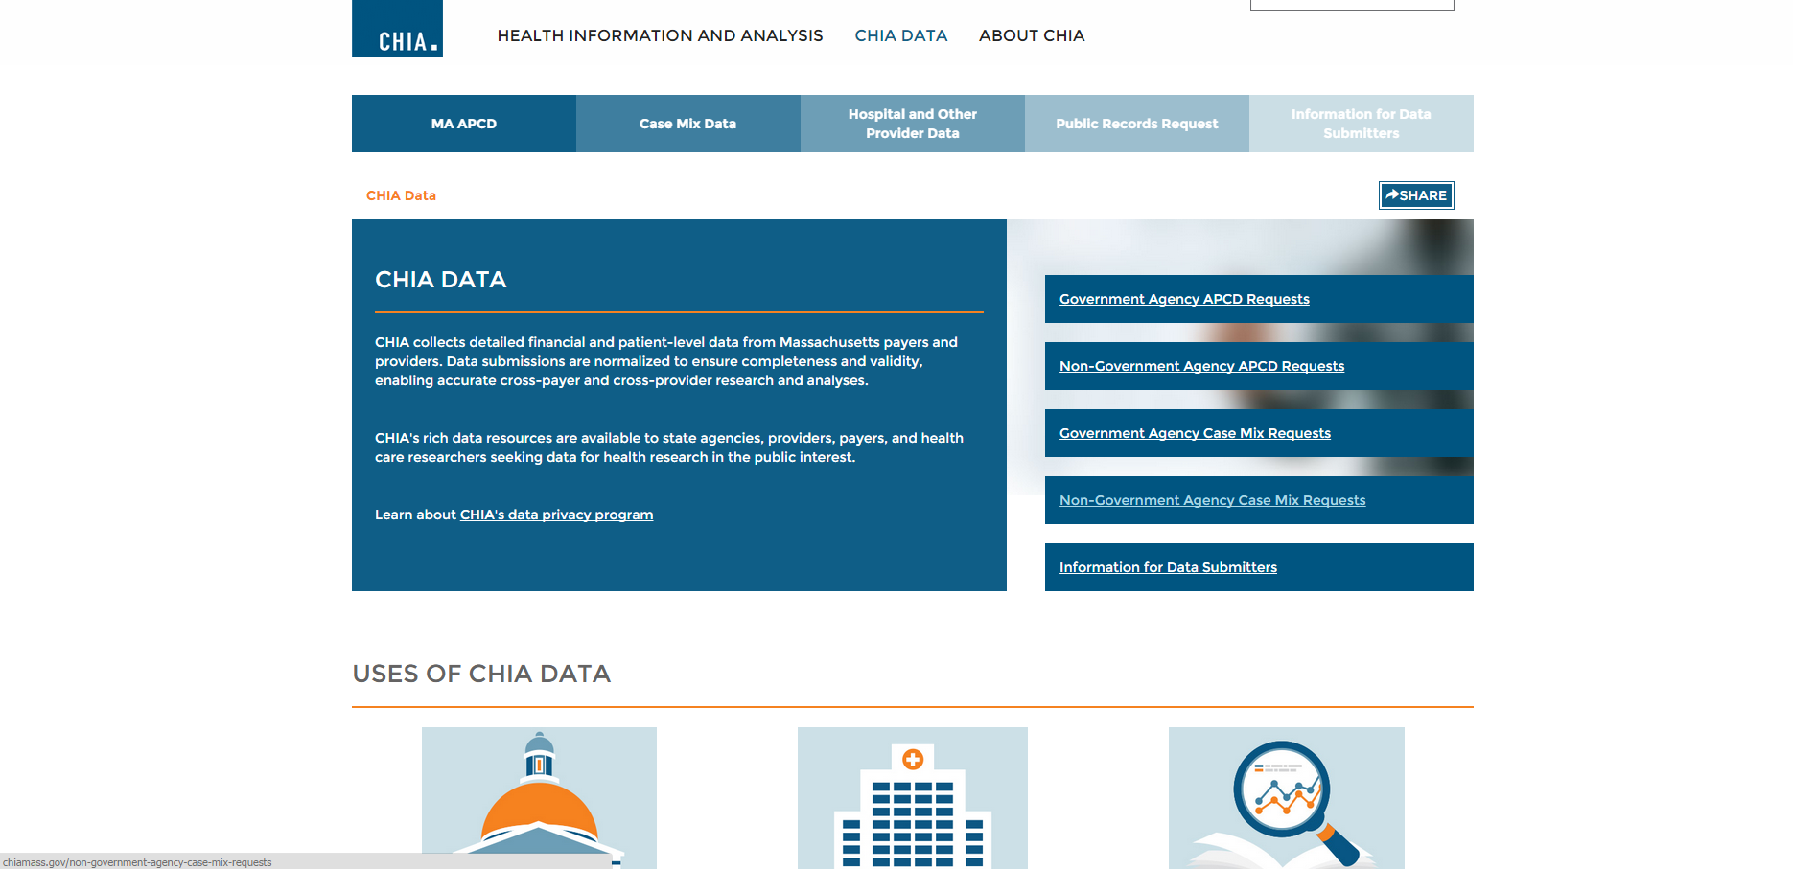
CHIA Website Updates
New landing page for CHIA Data: http://chiamass.gov/chia-data/

Slide 6
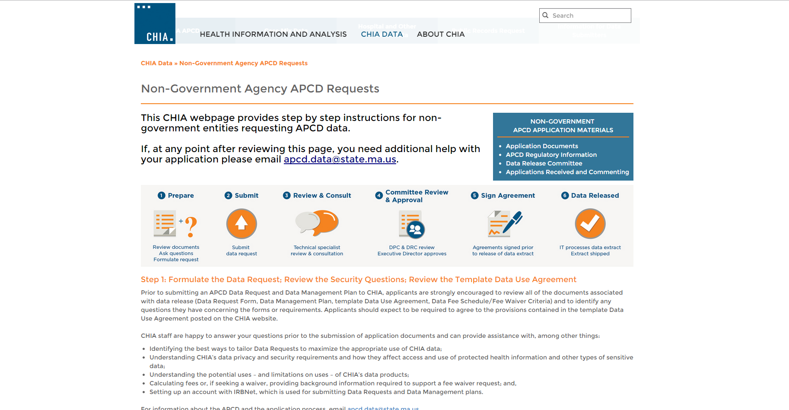
CHIA Website Updates
Some recent content changes to the application pages:
Instructions for Non-Government Agencies (MA APCD Requests)
Notes:
.

Slide 7
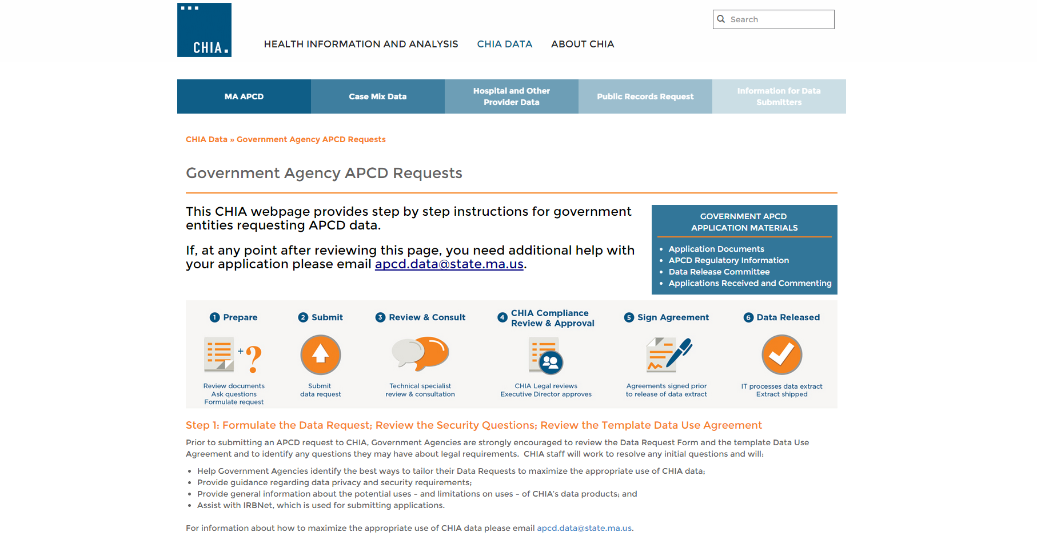
CHIA Website Updates
Instructions for Government Agencies (MA APCD Requests)

Slide 8
CHIA Website Updates
Case Mix Application pages:
Government Requests - http://chiamass.gov/government-agency-case-mix-requests/
Non-Government Requests - http://chiamass.gov/non-government-agency-case-mix-requests/

Slide 9
Common Application Issues and Questions

Slide 10
Application Fees
Application Fee Remittance Form for non-government MA APCD and Case Mix requests: http://chiamass.gov/assets/Uploads/apcd-3-0/application-materials/Non-Government-APCD/1.-Fee-Remittance-or-Fee-Waiver-Request-Form.pdf
Reminders:
  Submit this form with your check
  Note CHIA’s address has changed to 501 Boylston
  Online payment is not currently an option.

Slide 11
APCD Extract Size
Question:
What is the typical size of an MA APCD extract? We need to determine how much storage capacity we need to purchase.
Answer:
For a typical request, 1.5TB-2.0TB is a good estimate. It can be more or less than that, depending on how many years are requested and the number of elements requested.

Slide 12
Single vs Multiple Use
Question:
Our APCD research project has multiple aims. Does this qualify as Single or Multiple use?
Answer:
A single use project can have multiple aims. For the APCD, CHIA Administrative Bulletin 15-02 defines Single Use as “one-time uses such as those that cover one project or study.”
The “product” of a single use is a journal article, seminar, or other report on the project or study that may contain summaries of the data pertinent to the research or analysis.

Slide 13
Single vs Multiple Use
Multiple Use definition (from Administrative Bulletin 15-02):
a project or study involving limited ancillary uses, such as:
  development and sale of custom reports for specific clients where the data is part of a larger analytical service;
  analyses by a provider, plan or other organization where use of the data functions as a site license; or
  development and sale of analytical tools such as severity indices or weights where the data is a component used in deriving the tool but the tool does not access or disclose the data; or
multiple primary uses, such as:
  development and sale of reports principally composed of all or a portion of the data;
  development and sale of a product facilitating the use of all or a portion of the data; or
  integrating the data with data from other permitted sources, with or without related

Slide 14
User Questions

Slide 15
User Question: Final amounts
Question:
Do the costs on the final version line of the claim show the final amount that the individual/insurer is paying or are costs added/subtracted along the way when there are multiple versions making it necessary to sum over the entire claim to get the final amounts?
Answer:
Both the version number and the status of the claim have to be considered. For example, if the claim is the highest version and the amount is a backout then the amount should be subtracted from the original claim.

Slide 16
User Question: Adjudicated claims
Question:
When a claim is adjudicated, is it always the case that a new version of the same claim (same claim ID i.e. payer + payerclaimcontrolnumber) is created or are there cases/insurers who generate an entirely new claim?

Slide 17
User Question: Adjudicated claims
Answer:
You have to pay attention to the version number, claim status, and claim line type. This allows you to distinguish an amendment (Claim Line Status Code A – Highest Version Code 2) to the original claim (Claim Line Status Code O – Highest Version Code 0).
In instances where there is a new claim, the former claim number field is populated, although some carriers have a variance on reporting the former claim number because that data isn’t currently integrated into the system from which they generate their APCD for the State.

Slide 18
User Question: Adjudicated claims
Payer Claim Control Number | Line Counter | Version Number | Claim Line Type | Claim Status | Procedure Code | Charge Amount | Paid Amount | Date of Service From
MZ110228E5331 | 1 | 0 | O | 1 | 99401 | $ 50.00 | $ 25.00 | 2/17/2011
MZ110228E5331 | 1 | 1 | B | 22 | 99401 | $ 50.00 | $ (25.00) | 2/17/2011
MZ110228E5331 | 1 | 2 | A | 1 | 99401 | $ 50.00 | $ 30.00 | 2/17/2011

Slide 19
User Question: Principle diagnosis field
Question:
Is the use of the principle diagnosis field consistent and is it always used as the primary purpose of the visit?
Answer:
Yes, with respect to claims data.
For billing purposes, the principal diagnosis is part of the algorithm that drives the creation of outpatient Ambulatory Payment Classification Groupers (APG) and Inpatient Diagnosis Related Groupers (DRGs).

Slide 20
Questions?
General questions about the APCD:
(CHIA-APCD@state.ma.us)
Questions related to APCD applications: (apcd.data@state.ma.us)
Questions related to Casemix: (casemix.data@state.ma.us)

Slide 21
Calendar
April 30 – April Data Release Committee Meeting
May 26 – May APCD / Case Mix User Workgroup
May 28 – May Data Release Committee Meeting

