Slide 1
Monthly APCD User Workgroup Webinar
April 22, 2014

Slide 2
Agenda
Release 2.1
Master Patient Index
Applying for Release 2.1
Questions/SME Office Hours

Slide 3
Release 2.1 Features
Same data as in Release 2.0
  Dates of service (2009-12 paid thru June 13)
  No new data submissions
Important data enhancements
  Highest version flags for three more payers
  Master Patient Index on CY 2011 and 2012* data
* Including 6 months of run out.

Slide 4
Master Patient Index - Summary
Custom probabilistic matching algorithm based on MA APCD data submissions
  IBM Initiate Software
  Refined by 12,000+ manual reviews of proposed matches by CHIA staff
Resulting data elements
  MEID – Member Enterprise ID
  MCL - Matching Confidence Level

Slide 5


The Problem
Over 100 sources of data
Rolling 24 months of eligibility
65M records/month
Probabilistic model:
  Low tolerance for false positives
  Minimize false negatives
  No manual reviews
Matching Decision
Match
Don’t Match
Same
Member
Correct
Decision
False
Negative
Truth
Different
Member
False
Positive
Correct
Decision
Adapted from IBM

Slide 6
Data Elements Used in Model
Partial List
  Member Name
  Member SSN
  Member DOB
  Member Address
  Member Gender
  Subscriber SSN
  CarrierSpecificUniqueMemberID and Organization ID

Slide 7
Comparison Components
False negatives are often caused by variation in data – nicknames, spelling error, transpositions, etc.
The comparison functions compare attribute values from two records and determine how closely they match
They are empirically derived
  When you compare attributes, what types of errors do you observe?
  How do you measure “close”?
IBM Initiate has a library of these functions which include …
  General routines which can be applied to arbitrary attributes
    Edit distance – 555059552 and 554045952 are 2 apart
    Resolution-based – postal codes agree exactly or on the first n digits
  Specific routines based on IBM experience
    Person names – Exact match, nickname match, phonetic match, name-to-initial match, edit distance – check all alignments
    Address – Consider different weights for numeric tokens versus alpha tokens
Source: IBM

Slide 8
Modeling Process
The IBM MDM Weight Generation Process
Manual Adjustment and Adding of Weights
  Based on feedback from Sample Pairs Review process
  Over 12,000 samples reviewed by hand
Creation of filters to reduce false positives, for example to assure the following types of matches can not be linked even with some similar data fields:
  Father/Son, Mother/Daughter
  Siblings
  Twins

Slide 9
The Matching & Linking Process
1
The MDS receives a record added to source
4
The MDS selects candidates from the DB
2
The MDS standardizes the record…
Standardize
And Derive
3
SMTH
… and creates derived data
Select
Candidates
5
SMZT
IBM Initiate Master Data Service™
Engine
SMZT
JNZ
12
YNG
SMTH
Smith
SMTH
Compare
and Score
-2
PLK
RLF
RLF
1
SPNR
SPNR
PWL
Link (or not)
JTR
6
5
And links the inbound record
The MDS scores the comparisons
1
2
3
Source: IBM

Slide 10
Result: Member Enterprise ID
19 digit number
Assigned by the system to each “entity group”
No embedded intelligence in the number
Appears on the Member Eligibility and Claims files

Slide 11
Entity Group Simplified Example
 | Name | Address | DOB | Gender
MC Record 1 | Charles M Smith | 18 Main Street | 12/12/94 | M
MC Record 2 | Charles Smith | 18 Main St | 12/12/95 | M
MC Record 3 | CM Smith | 18MainSt | 12/12/94 | M
ME Record 1 | Charlie Smith | 19 Main St | 12/2/94 | Unknown
ME Record 2 | Charles Smith | 18 Main | 12/12/94 | F
PC Record 1 | Charles N Smith | 18 Main Street | 12/12/84 | M

Slide 12
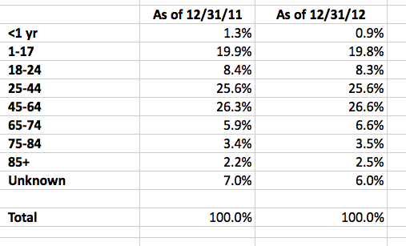
Master Patient Validation
Distribution of Member Enterprise IDs by Age
YE 2011 and 2012

Slide 13
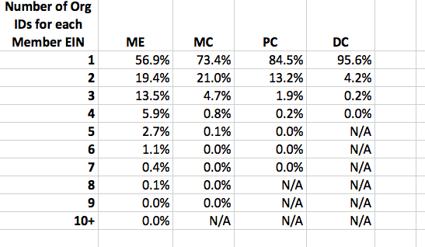
Master Patient Validation
Number or Org IDs for Member Enterprise ID in 2011 and 2012
*Excludes carve outs.

Slide 14
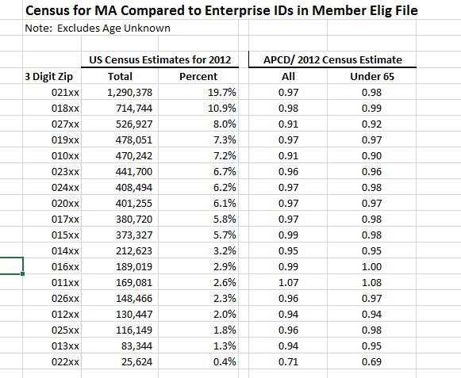
Master Patient Validation
Member Enterprise ID Compared to US Census Estimate by MA 3 Digit Zip Code

Slide 15
Matching Confidence Level
Assigned by CHIA to each entity group
Based on lowest match value…weakest link
Three values
Value | Meaning
2 | High Confidence Level
1 | Low Confidence Level
0 | Singleton Member Enterprise ID appears in just one file type

Slide 16
Among Topics CHIA is Analyzing
Whether singletons are more prevalent in certain payers and/or file types
Linkages between carve out vendors and primary risk holders
Turnover, persistency, etc.

Slide 17
Receiving Release 2.1
New documentation and application forms available on/around April 30th
Fulfillment times are not expected to change (3 months from initial application to delivery of data, on average)
You can apply for Release 2.1 on current forms and start the review process now

Slide 18
May Dates
– Monthly APCD Technical Assistance Group Meeting
– Monthly APCD User Workgroup Webinar
– Data Release Committee (DRC) Meeting

Slide 19
Questions?
General questions about the APCD:
(CHIA-APCD@state.ma.us)
Questions related to APCD applications: (apcd.data@state.ma.us)
Questions related to Casemix: (casemix.data@state.ma.us)

