Slide 1
Monthly MA APCD User Workgroup Webinar
August 26th, 2014

Slide 2
Agenda
Announcements
Common Application Issues / Questions
Questions from Current APCD Users
Tutorial on how to count patients admitted through the ED in Case Mix data
Tutorial on how to identify managed care patients in the MA APCD

Slide 3
Announcements
Case Mix Level 1 is now fully de-identified
  Still not a “public” dataset, however
  You must still apply for the data the same way you would apply for any other Case Mix data

Slide 4
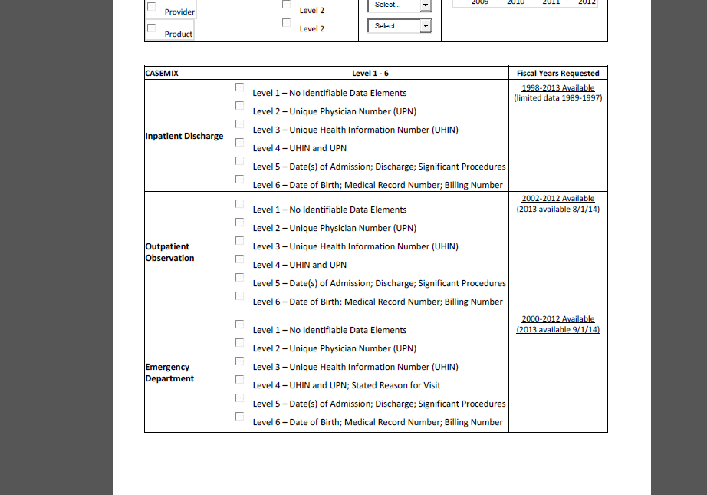
Common Application Issues
#1 – Failure to specify which years of data are requested

Slide 5
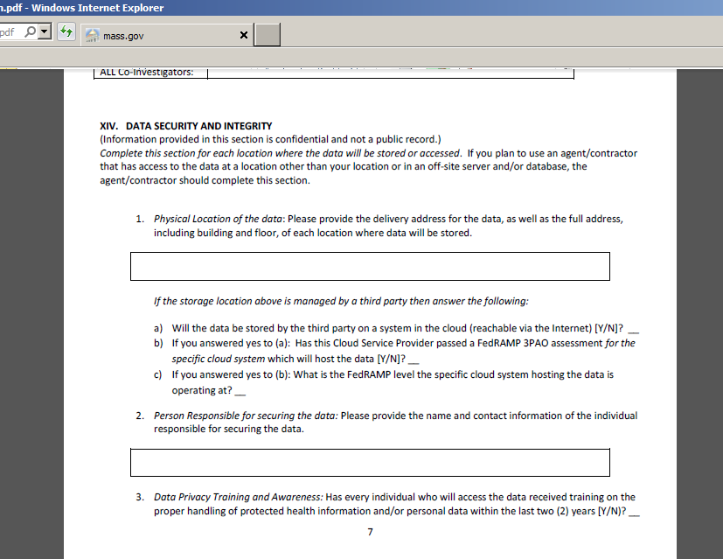
Common Application Issues
#2 - Data security questions left BLANK

Slide 6
Common Application Issues
#3 – Missing application materials
Required prior to REVIEW:
Data Request Application
Data Specification Worksheet
Research Methodology
Application Fee / Request for Fee Waiver
Documentation of IRB Approval (if necessary)
Required prior to FULFILLMENT:
Data Use Agreement
Confidentiality Agreements for All Members of the Project Team
Research Methodology
Medicaid Acknowledgement of Conditions (if applicable)
Fee Waiver Request
Required prior to DELIVERY OF DATA:
Data Fees
[unless you applied for and were granted a fee waiver by CHIA]

Slide 7
Questions from MA APCD Users
QUESTION #1
The Member Deductible (ME049), Medical Deductible (ME111), Pharmacy Deductible (ME112), and Behavioral Health Deductible (ME114) seem to be categorical variables.
For instance for Member Deductible, values range from 0-60, with smaller step-wise increments in the lower values (0,1, 1.5, 2, 2.4, 4, 3.5, 4, 5, 6, 7….40, 50, 60 etc).
This does not match what is specified in the submission guidelines.

Slide 8
Questions from MA APCD Users
QUESTION #1 - Answer
For currency fields, CHIA imputes a decimal. Note that '0' is a value (not null).

Slide 9
Questions from MA APCD Users
QUESTION #2
Around 54% of members in the claims sample (when de-duplicated by payer specific member code) have no value in the Member Deductible (ME049) variable.
Do you have any thoughts on why these values might be missing for those members?

Slide 10
Questions from MA APCD Users
QUESTION #2 - Answer
A-level fields can have a value of '0'. Please note that member deductible (ME049) is not the same as medical deductible (ME111), as described in the Submission Guide.
Note that about 90% of ME049 values are expected to be valid and that carriers may request a variance for a threshold lower than 90%.

Slide 11
Questions from MA APCD Users
QUESTION #3
The Product File Layout makes references to a Lookup Table similar to the other files (Medical Claims, Dental Claims, etc), but there does not seem to be an appended lookup table in this file’s documentation.
Could you point us to the correct document to find the file element Lookup Table for the Product File?
We do see similar information in the Product File submission guide – can we assume those definitions are the same as what would be found in the Lookup Table?

Slide 12
Questions from MA APCD Users
QUESTION #3 - Answer
Tables are embedded in the Submission Guide. Please note that tables will be added to the Release 3.0 Documentation Guide.

Slide 13
Questions from MA APCD Users
QUESTION #4
What is a Coordinated Care model (PR014) for APCD purposes? Does this include HMOs?
Currently appears that 75% of patients are in a “coordinated care model.”
The submission guide states that “1” means “Member's care is clinically coordinated/managed,” but we were wondering if you have further insight into how the payer determines or tracks this field.

Slide 14
Questions from MA APCD Users
QUESTION #4 - Answer
With the 649,759 Products that have Code 1 (Yes) for the Coordinated Care Model, 88.98% of those products are attributable to HMOs.
For Release 2.1, this is a C-level field.
Payers provide information on their website about their Coordinated Care Models. In addition, payers are indicating on their websites their support of GIC’s Centered Care Initiative. For more information on this initiative and how it relates to coordinated care, see GIC website.

Slide 15
Questions from MA APCD Users
QUESTION #5
What is a Health Care Home (ME035-39) for APCD purposes?
Currently 7% of patients are reported as in one.
The list of named Health Care Homes includes large hospitals and individual providers. The submission guide defines these as “patient centered medical home,” so does that mean that these patients were assigned to a recognized PCMH as of the date of submission?

Slide 16
Questions from MA APCD Users
QUESTION #5 - Answer
Approved PCMH is determined by each carrier using their own criteria.
For B- and C-level fields, intake edits are applied but a file does not fail (as noted in the Documentation).

Slide 17
TUTORIAL
How to Count Patients Admitted from the Emergency Department (ED) in the Casemix Hospital Discharge Data (HDD)

Slide 18




How Do I Count Patients Admitted from the Emergency Department (ED) in the Casemix Hospital Discharge Data (HDD)?
Patient Inpatient Admissions Trajectory
Emergency Department
Patient Arrives at Outpatient ED
Patient is a direct Outpatient
Observation Stay
Patient Admitted to Hospital
Patient is a direct Inpatient Admission
Routine Discharge, Left Against Medical Advice, Discharged/Transferred to another facility, Expired while inpatient
Patient Seen in Observation Stay
Dead on Arrival, Routine Department, Left Against Medical Advice, Transferred, Expired in ED
Patient Admitted to Hospital
Routine Departure, Left Against Medical Advice, Transferred, Expired in Observation Stay
Patient Admitted to Hospital
Observation Stay
Inpatient Admission

Slide 19

How to Count Patients Admitted from the Emergency Department (ED) in the Casemix Hospital Discharge Data (HDD)
Patients admitted directly from the ED do not have a record in the ED Visit data. Services associated with their ED visit are rolled into their inpatient hospital discharge data (HDD). If you need to include these patients in an ED volume count or determine what proportion of ED patients contribute to inpatient discharge volume, here are the methods you can use.
ED Flag Code
HDD contains an ED Flag Code with the following coding options:
METHOD
Filter by ED Flag Code 2
ED Flag Code | Admitted ED Patient Status Definition
0 | Not admitted from the ED, no ED visit reflected in this record
1* | Not admitted from the ED, but ED visit(s) reflected in this record
2 | Admitted from the ED
Filter HDD by ED Flag Code 2 to count inpatient discharges admitted from the ED
Approximately 90% of hospitals submit enough data ED Flag Code data to determine the number of patients admitted through the ED. Other field can be used to determine admissions through ED for the other 10%.
* Note: Code 1 is for patients not admitted as an inpatient directly from the ED, but a recent ED visit is included in
this record because of “payment window” rules.

Slide 20
How Do I Count Patients Admitted from the Emergency Department (ED) in the Casemix Hospital Discharge Data (HDD)? (continued)
Source of Admission
While 90% of hospitals consistently use the ED Flag Code to indicate admissions through ED, for the 10% that do not, primary and secondary source of admission codes can be used.
HDD contains Source of Admission Code with the following coding options:
0 = Information N/A | 9 = Other (to include level 4 Nursing Facility)
1 = Direct Physician Referral | L = Outside Hospital Clinic Referral
2 = Within Hospital Clinic Referral | M = Walk-In/Self Referral
3 = Direct Health Plan or HMO Referral | R = Within Hospital ED Transfer
4 = Transfer from an Acute Hospital | T = Transfer from Another Institution’s Ambulatory Surgery
5 = Transfer from a SNF | W = Extramural Birth
6 = Transfer from Intermediate Care | X = Observation
7 = Outside Hospital ED Transfer | Y = Within Hospital Ambulatory Surgery Transfer
8 = Court/Law Enforcement
METHOD
Filter by Code R
Filter HDD by Primary or Secondary Source of Admission Code R to count Inpatient discharges admitted from the ED

Slide 21
How Do I Count Patients Admitted from the Emergency Department (ED) in the Casemix Hospital Discharge Data (HDD)? (concluded)
Revenue Codes
Outpatient ED services provided to those admitted to inpatient status appear in the inpatient HDD Revenue Codes.
HDD contains Revenue Codes with the following coding options for ED use:
METHOD
Filter by Revenue
Codes
0450 = Emergency Room
0451 = Emergency Room: EM/EMTALA
0452 = Emergency Room: ER/ Beyond EMTALA
0456 = Emergency Room: Urgent care
0459 = Emergency Room: Other emergency room
0981 = Professional fees : Emergency room
Filter HDD by Revenue Codes associated with ED use
The most commonly used revenue code for emergency department services is Revenue Code 0450. In the past 2 years, a few began using codes 0459 and 0981.

Slide 22
TUTORIAL
What APCD Fields Can be Used to Filter for Medicaid Managed Care Beneficiaries?

Slide 23
In Currently Released Data, Two APCD Fields in the Product File and Eligibility File Can be Used to Filter for Medicaid Managed Care Beneficiaries
Product File – PR004 – Product Line of Business
Member Eligibility – ME003 – Insurance Type /Product
Code | Product Line Of Business Model
12 | Preferred Provider Organization (PPO)
13 | Point of Service (POS)
14 | Exclusive Provider Organization (EPO)
15 | Indemnity Insurance
16 | Health Maintenance Organization (HMO) Medicare Advantage
AC | Accident Only
BH | Basic Hospital
CH | CHAMPUS
DM | Dental Maintenance Organization
DS | Disability
HC | HMO - Closed
HO | HMO - Open
IN | Individual
LM | Liability Medical
MC | Medicaid FFS
MO | Medicaid Managed Care Organization
MP | Medicare Primary
MR | Medicare
OF | Other Federal Program (e.g. Black Lung)
PC | Medicaid Primary Care Clinician Plan
PR | Preferred Provider Organization (PPO)
QM | Qualified Medicare Beneficiary/SLMB
SA | Self Administered Group
SC | Senior Care Option
SP | Supplemental Policy
TV | Title V
VA | Veterans Administration Plan
WC | Workers' Compensation
ZZ | Mutually Defined Other
Code | Insurance Type
12 | Preferred Provider Organization (PPO)
13 | Point of Service (POS)
14 | Exclusive Provider Organization (EPO)
15 | Indemnity Insurance
16 | Health Maintenance Organization (HMO) Medicare Advantage
17 | Dental Maintenance Organization (DMO)
AM | Automobile Medical
DS | Disability
HM | Health Maintenance Organization
HN | HMO Medicare Risk/Medicare Part C
LI | Liability
LM | Liability Medical
MA | Medicare Part A
MB | Medicare Part B
MC | Medicaid
MD | Medicare Part D
MO | Medicaid Managed Care Organization
MP | Medicare Primary
OF | Other Federal Program (e.g. Black Lung)
QM | Qualified Medicare Beneficiary
SC | Senior Care Option
SP | Supplemental Policy
TV | Title V
VA | Veterans Administration Plan
WC | Workers' Compensation

Slide 24
In the June 2013 APCD Specifications, a new Medical Claims Field was incorporated to designate Medicaid Managed Care Beneficiaries
In addition to Product File – PR004 – Product Line of Business and
Member Eligibility – ME003 – Insurance Type /Product, in June 2013 filing specifications a new data element to designate
New Field MC241 Member Enrollment Type
Value | Description
1 | FIG - Fully-Insured Commercial Group Enrollee
2 | SIG - Self-Insured Group Enrollee
3 | GIC - Group Insurance Commission Enrollee
4 | MCO - MassHealth Managed Care Organization Enrollee
5 | Supplemental Policy Enrollee
6 | ICO - Integrated Care Organization
0 | Unknown / Not Applicable
**Will be available with Release 3.0**

Slide 25
Questions?
General questions about the APCD:
(CHIA-APCD@state.ma.us)
Questions related to APCD applications: (apcd.data@state.ma.us)
Questions related to Casemix: (casemix.data@state.ma.us)

Slide 26
Upcoming Workgroup Topics
CHIA will be publishing data profiles in the coming months
  Frequencies on common fields for the top 7 payers
Lessons learned from CHIA’s analysis of the Member Eligibility file
Additional Suggestions?

Slide 27
Poll
Are you interested in seeing more information / tutorials during these webinars on Case Mix data?

