Slide 1
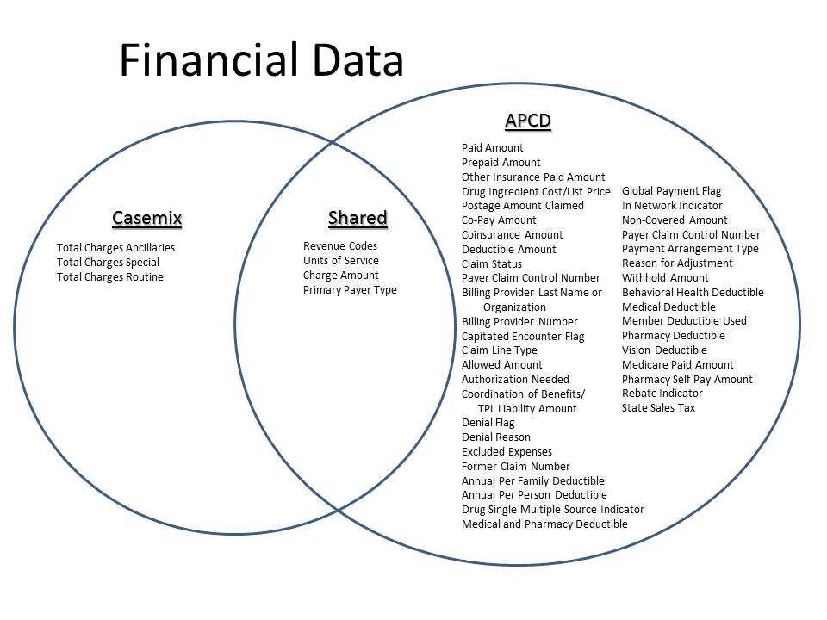
Question: What is the difference between the Financial Data in Case Mix and MA APCD?
Answer: Case Mix data is limited to charges, revenue codes, service units, and payer information. The MA APCD contains all of this information in addition to detail payment amounts by insurer and patient. See Venn Diagram below.

