Slide 1
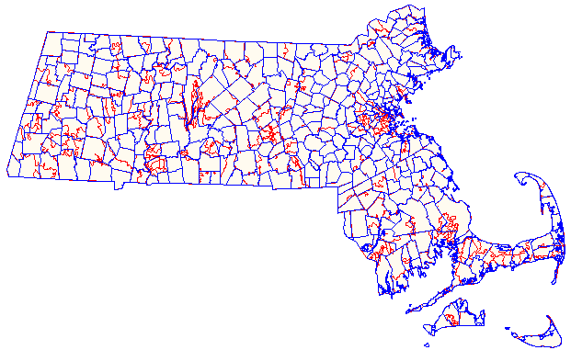
Question: What is the Difference between 3-Digit and 5-Digit Population Counts?
Answer: Many researchers request 5-Digit ZIP for the purposes of linking with the Census ZIP Code Tabulation areas. The Census Bureau records 550 ZIP Code Tabulation Areas (ZCTA) for Massachusetts. The population for the smallest ZCTA requires cell suppression. The largest ZCTA is 02301 (Brockton) which has a ZCTA population of 61,025. Both the ZCTA 3-Digit and the MassGIS quarterly update from US Postal Service for Massachusetts 3-Digit ZIP Code contain 18 grouping with the largest population (1,283,942) in 021 and the smallest population (28,215) in 022 (see Table 1 below) .
Table 1. MA 3-Digit ZIP Code Populations
Always Keep in Mind that Zip Codes Cut Across Multiple Political Boundaries
ZIP CODE | 3-Digit Population
010 | 469,375
011 | 168,835
012 | 130,689
013 | 83,111
014 | 211,812
015 | 373,719
016 | 188,402
017 | 379,027
018 | 713,126
019 | 476,314
020 | 400,371
021 | 1,283,942
022 | 28,215
023 | 441,063
024 | 408,771
025 | 116,621
026 | 147,883
027 | 526,336
Municipalities
Zip Codes
ZIP Codes generally do not show any respect for state, municipal, county, or census statistical area boundaries. They are administrative units for mail carrier routes that intertwine across political geographic boundaries like spaghetti, and are subject to continuous alteration or elimination.

