Slide 1


Statewide Quality Advisory Committee (SQAC)
Evaluation Workgroup Meeting
August 1, 2013

Slide 2
Purpose of the Workgroup
To review and revise the Committee’s draft evaluation process and criteria for non-mandated measures
To develop and recommend an evaluation process and criteria to the Committee on August 19th

Slide 3
Current SQMS Measure Evaluation
Current evaluation tool is based on the Expert Panel on Performance Measurement / Health Care Quality and Cost Council (EPPM/QCC) criteria
Received feedback that SQMS evaluation could be
  Clearer and more transparent
  More meaningful
  More efficient
Considered National Quality Forum, Measure Applications Partnership and other evaluation frameworks when developing proposed revisions

Slide 4
Crosswalk of Measure Evaluation
Evaluation Tool | Condition(s) for Evaluation | Evaluation Criteria | Scoring | Score Thresholds for Recommendation
SQAC 2012, based on EPPM/QCC | Must address priority area | Drawn from nationally-accepted std. set Meaningful to patients and providers Stable and reliable Sufficient variability or insufficient performance Measured entity associated with variance Provider engagement in measure develop. | 0-10, without definitions | No
NQF | 1. Public domain 2. Identified entity responsible for measure maintenance 3. Intended use includes both public reporting and QI 4. Complete information | Important to measure and report Reliable/valid Usable Feasible | High, medium, low and insufficient, with definitions | Yes
MAP | No | NQF endorsement (or expedited review) Meets NQS priorities Addresses high-impact conditions Aligns with intended program use Set inc. appropriate mix of measure types Enables measurement across person-centered episode Considers health disparities Promotes parsimony | Expert judgment of Committee | Expert judgment of Committee
SQAC 2013 | Must address priority area | Ease of measurement Validity Field implementation Amenable to provider intervention | 1-5, with definitions | Yes

Slide 5
Draft Revisions to SQMS Evaluation
Based on the review of nationally accepted evaluation criteria, SQAC staff
  Kept the QCC/EPPM criteria
  Streamlined criteria, based on NQF process
  Kept condition for evaluation (meets priority area)
  Reduced score range from 0-10 to 1-5 rating
  Developed a definition for each rating
  Created a score threshold for each recommendation level

Slide 6
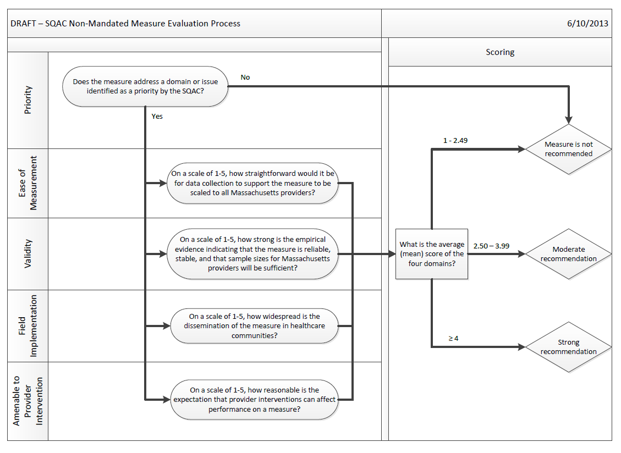
Draft SQAC Evaluation Process

Slide 7
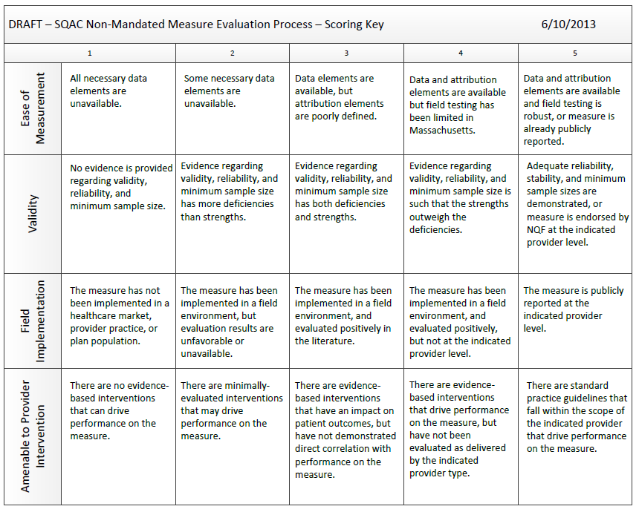
Draft SQAC Evaluation Criteria

Slide 8
Discussion
Review and revise draft evaluation process and criteria
Goal
Present recommended evaluation process and criteria at the next SQAC meeting
    Monday, August 19th
  3-5 p.m.
2 Boylston Street, 5th Floor
Boston, MA 02116

