Slide 1

Case Mix Data collection
Behavioral Health Inpatient Data
(BHID)
Mar 27, 2018
Notes:
Hello.
Welcome to CHIA’s Technical Advisory Group Meeting to Review the Draft Submission Guide for Collecting Inpatient Discharge Data from Behavioral Health Facilities.
My name is Betty Harney and I’m the Data Curator at CHIA.

Slide 2
Webinar Agenda
Introductions
Project Status: Milestones
Tools: System Access
Submission Guide: Business Rule Updates
Session Wrap-Up

Slide 3
Project Status: CHIA High-Level Project Steps
Step 1
Gather Business Requirements
Step 2
Adopt Submission Guidelines
Step 3
Develop Supporting Systems
Step 4
Step 5
Collect Test Data from Facilities
Collect Production Data from Facilities

Slide 4
Project Status: Project Milestones
Milestone Tasks | Targeted Dates
Submit Data to CHIA Submissions Test Application | April, 2018
Submit Quarter 1 (Reporting Period: October 1 – December 31) | June, 2018
Submit Quarter 2 (Reporting Period: January 1 – March 31) | June 14, 2018
Submit Quarter 3 (Reporting Period: April 1 – June 30) | September 13, 2018
Submit Quarter 4 (Reporting Period: July 1 – September 30) | December 14, 2018
NOTE: Facility file submissions are typically required no later than 75 Days following the end of the reporting period.

Slide 5
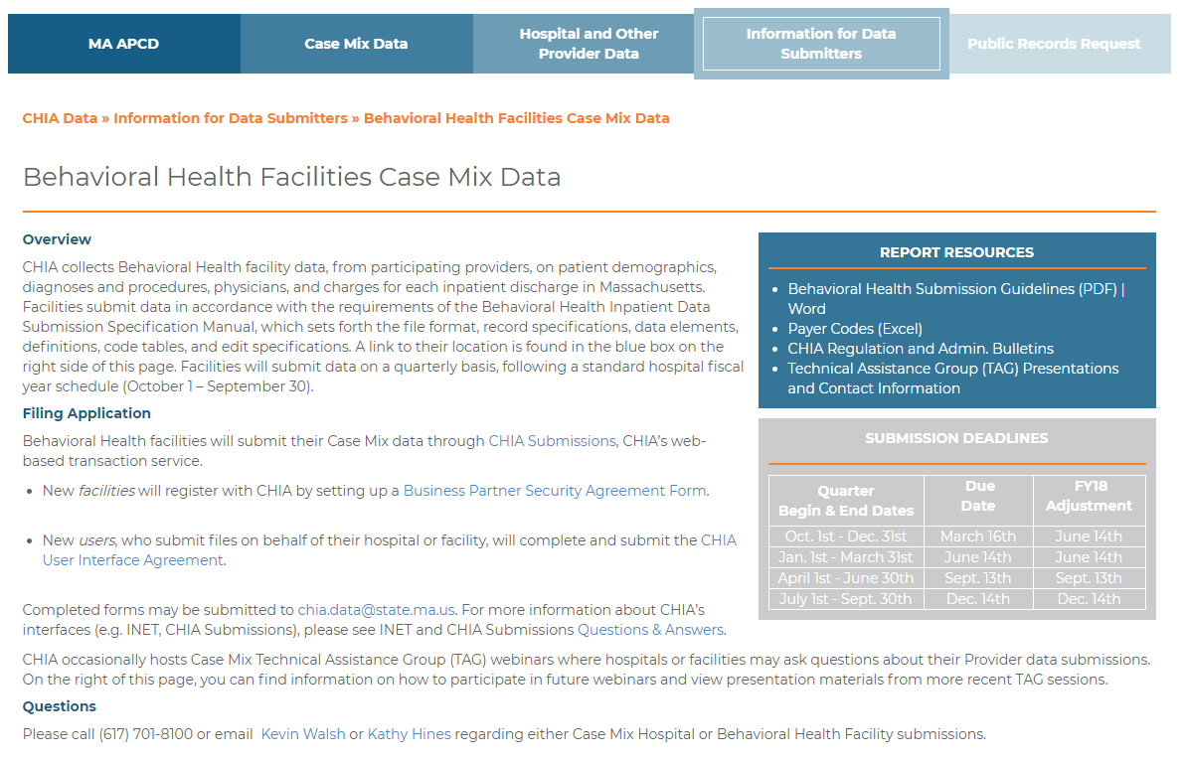
Tools: System Access
http://www.chiamass.gov/behavioral-health-facilities-case-mix-data/

Slide 6
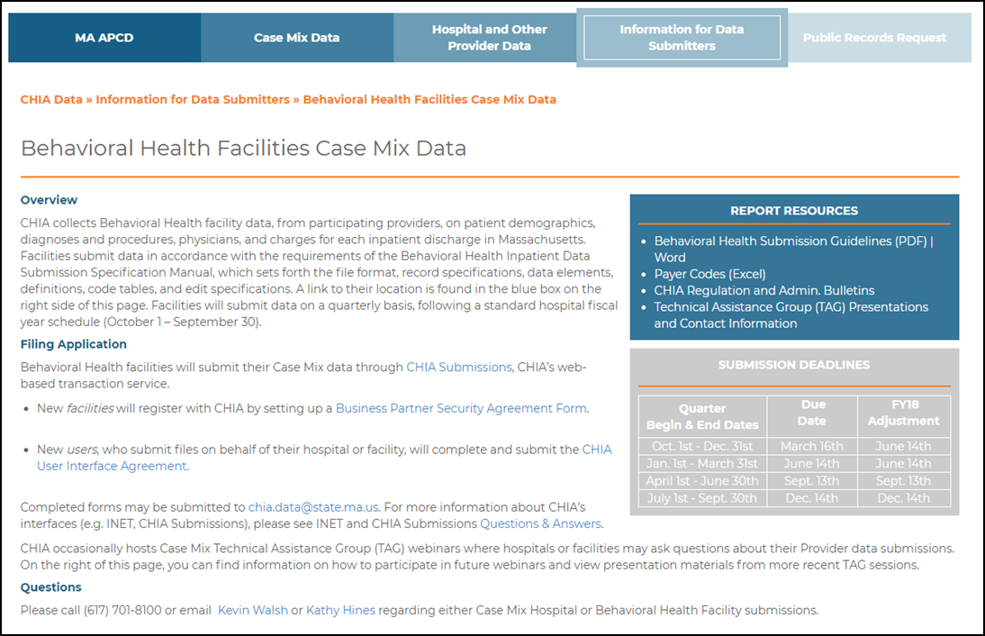
Tools: System Access
http://www.chiamass.gov/behavioral-health-facilities-case-mix-data/
6

Slide 7
Submission Guide: Rule Updates
Record Type 65
Field No. | Field Name | Picture | Spec. | Field Position From-Through | Edit Specifications | Error Type
2 | Sequence | 99 | R/Z | 3 4 | - Must be numeric - If first record following Medical - Diagnosis Record Type '60' sequence must = '01' - For each subsequent occurrence of Record Type '65' sequence must be incremented by one | A
5 | Significant HCPCS/CPT Procedure I | X(10) | L/B | 30 39 | - May only be present if Principal HCPCS/CPT Procedure Code is present - Must be valid HCPCS/CPT code - Must be valid for patient sex | A

Slide 8
Submission Guide Questions
Q: RT01 – Field No. 2 – Would this EIN be the facility’s tax ID?
A: An Employer Identification Number (EIN) is also known as a Federal Tax Identification Number which is used to identify business entities.
Q. RT01 – Field No. 3 – Will there be an issue if the Submitter Name is too long and is cut off (18 character length)?
A. Yes, it needs to be abbreviated in some way to fit within the stated available field positions. This has been general practice with how Acute Hospitals have been submitting Case Mix files today. (e.g. Hallmark Health – Melrose Wakefield Hospital Campus is entered as “Hallmark Health”)
Q. RT01 – Field No. 9 – What is Submission Number? The number of submissions that have been made per quarter or does this pertain to the number of submissions the facility has made all time?
A: Submission Number is for provider use in assigning version control or revision management number. CHIA does not validate for accuracy against your submissions.
Q: RT10 – Field No. 11 – Is Organization ID also considered Facility ID?
A: An Organization (Org ID) is a number assigned by CHIA as an internal unique identifier and not to confuse with the first question on this list. The ORG ID is typically assigned upon completing the Business Partner Agreement with CHIA. Most facilities are already registered in deliver financial or other reporting to CHIA.
Q: RT20 – Field No. 10 – Is secondary source of admission required? It says “Must be present, if applicable”. If not, then can this be left blank?
A: CORRECTED FROM WEBINAR: Yes the item must be present. However, if there was no Secondary Source of Admission, then the entry is left BLANK (unpopulated).

Slide 9
Support: Data Liaison Assignments
Each facility will soon be assigned a specific CHIA Health Care Data Liaison, for day-to-day operations support.
They are your primary point of contact for:
File status,
Field level edits/errors,
Technical system questions
Case Mix Intake team members include:
Cynthia Dukes-Reed - Sr. Health Care Data Liaison
Linda Stiller - Sr. Health Care Data Liaison
Kevin Walsh – Case Mix Data Compliance and Support Manager
Each assigned liaison will contact your team directly with any additional updates.
Please feel free to call on this team as needed. We are here to support you!

Slide 10
Session Wrap-Up: Next Steps
System Access
Contact Information
TAG Session Schedule – Monthly
- All Webinar materials will be posted to the CHIA website http://www.chiamass.gov/behavioral-health-facilities-case-mix-data/
Open Discussion – Questions - Comments

Slide 11
CHIA Contact Information:
Kathy Hines, Senior Director of Partner Operations and Data Compliance
Kathy.Hines@MassMail.State.MA.US
Data Compliance and Support Team
Kevin Walsh, Manager
Kevin.P.Walsh@MassMail.State.MA.US
Cynthia Dukes-Reed, Sr. Health Care Data Liaison
Cynthia.Dukes-Reed@MassMail.State.MA.US
Linda Stiller, Sr. Health Care Data Liaison
Linda.Stiller@MassMail.State.MA.US
Application Support Help Desk (CHIA Submissions System Access)
CHIA-DL-Data-Submitter-HelpDesk@MassMail.State.MA.US / 617-701-8217

Slide 12
THANK YOU FOR JOINING US TODAY!

