Slide 1

Case Mix Data collection
Behavioral Health Inpatient Data
(BHID)
Feb 6, 2018
Notes:
Hello.
Welcome to CHIA’s Technical Advisory Group Meeting to Review the Draft Submission Guide for Collecting Inpatient Discharge Data from Behavioral Health Facilities.
My name is Betty Harney and I’m the Data Curator at CHIA.

Slide 2
Webinar Agenda
Introductions
Project Status: Milestones
Tools: System Access
- CHIA Submissions
- File Secure
Submission Guide: Business Rule Updates
Support: Data Liaisons
- Contact Information
Session Wrap-Up: Next Steps

Slide 3
Project Status: CHIA High-Level Project Steps
Step 1
Gather the Business Requirements
Step 2
Adopt the Submission Guidelines
Step 3
Develop the Supporting Systems
Step 4
Step 5
Collect Test Data from Facilities
Collect Production Data from Facilities

Slide 4
Project Status: Project Milestones
Milestone Tasks | Targeted Dates
Submit Data to CHIA Submissions Test Application | April, 2018
Submit Quarter 1 (Reporting Period: October 1 – December 31) | May, 2018
Submit Quarter 2 (Reporting Period: January 1 – March 31) | June 14, 2018
Submit Quarter 3 (Reporting Period: April 1 – June 30) | September 13, 2018
Submit Quarter 4 (Reporting Period: July 1 – September 30) | December 14, 2018
NOTE: Facility file submissions are typically required no later than 75 Days following the end of the reporting period.

Slide 5
Tools: CHIA Submissions
CHIA Submissions: Is the Center’s online file submission/retrieval tool. Providers will apply for access using the CHIA User Interface Agreement found on the Case Mix Behavioral Health web page for Data Submitters.
System Functionality Includes:
Software Access: Users can download a copy of File Secure - CHIA’s encryption software; the program hashes sensitive PHI/PII data and encrypts the file as a whole.
Web-Based Upload/Download capability: Upload encrypted/hashed quarterly files and download Edit Detail Report files, which provide file status, and may include helpful file error details.
Security : CHIA’s secured file transmission environment is HTTPS based. File encryption is AES 256 and each facility will have its own unique encryption key. Only CHIA and the facility have access to the facility-specific key.
System Requirements:
CHIA Submissions is designed for use with the Google Chrome browser only. (Unsupported: Internet Explorer, Edge, Firefox, Safari, Opera)

Slide 6
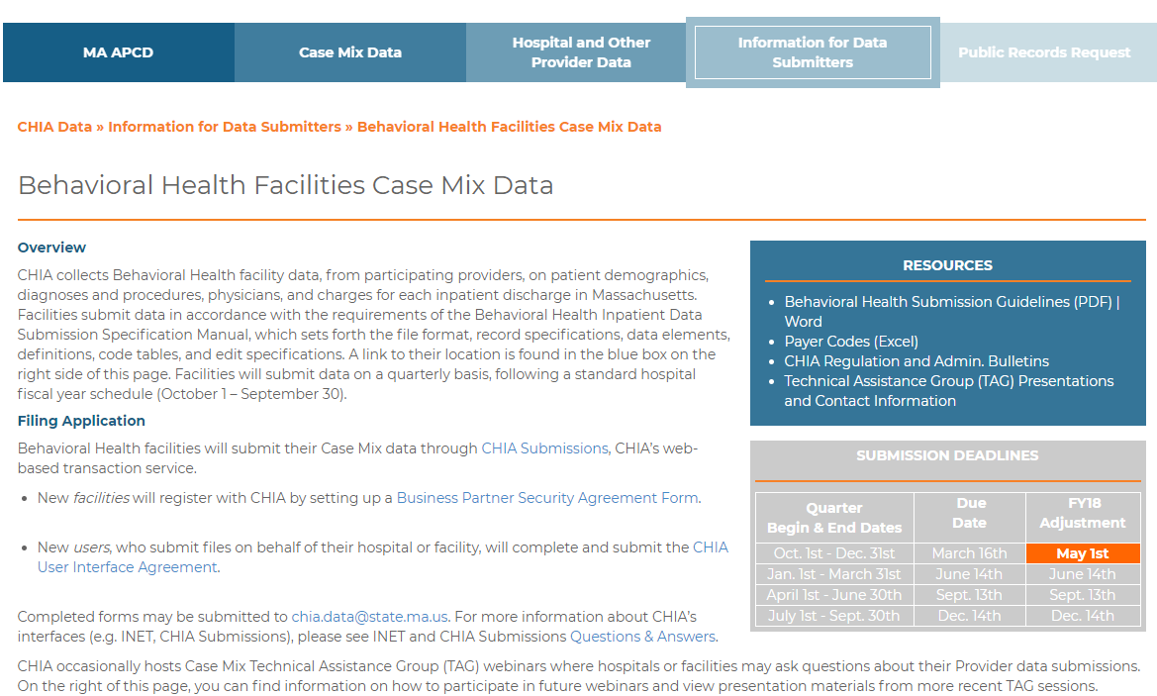
Tools: System Access
http://www.chiamass.gov/behavioral-health-facilities-case-mix-data/

Slide 7
Tools: System Access
http://www.chiamass.gov/behavioral-health-facilities-case-mix-data/
7

Slide 8
Submission Guide: Rule Updates
Record Type 65
Field No. | Field Name | Picture | Spec. | Field Position From-Through | Edit Specifications | Error Type
2 | Sequence | 99 | R/Z | 3 4 | - Must be numeric - If first record following Medical - Diagnosis Record Type '60' sequence must = '01' - For each subsequent occurrence of Record Type '65' sequence must be incremented by one | A
5 | Significant HCPCS/CPT Procedure I | X(10) | L/B | 30 39 | - May only be present if Principal HCPCS/CPT Procedure Code is present - Must be valid HCPCS/CPT code - Must be valid for patient sex | A

Slide 9
Support: Data Liaison Assignments
Each facility will soon be assigned a specific CHIA Health Care Data Liaison, for day-to-day operations support.
They are your primary point of contact for:
File status,
Field level edits/errors,
Technical system questions
Case Mix Intake team members include:
Cynthia Dukes-Reed - Sr. Health Care Data Liaison
Linda Stiller - Sr. Health Care Data Liaison
Kevin Walsh – Case Mix Data Compliance and Support Manager
Each assigned liaison will contact your team directly with any additional updates.
Please feel free to call on this team as needed. We are here to support you!

Slide 10
CHIA Contact Information:
Kathy Hines, Senior Director of Partner Operations and Data Compliance
Kathy.Hines@MassMail.State.MA.US
Data Compliance and Support Team
Kevin Walsh, Manager
Kevin.P.Walsh@MassMail.State.MA.US
Cynthia Dukes-Reed, Sr. Health Care Data Liaison
Cynthia.Dukes-Reed@MassMail.State.MA.US
Linda Stiller, Sr. Health Care Data Liaison
Linda.Stiller@MassMail.State.MA.US
Application Support Help Desk (CHIA Submissions System Access)
CHIA-DL-Data-Submitter-HelpDesk@MassMail.State.MA.US / 617-701-8217

Slide 11
Session Wrap-Up: Next Steps
System Access
Liaison Contact:
Establish Facility Technical Contacts
TAG Session Schedule – Monthly
- All Webinar materials will be posted to the CHIA website http://www.chiamass.gov/behavioral-health-facilities-case-mix-data/
Open Discussion – Questions - Comments

Slide 12
THANK YOU FOR JOINING US TODAY!

