Slide 1

Massachusetts Acute Care Hospital Data: Technical Assistance Group (TAG)
July 29, 2021

Slide 2
Agenda
Hospital Case Mix Revised Filing Requirements
- Hospital Inpatient Discharge Data (HIDD)
- COVID Test Results
- Emergency Department Visit Data (EDD)
- Outpatient Observation Stay Data (OOD)
Hospital Case Mix Intake
Data Quality Review
Questions

Slide 3
Hospital Case Mix Submittal Schedule - Revised
Quarter | Quarter Begin & End Dates | Data Due: | Due Date for Data File:
1 | 10/1 – 12/31 | Preliminary Q1 (Discharges 10/1 - 12/31) | 31-Jan
1 | 10/1 – 12/31 | Final Complete Q1 | 16-Mar
2 | 1/1 – 3/31 | Preliminary Q2 (Discharges 1/1 - 3/31) | 30-Apr
2 | 1/1 – 3/31 | Final Complete Q2 | 14-Jun
3 | 4/1 – 6/30 | Preliminary Q3 (Discharges 4/1 - 6/30) | 31-Jul
3 | 4/1 – 6/30 | Final Complete Q3 | 13-Sep
4 | 7/1 – 9/30 | Preliminary Q4 (Discharges 7/1 - 9/30) | 31-Oct
4 | 7/1 – 9/30 | Final Complete Q4 | 14-Dec

Slide 4
Hospital Case Mix Submittal Timeline
Jul 2021 | Oct 2021 | Jan 2022 | Apr 2022
Preliminary FY 2021 Q3 HIDD files due by July 31, 2021 Preliminary EDD/OOD files to begin with Q4 due in October 2021
 | Preliminary FY 2021 Q4 files due by October 31, 2021
 |  | Preliminary FY 2022 Q1 files due by January 31, 2022
 |  |  | Preliminary FY 2022 Q2 files due by April 30, 2022
Final Submissions due 75 days after the close of the Quarter (9/13, 12/14, 3/16, 6/14) | due 75 days | after close of the | Quarter

Slide 5
MA Hospital Case Mix Intake
FY 2021 Final Q1 & Q2 files (HIDD/COVID/EDD/OOD) should be in/passed, including HIDD-COVID Match reports.
Please work with Linda & Hadish in submitting any overdue files.
FY 2021 Verification Reports to be shared soon for hospital review, data corrections and file resubmissions.
FY 2021 Preliminary EDD/OOD files to begin with Q4 submissions due October 31, 2021. No HIDD/COVID files due August 7, 2021.
CHIA is not making any Submission Guide updates for FY 2022.

Slide 6
CHIA Email Addresses
All CHIA staff have migrated to MS Office 365 and now have new email addresses.
Old format: firstname.lastname@state.ma.us
New format: firstname.lastname@chiamass.gov
Please have your IT allow traffic from this new chiamass.gov domain. Check your spam/junk folders as well.

Slide 7

MA Hospital Case Mix Data Quality
Reported Race in Pediatric Population

Slide 8
Significant Increase in Pediatric Patients Coded as ‘Unknown’ Race Over the past 8 years, use of the coding option ‘Unknown’ race increased for all age groups but is significantly higher for the pediatric population. Table 1 below shows the increase in percent of patients coded as ‘Unknown’ by age group in the hospital inpatient discharge data from FY2013 to FY2020. In FY2013, only 14% of patients ages 0 to 4 were coded as ‘Unknown’, in FY2020 Unknowns have increased to 34%.
Table 1. HIDD FY2013 to FY2020 Percent ‘Unknown’ Race by Age Group

Slide 9
High Quality ED Visit Data on Race with Deterioration in Pediatric Data Even though the use of ‘Unknown’ Race coding has also increased in the ED Visit Data for the pediatric population and the ED has a higher volume of data than HIDD, Table 2 below shows that the ED Visit Data continues to have higher quality data than the HIDD. The quality of known data for the adult population is among the best in the nation.
Table 2. ED FY2013 to FY2020 Percent ‘Unknown’ Race by Age Group

Slide 10
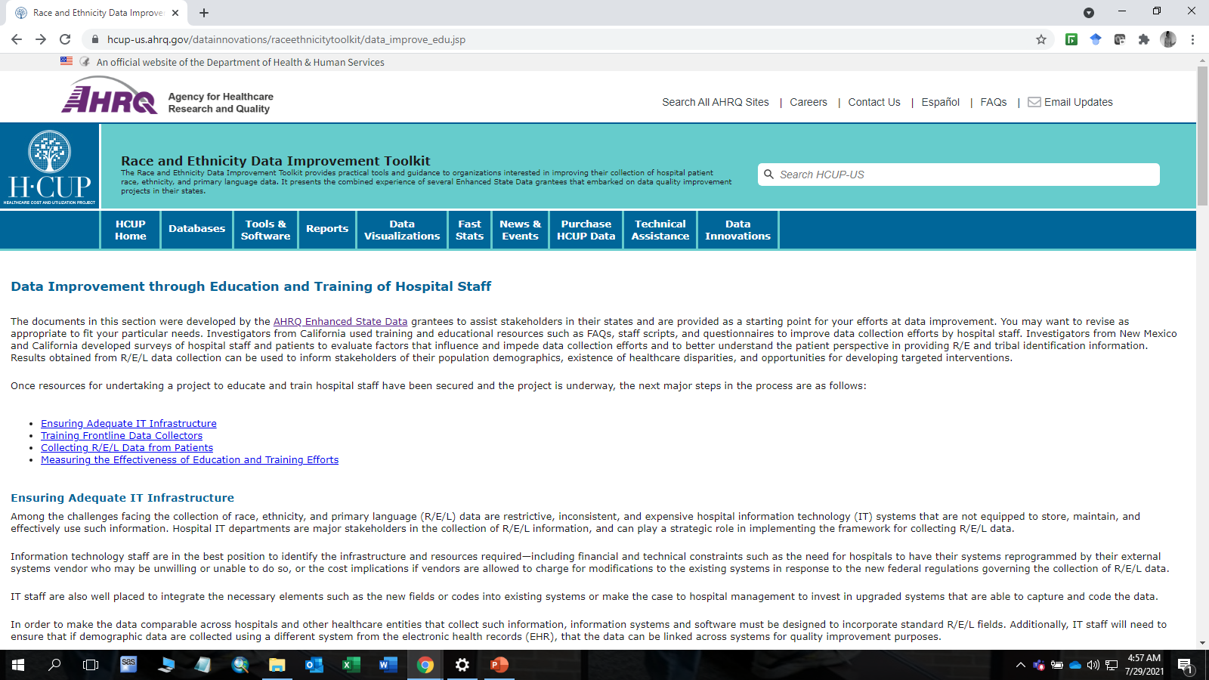
AHRQ has Training Toolkits for Hospitals on Race and Ethnicity Data Collection

Slide 11
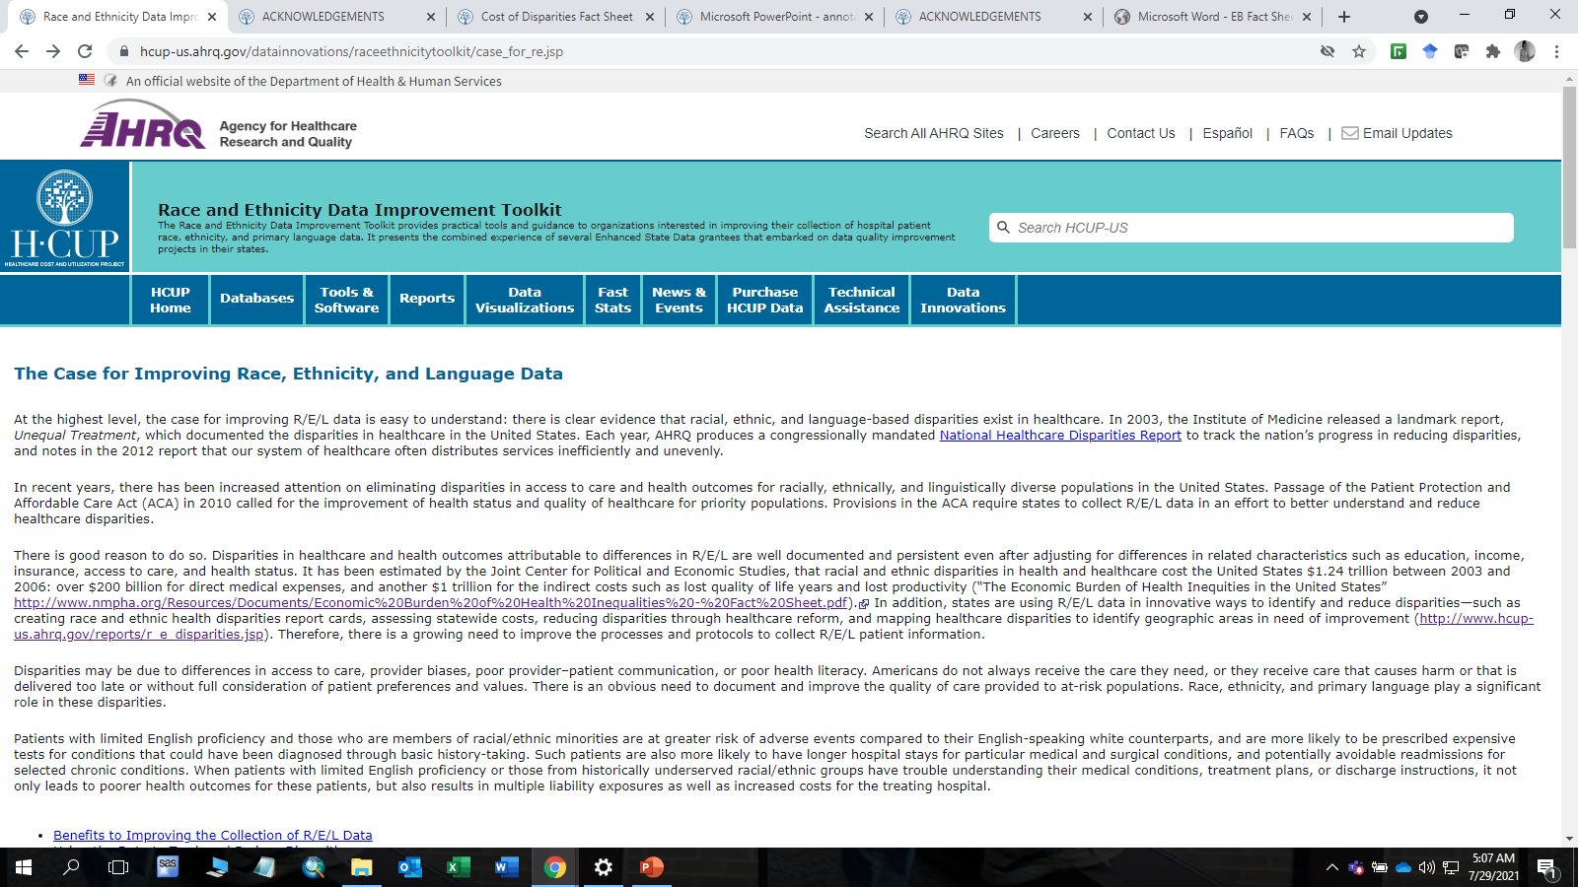
AHRQ Training Toolkits include Information on the Rationale for Improving Race and Ethnicity Data Quality

Slide 12
Next Meetings
Quarterly TAG meetings:
October 2021
January 2022
April 2022
July 2022

Slide 13
Questions?

