Slide 1

Case Mix Updates Webinar
June 6, 2019

Slide 2
Agenda
2:00 Welcome
2:05 FY20 Submission Guide Highlights
2:15 Walk Through of Proposed Changes
2:40 Timeline / Next Steps
2:45 Verification Reports/Potential Survey
2:55 Questions & Comments

Slide 3
submission guide Highlights

Slide 4
Submission Guide Change Highlights
Key Changes: New Fields | File Types
Health Plan Member/Subscriber Flag | All
Payer Type | ED/OOD only
Additional diagnosis codes | OOD Only
Additional CPT codes | OOD Only
Key Changes: Field Updates | File Types
ED Boarding Fields moved to ‘B’ category | HIDD/OOD
Diagnosis/External Cause/Procedure Code edits streamlined | All
Other assorted field/edit updates | All

Slide 5
Changes & Revisions
For
Hospital inpatient

Slide 6
Hospital Inpatient Discharge Data
Record Type | Fields | New - Update | Description of requirement
20 | Primary/Secondary Type/Source of Payment | U | Remove 'NOTE' edit on the primary/secondary type and source of payment agreement
20 | Medicaid/MassHealth ID | U | Require ID for MassHealth/HSN payer ONLY (not MCO/ACO)
20 | Patient Last Name | U | Change to required.
20 | Patient First Name | U | Change to required.
25 | Health Plan Member/Subscriber Flag | N | Must be present.
45 | Principal External Cause of Injury Code/ ICD Indicator | U | Streamline Edits; Remove ICD9
45 | Number of Hours in ED/ED Registration Date and Time/ ED Discharge Date and Time | U | Update error category to a 'B'
50 | Assoc. Diagnosis Code I - XIV | U | Streamline Edits; Remove ICD9

Slide 7
Hospital Inpatient Discharge Data
Health Plan Member/Subscriber Flag
Valid Entries | Definition
1 | Health Plan Member ID (RT25 Field 19) is the Member ID
2 | Health Plan Member ID (RT25 Field 19) is the Subscriber ID
3 | It is unknown whether the Health Plan Member ID is for the subscriber or member

Slide 8
Hospital Inpatient Discharge Data
Field Name | Edit Specifications
Principal External Cause Code | Must be present if principal diagnosis is an ICD-10-CM S-code (S00- S99), May be present if principal diagnosis is an ICD-10-CM T-code (T00-T88), If present, must be a valid ICD-10-CM external cause code (V00-Y89). Additional (V00-Y89) and supplemental (Y90-Y99) ICD external cause codes shall be recorded in associated diagnosis fields.
Field Name | Edit Specifications
Assoc. Diagnosis Code l | Only permitted if prior diagnosis is entered Must be valid ICD code in diagnosis file Sex of patient must agree with diagnosis code for sex specific diagnosis May be an ICD external cause code (V00-Y99). Must agree with ICD Indicator

Slide 9
Changes & Revisions
For
Hospital Emergency

Slide 10
Hospital Emergency Department Data
Record Type | Fields | New - Update | Description of requirement
20 | Primary/Secondary Type/Source of Payment | U | Remove 'NOTE' edit on the primary/secondary type and source of payment agreement
20 | Medicaid/MassHealth ID | U | Require ID for MassHealth/HSN payer ONLY (not MCO/ACO)
20 | Payer Type Code | N | See next slide
20 | Principal External Cause of Injury Code/ ICD Indicator/ Procedure Code | U | Streamline Edits; Remove ICD9
20 | Stated Reason for Visit | U | Must be NULL/blank due to high risk of PHI.
25 | Health Plan Member/Subscriber Flag | N | Must be present.
50 | Associated Diagnosis Code 1 - 15 | U | Streamline Edits; Remove ICD9
50 | Patient Last Name | U | Change to required.
50 | Patient First Name | U | Change to required.

Slide 11
Hospital Emergency Department Data
Field Name | Edit Specifications
Primary/Secondary Payer Type Code | Must be present. Must be valid as specified in Outpatient Emergency Department Visit Data Code Tables Section ll. If Medicaid is one of two payers, Medicaid must be coded as the secondary type and source of payment unless Free Care is the secondary type and source of payment.

Slide 12
Hospital Emergency Department Data
* PAYER TYPE CODE | PAYER TYPE ABBREVIATION | * PAYER TYPE DEFINITION
1 | SP | Self Pay
2 | WOR | Worker's Compensation
3 | MCR | Medicare
F | MCR-MC | Medicare Managed Care
4 | MCD | Medicaid
B | MCD-MC | Medicaid Managed Care
5 | GOV | Other Government Payment
6 | BCBS | Blue Cross
C | BCBS-MC | Blue Cross Managed Care
7 | COM | Commercial Insurance
D | COM-MC | Commercial Managed Care
8 | HMO | HMO
9 | FC | Free Care
0 | OTH | Other Non-Managed Care Plans
E | PPO | PPO and Other Managed Care Plans Not Classified Elsewhere
H | HSN | Health Safety Net
J | POS | Point-of-Service Plan
K | EPO | Exclusive Provider Organization
T | AI | Auto Insurance
N | None | None (Valid only for Secondary Payer)
Q | CommCare | Commonwealth Care/ConnectorCare Plans
Z | DEN | Dental Plans

Slide 13
Changes & Revisions
For
Hospital outpatient observation

Slide 14
Hospital Outpatient Observation Data
Field No. | Fields | New - Update | Description of requirement
7 | Medicaid/MassHealth ID | U | Require ID for MassHealth/HSN payer ONLY (not MCO/ACO)
103 | Payer Type Code | N | See next slide
21-22 | Primary/Secondary Type/Source of Payment | U | Remove 'NOTE' edit on the primary/secondary type and source of payment agreement
28-32; 72-78 | ICD Indicator/ Principal External Cause of Injury Code/ Assoc_DX1 – Assoc_DX15 | U | Streamline Edits; Remove ICD9; Add 5 additional diagnosis code fields
62-68; 79-83 | Condition Present on Observation | U | Change to “May” be present when Associated Diagnosis Code is present.
85 | Patient Last Name | U | Change to required.
86 | Patient First Name | U | Change to required.
87-91 | Number of Hours in ED/ED Registration Date and Time/ ED Discharge Date and Time | U | Update error category to a 'B'
92 | Health Plan Member/Subscriber Flag | N | Must be present.
93-102 | Assoc_DX11- Assoc_DX15; CPT6 – CPT10 | N | Add 5 additional associated diagnosis codes; Add 5 additional CPT codes
Notes:
Add Health Plan flag #92 Health Plan Member/Subscriber Flag
N
Must be present.

Slide 15
Hospital Outpatient Observation Data
Field Name | Edit Specifications
Primary/Secondary Payer Type Code | Must be present. Must be valid as specified in Outpatient Observation Data Code Tables. If Medicaid is one of two payers, Medicaid must be coded as the secondary type and source of payment unless Free Care is the secondary type and source of payment.

Slide 16
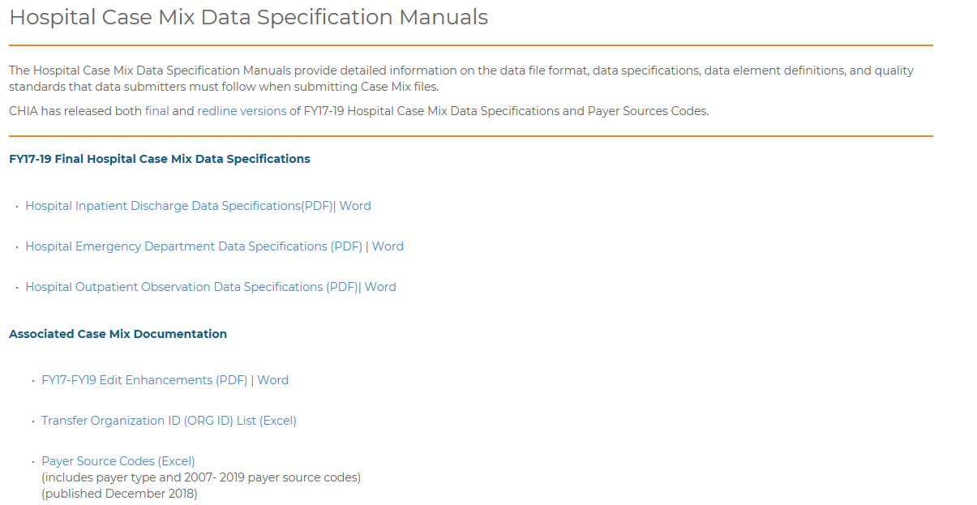
Submission Guides Will Be Published to CHIA Website http://www.chiamass.gov/hospital-data-specification-manuals/

Slide 17
Timeline / Next Steps:
FY20 Case Mix Intake Process | Draft Timeline
Provider Comment Period Ends | July 5, 2019
Administrative Bulletin and Guides Adopted | July 2019
CHIA and Providers Update Systems | July – December 2019
Provider Testing Period | January 2020
Quarter 1 Submission | March 16, 2020

Slide 18
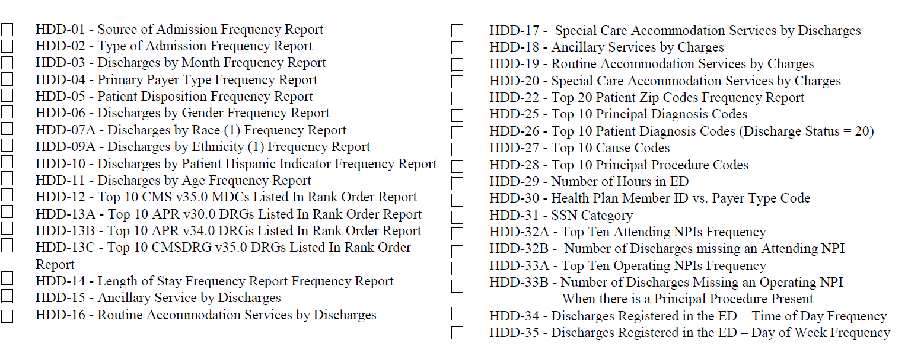
VERIFICATION REPORTS/SURVEY

Slide 19
Questions & Comments

Slide 20
Follow-up Contacts
Kathy Hines, Senior Director of Partner Operations and Data Compliance Kathy.Hines@MassMail.State.MA.US
Catherine Houston, Manager – Hospital Data Compliance Catherine.Houston2@MassMail.State.MA.US
Hospital Liaisons:
Linda Stiller, Senior Health Care Data Liaison Linda.Stiller@MassMail.State.MA.US
Hadish Gebremedhin, Health Care Data Liaison Hadish.Gebremedhin@MassMail.State.MA.US

