Slide 1
Monthly MA APCD / Case Mix User Workgroup Webinar
September 29, 2015

Slide 2
Agenda
Announcements
  Enrollment Trends Follow Up
  MA APCD Release 4.0 (CY 2014)
  Limited Data Sets
Common Application Issues
User Questions
Q&A

Slide 3
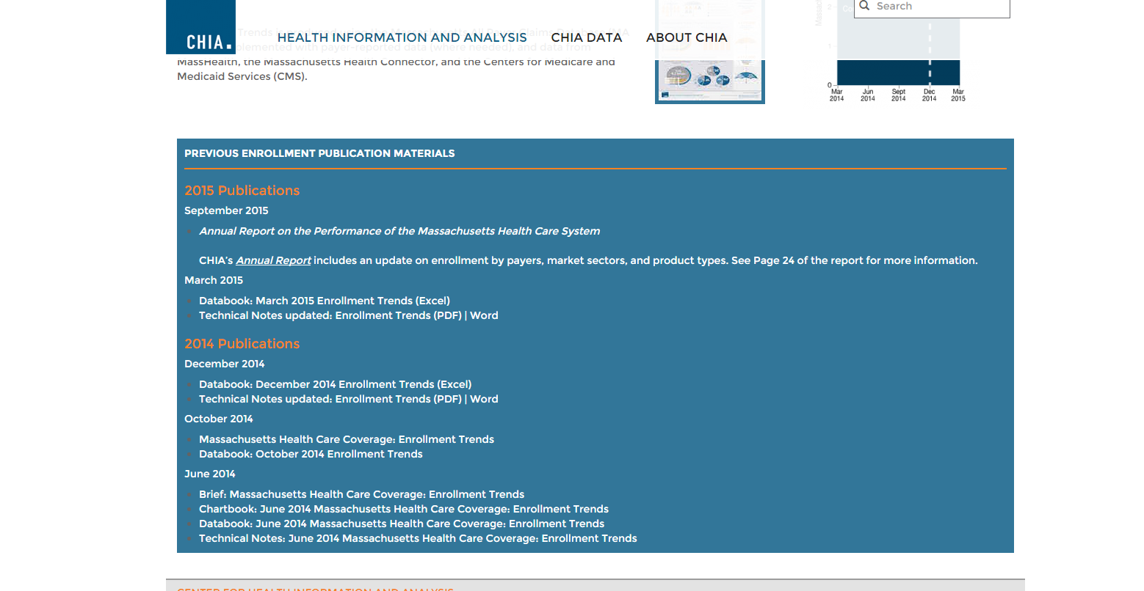
Enrollment Trends Follow-Up
(from the July presentation)
The Enrollment Trends SQL/SAS code is now available to the public
You may find it on the CHIA website’s Enrollment Trends page in the “Publication Materials” section

Slide 4
MA APCD Release 4.0
Will begin accepting applications in November 1
  An eblast will be sent once new application materials are posted
  Sign up for MA APCD announcements here: http://www.chiamass.gov/join-apcd-email-list/
Features / Enhancements:
  Data for CY 2010-2014 as paid through June 30, 2015
  Master Patient Index applied to all years
  Claim line versioning for the largest payers
  MassHealth Enhanced Eligibility Data (for Government Applicants only)

Slide 5
MassHealth Enhanced Eligibility (MHEE)
MHEE data derived by the Executive Office of Health and Human Services
Combines Medicaid Management Information System (MMIS) eligibility, managed care enrollment, Long Term Care (LTC) residency, Medicare eligibility and other member information into a single analytic resource, with non-overlapping effective dates
As a result, it provides a comprehensive view of MassHealth members on any given day
It will be available to Government applicants only.

Slide 6
Change in How APCD Requests are Made and Fulfilled
All requests for Release 4.0 by Non-Government applicants will be filled using Limited Data Sets (LDSs)
Thank you for comments many of you shared about the LDS

Slide 7
Recall Issues With Current Process
Requests are at the element level
Completing request is time intensive – for requestors and CHIA
Reviewing and fulfilling data requests are resource intensive
Data elements with a significant amount of missing data forces users to unexpectedly revise their analytic plans
  B and C elements with low thresholds, many variances
Level 2 data elements currently in release may pose re-identification risk
Amendments (additional elements) often requested

Slide 8
Goals for Limited Data Set (LDS)
Protect patient privacy
Serve analytic needs of the non-gov’t users as is possible
  Gov’t users would get access to all MA APCD data as needed
Streamline request and review processes

Slide 9
CHIA Methodology
Determined what must be excluded:
  HIPAA-defined direct identifiers with the exception of carrier specific subscriber and members IDs which are hashed
  All Level 3 MA APCD data elements
Excluded elements due to significant amount of missing data:
  Examples: inpatient DRGs, outpatient APCs, hours of admit/discharge, race and ethnicity
Investigated elements that potentially should be excluded due to patient privacy concerns
  Free text fields, including carrier-defined/non-standard lookup tables, names of drugs, street addresses

Slide 10
CHIA Methodology – con’t
Exclude certain quasi-identifiers:
  Which make individuals unique in the population and thus possibly used for indirect re-identification
  Examples: Disability Indicator, Family Planning Indicator, Member SIC code
Retained, but ranged, the following:
  Individual relationship code
  Gender
Maintained substance abuse (Part 2) filter
Created 11 LDS files
  Three for PV
  Two each for MC, PC, DC
  One for PR and ME

Slide 11
Based on User Input:
“Ranged” Geography and Age Information to Reduce Risk of Re-identification
Geography:
  MA – 3 or 5 digit zip
  New England States and New York – statewide only
  Balance – recoded to “other”
Age
  In years at date of service and as of 12/31
  Cohorts for 65-74 and 75+
  (Medicare FFS not in MA APCD for non gov’t users)

Slide 12
LDS for MA APCD
Applies to non-government users only
Simplified request form. Requestors need to justify need for:
  Geo breakout – 3 or 5 digit for MA
  Unencrypted NPI
  LDS files needed – not elements
DUAs and Data Management Plans still required
MassHealth will continue to review requests for MassHealth data
Details on LDS files will be posted

Slide 13
Moving to the LDS
New requests for Release 3.0 (customized extracts) will no longer be accepted as of November 1st
Applicants who requested Release 3.0 that are currently under CHIA review have the opportunity to request Release 4.0 using the LDS
Release 3.0 requests will be reviewed, but priority will be given to Release 4.0 LDS requests

Slide 14
MA APCD User Symposium
November 5th in Boston
Sponsored by the Blue Cross Blue Shield Foundation of MA
Will include an update on the MA APCD, a user panel and a discussion on future MA APCD enhancements
Invitations were sent by BCBS Foundation to current users last week
If you did not receive an invitation and would like to attend, please contact CHIA (apcd.data@state.ma.us)

Slide 15
MA APCD Submission Guide – 5.0
We are currently working on developing 5.0 MA APCD Submission guides for the carriers including new/updated elements, conditions, thresholds and guidelines
Looking for input from MA APCD data users on what are:
  Priority elements that could have better quality
  What data do we want to add, change or remove in MA APCD?
Contact Lauren Dale with input by 10/15: Lauren.Dale@state.ma.us

Slide 16
Common Application Issues and Questions

Slide 17
Application Revisions
Please remember to “lock” your application on IRBNet after you’ve finished making revisions to your application
Locking the application will send an automatic notification to CHIA staff letting them know that your revisions are complete and uploaded

Slide 18
Hard Drives
Please remember to return your hard drive to CHIA after you’ve loaded your data
CHIA has a limited number of hard drives, so help us ensure we have a steady supply ready to deliver data to the MA APCD user community

Slide 19
User Questions

Slide 20
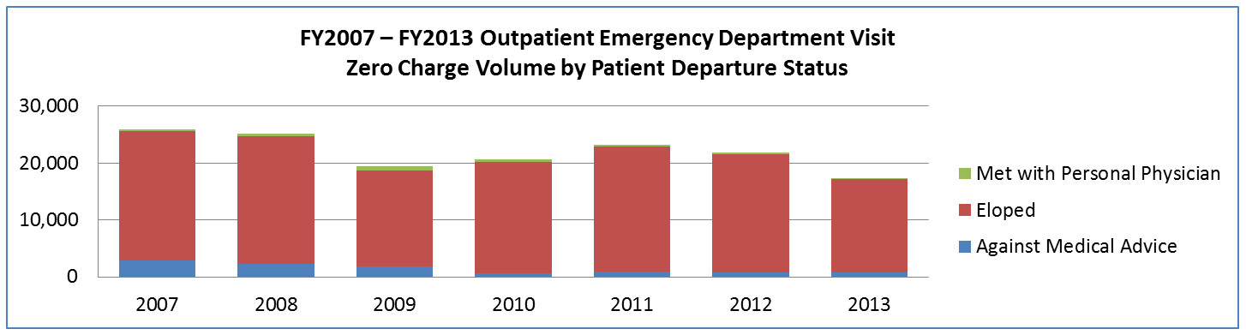
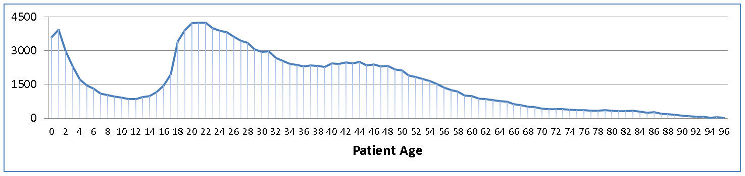
Question: Why are there Zero Charges on Thousands of
Case Mix Outpatient Emergency Department Records?
Answer: Over the past 7 years, 92% of the zero charge ED visit records are for patients who eloped, 7% for patients who left against medical advice and 1% percent for patients who met with their person physician.
FY2007 – FY2013 Age Distribution of Patients with Zero Charges who Elope or Leave Against Medical Advice (Approximately 25% attributable to those between ages 18 to 26 years old)

Slide 21
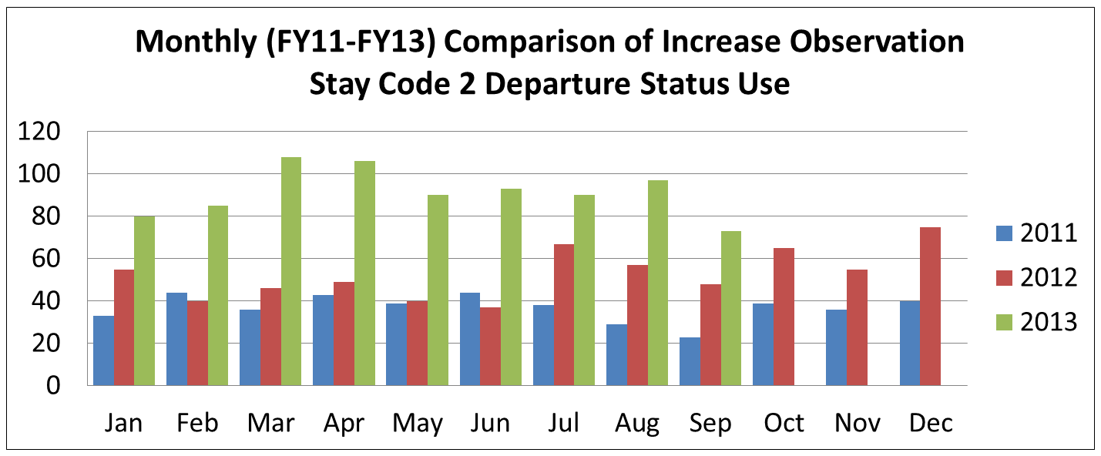
Question: If a patient is admitted from the ED or Observation Stay (OS), we understood that their services are rolled into their case mix inpatient record and will not appear in the ED or OS data release. If that is truly the case, what does OS Departure Status = 2 (Admitted to Hospital) mean?
Answer: Medicare guidelines indicate that Code 2 is used when the hospital is aware of a planned admission even if it doesn’t occur immediately after the discharge. CHIA was able to corroborate that, yes, Code 2 patients were admitted, some to the same hospital, some to different hospitals, and some not immediately after they end their observation stay. In the table below, you will see that the use of OS Code 2 has escalated in the past two years. Even with the partial calendar year 2013 data, the number is higher than previous years.
Oct – Dec
Data Pending

Slide 22
Questions?
General questions about the APCD:
(CHIA-APCD@state.ma.us)
Questions related to APCD applications: (apcd.data@state.ma.us)
Questions related to Case Mix: (casemix.data@state.ma.us)
REMINDER: Please include your IRBNet ID#, if you currently have a project using CHIA data

Slide 23
Calendar
October 23 – Data Release Committee Meeting
October 27 – Next MA APCD / Case Mix User Workgroup Meeting
November 5 – MA APCD User Symposium

