Slide 1
Monthly MA APCD / Case Mix User Workgroup Webinar
October 27, 2015

Slide 2
Agenda
Announcements
  MA APCD Release 4.0 Application Preview
Common Application Issues
User Questions
Q&A

Slide 3
MA APCD User Symposium
November 5th in Boston
Sponsored by the Blue Cross Blue Shield Foundation of MA
Will include an update on the MA APCD, a user panel and a discussion on future MA APCD enhancements
Invitations were sent by BCBS Foundation to current users in September – please RSVP!
If you did not receive an invitation and would like to attend, please contact CHIA (apcd.data@state.ma.us)

Slide 4
MA APCD Release 4.0
Will begin accepting applications on November 1st
  An e-blast will be sent once new application materials are posted
  Sign up for MA APCD announcements here: http://visitor.r20.constantcontact.com/manage/optin?v=001lJYdiyZRKBQsmd0hUv6FHv5YP1gsxUkm0gLxIJwIJE5jQr9htcWt_FJWOElloBfxR4ObbQTtFHCT6KFKW5SNGNRO1tlwcH_jg2r2w58x-k7rHaRr5KAJTvKmqBLUqQg6miMGs16BAc01jTQ4xmkDgXS6KokB0jXOcfuZeH-Ydpo%3D
Features / Enhancements:
  Data for CY 2010-2014 as paid through June 30, 2015
  Master Patient Index applied to all years
  Claim line versioning for the largest payers
  MassHealth Enhanced Eligibility Data (for Government Applicants only)

Slide 5
MassHealth Enhanced Eligibility (MHEE)
MHEE data derived by the Executive Office of Health and Human Services
Combines Medicaid Management Information System (MMIS) eligibility, managed care enrollment, Long Term Care (LTC) residency, Medicare eligibility and other member information into a single analytic resource, with non-overlapping effective dates
As a result, it provides a comprehensive view of MassHealth members on any given day
It will be available to Government applicants only.

Slide 6
LDS for MA APCD
Applies to non-government users
Simplified request form. Requestors need to justify need for:
  Geo breakout – 3 or 5 digit for MA
  Unencrypted NPI
  LDS files needed – not elements
DUAs and Data Management Plans still required
MassHealth will continue to review requests for MassHealth data
Details on contents LDS files will be posted

Slide 7
Goals for Limited Data Set (LDS)
Protect patient privacy
Serve analytic needs of the non-gov’t users as is possible
  Gov’t users would get access to all MA APCD data as needed
Streamline request and review processes

Slide 8
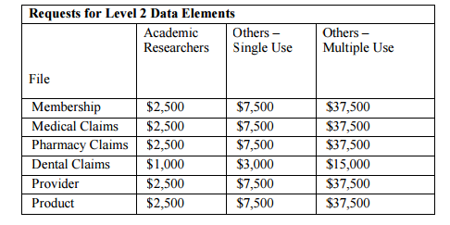
LDS Pricing
Data fees for the MA APCD will not change with the LDS
Fees will still be based on the number of files requested:
MA APCD Fee Schedule: http://www.chiamass.gov/assets/docs/g/chia-ab/1506.pdf

Slide 9
Moving to the LDS
New requests for Release 3.0 (customized extracts) will no longer be accepted as of November 1st
Applicants who have requested Release 3.0 that are currently under CHIA review have the opportunity to request Release 4.0 using the LDS
Release 3.0 requests will be reviewed, but priority will be given to Release 4.0 LDS requests

Slide 10
LDS Application Preview

Slide 11
Common Application Issues and Questions

Slide 12
Application Revisions
Please remember to “lock” your application on IRBNet after you’ve finished making revisions to your application
Locking the application will send an automatic notification to CHIA staff letting them know that your revisions are complete and uploaded

Slide 13
Hard Drives
Please remember to return your hard drive to CHIA after you’ve loaded your data
CHIA has a limited number of hard drives, so help us ensure we have a steady supply ready to deliver data to the MA APCD user community

Slide 14
User Questions

Slide 15
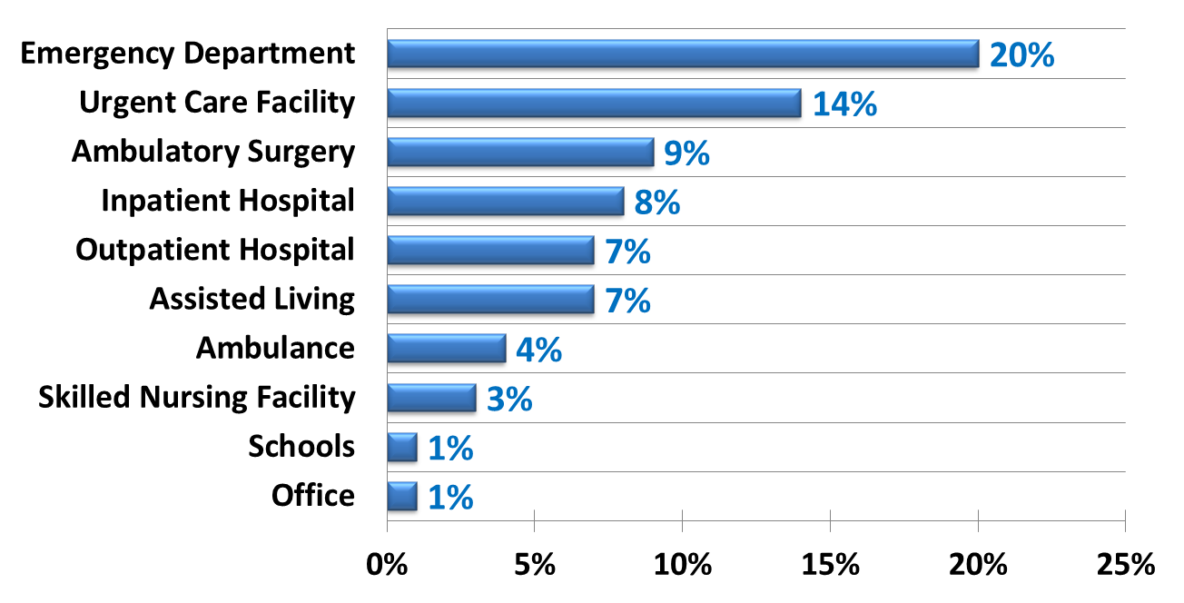
Question: I want to use MA APCD to analyze motor vehicle crash injuries. Does the low completeness of external-cause-of-injury codes for injury diagnoses vary by care setting?
Answer: Yes, we looked at E-Codes populated in the dedicated E-Code field or in associated diagnosis codes fields for claims that had an injury diagnosis in any diagnosis field and found that Emergency Departments and Urgent Care Facilities had the highest rate of completeness while Schools and Offices had the lowest. Also, Professional claims had 4% versus 17% for Facility claims.
Percent Completeness of E-Codes for any Injury Diagnosis by Care Setting
When limited to Principal Diagnosis:
Air Medical Ambulance 52%
Emergency Department 29%
Inpatient Hospital 27%

Slide 16
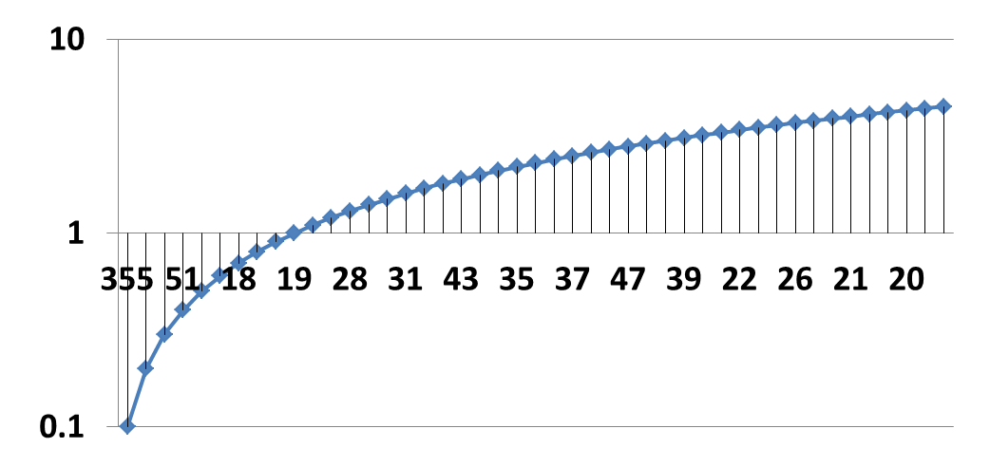
Question: Even though the ED Visit Rate has decreased since FY2012, the FY2014 ED Visit data shows a 24% increase in the ED Death Rate and 26% increase in the Dead on Arrival rate. Is that data accurate?
Answer: Hospitals review and return validation reports before CHIA releases their data. For ED Deaths, part of the increase may be attributable to deaths associated with substance abuse disorders, alcohol-related disorders, and severe open head injury wounds. For dead on arrivals, we did identify an anomaly in the use of the DOA code in FY2014 and FY2013 with a shift in reporting in ED death volume to dead on arrivals. Our State Medical Examiner’s criteria for a dead on arrival is a patient who arrives in asystole, with no cardiac electrical activity, meaning no blood is flowing to the brain or other vital organs. Based on FY2010 – FY2014 ED data, most DOAs have an LOS less than 15 minutes. The anomaly is in the length of stay for DOAs exceeding an hour suggesting an ED Death instead of a DOA.
FY2010 to FY2014 Aggregated DOA Volume by Length of Stay
Length of Stay
LOS > 1 hour
LOS < 1 hour
Dead on Arrivals*
* Small DOA Cells Suppressed

Slide 17


Question: I would like to analyze procedures performed by ambulance services licensed by Massachusetts. Are claims for all of these ambulance services in the MA APCD?
Answer: Yes, the MA APCD medical claims contains claims from the ambulance services licensed by the state including both public, private, hospital-based, and fire department based, and also ambulance services licensed outside of the state. There are instances where the provider file contains the service license number issued by DPH. Some large services with multiple locations might share the same NPI, while others might have a different NPI for different locations.
HCPCS codes allow you to distinguish basic transports from paramedic advanced life support. Procedure code modifiers can distinguish origin and destination type and special circumstances, such a multiple transport. Private payers, MassHealth and CMS have online their payment rules for specific HCPCS codes. For example, they might restrict payment to in state transports or might limit payment for ambulance wait time.

Slide 18
Question: With regard to MA APCD data, are the claim code and entity type flags, something that is added by CHIA, or are they present on the claim?
Answer: The Type of Claim Code (MC094) is submitted by the insurance carrier. They are instructed to report the value that defines the type of claim submitted for payment using the following coding options:
Value Description
001 Professional
002 Facility
003 Reimbursement Form
Likewise, the entity type (MC027) is submitted by the insurance carrier using the following coding options:
Value Description
1 Person
2 Non-person entity

Slide 19
Question: In Release 3, how many of the payers have pharmacy claims versioned?
Answer: Release 3.0 pharmacy claims have been versioned for:
MassHealth
BlueCross Blue Shield of Massachusetts
Harvard Pilgrim Health Plan
Tufts Health Plan
These payers are versioned for incurred periods January 2010 through December 2013. For all other carriers , you will see the number ‘9’ in the version field.

Slide 20
Question: If newborn services claims are bundled with the Mother’s claim and the MA APCD does not contain a dedicated field for birthweight, how do I find low birthweight babies?
Answer: Only healthy baby claims are bundled with the mother’s claim. The fifth digit sub-classification of the baby’s diagnosis code 764 (slow fetal growth) and 765 (low birthweight) will indicate the baby’s weight range:
Fifth Digit Weight Range
0 unspecified [weight]
1 less than 500 grams
2 500-749 grams
3 750-999 grams
4 1,000-1,249 grams
5 1,250-1,499 grams
6 1,500-1,749 grams
7 1,750-1,999 grams
8 2,000-2,499 grams
9 2,500 grams and over

Slide 21
Questions?
General questions about the APCD:
(CHIA-APCD@state.ma.us)
Questions related to APCD applications: (apcd.data@state.ma.us)
Questions related to Case Mix: (casemix.data@state.ma.us)
REMINDER: Please include your IRBNet ID#, if you currently have a project using CHIA data

Slide 22
Calendar
November 5 – MA APCD User Symposium
November 19 – Data Release Committee Meeting
November 24 – Next User Workgroup Webinar

