Slide 1
CHIA user workgroup
Don Kirkwood (Manager of Data Release and Procurement)
Anne Medinus (Senior Research Account Specialist)
Sylvia Hobbs (Associate Director of Data Strategy and User Support)
May 28, 2024
CENTER FOR HEALTH INFORMATION AND ANALYSIS

Slide 2
Agenda
Announcements:
MA APCD Release CY 2021 and CY2022 Updates
Update to the MA APCD Application
FY22 Case Mix Release Updates
Website Updates
How to Check the Status of Your Release
User Support Questions
Target Dates for Case Mix Data Availability
Cost of Data Application
Transfer Variable Case Mix Dataset
Identifying Transfer and Treatment Hospitals in Case Mix
Diagnosis and Procedure Codes in Case Mix
Deep Dive into Present on Admission Indicators
The Impact of Gobeille on Pharmacy and Dental Claims
Q&A

Slide 3
MA APCD Calendar Years 2021 and 2022
Available for request
Applicants with approved projects that require updated MA APCD data (CY 2021 Data or CY2022) should submit to CHIA a completed Exhibit B (Certificate of Continued Need and Compliance) of the Data Use Agreement. After submitting a completed Exhibit B, you will receive an invoice (if applicable) for the requested data. Upon payment of the invoice the order for the data will be placed.
CY 2021 Data includes medical, pharmacy, and dental claims incurred between January 1, 2017, and December 31, 2021, and it includes six (6) months of run-out (paid claims through June 30, 2022). In addition to claims data, the release contains relevant reference files including member eligibility, providers, products, and benefit plans. This data encompasses public and private payers as well as fully-insured and self-insured plans. Keep in mind that due to the Supreme Court decision, Gobeille v. Liberty Mutual, the self-insured plans are severely reduced starting in 2016. This release also includes MassHealth Medicaid data in the MA APCD for the period of calendar years 2017-2021.
continued

Slide 4
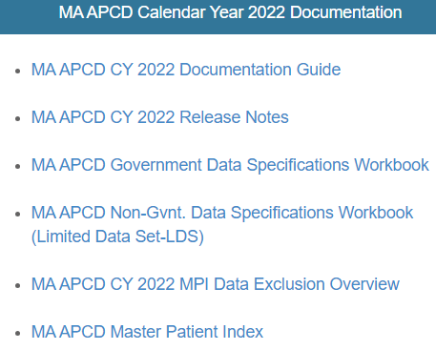
MA APCD Calendar Years 2021 and 2022 (continued)
The new CY 2022 Data includes medical, pharmacy, and dental claims incurred from January 1, 2018, through December 31, 2022, and includes six (6) months of run-out (paid claims through June 30, 2023). This release also includes MassHealth Medicaid data in the MA APCD for the period of calendar years 2018-2022. As with CY2021, this data encompasses public and private payers as well as fully-insured and self-insured plans. Again, keep in mind that due to the Supreme Court decision, Gobeille v. Liberty Mutual, the self-insured plans are severely reduced starting in 2016.
The new CY 2022 Documentation Guide
and Release Notes are available on
CHIA’s website for your review before
using the data.
https://www.chiamass.gov/ma-apcd/

Slide 5
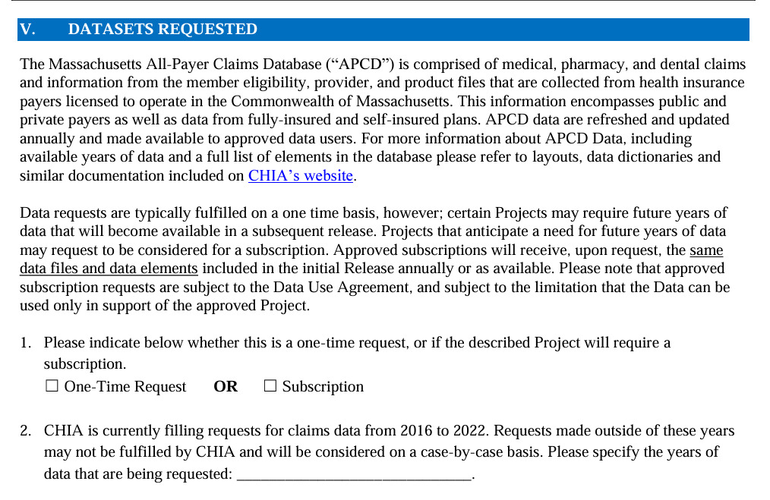
Updates to the MA APCD Application
When applying for CHIA data, always check the website to download and use the most recent version of the data request application. For example, the MA APCD application was last revised in December 2023 to update the full year date ranges available for purchase.
See application excerpt below.

Slide 6
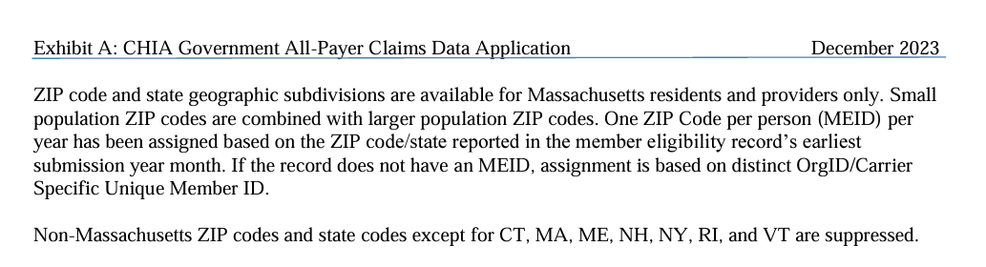
Updates to the MA APCD Application (continued)
In addition, the December 2023 revision to MA APCD application specifies that the member ZIP code geographic data is now only released at the level of one ZIP code per person per year based on the member’s ZIP code reported in the member’s earliest submission year month.
See application excerpt below.

Slide 7

Case Mix FY2022 Release
*CURRENT* RELEASE TIMEFRAMES FOR EACH FILE:
Hospital Inpatient Discharge Data (HIDD)
FY2022 Now Available for Request
Outpatient Emergency Department Visit Data (ED)
FY2022 Now Available for Request
Outpatient Observation Stay Data (OOD)
FY2022 Now Available for Request
Applicants with approved projects using previous years data (e.g., FY 20, FY21) that require newly available year(s) of case mix data (e.g., FY 22) should submit to CHIA a completed Exhibit B (Certificate of Continued Need and Compliance) of the Data Use Agreement. After submitting a completed Exhibit B you will receive an invoice (if applicable) for the requested data. Upon payment of the invoice the order for the data will be placed.
continued

Slide 8
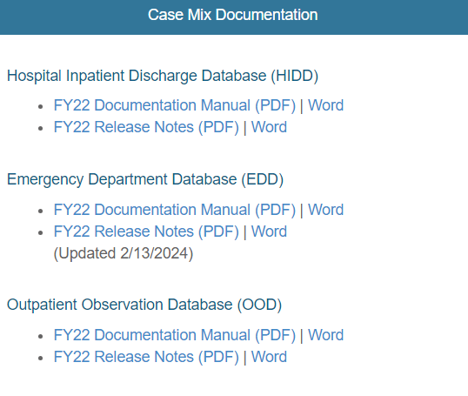
Case Mix FY2022 Release (continued)
The Documentation Manuals and Release Notes for the FY2022 case mix data are available on CHIA’s website. (https://www.chiamass.gov/case-mix-data/ ). There have been new updates to the FY2022 ED data release notes.

Slide 9
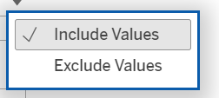
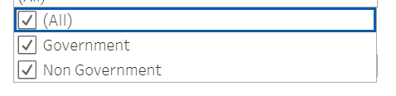
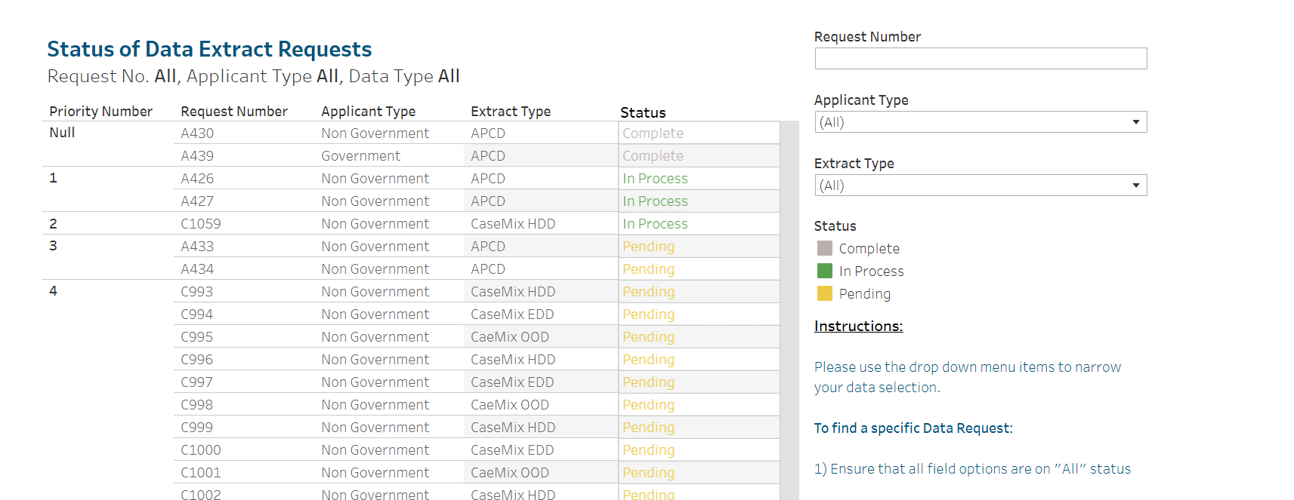
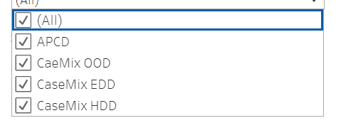
How to Check the Status of Your Release
Visit http://www.chiamass.gov/status-of-data-requests/ to check the status of data extracts and releases. The status website has drop down menus, as shown below, which allow you to narrow your search by request number, applicant type, and extract type.

Slide 10
USER questions

Slide 11

Question: When will the 2023 data be available for HIDD and EDD?
Answer: The FY 2023 HIDD and EDD are not available yet. The target release dates for HIDD and EDD are June 2024 and August 2024, respectively. Please see the following link for more information:
Status of Data Requests (chiamass.gov)
Question: I just want to confirm that to obtain the data for 2022 and 2023 HIDD and EDD would cost $100 for application fee and $4020 correct?
Answer: For information about application for the case mix data, please click on the following link:
https://www.chiamass.gov/non-government-agency-case-mix-requests/

Slide 12

Question: Is there a reliable transfer variable in the dataset that is filled out for the majority of patients with meaningful data (not just filled out with "unknown") for both 2022 and 2023?
Answer*:
The HIDD has a transfer variable “IdOrgTransfer” which has a record of all transfers of patients from one hospital to another. In FY 2022, the “IdOrgTransfer” variable showed that 52,689 of the 729,319 total discharges were transfers from one hospital to another. The “IdOrgTransfer” field is only populated when there is a transfer. There are no “Unknowns”.
Additionally, HIDD has the variable “AdmissionSourceCode”, which among others includes these 2 codes:
‘R’ (Transfer from within hospital) &
‘7’ (Outside hospital ED transfer).
* Note that the question pertains to HIDD & EDD.

Slide 13

Question: Can I see what hospitals each patient were seen in the ED and what hospital they were admitted to for both 2022 and 2023?
Answer*: Yes, you can.
The EDD has the variable “IdOrgSite”, which is the hospital where the patient was treated, and the variable “Source Of Visit”, which shows where the patient came from, and how the patient got to the Emergency room.
The HIDD has variables “AdmissionSourceCode”, which includes codes ‘R’(Transferred from within the hospital ED) & ‘7’ (Outside hospital ED transfer), and “EDFlagCode”, which includes code ‘2’ (Admitted from the ED).
You can track the patient using the “UHIN” or “Mother’s UHIN” variable in EDD and HIDD. These are buy-ups.
*Note that the question pertains to EDD & HIDD.

Slide 14
Question: I just want to confirm that ICD codes and CPT and billing codes are included in both the 2022 and 2023 dataset?
Answer*: Yes, there are ICD Diagnosis and Procedure codes and CPT codes in the case mix dataset.
The variable “ICDIndicator” in the EDD shows if the diagnosis, Ecodes, & procedure codes are ICD-10. The EDD also has variables “ProcedureCodingType” &“PrincipalDiagnosisCode” that show the procedures and diagnosis.
Similarly, the HIDD includes the variables “ICDIndicator”, “PrimaryDiagnosisCode”, which is the ICD- 10-CM code for the patient’s condition, and “PrincipalProcedureCode”, which is the ICD 10 for the principal procedure provided the patient in the inpatient facility.
* Please note that the question pertains to HIDD and EDD.

Slide 15
Question: Both the case mix hospital inpatient discharge data (HIDD) and the All-Payer Claims Data (MA APCD) medical claims have present on admission indicator (POA) fields, but there is more POA data in HIDD than MA APCD inpatient claims. What is the reason for this difference and are there any tradeoffs to using one or the other?
Present on Admission Indicators
Answer: The POA indicator is a qualifier for each diagnosis code indicating the onset of diagnosis preceded or followed admission. It is important to note that HIDD and MA APCD have different filing specifications. The reasons for the difference in volume of POA data are as follows:
The magnitude of POA data is larger in HIDD because in the context of “case mix”, the limit was lifted on the number of associated diagnosis codes in HIDD to better capture the hospital specific complexity and severity of cases influencing clinical outcomes and charges.
The MA APCD is limited to 24 associated diagnosis codes, therefore there is only a POA indicator for the principal diagnosis codes and the 24 associated diagnosis codes.
In MA APCD, POA is required when Type of Claim (MC094) = Facility (Code 002) , Admitting Diagnosis (MC039) and Principal Diagnosis (MC041) are populated and is not required when Types of Facility (MC245) is a Skilled Nursing Facility/Long Term Care Facility (Code 2), Designated Cancer Center (Code 5), Designated Inpatient Children’s Hospital (Code 6), Inpatient Rehabilitation Facility (Code 7) or Critical Access Hospital (Code 9).
continued

Slide 16
Answer (continued): To consider the trade-off when using the POA indicators to capture conditions not present on admission when only 24 associated are used, even though the percentage of HIDD with greater than 24 diagnosis codes has increased from FY2015 to FY2023 (see Table 1 below), in any give year less than 1% of such discharges have conditions not present on admission.
Present on Admission Indicators
Therefore, there is not a significant loss in the ability to measure not present on admission, since over 20% of discharges with less than 24 diagnosis codes have conditions not present on admission (see Table 2 below) versus discharges with greater than 24 diagnosis codes where the percent with conditions not present on admission remained less than 1% (significantly smaller) every year from FY2015 to FY2023.

Slide 17
Question: Gobeille v. Liberty Mutual Insurance Company, decided in 2016, significantly impacted the reporting of medical claims data? What impact did it have on the volume of dental claims and pharmacy claims?
Gobeille Revisited
Answer: Comparing Pre-Gobeille (CY2015) to CY2023, there was a 66% drop in dental claims (See Table 1 below) and 29% drop in pharmacy claims (See Table 2 below).
Table 1. Change in Volume of Dental Claims Before and After Gobeille
Year | Unknown/ Not Applicable | Fully-Insured Commercial Group | Self-Insured Group | Group Insurance Commission | MassHealth Managed Care Organization | Supplemental Policy | Integrated Care Organization or Senior Care Option | Accountable Care Organization (MassHealth Only)
2015 | 2,191,686 | 9,059,959 | 3,155,074 | 180,486 | 4,490,982 | - | 115,319 | -
2016 | 2,117,849 | 7,076,305 | 2,149,486 | 260,143 | 4,666,216 | - | 111,592 | -
2017 | 2,520,620 | 7,322,286 | 1,610,755 | 273,447 | 4,639,729 | - | 134,981 | -
2018 | 1,822,258 | 7,760,571 | 1,263,091 | 292,157 | 5,185,791 | - | 146,932 | 92,201
2019 | 1,773,619 | 7,789,036 | 1,201,852 | 306,947 | 3,841,983 | - | 172,427 | 1,428,906
2020 | 1,114,166 | 6,221,861 | 951,138 | 255,564 | 1,925,294 | - | 119,682 | 1,839,091
2021 | 1,415,462 | 7,738,811 | 1,030,492 | 333,783 | 2,639,990 | - | 165,613 | 2,527,750
2022 | 1,565,287 | 8,053,132 | 1,058,142 | 378,782 | 2,919,683 | - | 156,492 | 2,762,031
2023 | 1,743,189 | 7,836,123 | 1,975,940 | 359,924 | 2,379,660 | 3,672 | 179,996 | 3,743,470
Table 2. Change in Volume of Pharmacy Claims Before and After Gobeille
Year | Unknown/ Not Applicable | Fully-Insured Commercial Group | Self-Insured Group | Group Insurance Commission | MassHealth Managed Care Organization | Supplemental Policy | Integrated Care Organization or Senior Care Option | Accountable Care Organization (MassHealth Only)
2015 | 111,229,335 | 17,119,316 | 10,005,371 | 770,171 | 16,978,343 | 85,742 | 1,307,399 | 3
2016 | 129,897,331 | 15,734,285 | 1,790,867 | 770,327 | 14,700,985 | 95,621 | 1,652 | 141
2017 | 117,257,946 | 16,590,712 | 3,132,962 | 744,306 | 14,836,196 | 96,602 | 39,805 | 524,987
2018 | 117,935,226 | 17,202,568 | 2,997,051 | 261,666 | 10,786,269 | 34,770 | 108,353 | 6,427,724
2019 | 116,394,542 | 17,011,180 | 2,426,521 | 2,322 | 10,233,883 | 22,397 | 120,874 | 7,392,937
2020 | 114,524,120 | 15,728,417 | 1,720,123 | 3,018 | 9,786,254 | 14,412 | 114,964 | 7,698,421
2021 | 121,098,338 | 17,219,856 | 2,560,362 | 14,815 | 10,636,783 | 2,720 | 423,710 | 8,617,745
2022 | 102,102,815 | 17,008,625 | 7,153,758 | 2,170 | 10,340,126 | 39,210 | 1,712,902 | 8,365,408
2023 | 78,953,210 | 22,759,667 | 6,674,243 | 6,374 | 6,698,784 | 96,530 | 2,450,689 | 9,735,583

Slide 18
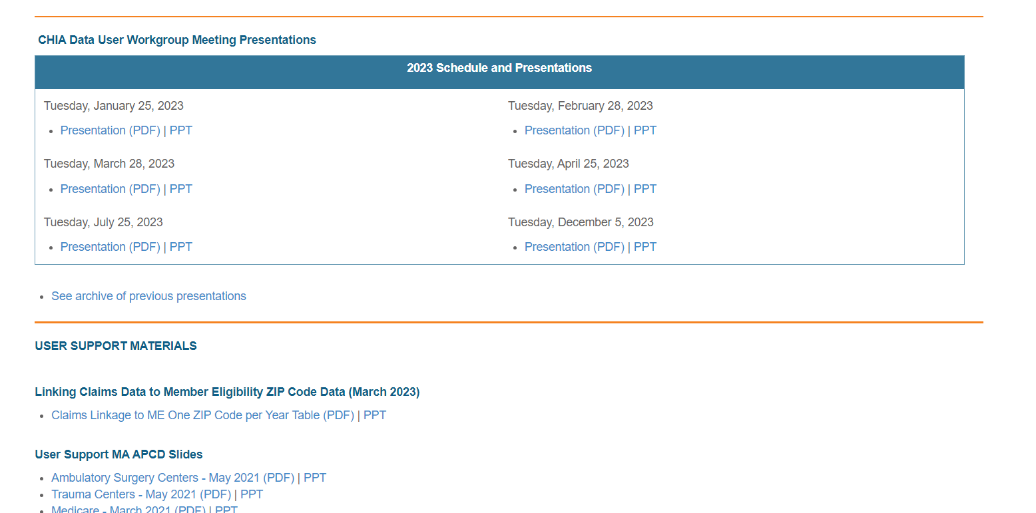
Where can I find past User Workgroup Presentations?
http://www.chiamass.gov/ma-apcd-and-case-mix-user-workgroup-information/

Slide 19
When is the next User Group meeting?
The next User Group will meet Tuesday June 25, 2024.
http://www.chiamass.gov/ma-apcd-and-case-mix-user-workgroup-information/

Slide 20
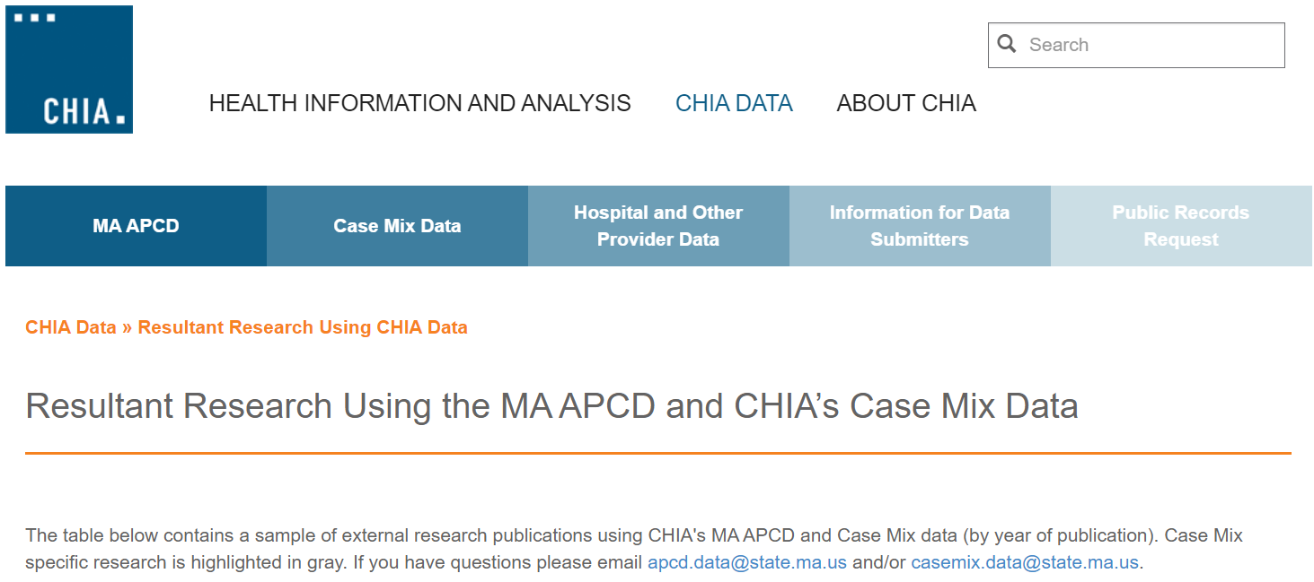
Resultant Research Using CHIA Data
https://www.chiamass.gov/resultant-research-using-chia-data

Slide 21
Questions?
Questions related to MA APCD:
apcd.data@chiamass.gov
Questions related to Case Mix:
casemix.data@chiamass.gov
REMINDER
CHIA still receives a high volume of email from data users who do not include their IRBNet ID. If you are in the process of or have already submitted a data application to CHIA through IRBNet https://www.irbnet.org/release/home.html, due to the volume of email CHIA receives, please remember to always include your IRBNET ID# in the subject line of your email. Doing so facilitates tracking your application and expediting responses to any questions.

