Slide 1
CHIA user workgroup
Don Kirkwood (Manager of Data Release and Procurement)
Anne Medinus (Senior Research Account Specialist)
Sylvia Hobbs (Associate Director of Data Strategy and User Support)
March 26, 2024
CENTER FOR HEALTH INFORMATION AND ANALYSIS

Slide 2
Agenda
Announcements:
  MA APCD Release CY 2021 and CY2022 Updates
  Update to the MA APCD Application
  FY22 Case Mix Release Updates
Website Updates
User Support Questions
  Number of Files in a given MA APCD Subscription
  Size of a Data Extract
  Size of the Largest File
  Data Format
  Inpatient Psychiatric Facilities
  Currency Fields
  Provider Location
Q&A

Slide 3
MA APCD Calendar Years 2021 and 2022
  Available for request
  Applicants with approved projects that require updated MA APCD data (CY 2021 Data or CY2022) should submit to CHIA a completed Exhibit B (Certificate of Continued Need and Compliance) of the Data Use Agreement. After submitting a completed Exhibit B, you will receive an invoice (if applicable) for the requested data. Upon payment of the invoice the order for the data will be placed.
  CY 2021 Data includes medical, pharmacy, and dental claims incurred between January 1, 2017, and December 31, 2021, and it includes six (6) months of run-out (paid claims through June 30, 2022). In addition to claims data, the release contains relevant reference files including member eligibility, providers, products, and benefit plans. This data encompasses public and private payers as well as fully-insured and self-insured plans. Keep in mind that due to the Supreme Court decision, Gobeille v. Liberty Mutual, the self-insured plans are severely reduced starting in 2016. This release also includes MassHealth Medicaid data in the MA APCD for the period of calendar years 2017-2021.
continued

Slide 4
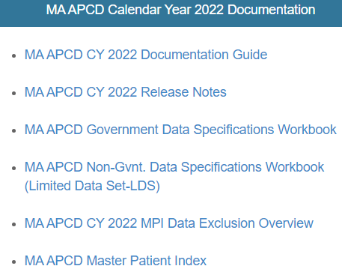
MA APCD Calendar Years 2021 and 2022 (continued)
  The new CY 2022 Data includes medical, pharmacy, and dental claims incurred from January 1, 2018, through December 31, 2022, and includes six (6) months of run-out (paid claims through June 30, 2023). This release also includes MassHealth Medicaid data in the MA APCD for the period of calendar years 2018-2022. As with CY2021, this data encompasses public and private payers as well as fully-insured and self-insured plans. Again, keep in mind that due to the Supreme Court decision, Gobeille v. Liberty Mutual, the self-insured plans are severely reduced starting in 2016.
  The new CY 2022 Documentation Guide
  and Release Notes are available on
  CHIA’s website for your review before
  using the data.
  https://www.chiamass.gov/ma-apcd/

Slide 5
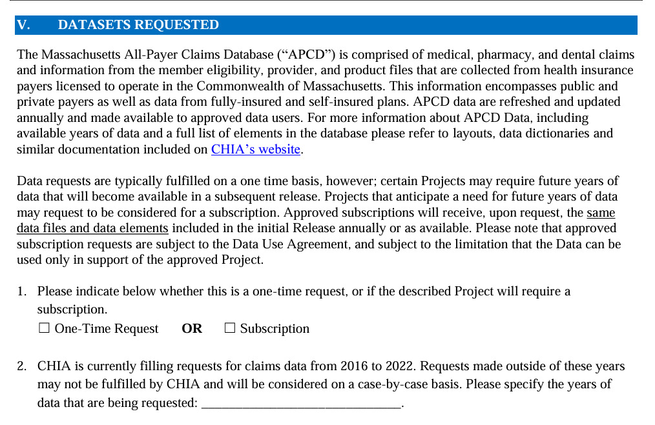
Updates to the MA APCD Application
When applying for CHIA data, always check the website to download and use the most recent version of the data request application. For example, the MA APCD application was last revised in December 2023 to update the full year date ranges available for purchase.
See application excerpt below.

Slide 6
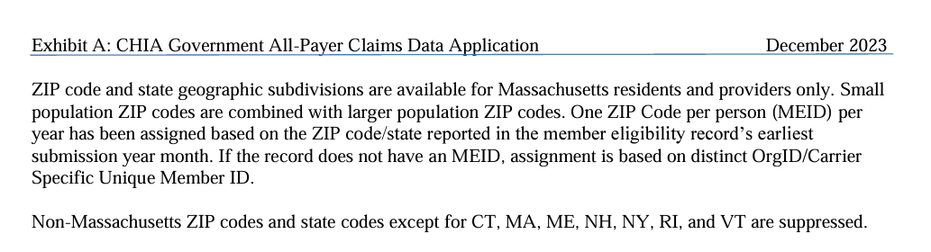
Updates to the MA APCD Application (continued)
In addition, the December 2023 revision to MA APCD application specifies that the member ZIP code geographic data is now only released at the level of one ZIP code per person per year based on the member’s ZIP code reported in the member’s earliest submission year month.
See application excerpt below.

Slide 7

Case Mix FY2022 Release
*CURRENT* RELEASE TIMEFRAMES FOR EACH FILE:
  Hospital Inpatient Discharge Data (HIDD)
  FY2022 Now Available for Request
  Outpatient Emergency Department Visit Data (ED)
  FY2022 Now Available for Request
  Outpatient Observation Stay Data (OOD)
  FY2022 Now Available for Request
  Applicants with approved projects using previous years data (e.g., FY 20, FY21) that require newly available year(s) of case mix data (e.g., FY 22) should submit to CHIA a completed Exhibit B (Certificate of Continued Need and Compliance) of the Data Use Agreement. After submitting a completed Exhibit B you will receive an invoice (if applicable) for the requested data. Upon payment of the invoice the order for the data will be placed.
continued

Slide 8
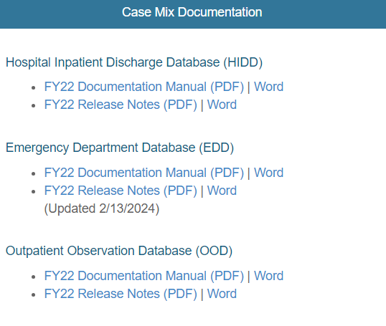
Case Mix FY2022 Release (continued)
  The Documentation Manuals and Release Notes for the FY2022 case mix data are available on CHIA’s website. (https://www.chiamass.gov/case-mix-data/ ). There have been new updates to the FY2022 ED data release notes.

Slide 9
Website Release Updates
  Updates on the production of MA APCD and case mix databases and status of data requests are now posted to CHIA’s website!
    Aim #1 is to provide weekly or bi-weekly status update on CHIA data products as they are in development.
    Aim #2 is to provide applicants with information about expected fulfillment status for individual data requests.
    Request IDs will be communicated to Data Requestors via email.
  Please visit http://www.chiamass.gov/status-of-data-requests/ to see the current status of data extracts and releases.
  You can also sign up to receive updates on the status of MA APCD and case mix data requests and data release information by filling out the form at the following link: https://lp.constantcontactpages.com/su/NYBm5Bs

Slide 10
USER questions

Slide 11
Question: What is the total size of the data extract for the MA APCD CY 2021 subscription?
Answer:
MA APCD File Size
This answer pertains to this user’s specific extract.
 | Medical Claims, including Medicaid Claims | Member Eligibility, including Medicaid Eligibility | Provider, including Medicaid Providers | Product, including Medicaid Products
Size | 1.5 TB | 112.40 GB | 33.78 GB | 226.58 MB
Rows (Lines) | 1,497,415,560 | 289,406,456 | 98,102,250 | 1,408,206
Question: What is the size of the largest file if the extract consists of multiple files?
Answer:
  One file is created per file type regardless of the size.
  One thing to remember about the size, the number of lines (rows) and size could differ based on the number of buy-ups and data elements requested, despite requesting the same number of years on an application.
  As shown in the user specific question above.

Slide 12
MA APCD File Format and
File Count
Question: Could you confirm whether the data is formatted as asterisk-delimited text files?
  Answer: The data is asterisk delimited.
  Question: Is the data compressed?
  Answer: No. The data is not compressed.
Question: How many files are included in the CY 2021 APCD data extract if we subscribe to Medical Claims, Member Eligibility, Provider, Product, and Medicaid Data?
Answer: There are 4 files. The Medicaid related data is included in each of the files. If you also subscribe to the MassHealth Enhanced Eligibility (MHEE) data, the MHEE data is sent as a separate file.

Slide 13
Question: Our research focuses on analyzing inpatient psychiatric care using the MA APCD medical claims file. Which variables within the MA APCD can be utilized to filter for inpatient psychiatric care?
Inpatient Psychiatric Hospital Medical Claims
Answer: There are several fields with coding options for inpatient psychiatric hospitals. The National Uniform Claim Committee (NUCC) maintains service provider taxonomy code as part of a system used to classify health care providers by specialty and area of practice. Both the MA APCD medical claims table and the MA APCD provider table have dedicated fields for reporting the service provider specialty using the NUCC taxonomy codes.
The taxonomy code for an inpatient psychiatric hospital is 283Q00000X.
This taxonomy code is reported in two MA APCD fields MC032 (Service Provider Specialty) and PV022 (Taxonomy).
Highest Volume Inpatient Psychiatric Hospitals MiraVista Behavioral Health Center
Worcester Recovery Center & Hospital
McLean Hospital
Fuller Hospital
Southcoast Behavioral Health
Pembroke Hospital
Taravista Behavioral Health Center
Bournewood Hospital
Arbour Hospital
HRI Hospital
Dr. Solomon Center Fuller MHC
High Point Treatment Center
Walden Behavioral Care
Haverhill Pavilion Behavioral Health
Hospital for Behavioral Medicine
Baldpate Hospital
Austin Riggs Center
MC032
Service Provider Specialty
Filter by
283Q00000X
PV022
Taxonomy
continued

Slide 14
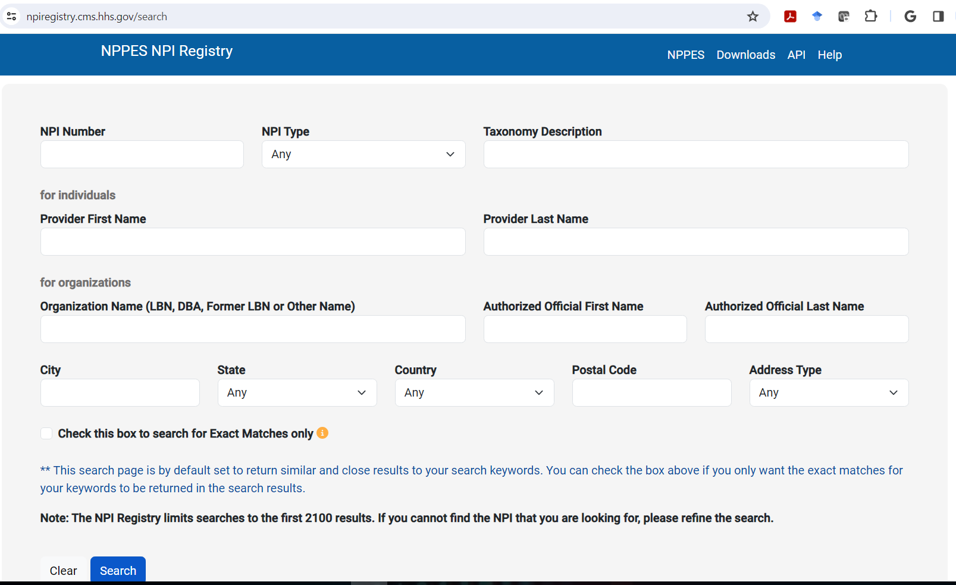
Answer (continued): The Centers for Medicare & Medicaid (CMS) National Plan and Provider Enumeration System (NPPES) National Provider Identifier (NPI) Registry at https://npiregistry.cms.hhs.gov/search can also be used obtain the NPIs of psychiatric hospitals and the NPIs can be used in the MA APCD. Below is the search screen for the NPI Registry.
Inpatient Psychiatric Hospital Medical Claims
continued

Slide 15

Answer (continued): In the CMS NPPES NPI Registry search screen options, for NPI Type select “Organization”, for Taxonomy Description enter “psychiatric hospital”, and for State select Massachusetts as shown in the screen below.
Inpatient Psychiatric Hospital Medical Claims
continued

Slide 16
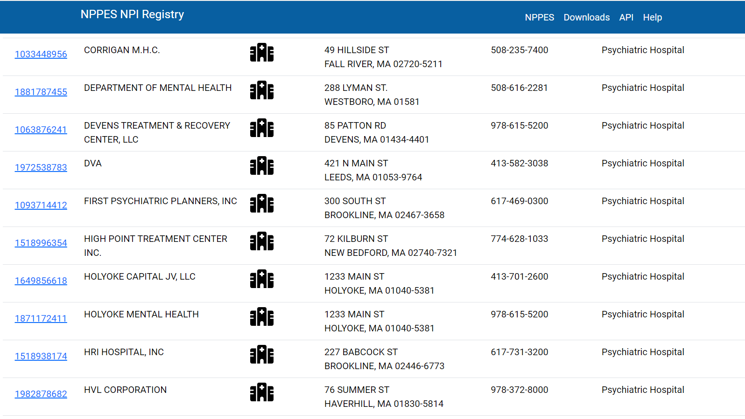
Answer (continued): It is important to note that state agencies, federal agencies, different types of corporations and LLCs will be listed as the organization for their psychiatric hospitals, for example, Massachusetts Department of Mental Health hospitals, Veteran Affairs hospitals (DVA), or hospitals which are part of a different corporate entities or limited liability corporation. See organizations highlighted below.
Inpatient Psychiatric Hospital Medical Claims
continued

Slide 17
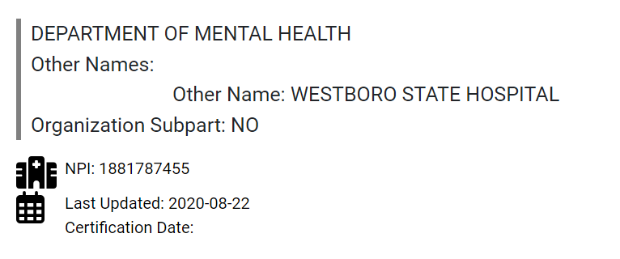
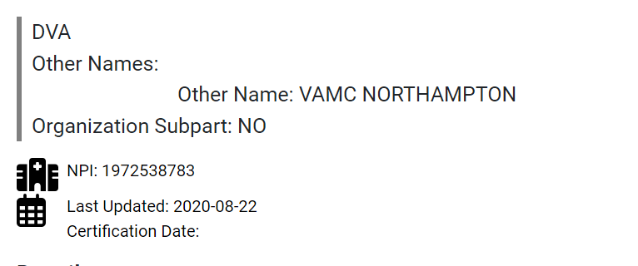
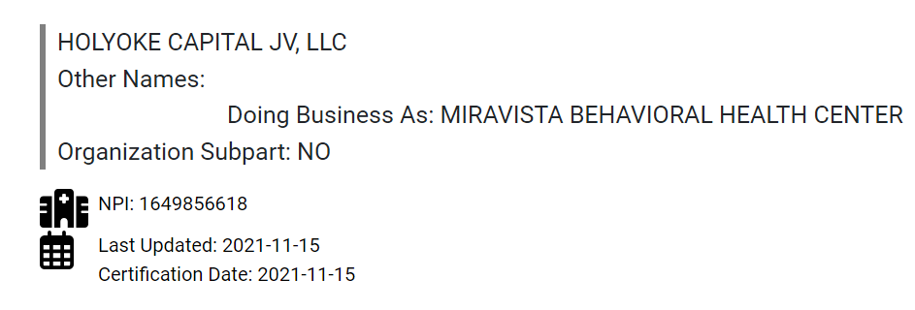

Answer (continued): When you click on the NPI listings for the Department of Mental Health, the DVA, Holyoke Capital JV, LLC, or HVL Corporation, you will see the hospital name as shown below. This is important to note because in the MA APCD, at the medical claim line level, there will be instances where the umbrella government agency or corporate entity is listed as the billing or service provider organization associated the NPI.
Inpatient Psychiatric Hospital Medical Claims
continued

Slide 18
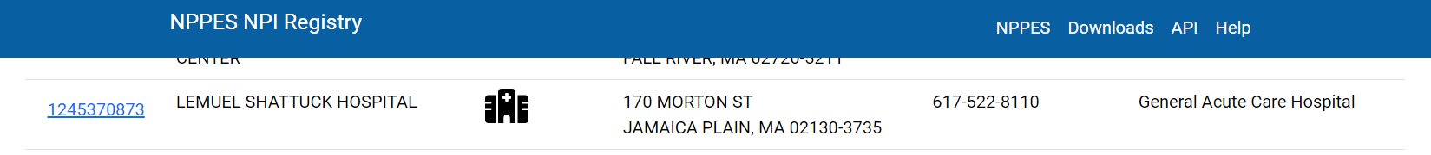
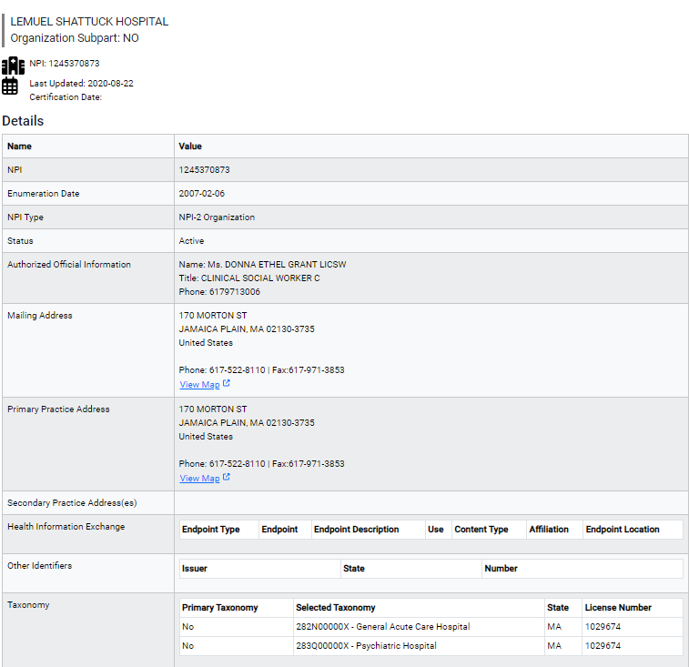
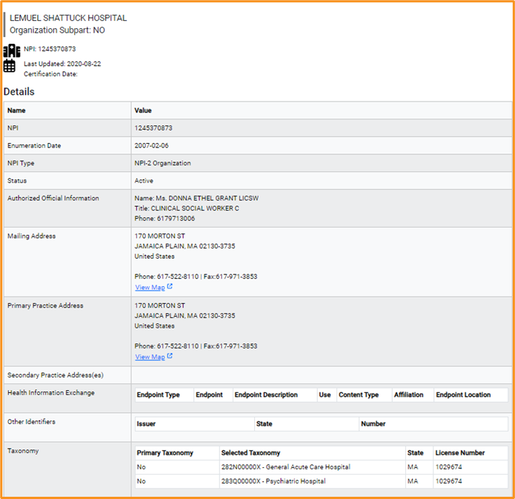
Answer (continued): There will be instances where acute care hospitals are in your search results for psychiatric hospitals. In those instances, the hospital is licensed with multiple taxonomies, such as Lemuel Shattuck Hospital. When you click on its NPI detail listing, you will see it also has the taxonomy of a psychiatric hospital as shown below.
Inpatient Psychiatric Hospital Medical Claims
Lemuel Shattuck Hospital’s Detail NPI Registry Listing
Lemuel Shattuck Hospital’s Multiple Taxonomies
continued

Slide 19
Answer (continued): Both acute care and psychiatric hospitals can have licensed psychiatric beds. The utilization of beds can be determined in the MA APCD by accommodation codes in the revenue code field. The most common accommodation revenue codes used by inpatient psychiatric hospitals are listed below in Table 1
Inpatient Psychiatric Hospital Medical Claims
It is important to keep in mind that not all inpatient stays will have an accommodation revenue codes. Different payment arrangement models, such as capitation models, global payment models, bundled payments or value-based care models for ACOs, do not necessarily require a medical claim bill include full listing through revenue codes. The Department of Mental Health has a listing of licensed psychiatric beds (updated 12/13/2023) online at: https://www.mass.gov/doc/dmh-licensed-hospital-list-1/download
Table 1. Common Accommodation Codes used by Psychiatric Hospital
continued

Slide 20
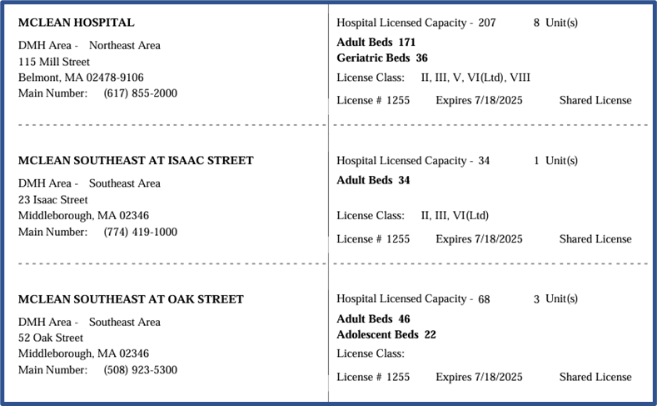
Answer (continued): When analyzing inpatient psychiatric care by bed capacity, the Massachusetts Department of Mental Health (DMH) has a helpful document which lists psychiatric beds licensed by DMH (updated 12/2023) by DMH at: https://www.mass.gov/doc/dmh-licensed-hospital-list-1/download . This document lists psychiatric bed capacity at both dedicated inpatient psychiatric facilities and hospital which also have a taxonomy of general acute care. Below is an example of the listing for McLean Hospital.
Inpatient Psychiatric Hospital Medical Claims
McLean Hospital Licensed Capacity (Updated 12/13/2023)
continued

Slide 21
Answer (continued): There are other fields in the MA APCD medical claims, such as the Type of Facility (MC245), which have a coding option for inpatient psychiatric facilities. See below. You could use this field to filter for inpatient psychiatric claims with the recommendation this field be used in combination with the specialty field. For example, WHERE typeoffacility = ‘8’ OR serviceproviderspecialty = ‘283Q00000X’.
Inpatient Psychiatric Hospital Medical Claims
Whenever you are uncertain about which MA APCD field to use in a query, consult the filing threshold detailed in CHIA’s MA APCD filing specifications (see: https://www.chiamass.gov/apcd-data-submission-guides/ ). The thresholds in the filing specifications will help you understand the level of completeness expected for that field. For example, the service provider taxonomy (MC032) is required on all claim lines, with a 98% threshold as a category ‘A2’ which means the data is required to be valid per Conditions and must meet threshold percent with no more than 2% variation. However, while the type of facility (MC245) also has a 98% threshold, it is a category ‘B’ data element, which means the data is requested and errors are reported but will not cause a file to fail.
Table 1. Types of Facilities in MC245
Value | Description
1 | General Acute Care Facility
2 | Skilled Nursing Facility/Long Term Care Facility
3 | Intermediate Care Facility
4 | Hospice Facility
5 | Designated Cancer Center
6 | Designated Inpatient Children’s Hospital
7 | Inpatient Rehabilitation Facility
8 | Inpatient Psychiatric Hospital
9 | Critical Access Hospital
10 | VNA/Home Care
70 | Other Type of Facility
continued

Slide 22
Answer (continued): When analyzing any inpatient care, it is important to note that the magnitude (approximately 85%) of the MA APCD claim lines are for outpatient care. If you are having problems untangling inpatient claim lines from outpatient claim lines, you can test adding one or more filters in the medical claims are more common on inpatient claims as shown below, but again pay close attention to the filing thresholds. Commonly populated means that the field is not always populated.
Inpatient Psychiatric Hospital Medical Claims
Medical Claims Fields Commonly Populated on Inpatient Claims
MC018 – Admission Date (Is not Null)
MC020 – Admission Type (Is not Null)
MC021 – Admission Source (Is not Null)
MC027 – Entity Type (Filter by Code 2 for non-person entity)
MC034 – Service Provider State (Filter by MA for Massachusetts)
MC036 - Type of Bill on Facility Claims (Filter by Code 11 for Hospital Inpatient Care)
MC069 – Discharge Date (Is not Null)
MC094 – Type of Claim (Filter by Code 002 for Facility)
continued

Slide 23

Negative Dollar Amounts
Question: We’ve come across negative numbers for paid amount and prepaid amounts. Can you tell us why that is the case? Also, can I ask what is the prepaid amounts?
Answer: Negative dollar amounts in the MA APCD usually indicate adjustments or credits applied to an account. These adjustments can occur for several reasons:
Refunds: Negative amounts can also reflect refunds processed for several reasons, such as overpayment by the patient or insurer, or if a service was canceled and not provided. You might see this in MA APCD pharmacy claims when someone fails to pick up a prescription and medication is returned to supply.
Payment Corrections: If there was an error in the original payment calculation, a negative adjustment might be made to correct the mistake. Sometimes when amounts kick in from copayments, deductibles, or insurance reimbursements, other amounts in the eleven MA APCD currency fields on the medical claim must be corrected.
Claim Adjustments: Sometimes, after a claim has been processed, adjustments are made based on negotiated rates, policy terms, or after an audit of the services billed. These adjustments can result in negative amounts to align the charges with the agreed-upon rates or policy coverage.
Overpayment: If an insurance company or patient pays more than the final billed amount for a service, the excess payment is often reflected as a negative amount. This could indicate that the payer is due a refund or that the amount will be credited against future charges. This sometimes happens if a person is dually eligible and a secondary or tertiary payment kicks in.
Also, in the context of negative dollar amounts, pay attention to the Claim Line Type field which indicates whether the field is an amendment, backout, original, replacement, or void. CHIA has incorporated into the MA APCD the Highest Version Paid Indicator is intended only to designate the highest version of a claim line that was PAID. This is the version indicator approved by carriers through discussions with CHIA for MA APCD release and financial analysis purposes . Also, the Highest Version Indicator indicates that the claim line is the highest version claim line, which can include paid or denied claim claims. See: https://www.chiamass.gov/assets/Uploads/Version-Flags-MAY-2020.pdf
continued

Slide 24
Prepaid Amount
Answer (continued): With regards to the prepaid amount, see page 10 of the MEDICAID NATIONAL CORRECT CODING INITIATIVE TECHNICAL GUIDANCE MANUAL (see: https://www.cms.gov/files/document/medicaid-ncci-technical-guidance-manual-03152024.pdf ), they explain that:
  “In a risk-based managed-care arrangement, the state Medicaid agency pays an MCO a monthly prepaid amount for each Medicaid enrollee, which covers all or most Medicaid-covered services provided to each enrollee. The MCO may reimburse those who provide covered services to the Medicaid enrollees on an FFS, contract, sub-capitated, or other bundled/global payment basis.”
The prepaid amount can be used by both Health Maintenance Organizations (HMOs) and Managed Care Organizations (MCOs), where a fixed, upfront fee is paid on a monthly or annual basis. This prepaid amount covers a comprehensive range of healthcare services defined in the member's contract, without requiring significant additional payment at the time of service. The focus is on controlling cost and ensuring the use of annual (routine) preventive healthcare, encouraging members to use their prepaid services without the worry of high medical bills for individual visits or treatments.
The prepaid amount allows for more predictable healthcare costs for carriers and members. In exchange, members typically agree to receive care exclusively from providers within the HMO's and MCO’s network, except in emergencies, and they often need a referral from their primary care physician to see specialists. The goal is to manage healthcare costs more effectively while providing accessible, coordinated care to members.
Again, see CMS Technical Guidance Manual for additional details.

Slide 25

Provider Details
Question: Before applying for the MA APCD, we wanted to determine if the medical claims LDS table included fields to determine the provider who rendered medical care and the provider location.
Answer: The data elements MC134 Plan Rendering Provider and MC135 Provider Location are included in the medical claims LDS table. Insurance carriers use these elements to describe precisely who performed the services on the patient and where the service was rendered
  The intent of MC134 – Plan Rendering Provider is to capture the details of the individual that performed the service on the patient or for the patient (lab technician, supply delivery, etc.).
  The intent of MC135 – Provider Location is to capture the details of the site where the Plan Rendering Provider delivered those services (Office, Hospital, etc.)

Slide 26
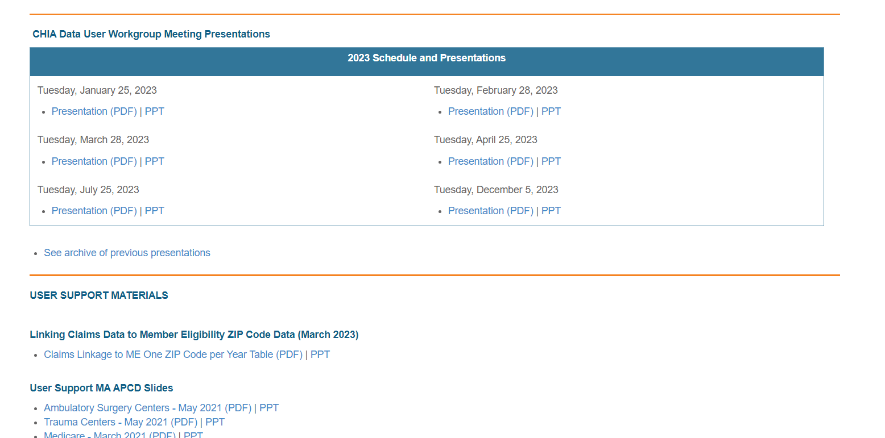
Where can I find past User Workgroup Presentations?
http://www.chiamass.gov/ma-apcd-and-case-mix-user-workgroup-information/

Slide 27
When is the next User Group meeting?
The next User Group will meet Tuesday April 23, 2024.
http://www.chiamass.gov/ma-apcd-and-case-mix-user-workgroup-information/

Slide 28
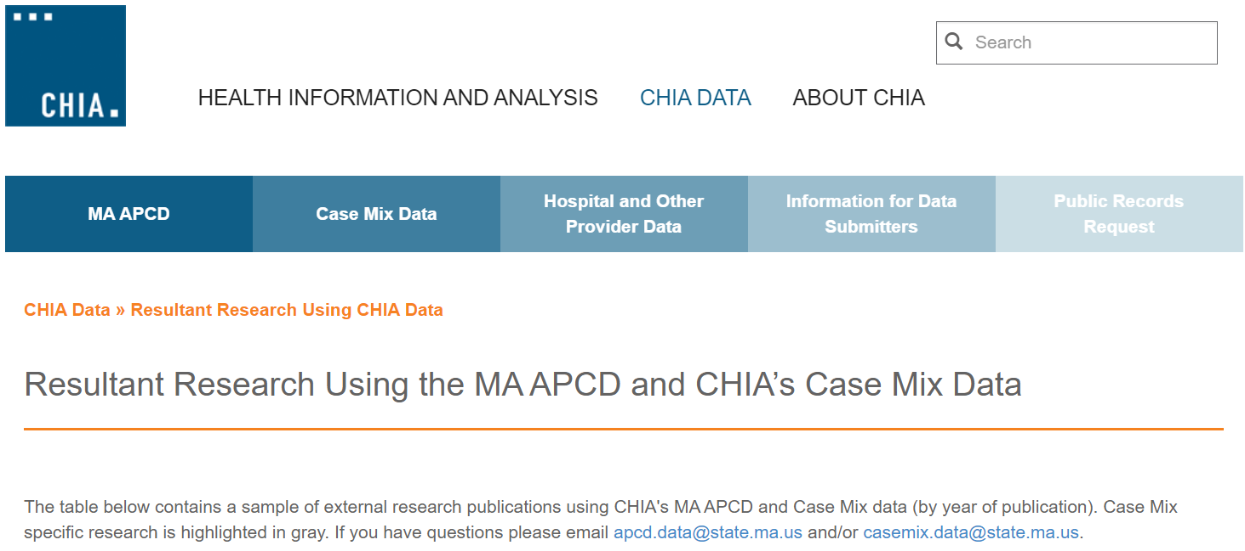
Resultant Research Using CHIA Data
https://www.chiamass.gov/resultant-research-using-chia-data

Slide 29
Questions?
Questions related to MA APCD:
apcd.data@chiamass.gov
Questions related to Case Mix:
casemix.data@chiamass.gov
REMINDER
CHIA still receives a high volume of email from data users who do not include their IRBNet ID. If you are in the process of or have already submitted a data application to CHIA through IRBNet https://www.irbnet.org/release/home.html, due to the volume of email CHIA receives, please remember to always include your IRBNET ID# in the subject line of your email. Doing so facilitates tracking your application and expediting responses to any questions.

