Slide 1
CHIA user workgroup
Don Kirkwood (Manager of Data Release and Procurement)
Sylvia Hobbs (Manager of User Support)
Scott Curley (Manager Privacy & Compliance)
June 28, 2022
CENTER FOR HEALTH INFORMATION AND ANALYSIS

Slide 2
Agenda
Announcements:
  APCD Release CY 2020 Updates
  FY20 Case Mix Release Projections
Website Updates
User Support Questions
  Multiple State APCDs
  Sources for Comparing APCD policies
  Sources for Comparing APCD data elements
  The Status Research Using APCDs
Q&A

Slide 3
MA APCD CY 2020 (Release 10.0)
  Available for request
  Applicants with approved projects that require updated APCD data (CY 2020 Data) should submit to CHIA a completed Exhibit B (Certificate of Continued Need and Compliance) of the Data Use Agreement. After submitting a completed Exhibit B you will receive an invoice (if applicable) for the requested data. Upon payment of the invoice the order for the data will be placed.
  CY 2020 Data includes data on services from January 2016 – December 2020 with six months of claim runout.

Slide 4

Case Mix FY21 Release
*CURRENT* RELEASE TIMEFRAMES FOR EACH FILE:
  Inpatient (HIDD)
  Available for request
  Emergency Department (ED)
  August 2022
  Outpatient Observation (OOD)
  September 2022
  Applicants with approved projects that require newly available year(s) of Case Mix Data (e.g., FY 19) should submit to CHIA a completed Exhibit B (Certificate of Continued Need and Compliance) of the Data Use Agreement. After submitting a completed Exhibit B you will receive an invoice (if applicable) for the requested data. Upon payment of the invoice the order for the data will be placed.

Slide 5
Website Release Updates
  Updates on the production of APCD and Case Mix databases and status of data requests are now posted to CHIA’s website!
    Aim #1 is to provide weekly or bi-weekly status update on CHIA data products as they are in development.
    Aim #2 is to provide applicants with information about expected fulfillment status for individual data requests.
    Request IDs will be communicated to Data Requestors via email.
  Please visit http://www.chiamass.gov/status-of-data-requests/ to see the current status of releases.

Slide 6
USER questions

Slide 7

Question: Before applying for all-payer claims data, I want to understand how states differ in data release regulations and data fields available. What would be the best approach for getting this information?
COMPARING
POLICIES AND DATA
Answer: The APCD Council, a collaborative of government, private, non-profit, and academic organizations focused on improving the development and deployment of state-based APCDs, convene and coordinated by the University of New Hampshire’s Institute for Health Policy and Practice and the National Association of Health Data Organizations (NAHDO), maintains an interactive state update map with clickable links that direct you to each state’s APCD data
collection status, regulations, policies and data fields available, see: https://www.apcdcouncil.org/state/map
STATUS OF ALL PAYER CLAIMS DATA COLLECTION IN 50 STATES
32% of States Existing APCD Arkansas Colorado Connecticut Delaware Florida Kansas Maine Maryland Massachusetts Minnesota New Hampshire New York Oregon Utah Vermont Virginia
14% of States Existing Voluntary APCD California Michigan Missouri Oklahoma South Carolina Washington Wisconsin
Existing or
Existing Voluntary
Existing
or
Existing Voluntary
Continued

Slide 8
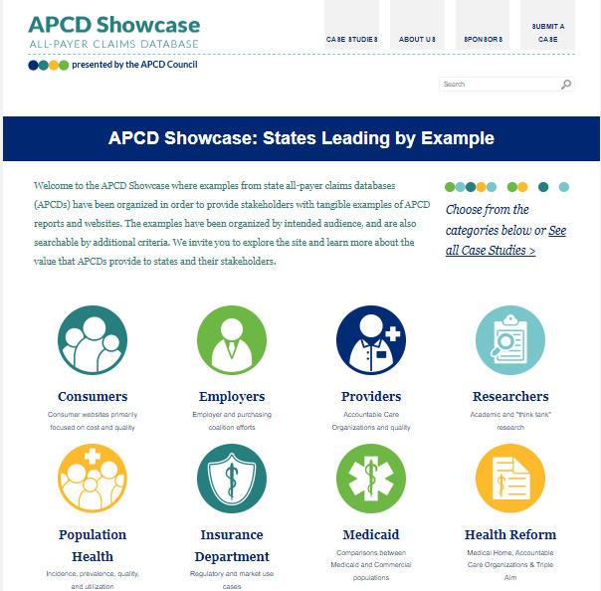


COMPARING
POLICIES AND DATA
Answer (continued): In addition, the APCD Council also maintains a “State Efforts”
directory with three separate web pages which contain specific link addresses for:
State APCD legislation enabling the collection of health care claims data:
https://www.apcdcouncil.org/apcd-legislation-state
State claims data release rules and procedures governing the process of requesting data: https://www.apcdcouncil.org/claims-data-release-rules
State claims data collection rules for what can and should be collected in an all-payer claims database: https://www.apcdcouncil.org/claims-data-collection-rules
State data access applications and request procedures: https://www.apcdcouncil.org/state-data-access
The APCD Council includes an interactive APCD Showcase at: https://www.apcdshowcase.org/ organized into eight categories of case study stakeholders.
Continued

Slide 9
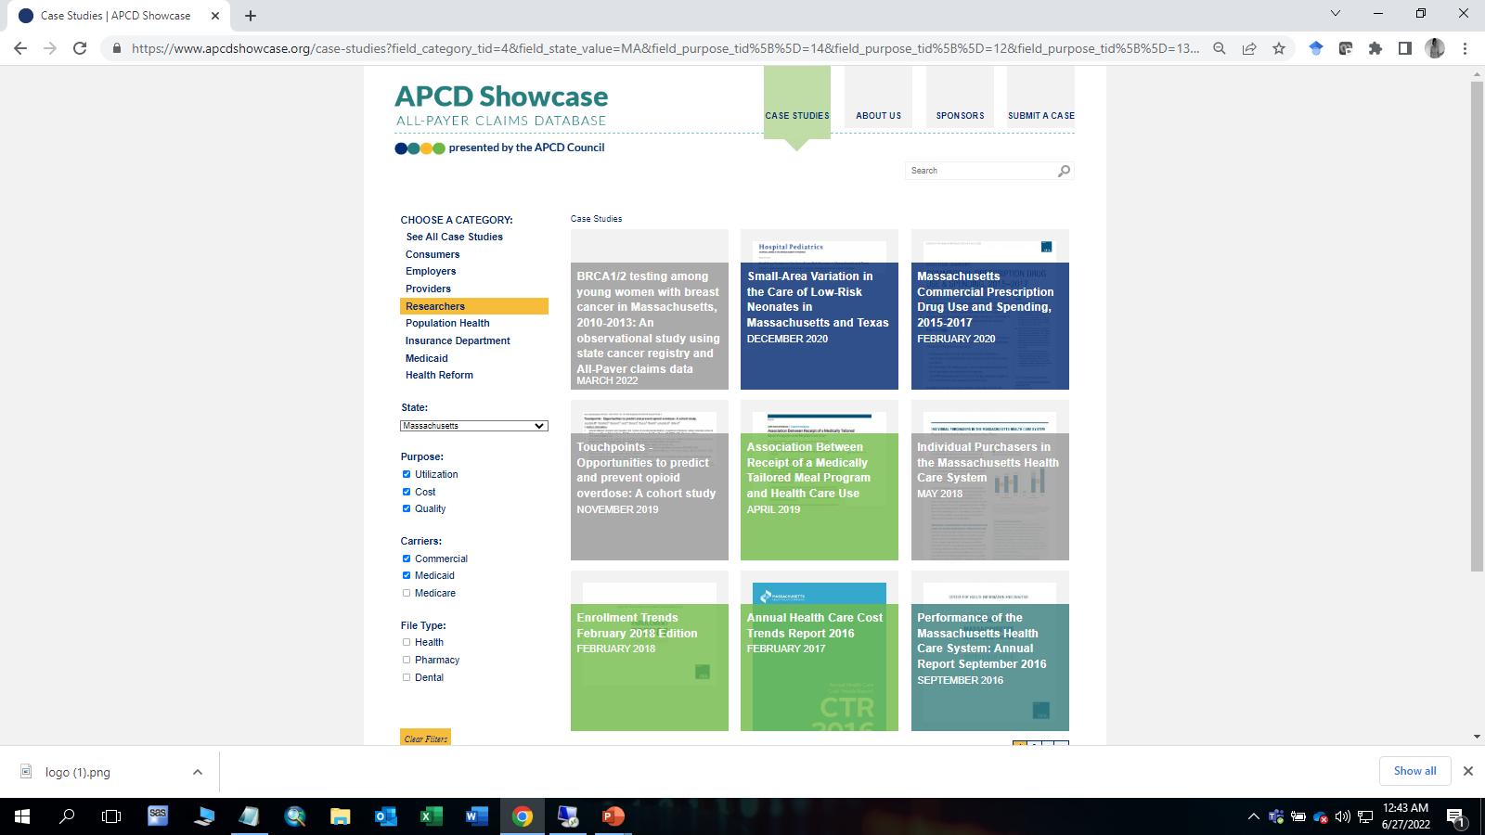
COMPARING
POLICIES AND DATA
Answer (continued): For example, the APCD Showcase has a dropdown box which allows you to select studies from a specific state based on each of the stakeholder categories, the purpose of the study (utilization, cost, quality), the carrier’s data used (commercial, Medicaid, Medicare), and the file type (health, pharmacy, dental). In the example, to the right, Massachusetts has been selected and eleven studies are returned. Please keep in mind that this site is limited to select studies which have been submitted by the authors or stakeholders for showcased by the APCD Council.
Continued

Slide 10
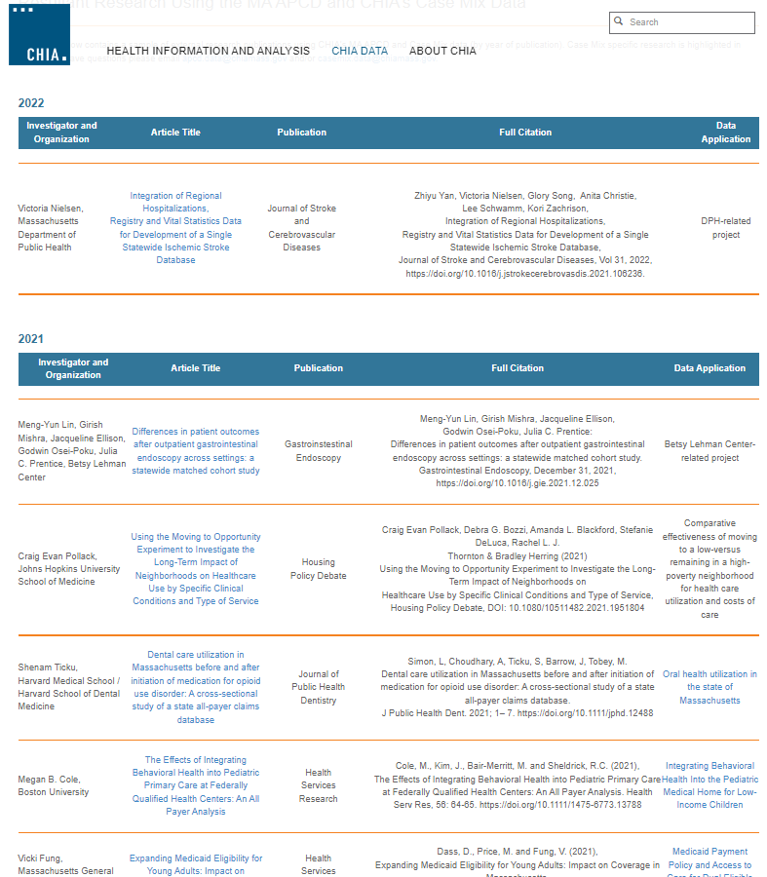
COMPARING
POLICIES AND DATA
Answer (continued): CHIA also posts a list of publications using the MA APCD which can be found on the Resultant Research Using the MA APCD and CHIA’s Case Mix Data website at: https://www.chiamass.gov/resultant-research-using-chia-data/ The table website contains a sample of external research publications using CHIA's MA APCD and Case Mix data (by year of publication). These publications are found through periodic literature searches or when authors notify CHIA of publication.
Continued

Slide 11
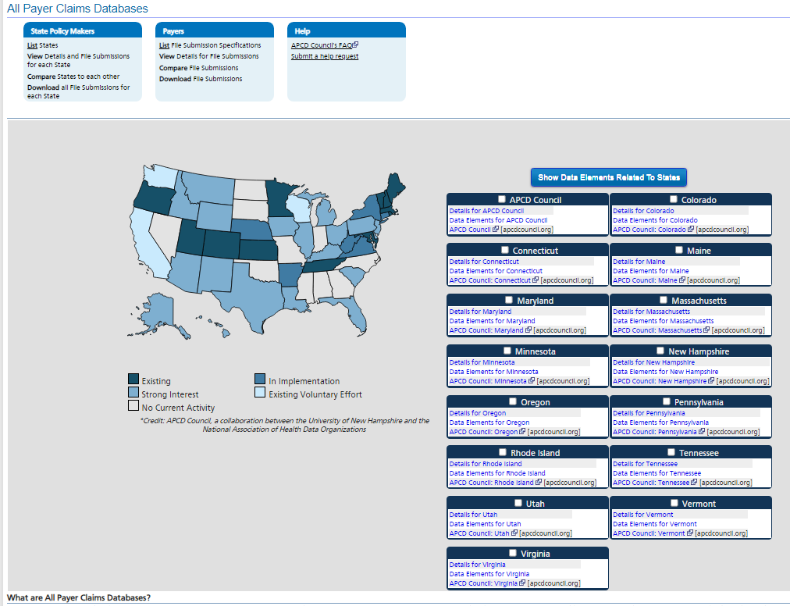
Answer (continued): Another robust tool for comparing APCD data fields by State is AHRQ’s United States Health Information Knowledgebase (USHIK) which contains information from healthcare-related initiatives, including All-Payer Claims Databases, CMS Quality Reporting, Children's EHR Format, Clinical Quality Measures available for feedback, AHRQ's Patient Safety / Common Formats, and others.
COMPARING
POLICIES AND DATA
https://ushik.ahrq.gov/mdr/portals/apcd
Continued

Slide 12
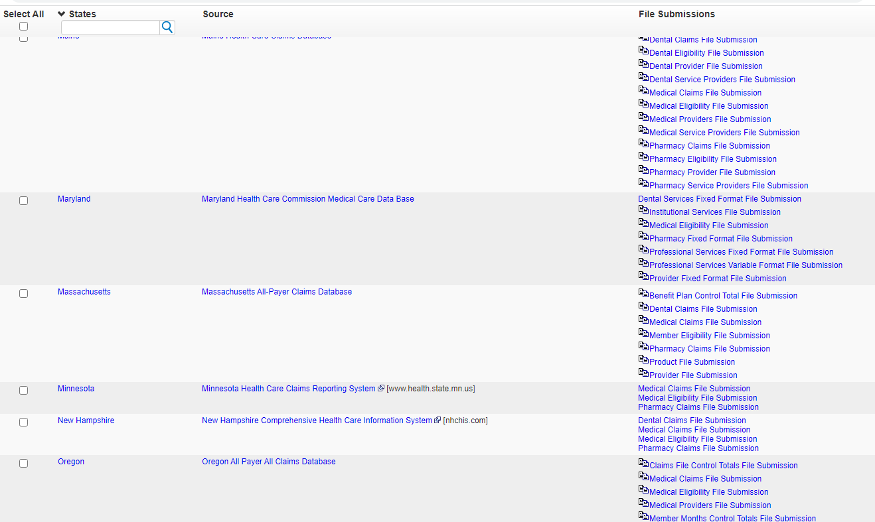
Answer (continued): USHIK is a robust interactive portal which allows you to select which state APCDs you would like to compare files and data you would like to compare with the option of downloading the selected fields compared in an EXCEL spreadsheet. Below is an example of the compare state option screen looks like.
COMPARING
POLICIES AND DATA
Continued

Slide 13
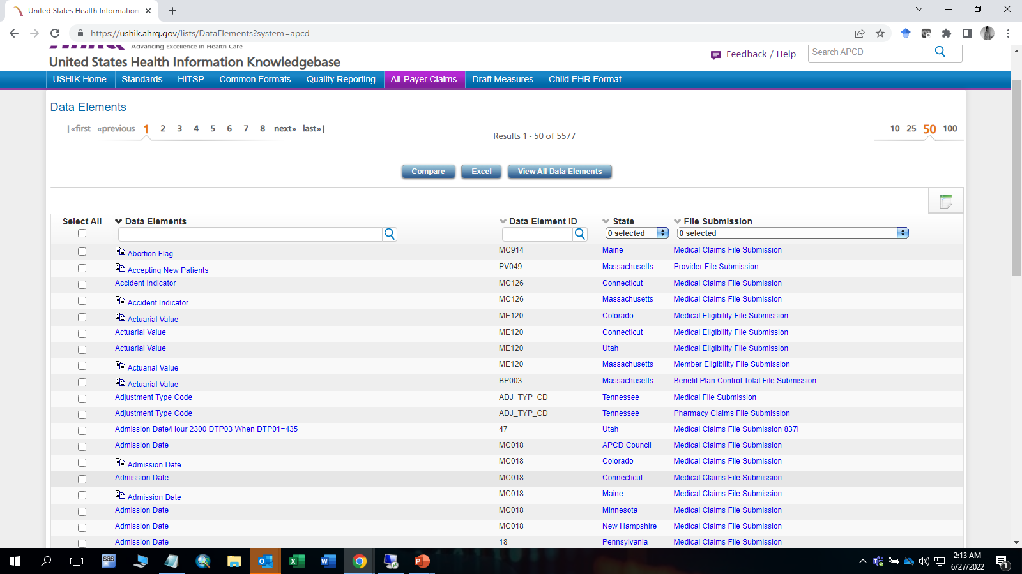
Answer (continued): USHIK also provides a selection menu to drill down and select from any of the 5,577
APCD data elements collected by all the states. For example, you can see that the Maine is the only state that has an abortion flag field in its medical claims and Massachusetts, Colorado, Connecticut, and Utah are the only states which have actuarial value. It is important to note that this data is subject to change and updates that have not been reflected in the comparison tool.
COMPARING
POLICIES AND DATA
Continued

Slide 14
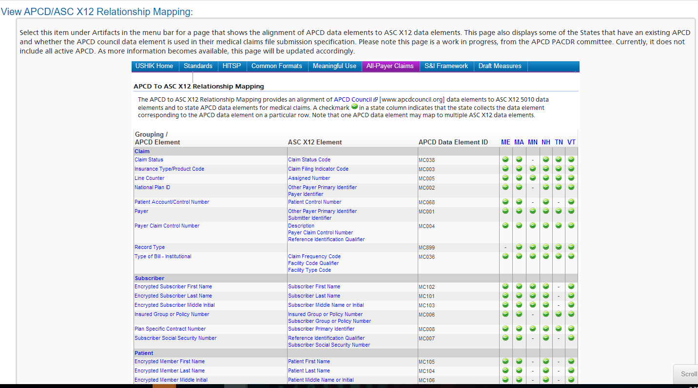
Answer (continued): USHIK also enables a mapping of the relationship between each state’s APCD data element in alignment with the APCD Council’s definition based on the American National Standards Institute Accredited Standards Committee X12 (ANSI ASC X12). In the example shown below, you will see that most of the Massachusetts data elements are in alignment with the ASC X12 standard.
COMPARING
POLICIES AND DATA
Continued

Slide 15
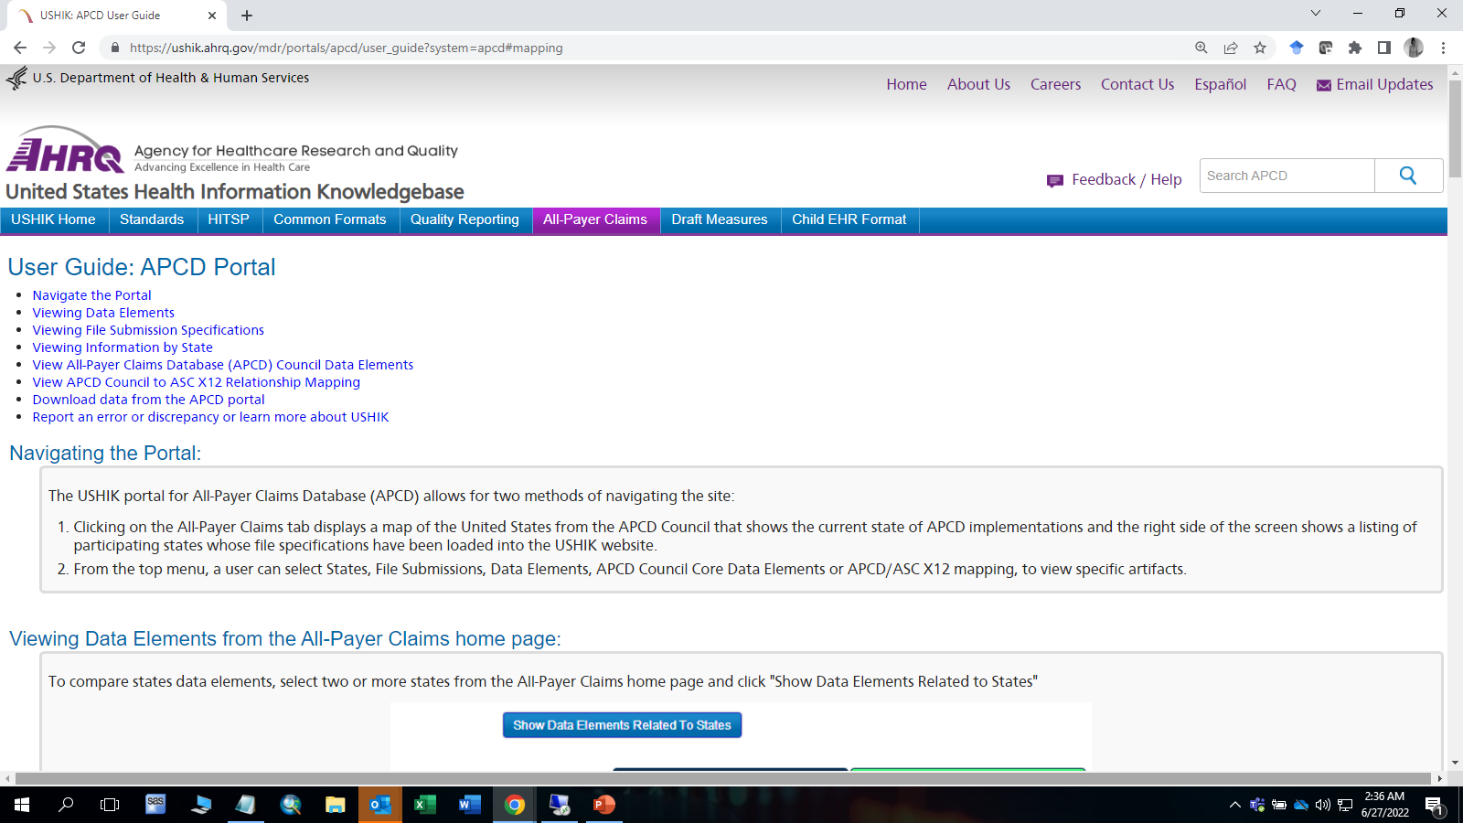
Answer (continued): The AHRQ USHIK Portal has an easily accessible User Guide which explains how to use all of the interactive query tools in the portal, including how to use the data selection menu bar and how to create lists by state, and sorting alphabetically by data element name.
COMPARING
POLICIES AND DATA
https://ushik.ahrq.gov/mdr/portals/apcd/user_guide
Continued

Slide 16
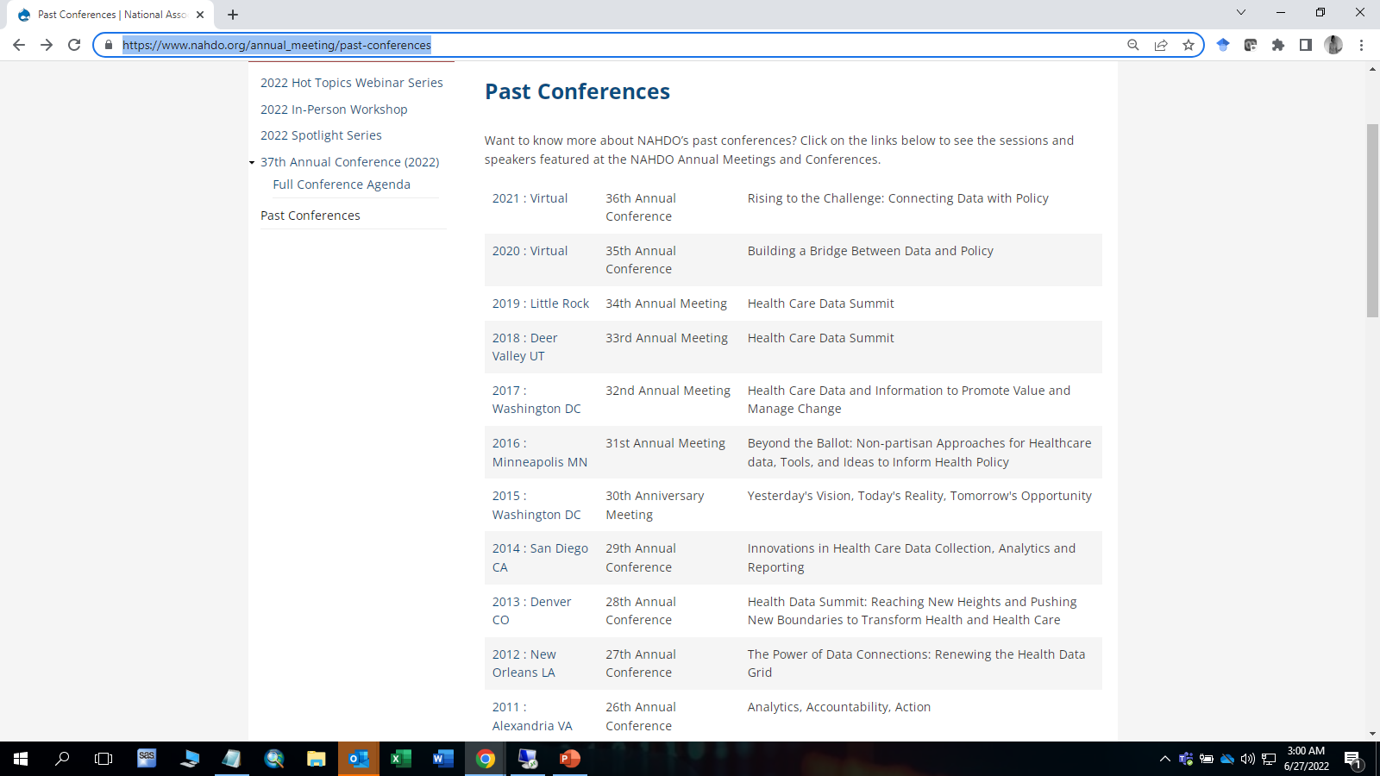

Answer (continued): A final resource on state APCDS is the National Association of Health Data Organizations (NAHDO). NAHDO maintains an online compendium of all past presentations on APCDs at their conferences available at: https://www.nahdo.org/annual_meeting/past-conferences
COMPARING
POLICIES AND DATA
https://www.nahdo.org/

Slide 17
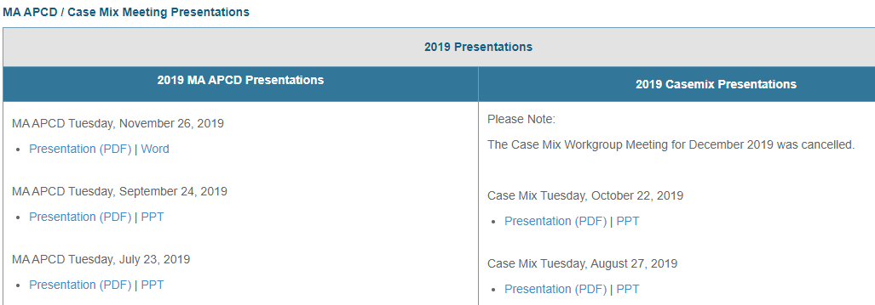
Where can I find past User Workgroup Presentations?
http://www.chiamass.gov/ma-apcd-and-case-mix-user-workgroup-information/

Slide 18
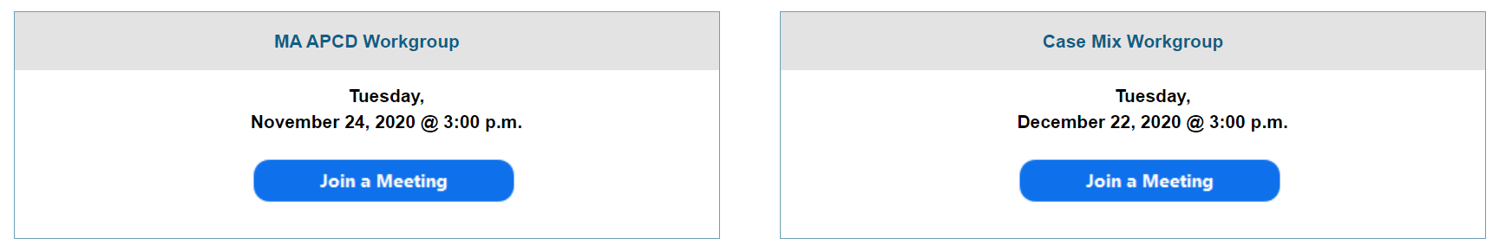
When is the next User Group meeting?
The next User Group will meet Tuesday, July 26.
http://www.chiamass.gov/ma-apcd-and-case-mix-user-workgroup-information/

Slide 19
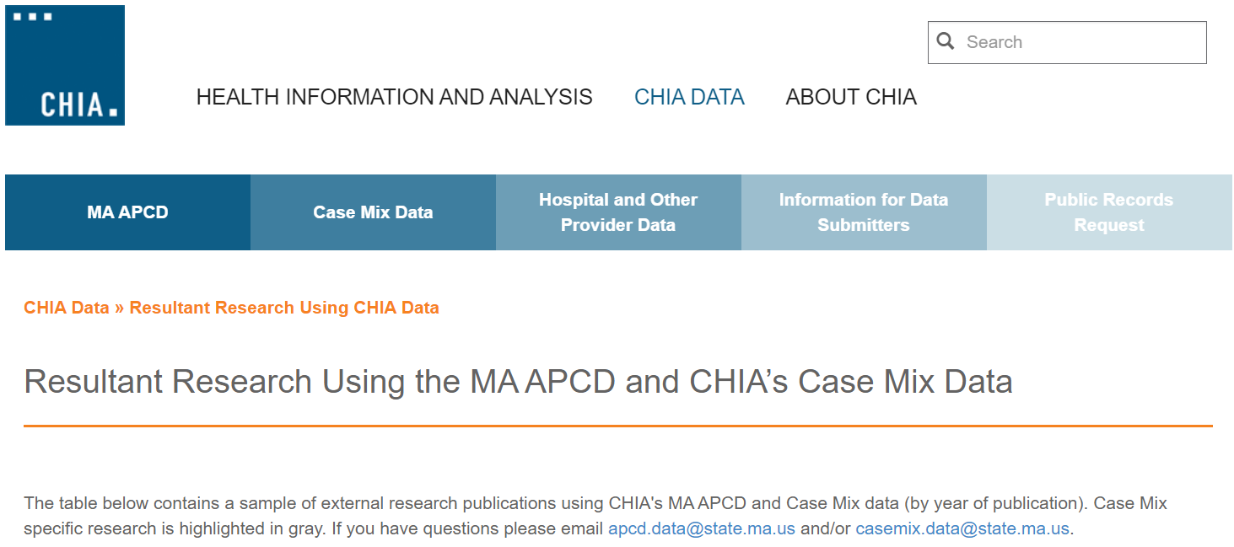
Resultant Research Using CHIA Data
https://www.chiamass.gov/resultant-research-using-chia-data

Slide 20
Questions?
Questions related to MA APCD:
apcd.data@chiamass.gov
Questions related to Case Mix:
casemix.data@chiamass.gov
REMINDER: Please include your IRBNet ID#, if you currently have a project using CHIA data.

