Slide 1
CHIA user workgroup
Don Kirkwood (Manager of Data Release and Procurement)
Sylvia Hobbs (Associate Director of Data Strategy and User Support)
January 23, 2024
CENTER FOR HEALTH INFORMATION AND ANALYSIS

Slide 2
Agenda
Announcements:
MA APCD Release CY 2021 Updates
New! MA APCD Release CY 2022 Available
FY22 Case Mix Release Updates
Website Updates
User Support Questions
ICD-10-CM Updates to Granularity in Cannabis Diagnosis Codes
Inpatient Accommodations Coding
Specific Fields to Use when Consolidating MA APCD Releases
Expected Distribution of Diagnosis and Procedure Codes
Q&A

Slide 3
MA APCD Calendar Year 2021
Available for request
Applicants with approved projects that require updated MA APCD data (CY 2021 Data) should submit to CHIA a completed Exhibit B (Certificate of Continued Need and Compliance) of the Data Use Agreement. After submitting a completed Exhibit B you will receive an invoice (if applicable) for the requested data. Upon payment of the invoice the order for the data will be placed.
CY 2021 Data includes medical, pharmacy, and dental claims incurred between January 1, 2017, and December 31, 2021, and it includes six (6) months of run-out (paid claims through June 30, 2022). In addition to claims data, the release contains relevant reference files including member eligibility, providers, products, and benefit plans.

Slide 4
MA APCD Calendar Year 2022
NEW! MA APCD Calendar Year 2022 Available for request
Calendar Year (CY) 2022 data holds data collected from health insurance payers licensed to operate in the Commonwealth of Massachusetts. The data includes on health care activity that occurred from January 1, 2018, through December 31, 2022. MA APCD CY 2022 includes medical, pharmacy, and dental claims incurred between January 1, 2018, and December 31, 2022. This release includes six (6) months of run-out (paid claims through June 30, 2023). This data encompasses public and private payers as well as fully-insured and self-insured plans. Keep mind that due to the Supreme Court decision, Gobeille v. Liberty Mutual, the self-insured plans are severely reduced starting in 2016. This release also includes MassHealth Medicaid data in the MA APCD for the period of calendar years 2018-2022.

Slide 5

Case Mix FY2022 Release
*CURRENT* RELEASE TIMEFRAMES FOR EACH FILE:
Hospital Inpatient Discharge Data (HIDD)
FY2022 Now Available for Request
Outpatient Emergency Department Visit Data (ED)
FY2022 Now Available for Request
Outpatient Observation Stay Data (OOD)
FY2022 Now Available for Request
Applicants with approved projects using previous years data (e.g., FY 20, FY21) that require newly available year(s) of case mix data (e.g., FY 22) should submit to CHIA a completed Exhibit B (Certificate of Continued Need and Compliance) of the Data Use Agreement. After submitting a completed Exhibit B you will receive an invoice (if applicable) for the requested data. Upon payment of the invoice the order for the data will be placed.

Slide 6
Website Release Updates
Updates on the production of MA APCD and case mix databases and status of data requests are now posted to CHIA’s website!
Aim #1 is to provide weekly or bi-weekly status update on CHIA data products as they are in development.
Aim #2 is to provide applicants with information about expected fulfillment status for individual data requests.
Request IDs will be communicated to Data Requestors via email.
Please visit http://www.chiamass.gov/status-of-data-requests/ to see the current status of data extracts and releases.
You can also sign up to receive updates on the status of MA APCD and case mix data requests and data release information by filling out the form at the following link: https://lp.constantcontactpages.com/su/NYBm5Bs

Slide 7
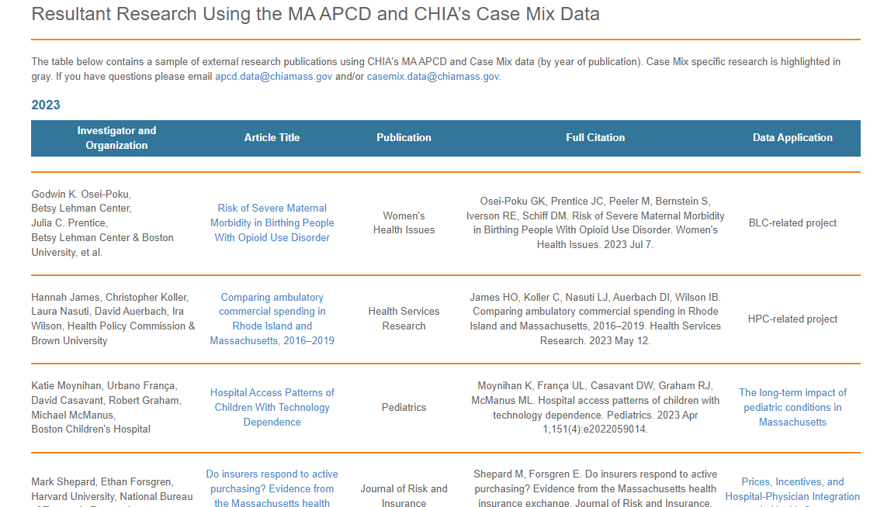
Website Release Updates (continued)
Links to examples of resultant research using CHIA data can be found at the following link: https://www.chiamass.gov/resultant-research-using-chia-data/

Slide 8
USER questions

Slide 9
Question: I understand that since the original ICD-10-CM implementation, there have been updates in ICD-10-CM to increase the granularity in diagnosis codes associated with cannabis related morbidity. I am applying for the outpatient emergency department visit data and wanted to know to what extent the more granular codes are being used by hospital coders in the case mix data.
Granularity in ICD-10-CM
Cannabis Codes
Answer: During a prior CHIA User Support Webinar after initial ICD-10-CM implementation, CHIA reported that cannabis diagnosis codes had increased from 8 codes in ICD-9-CM to 78 diagnosis codes in ICD-10-CM. Subsequent updates to ICD-10-CM have increased in the granularity of cannabis codes to 130 diagnosis codes in ICD-10-CM. In reviewing the extent to which data submitters maximize the utility of the increased coding options in the outpatient emergency department visit (ED), outpatient observation stay (OS), and hospital inpatient discharge data coding (HIDD), the FY2022 for all three care settings revealed the highest ever use of granular cannabis coding options, with the highest number of distinct codes used in HIDD, followed by ED and OS. See Figure 1 below.
continued

Slide 10
RANK | Hospital Inpatient Discharge Top 10 Cannabis Diagnoses
1 | Cannabis use, unspecified, uncomplicated
2 | Cannabis abuse, uncomplicated
3 | Cannabis dependence, uncomplicated
4 | Newborn affected by maternal use of cannabis
5 | Poisoning by cannabis, accidental (unintentional), initial encounter
6 | Cannabis abuse, in remission
7 | Cannabis use, unspecified with intoxication, unspecified
8 | Cannabis use, unspecified with unspecified cannabis-induced disorder
9 | Cannabis abuse with psychotic disorder, unspecified
10 | Cannabis abuse with other cannabis-induced disorder
RANK | Observation Stay Top 10 Cannabis Diagnoses
1 | Cannabis use, unspecified, uncomplicated
2 | Cannabis abuse, uncomplicated
3 | Cannabis dependence, uncomplicated
4 | Cannabis abuse with other cannabis-induced disorder
5 | Poisoning by cannabis, accidental (unintentional), initial encounter
6 | Cannabis use, unspecified with intoxication, unspecified
7 | Adverse effect of cannabis, initial encounter
8 | Cannabis dependence with other cannabis-induced disorder
9 | Cannabis use, unspecified with unspecified cannabis-induced disorder
10 | Cannabis use, unspecified with other cannabis-induced disorder
RANK | Emergency Department Top 10 Cannabis Diagnoses
1 | Cannabis use, unspecified, uncomplicated
2 | Cannabis abuse, uncomplicated
3 | Poisoning by cannabis, accidental (unintentional), initial encounter
4 | Cannabis abuse with other cannabis-induced disorder
5 | Cannabis use, unspecified with intoxication, unspecified
6 | Cannabis dependence, uncomplicated
7 | Adverse effect of cannabis, initial encounter
8 | Cannabis abuse with intoxication, unspecified
9 | Cannabis use, unspecified with intoxication, uncomplicated
10 | Cannabis use, unspecified with unspecified cannabis-induced disorder
Granularity in ICD-10-CM
Cannabis Codes
Answer (continued): In ranking the top ten cannabis diagnoses by care setting, a new granular code first appeared in the data in FY2019 ‘P0481’ newborn affected by maternal use of cannabis, ranks in FY2022, as the fourth leading cannabis related diagnosis code in the hospital inpatient discharge data. The new granular diagnosis code, ‘T40711A’ poisoning by cannabis, accidental (unintentional), initial encounter, ranked in the top ten for all care settings, with the high ranking of third place fore outpatient emergency department cannabis related visits.
In reviewing all cannabis diagnosis codes regardless of ranking, ‘P0481’ newborn affected by maternal use of cannabis has only been used in observation stay and inpatient discharge data. There are four new granular codes which, to date, have only been used in the ED data. Those codes are 'T40713A' Poisoning by cannabis, assault, initial encounter, 'T407X5D' Adverse effect of cannabis (derivatives), subsequent encounter, 'T40715D' Adverse effect of cannabis, subsequent encounter, ‘and T40716A' Underdosing of cannabis, initial encounter.
continued

Slide 11
Answer (continued): Even though the emergency department has the highest volume of
cannabis involved visits; cannabis involved health care utilization surged in all three-hospital
care settings during the onset of the 2020 pandemic, with the highest increase in observation
stay (47% increase), followed by the emergency department (17% increase), and hospital
inpatient discharge (10% increase). See below.
Granularity in ICD-10-CM
Cannabis Codes
FY2018 through FY2022 Utilization Volume for Cannabis Morbidity by Care Setting
Observation Stays
Inpatient Discharges
ED Visits

Slide 12

Question: My ongoing research has involved using multiple releases of the MA APCD. I am concerned about resource intensity with regards to shrinking storage space. From routine use, I have learned that subsequent MA APCD releases have overlapping data. While I would like to consolidate data to optimize resource efficiency and data processing, I want to ensure, in doing so, that I am maintaining data integrity and data quality. How would you recommend consolidating overlapping releases?
How to Squeeze
Your Data
Answer: When consolidating overlapping releases, the magnitude of overlapping data to reduce to one copy can be determined by joining the potentially overlapping claims table on three fields: 1) orgid, 2) submissioncontrolid and, 3) if dental claims (dentalclaimid), if medical claims (medicalclaimid), if pharmacy claims (pharmacyclaimid).
Count of Overlapping CY2021/CY2022 Medical Claims
SELECT COUNT(*)
FROM apcd_release_cy2021.tbl_medicalclaim m1
JOIN apcd_release_cy2022.tbl_medicalclaim m2 ON
m1.orgid = m2.orgid AND m1.medicalclaimid = m2.medicalclaimid AND
m1.submissioncontrolid = m2.submissioncontrolid
Percent of CY2021 and CY2022 Overlapping Claim Lines
Dental Claims Medical Claims Pharmacy Claims
CY2021 CY2022
CY2021 CY2022
CY2021 CY2022
34%
35%
36%
52.8 million
claim lines
54.7 million
claim lines
1.16 billion
claim lines
1.19 billion
claim lines
618 million
claim lines
596 million
claim lines

Slide 13
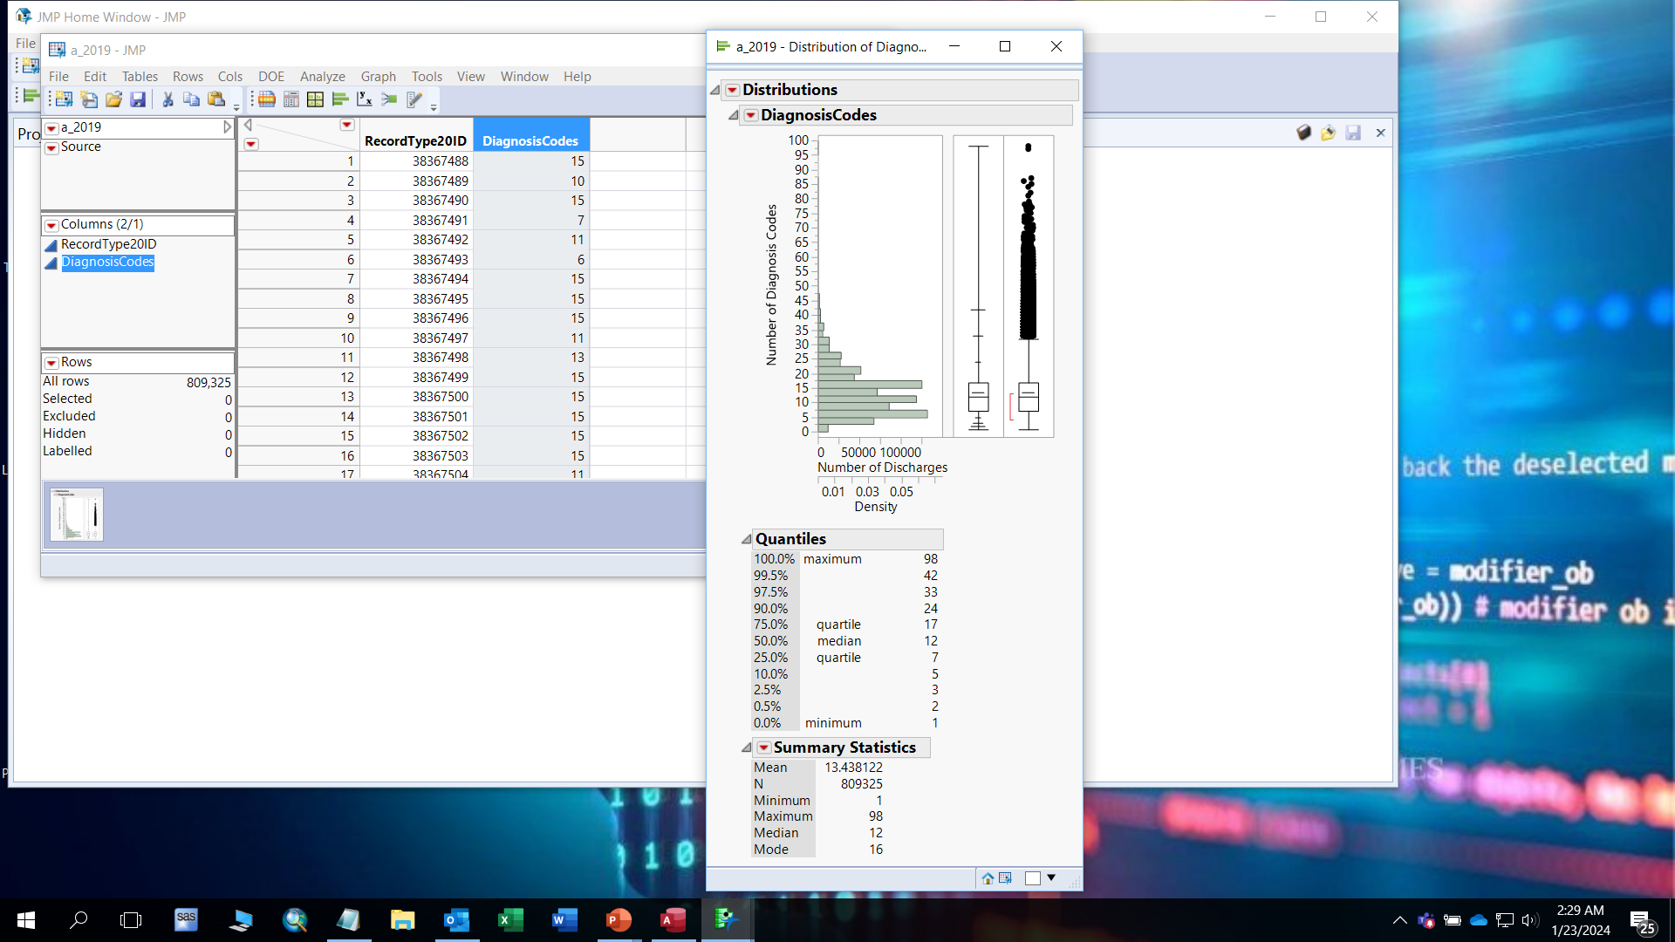
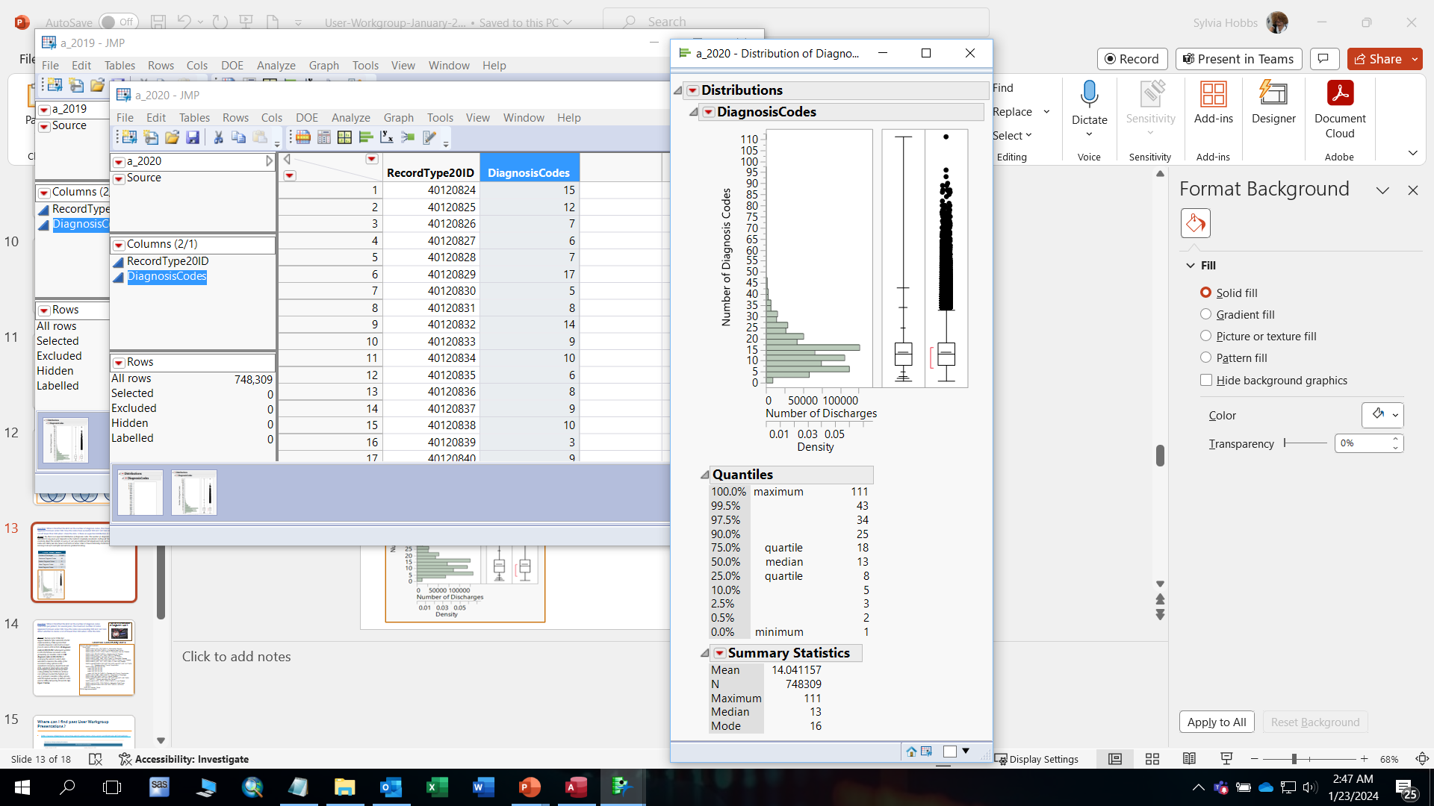
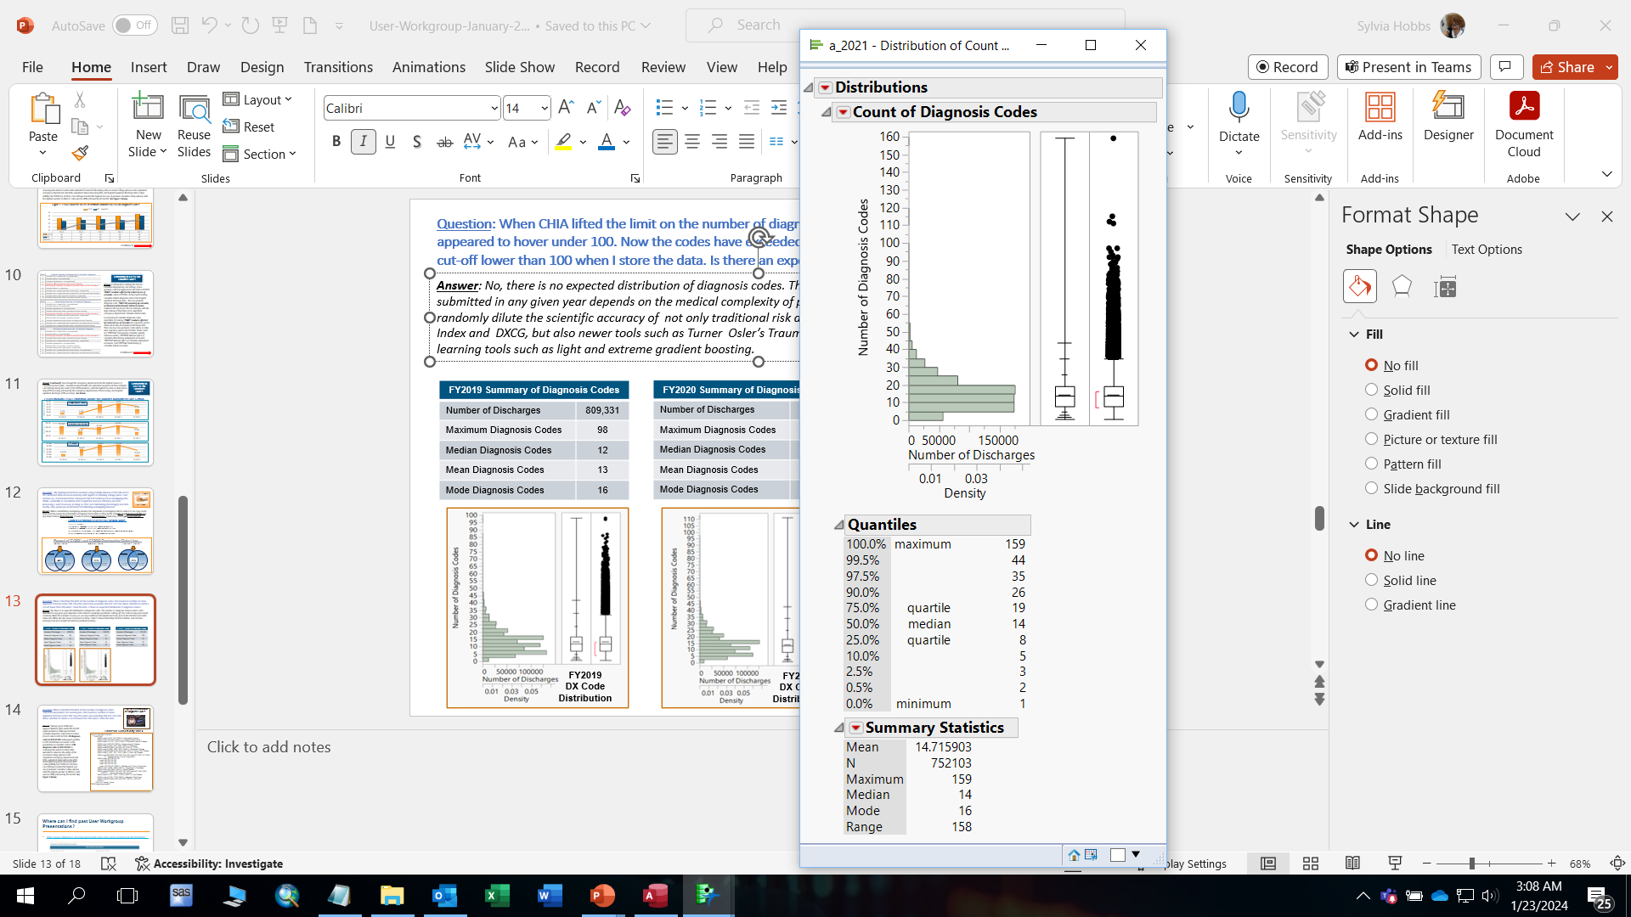
Question: When CHIA lifted the limit on the number of diagnosis codes, the maximum number of codes appeared to hover under 100. Now the codes have exceeded 100 and I am torn about whether to create a cut-off lower than 100 when I store the data. Is there an expected distribution of diagnosis codes?
Answer: No, there is no expected distribution of diagnosis codes. The number of diagnosis and procedure codes submitted in any given year depends on the medical complexity of patients. Cutting off the codes at any point would randomly dilute the scientific accuracy of not only traditional risk adjustment tools, such as the Charlson Comorbid Index and DXCG, but also newer tools such as Turner Osler’s Trauma Mortality Prediction Model and machine learning tools such as light and extreme gradient boosting. Even though the maximum number as gone up since the pandemic, as you can see from the quartile and outlier plots below, only a few patients contributed to that increase.
FY2019 Summary of Diagnosis Codes
Number of Discharges | 809,331
Maximum Diagnosis Codes | 98
Median Diagnosis Codes | 12
Mean Diagnosis Codes | 13
Mode Diagnosis Codes | 16
FY2020 Summary of Diagnosis Codes
Number of Discharges | 748,320
Maximum Diagnosis Codes | 111
Median Diagnosis Codes | 13
Mean Diagnosis Codes | 14
Mode Diagnosis Codes | 16
FY2021 Summary of Diagnosis Codes
Number of Discharges | 752,107
Maximum Diagnosis Codes | 159
Median Diagnosis Codes | 14
Mean Diagnosis Codes | 15
Mode Diagnosis Codes | 16
FY2019
DX Code
Distribution
FY2020
DX Code
Distribution
FY2021
DX Code
Distribution

Slide 14
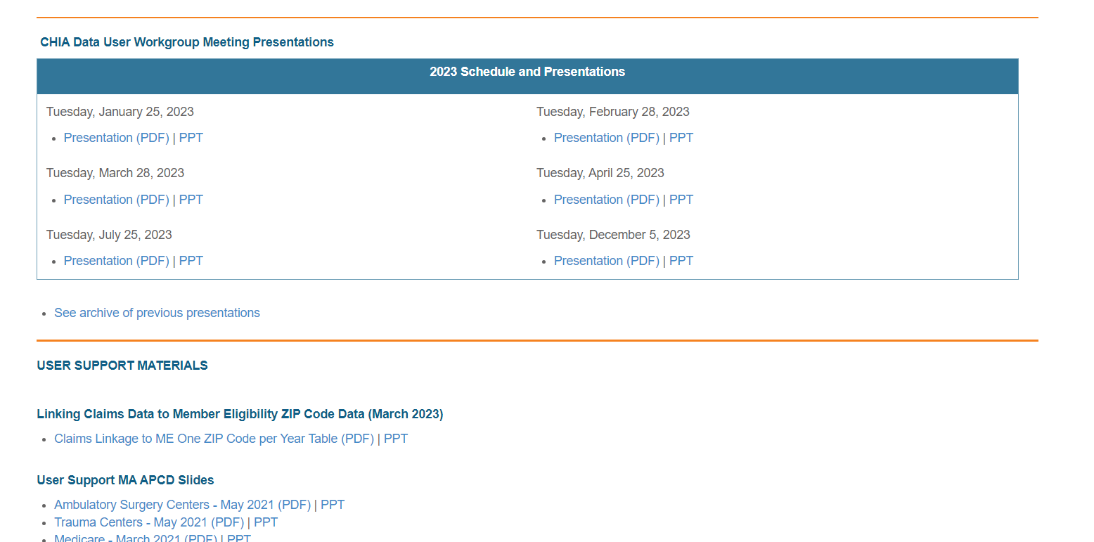
Where can I find past User Workgroup Presentations?
http://www.chiamass.gov/ma-apcd-and-case-mix-user-workgroup-information/

Slide 15
When is the next User Group meeting?
The next User Group will meet Tuesday February 27, 2024.
http://www.chiamass.gov/ma-apcd-and-case-mix-user-workgroup-information/

Slide 16
Questions?
Questions related to MA APCD:
apcd.data@chiamass.gov
Questions related to Case Mix:
casemix.data@chiamass.gov
REMINDER
CHIA still receives a high volume of email from data users who do not include their IRBNet ID. If you are in the process of or have already submitted a data application to CHIA through IRBNet https://www.irbnet.org/release/home.html, due to the volume of email CHIA receives, please remember to always include your IRBNET ID# in the subject line of your email. Doing so facilitates tracking your application and expediting responses to any questions.

