Slide 1
CHIA user workgroup
Don Kirkwood (Manager of Data Release and Procurement)
Sylvia Hobbs (Manager of User Support)
Scott Curley (Manager Privacy & Compliance)
January 26, 2021
CENTER FOR HEALTH INFORMATION AND ANALYSIS

Slide 2
Agenda
Announcements:
APCD Release 8.0 Updates
FY19 Case Mix Release Projections
Data Release and Application Update
Website Updates
Application Reminders
User Support Questions
Gender and Age
Diagnosis and Procedure codes in MA APCD compared to Case Mix
MEID completeness
MassHealth Claim Type Indicator
Q&A

Slide 3
MA APCD Release 8.0
Available NOW
Applicants with approved projects that require updated APCD data (Release 8.0) should submit to CHIA a completed Exhibit B (Certificate of Continued Need and Compliance) of the Data Use Agreement. After submitting a completed Exhibit B you will receive an invoice (if applicable) for the requested data. Upon payment of the invoice the order for the data will be placed.
Release 8.0 includes data on services from January 2014 – December 2018 with six months of claim runout (includes paid claims through 6/30/19).
Will be linkable to Release 7.0 via crosswalk
Additional information on highlights and enhancements will be presented in future APCD User Workgroups.

Slide 4

Case Mix FY19 Release
*CURRENT* RELEASE TIMEFRAMES FOR EACH FILE:
Inpatient (HIDD)
Available for request and delivery
Emergency Department (ED)
Available for request and delivery
Outpatient Observation (OOD)
Available for request
Applicants with approved projects that require newly available year(s) of Case Mix Data (e.g., FY 19) should submit to CHIA a completed Exhibit B (Certificate of Continued Need and Compliance) of the Data Use Agreement. After submitting a completed Exhibit B you will receive an invoice (if applicable) for the requested data. Upon payment of the invoice the order for the data will be placed.

Slide 5
Data Release and Application Updates
Due to Governor Baker’s emergency actions to limit the spread of COVID-19 CHIA’s workforce will be remote, for now. This arrangement will limit CHIA’s ability to produce and deliver data extracts. At this time, CHIA is releasing data and providing extracts to requestors.
During this time, CHIA will continue to accept and review data applications for both Case Mix and All-Payer Claims Database (MA APCD) datasets. Review committees, DRC and DPC, will continue their meetings remotely as necessary.
Due to CHIA’s physical office being closed, applications will be accepted without a fee. After receipt of the application, CHIA will issue an invoice which will allow applicants to remit payment online.
If you are a Data User that has a CHIA hard drive in your possession, please keep the hard drive at this time while CHIA’s physical office is closed.

Slide 6
Website Release Updates
Updates on the production of APCD and Case Mix databases and status of data requests are now posted to CHIA’s website!
Aim #1 is to provide weekly or bi-weekly status update on CHIA data products as they are in development.
Aim #2 is to provide applicants with information about expected fulfillment status for individual data requests.
Request IDs will be communicated to Data Requestors via email.
Please visit http://www.chiamass.gov/status-of-data-requests/ to see the current status of releases.

Slide 7
Application reminders

Slide 8
Fee Waiver Request Reminders
If you’re submitting a request for a fee waiver, remember to include the fee remittance form in your application package on IRBNet.
Remember to submit supporting documentation (if required).
If you’re requesting a financial hardship waiver, remember to submit information detailing your project’s financial situation (examples: project budget, grant funding, organizational / departmental funding). Also request to pay a specific price that you reasonably believe you’re able to afford to contribute.
CHIA generally does not offer full financial hardship fee waivers. We expect all applicants to have made an attempt to find funding to cover the full cost of the data fees.
Fee waiver requests can take some time to process – especially financial hardship requests.

Slide 9
USER questions

Slide 10

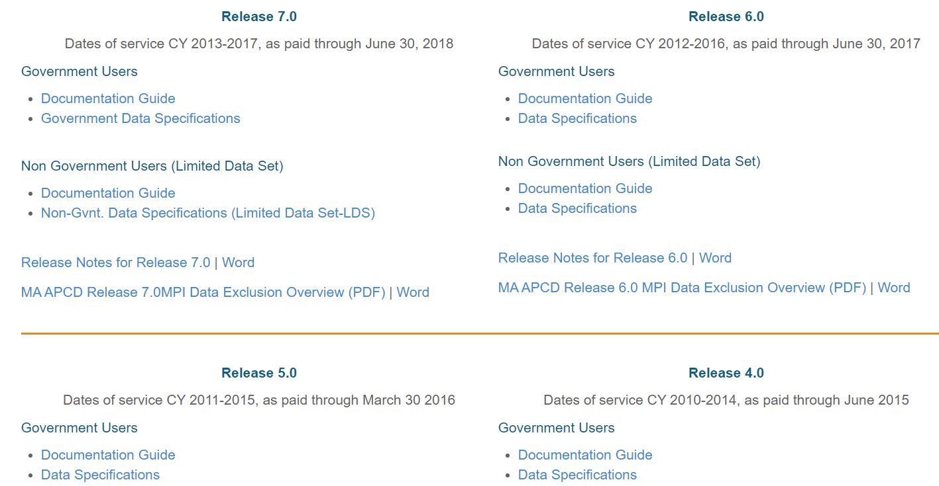
Question: I am using MA APCD Release 6.0 and will be doing so for several federally funded projects for the next three years. I cannot find any documentation at all on MA APCD Release 6.0. Why does CHIA only post documentation on MA APCD Release 8.0 on its website?
ARCHIVED
DOCUMENTS
Answer: Documentation on all prior Releases (7.0, 6.0, 5.0, 4.0, 3.0, 2.1, and 2.0) is available
on the CHIA website. This includes documentation for non-Government and Government data
users, data specifications, and release notes. The CHIA website link to archived MA APCD Release documents is:
https://www.chiamass.gov/ma-apcd-documentation-archive

Slide 11

Question: We've noticed that there are a substantial number of lines with missing
MEMBERLINKEIDs in both the Medical Claims and Membership Eligibility files. For
example, in the Membership Eligibility file, about 18% of all lines are with missing
MEMBERLINKEID for Release 6.0. I'm wondering if this is expected considering the ID
assigning algorithm that CHIA uses. In practice, would you suggest trying to fill in the missing MEMBERLINKEIDs using data elements like Carrier Specific Unique Member ID?
Answer: In October 2018, CHIA published, “MA APCD Release 6.0 Master Patient Index (MPI) Data Exclusion” at the following link:
https://www.chiamass.gov/assets/docs/p/apcd/MA-APCD-Release-6.0-MPI-Data-Exclusion-Overview.pdf
This document details by OrgID, including Pharmacy Benefit Managers, data not included in the MPI process in order to improve the quality of the MEMBERLINKID and decrease member data duplication. This document allows you to confirm from your data import what missing data should be expected by OrgID. In answer to your question, would one suggest trying to fill in the missing MEMBERLINKEIDs using the Carrier specific unique member ID, it is important to note that the MEMBERLINKEID and the Carrier Specific Unique Member ID serve different purposes. The Carrier Specific Unique Member ID in combination with the OrgID are used for within carrier analysis and the MEMBERLINKEID is used for across carrier analysis. So the answer is no, the Carrier Specific Unique Member ID cannot be used for across carrier analysis. Keep in mind the that the MEMBERLINKEID is a probabilistic enhancement for across carrier analysis created if demographic data is reliably populated. The missing MEMBERLINKEID add-on enhancement does preclude conducting routine within carrier analysis using the Carrier Specific Unique Member ID in combination with the OrgID.
Within Carrier Analysis
Across Carrier Analysis
OrgID
Carrier Specific Unique Member ID
Multiple Years of Data
DEMOGRAPHIC DATA
Carriers Submitting Reliable Data
MEMBERLINKEID

Slide 12
Question: What is the quality of completeness for the MassHealth Claim Type field (MC246)? Does the field only Include claims for the MassHealth payer ID or does it also include Health Safety Net, Massachusetts Behavioral Partnership, or other payers with Medicaid products?
CLAIM
TYPE INDICATOR
Answer: The MassHealth Claim Type has a high quality of completeness for the MassHealth payer ID where it is 100% populated. For Health Safety Net, it is 97% populated. For Boston Medical Center Health Plan which has seven different insurance products including Medicaid and MassHealth ACO products, it is populated on 74% of their claims. For Massachusetts Behavioral Partnership which manages behavioral health care for MassHealth, it is only populated on their hospital inpatient claims (using code ‘I’, see Table 1 below) which constitutes 1% of their claim volume. For Health New England which twelve different insurance products, it is likewise only populated on a small percent of their hospital inpatient claims limited to Medicaid insurance product type.
Table 1. Definitions for MassHealth Claim Type (MC246)

Slide 13
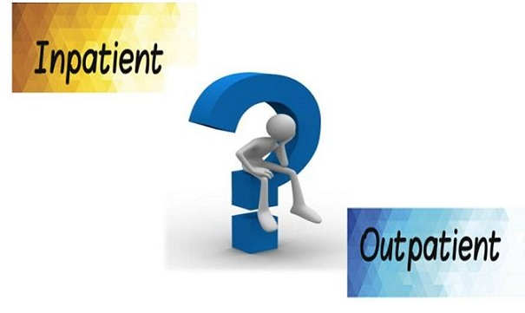
Diagnosis and
Procedure Codes
Question: Please clarify how the naming of diagnosis and procedure codes
in the MA APCD differs from inpatient and outpatient codes in case mix data.
For example in the MA APCD, there is admitting diagnosis, discharge diagnosis
principal diagnosis code, and 24 other diagnosis codes. Yet in case mix, we
can see primary diagnosis code and others principal diagnoses code. Are
these fields equivalent? In the 2015 case mix hospital discharge data (HDD),
the primary diagnosis and principal procedure code are reported;
but the 2013 and 2014 HDD files do not have those fields.
Answer: In the MA APCD, the admitting and discharge diagnosis fields are only populated on inpatient claims. The trigger for populating these field is if MC069 (Discharge Date) is populated. In case mix, the outpatient ED visit data and outpatient observation do not have admitting and discharge diagnoses, only HDD. When CHIA lifted the limit on diagnosis and procedure codes for the case mix HDD and ED Visit data, to accommodate unlimited one-to-many relationship, the diagnosis are reported in a separate table (see example in Table 1 below) which also accommodates the reporting of admitting and discharge diagnosis (see Table 2 definitions), that were not reported in HDD prior to FY2015. There is confusion in HDD case mix main discharge table around the field named “primary diagnosis” that in the filing specifications is called principal diagnosis and prior to 2015 was called principal diagnosis. Yes, that field is intended to be the principal diagnosis. To avoid confusion in their inpatient analysis, many users rename it as such.
Table 1. Example of HDD Diagnosis fields
Table 2. Definition of HDD Diagnosis Indicators
RecordType20ID | Indicator | DiagnosisCode | AssociatedIndicator
XXXXXXXX | A | J84116 | 0
XXXXXXXX | D | J84116 | 0
XXXXXXXX | S | E785 | 1
XXXXXXXX | S | E8342 | 2
XXXXXXXX | S | G2581 | 3
XXXXXXXX | S | E039 | 4
XXXXXXXX | S | I739 | 5
Indicator | Definition
A | Admitting Diagnosis
D | Discharge Diagnosis
S | Secondary (Associated) Diagnosis

Slide 14

Female Population
Age 20 to 44
Question: In order to study the MA Infertility Mandate, we are interested in determining the
volume of female population in 2018 and 2019 aged 20 to 44 years who fell into the following
categories, a) Private, fully-insured (MA Infertility Mandate), b. Private, self-insured, c) Publicly
insured (Medicaid, Medicare), d) Not insured. In addition we would like to determine
demographics of the women aged 20 to 44 years old that fall into each group in 2019?
a. Age distribution
b. Race distribution
c. Ethnic distribution
d. Language distribution
e. Zip code distribution for geographical evaluation and integration into deprivation index
Answer: The data is available to conduct this type of study (see Table 1 example below). However, in order to obtain detailed race, ethnicity, and language data by ZIP Code, age, and gender, you would have to link to the census ZIP code tabulation area measures data. This requires that you apply for the MA APCD data so that your project can be reviewed for privacy protection and by the Data Release Committee.
Table 1. Calendar 2018 Females Ages 20 to 44 by County and Product Enrollment Category
Member County | Unknown/ Not Applicable | Fully Insured Commercial | Self-Insured | GIC | MCO | Supplemental Policy | ICO or SCO | ACO
Barnstable | 16,811 | 16,609 | 8,058 | 839 | 11,909 | 15 | * | 3,024
Berkshire | 11,866 | 9,462 | 7,959 | 729 | 9,179 | * | * | 5,234
Bristol | 55,018 | 47,616 | 18,162 | 4,271 | 43,553 | 23 | 39 | 22,010
Dukes | 2,250 | 1,786 | 250 | 32 | 1,148 | * | * | 162
Essex | 75,350 | 75,856 | 26,050 | 7,162 | 54,299 | 29 | 536 | 11,449
Franklin | 5,251 | 7,285 | 1,955 | 1,105 | 4,893 | * | 45 | 931
Hampden | 47,030 | 37,975 | 16,433 | 5,606 | 47,890 | 13 | 1,105 | 25,083
Hampshire | 10,503 | 17,725 | 8,455 | 2,977 | 8,096 | * | 88 | 1,895
Middlesex | 124,366 | 184,035 | 82,734 | 13,595 | 73,922 | 59 | 867 | 28,219
Nantucket | 1,798 | 1,435 | 107 | * | 776 | * | * | 125
Norfolk | 46,111 | 79,967 | 31,362 | 6,385 | 29,551 | 22 | 248 | 12,686
Plymouth | 41,699 | 48,111 | 19,181 | 4,820 | 30,392 | 23 | 221 | 13,404
Suffolk | 93,686 | 106,491 | 38,256 | 4,843 | 63,957 | 21 | 911 | 28,606
Worcester | 73,157 | 78,779 | 44,272 | 7,922 | 56,615 | 27 | 822 | 12,578

Slide 15
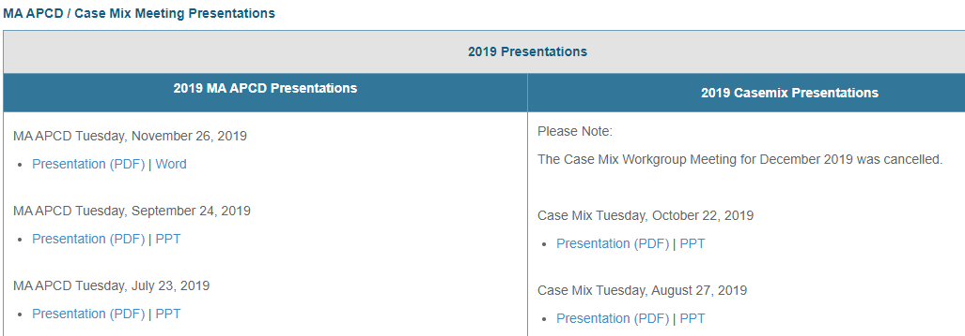
Where can I find past User Workgroup Presentations?
http://www.chiamass.gov/ma-apcd-and-case-mix-user-workgroup-information/

Slide 16
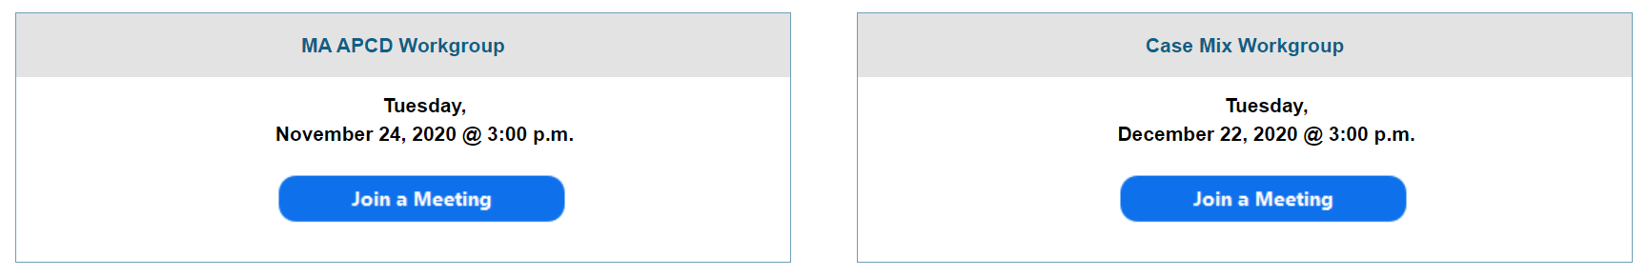
When is the next User Group meeting?
The next User Group will meet Tuesday, February 23.
http://www.chiamass.gov/ma-apcd-and-case-mix-user-workgroup-information/

Slide 17
Questions?
Questions related to MA APCD:
apcd.data@state.ma.us
Questions related to Case Mix:
casemix.data@state.ma.us
REMINDER: Please include your IRBNet ID#, if you currently have a project using CHIA data.

Slide 18
Call for Topics and Presenters
If there is a TOPIC that you would like to see discussed at an MA APCD or Case Mix workgroup in 2020, contact Amy Wyeth [amy.wyeth@state.ma.us]
If you are interested in PRESENTING at a MA APCD or Case Mix workgroup in 2020, contact Amy Wyeth [amy.wyeth@state.ma.us]
You can present remotely, or in-person at CHIA
We may be reaching out to some data users with invitations to present, and hope you will consider this!

