Slide 1
Monthly MA APCD / Case Mix User Workgroup Webinar
January 26, 2016

Slide 2
Agenda
Announcements
  Fee Schedule Changes
  Case Mix White Paper
  Upcoming Changes to the MA APCD / Case Mix User Workgroup
Application Reminders
Q&A

Slide 3
MA APCD Fee Schedule
Administrative Bulletin 16-02
957 CMR 5.00: Health Care Claims, Case Mix and Charge Data Release Procedures
Effective January 21, 2016
Available Here: http://www.chiamass.gov/assets/docs/g/chia-ab/16-02.pdf

Slide 4
MA APCD Fee Schedule
Notable Changes:
Fee category for “Academic Researchers” has been redefined as “Researchers”
“Student-directed research” no longer qualifies for a fee waiver.
Faculty advisors must apply as the “Researcher”
The development of a product is considered a “single use”; “multiple use” applies to the sale or general release of a product
Level 1 MA APCD data is no longer included in the fee schedule

Slide 5
New Fee Waiver Provision
CHIA may consider partial fee waivers or may enter into alternative payment arrangements with:
Researchers who wish to use the Data for a commercial purpose; and
other Applicants who can demonstrate:
  the Data will be used to fulfil a public purpose, and
  the payment of fees would constitute an undue financial hardship
  Such alternative payment arrangements may include licensing arrangements or other payment mechanisms.

Slide 6
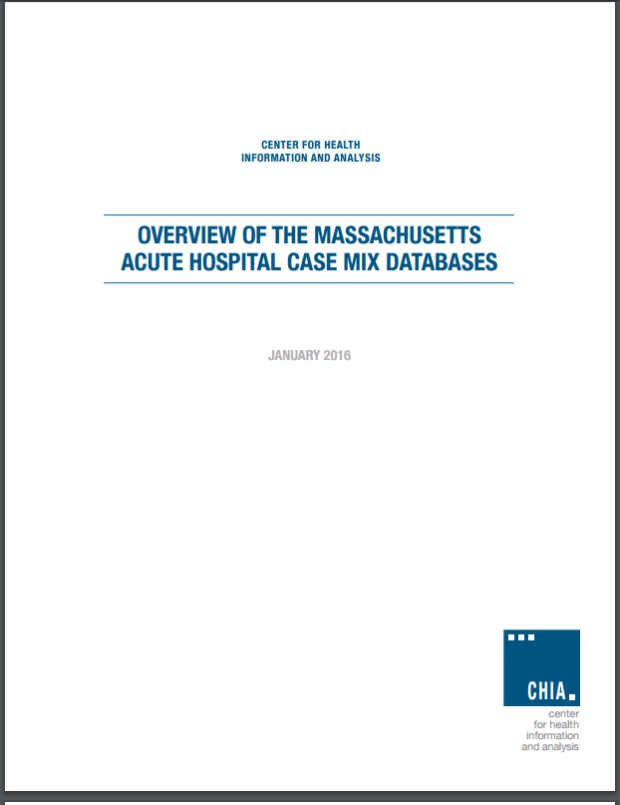
Case Mix White Paper
High-level overview of the Case Mix database, and how CHIA uses it to promote the public interest.
Available here: http://www.chiamass.gov/assets/Uploads/casemix/acute-hospital-case-mix-database-whitepaper-2016.pdf

Slide 7
User Workgroup Changes for 2016

Slide 8
Informed By
MA APCD User Symposium – November 2015
Informal feedback from users
Review of ResDAC website
Outreach to Colorado and Utah APCDs
Analysis of CHIA website traffic

Slide 9
2015 MA APCD User Symposium
Key Takeaways and Recommendations
Expand User Knowledge
  Continue current user workgroups, but also consider development of additional “interest groups” based on specific issues/areas of interest (e.g., prescription drugs, complex patients, methods, etc.) to identify opportunities for sharing best practices for coding, algorithm development, etc.
  Use CMS’s Research Data Assistance Center (ResDAC) as an example of a useful resource for user support and training

Slide 10
Separate APCD and
Case Mix User Workgroups
APCD and Case Mix will have separate workgroups that will take place on alternating months
  Still 4th Tuesday of the month
Why?
  Both user communities are large and growing
  Respond to request for topic-based interest groups
Notes:
Cumulative number of extracts released since 2013:
MA APCD = 90
Case Mix = 79

Slide 11
Logistics of Splitting into
Two Groups
  In the next week, you will receive:
  Cancellation of the current webinar registration/invite
  Registration links for new webinars
    Users are welcome to register for either APCD or Case Mix (or both!)
  An eblast with the 2016 schedule

Slide 12
User Workgroup Changes
Each user workgroup meeting will be more focused
  Sessions will be more like interest groups, with a rotating schedule of topics to be published in advance
  Topics are suggested by the user community
  More guest presentations from CHIA’s users and external users
Content from future and past presentations will be categorized by topic and posted to the CHIA website
  Easier to find information

Slide 13
Call for Topics and Presenters
If there is a TOPIC that you would like to see discussed at an MA APCD or Case Mix workgroup, contact Adam Tapply [adam.tapply@state.ma.us]
If you are interested in PRESENTING at an MA APCD or Case Mix workgroup, contact Adam Tapply [adam.tapply@state.ma.us]
  You can present remotely from your own office, or in-person at CHIA.

Slide 14
Also Coming in 2016
Quarterly workshops with overviews of our data assets and the application process
  Geared towards prospective applicants
June – Release of APCD Release 5.0 (CY 2015 data)
June - Release of Case Mix HIDD dataset
  Moving to LDS similar to APCD

Slide 15
Application Reminder
If you are requesting Unencrypted NPI (in the Medical Claims file, for example), but are NOT requesting the Provider File, please make sure you provide a justification for this on the application.
[You will not be charged for the Provider File in this situation]
The formatting will be fixed in an upcoming revision to the application.

Slide 16
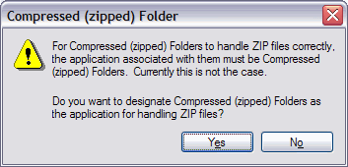

File Upload to IRBNet
Please avoid uploading compressed or zipped files to IRBNet. Through IRBNet, reviewers can read application materials completely online. File compression requires that the file be extracted to a local directory before reading and increases the risk of an inadvertent transfer of files not intended for upload or of a virus. IRBNet has the capacity to hold all of CHIA required application materials.

Slide 17
Questions?
Questions related to APCD : (apcd.data@state.ma.us)
Questions related to Case Mix: (casemix.data@state.ma.us)
REMINDER: Please include your IRBNet ID#, if you currently have a project using CHIA data

