Slide 1
CHIA user workgroup
Don Kirkwood (Manager of Data Release and Procurement)
Sylvia Hobbs (Associate Director of Data Strategy and User Support)
February 27, 2024
CENTER FOR HEALTH INFORMATION AND ANALYSIS

Slide 2
Agenda
Announcements:
MA APCD Release CY 2021 Updates
New! MA APCD Release CY 2022 Available
Update to the MA APCD Application
FY22 Case Mix Release Updates
Website Updates
User Support Questions
MemberLinkEIDs
Type of Bill on Facility Claims
Duplicate Data
ED Volume in Case Mix Data and Hospital Profile Reports
Behavioral Health Hospitals
Alcohol-Related Disorders
Gobeille Impact on Latest Release
MA APCD and Case Mix Payer Type Comparison
Q&A

Slide 3
MA APCD Calendar Year 2021
Available for request
Applicants with approved projects that require updated MA APCD data (CY 2021 Data) should submit to CHIA a completed Exhibit B (Certificate of Continued Need and Compliance) of the Data Use Agreement. After submitting a completed Exhibit B you will receive an invoice (if applicable) for the requested data. Upon payment of the invoice the order for the data will be placed.
CY 2021 Data includes medical, pharmacy, and dental claims incurred between January 1, 2017, and December 31, 2021, and it includes six (6) months of run-out (paid claims through June 30, 2022). In addition to claims data, the release contains relevant reference files including member eligibility, providers, products, and benefit plans.

Slide 4
MA APCD Calendar Year 2022
NEW! MA APCD Calendar Year 2022 Available for request
Calendar Year (CY) 2022 data holds data collected from health insurance payers licensed to operate in the Commonwealth of Massachusetts. The data includes on health care activity that occurred from January 1, 2018, through December 31, 2022. MA APCD CY 2022 includes medical, pharmacy, and dental claims incurred between January 1, 2018, and December 31, 2022. This release includes six (6) months of run-out (paid claims through June 30, 2023). This data encompasses public and private payers as well as fully-insured and self-insured plans. Keep mind that due to the Supreme Court decision, Gobeille v. Liberty Mutual, the self-insured plans are severely reduced starting in 2016. This release also includes MassHealth Medicaid data in the MA APCD for the period of calendar years 2018-2022.

Slide 5
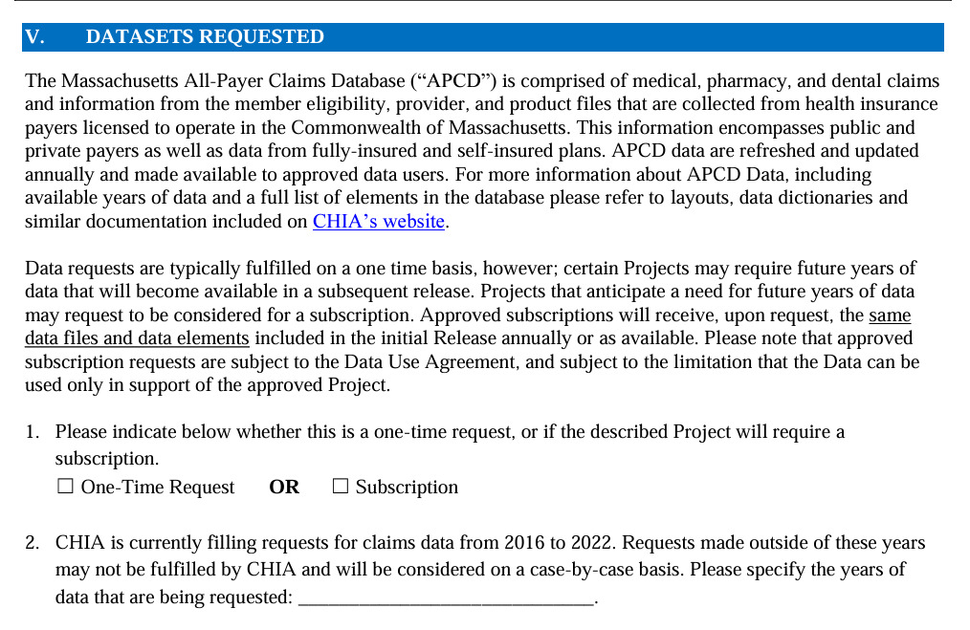
Updates to the MA APCD Application
When applying for CHIA data, always check the website to download and use the most recent version of the data request application. For example, the MA APCD application was last revised in December 2023 to update the full year date ranges available for purchase.
See application excerpt below.

Slide 6
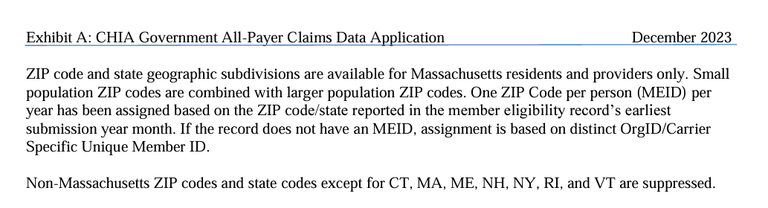
Updates to the MA APCD Application (continued)
In addition, the December 2023 revision to MA APCD application specifies that the member ZIP code geographic data is now only released at the level of one ZIP code per person per year based on the member’s ZIP code reported in the member’s earliest submission year month.
See application excerpt below.

Slide 7

Case Mix FY2022 Release
*CURRENT* RELEASE TIMEFRAMES FOR EACH FILE:
Hospital Inpatient Discharge Data (HIDD)
FY2022 Now Available for Request
Outpatient Emergency Department Visit Data (ED)
FY2022 Now Available for Request
Outpatient Observation Stay Data (OOD)
FY2022 Now Available for Request
Applicants with approved projects using previous years data (e.g., FY 20, FY21) that require newly available year(s) of case mix data (e.g., FY 22) should submit to CHIA a completed Exhibit B (Certificate of Continued Need and Compliance) of the Data Use Agreement. After submitting a completed Exhibit B you will receive an invoice (if applicable) for the requested data. Upon payment of the invoice the order for the data will be placed.

Slide 8
Website Release Updates
Updates on the production of MA APCD and case mix databases and status of data requests are now posted to CHIA’s website!
Aim #1 is to provide weekly or bi-weekly status update on CHIA data products as they are in development.
Aim #2 is to provide applicants with information about expected fulfillment status for individual data requests.
Request IDs will be communicated to Data Requestors via email.
Please visit http://www.chiamass.gov/status-of-data-requests/ to see the current status of data extracts and releases.
You can also sign up to receive updates on the status of MA APCD and case mix data requests and data release information by filling out the form at the following link: https://lp.constantcontactpages.com/su/NYBm5Bs

Slide 9
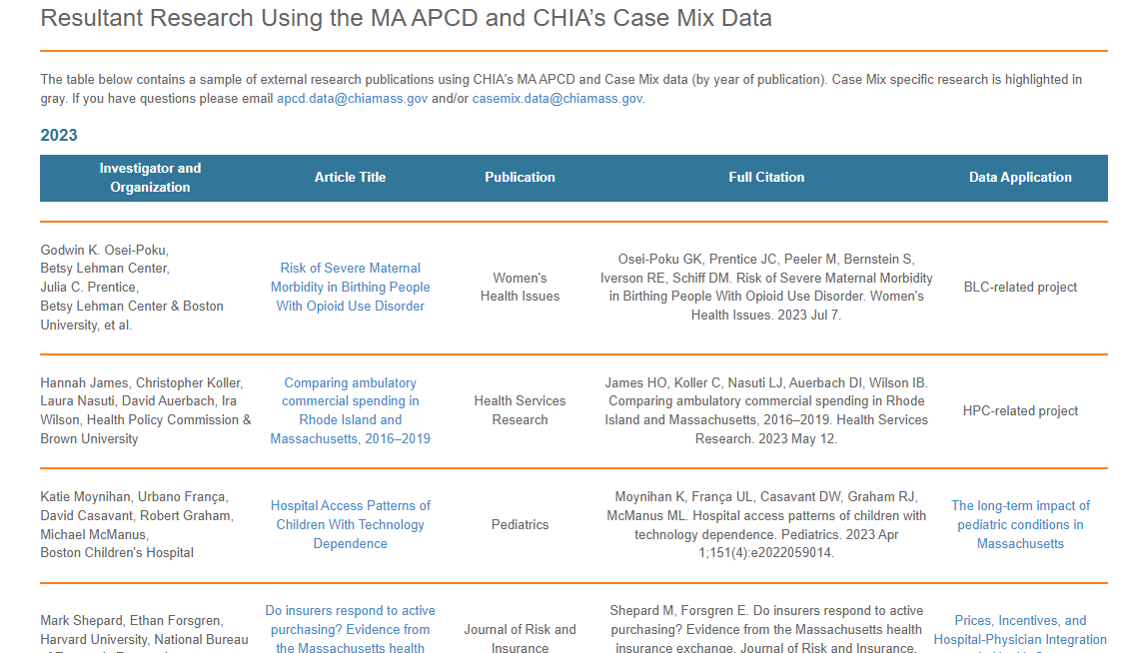
Website Release Updates (continued)
Links to examples of resultant research using CHIA data can be found at the following link: https://www.chiamass.gov/resultant-research-using-chia-data/

Slide 10
USER questions

Slide 11

Question: I am trying to track patients in the APCD. Why do I get inconsistent results when I use the Memberlinkeid and the Carrier Specific Unique Member Id?
Answer: CHIA created a Master Patient Index that assigns a single unique surrogate key (memberlinkeid) to each person, regardless of how many different carriers have submitted data about that person. Not all records will have an MEID.
The Carrier Specific Unique Member ID is a member ID specific to a carrier.

Slide 12

Question: What is the proper way to interpret the values of the Type of Bill on Facility (MC036)?
Answer: MC036 defines the type of bill on the facility claim. Type of Bill on Facility (MC036) should only be used if the Type of Claim is Facility (MC094 = 002). The leading zero is dropped. The first digit is the type of facility, and the second digit is where in the facility the service was provided.
For example, if Type of Bill = 11, the first 1 digit represents “Hospital” and the second 1 digit represents “Inpatient”. Similarly, if Type of Bill = 13, this would be interpreted as a Hospital Outpatient bill since the first digit represents “Hospital” and the second digit, ‘3’ represents “Outpatient”. This follows the National Uniform Billing Committee (NUBC) specifications. More information can be found here: https://www.nubc.org/.

Slide 13

Question: We noticed from a recently published Tech Appendix that there's a step that involves identifying duplicates for the same hospitalization. But based on the Case Mix white paper, it seems that each line in the Case Mix HIDD is a unique hospitalization. We're wondering if the de-duplication process was before data releases. Do we have to worry about duplicates in the Case Mix data we have?
Answer: Acute Care Hospitals are required to submit discharge data to CHIA in accordance with 957 CMR 8.00. A RecordType20ID is assigned to each unique discharge. Through this process, the file does not contain duplicate discharge records. In addition, hospitals verify the submission data midyear and at the end of the year. The Case Mix White Paper is available here: https://www.chiamass.gov/assets/Uploads/casemix/Case-Mix-Whitepaper.pdf
The researcher is referencing the technical appendix here: https://www.chiamass.gov/assets/docs/r/pubs/2023/Pediatric-Readmissions-Technical-Appendix-2023.pdf
Both the adult and pediatric readmissions analyses conducted by CHIA are originally based on methodology that relies on claims data. While the program was adapted for use with Case Mix data, our goal was to maintain fidelity to the original program as much as possible. This deduplication step is required as part of the overall methodology for readmissions analysis but is not reflective of the integrity of Case Mix data or the existence of a large number of duplicate visits in HIDD, EDD, or OOD data.

Slide 14

Question: We recently saw a report on Provider Profile on the CHIA website and realized that the provider profile for the ED data for a hospital in that report is different from the raw numbers we received from CHIA.
Answer: The source of the emergency department data you received is CHIA’s Case Mix data. The hospital profile report sources data from the Hospital Cost Report, the Hospital Discharge Database, and the Hospital Standardized Financial Statement Database.
Additionally, the FY 2020 Hospital Profile report on the CHIA website is based on each hospital’s Fiscal Year data reported on their cost report. So, a hospital whose Fiscal Year ends on June 30th, for instance, details the hospital’s experience from July 1, 2019 to June 30, 2020. The FY 2020 Emergency Department case mix data are based on the Hospital Fiscal Year October 1, 2019 to September 30, 2020.

Slide 15
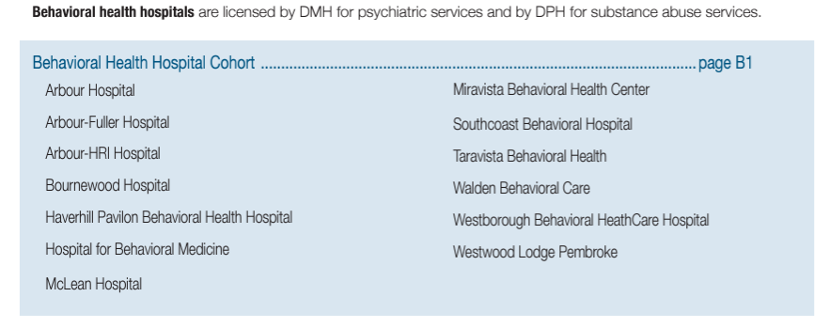
Question: The case mix hospital filing specifications available on the CHIA’s website indicate that CHIA is currently collecting case mix data from non-acute behavioral health hospitals. What is the difference between the inpatient behavioral health hospitals submitting case mix data and inpatient behavioral health hospitals submitted by insurance carriers available in the Massachusetts All Payer Claims Date?
Behavioral Health Hospitals
Answer: If you review CHIA’s FY2022 Introduction to Non-acute Hospitals available online at: https://www.chiamass.gov/assets/docs/r/hospital-profiles/2022/FY22-Massachusetts-Hospital-Profiles-INTRO-to-Non-Acute-Hospital-Cohort.pdf, you will find a list of private behavioral health hospitals in Massachusetts licensed by the Department of Mental Health for psychiatric services and by the Department of Public Health for substances abuse services. See below. The 13 Massachusetts hospitals in the list below are currently submitting data for the new case mix behavioral health inpatient discharge database.
continued

Slide 16
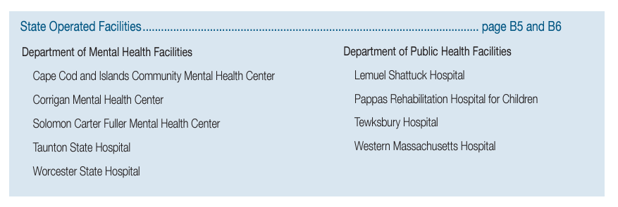
Behavioral Health Hospitals
Answer (continued): The Massachusetts All Payer Claims Data (MA APCD) includes
claims data for all care settings regardless of geographic boundaries. This includes
the inpatient behavioral health data from the 13 hospitals listed on the previous
slide, but also from state operated facilities listed below with behavioral health beds
(see below) and inpatient behavioral health hospitals in other states such as
Natchaug Hospital in Connecticut and Butler Hospital in Rhode Island.
When analyzing inpatient behavioral health care, it is important to keep in mind that the some of the Massachusetts Hospitals submitting acute care case mix data also have licensed behavioral health beds.
As of December 12, 2023, the Massachusetts Department of Mental Health lists 65 sites as having licensed inpatient behavioral health beds, see: https://www.mass.gov/doc/dmh-licensed-hospital-list-1/download
continued

Slide 17
Answer (continued): Although the MA APCD encompasses a vast array of inpatient
behavioral health care facilities, it is important for data users to be aware of the limitations
regarding the types of payers included and the count of beneficiaries who are self-insured.
When examining the scope of payer types represented in the behavioral health case mix data
collected thus far, it is evident that a significant proportion of patients are covered by payer types not accounted for in the MA APCD. This includes Medicare-Fee-for-Service and self-insured categories. Figure 1 below illustrates with red arrows the payer types present in the case mix behavioral health data that are absent from the MA APCD
Behavioral Health Payer Type Comparison
Figure 1. FY2018 through FY202 Case Mix Inpatient Behavioral Health Payers by Frequency of Discharges

Slide 18

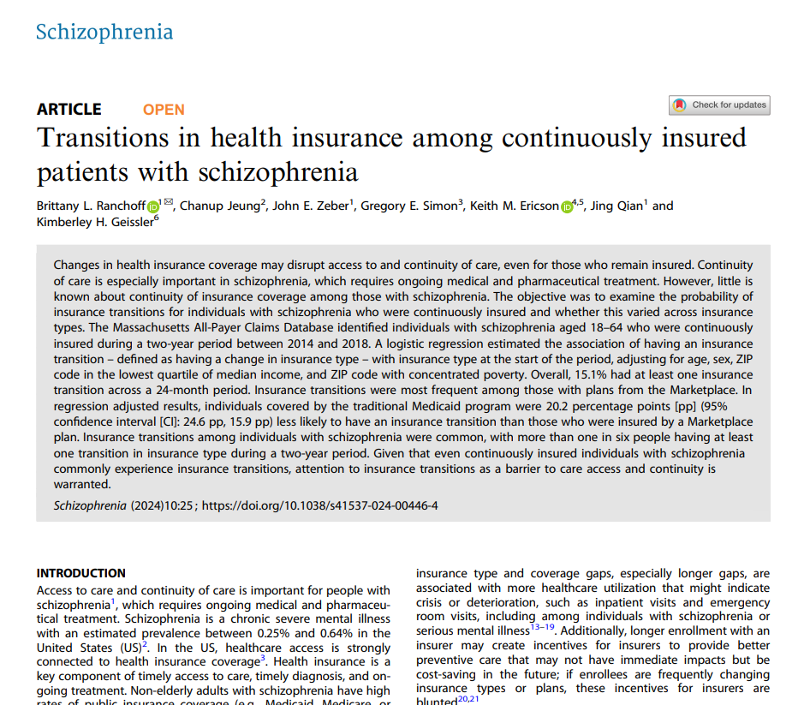
The most recent behavioral health study using the MA APCD is entitled Transitions in Health Insurance Among Continuously Insured Patients with Schizophrenia published this year in the journal Schizophrenia available at the following link: https://www.nature.com/articles/s41537-024-00446-4
Behavioral
Health
Research
Spotlight
Citation for this article: Ranchoff, B.L., Jeung, C., Zeber, J.E. et al. Transitions in health insurance among continuously insured patients with schizophrenia. Schizophr 10, 25 (2024). https://doi.org/10.1038/s41537-024-00446-4

Slide 19

Question: Due to the impact of Gobeille versus Liberty Mutual,
I understand that the MA APCD does not contain full reporting
by self-insured employers. Has that impact decreased on increased?
Impact of Gobeille vs. Liberty Mutual
Answer: As your can see in Figure 1 below, during the pre-Gobeille year 2015,
the self-insured represent 19.9% of all eligibility records, in 2023 the proportion has decreased to 3.9%.
Figure 1. 2015 through 2023 Proportion of Self-Insured Records in the MA APCD Member Eligibility Table

Slide 20
Question: During last month’s webinar, updates in ICD-10-CM which increased
the magnitude of granularity in specific substance use disorder diagnosis codes
was discussed. I have been using publicly available CDC data to analyze the
increase in alcohol related deaths and would like information on the use of more
granular coding in principal and associated diagnosis codes for alcohol related disorders.
Alcohol Related Disorders
Answer: Likewise, for cannabis disorders discussed last month, there has been a surge in data submitters maximizing the utility of more granular ICD-10-CM codes for alcohol related disorders. There are 74 diagnosis codes in ICD-10-CM in the F10 range for alcohol related disorders. In reviewing the extent to which data submitters increased using the range of coding options for alcohol related disorders from FY2018 to FY2022, there was a 17% increase in use of distinct codes in hospital inpatient discharge data (HIDD), a 20% increase in outpatient emergency department visit data (ED), and a 26% increase in observation stay (OS) See Figure 1 below.
continued

Slide 21
Table 1. ICD-10-CM ‘F10’ Range Top 10 Codes
Alcohol Related Disorders
Rank | HIDD Top 10 Alcohol Diagnoses
1 | Alcohol dependence with withdrawal, unspecified
2 | Alcohol abuse, uncomplicated
3 | Alcohol dependence, uncomplicated
4 | Alcohol dependence with intoxication, unspecified
5 | Alcohol dependence with withdrawal delirium
6 | Alcohol dependence with withdrawal, uncomplicated
7 | Alcohol dependence, in remission
8 | Alcohol abuse with intoxication, unspecified
9 | Alcohol abuse, in remission
10 | Alcohol abuse with withdrawal, unspecified
Rank | OS Top 10 Alcohol Diagnoses
1 | Alcohol abuse, uncomplicated
2 | Alcohol abuse with intoxication, unspecified
3 | Alcohol dependence, uncomplicated
4 | Alcohol dependence with intoxication, unspecified
5 | Alcohol dependence with withdrawal, unspecified
6 | Alcohol abuse, in remission
7 | Alcohol dependence, in remission
8 | Alcohol abuse with intoxication, uncomplicated
9 | Alcohol dependence with intoxication, uncomplicated
10 | Alcohol dependence with withdrawal, uncomplicated
Rank | ED Top 10 Alcohol Diagnoses
1 | Alcohol abuse with intoxication, unspecified
2 | Alcohol abuse, uncomplicated
3 | Alcohol abuse with intoxication, uncomplicated
4 | Alcohol dependence, uncomplicated
5 | Alcohol dependence with intoxication, unspecified
6 | Alcohol use, unspecified with intoxication, uncomplicated
7 | Alcohol dependence with intoxication, uncomplicated
8 | Alcohol use, unspecified with intoxication, unspecified
9 | Alcohol dependence with withdrawal, unspecified
10 | Alcohol dependence with withdrawal, uncomplicated
Answer (continued): In ranking the top ten alcohol ICD-10-CM ‘F10’ related diagnoses by care setting (See Table 1), alcohol dependence with withdrawal delirium only appears in the top ten diagnosis for inpatient care, and alcohol dependence in remission and abuse in remission only appear in the top ten for inpatient care and observation day. “Alcohol use” cases without dependence or abuse only appear in the top ten diagnosis for emergency department care. There are also ICD-10-CM ‘Y90’ codes which specifically record toxicology results for blood alcohol levels (see Table 2 below) and codes in the range of ‘O354*’ and ‘O9931*’ for the complicating effect of alcohol use on different trimesters of pregnancy.
Table 2. ICD-10-CM Codes for Blood Alcohol Levels
﻿DX Code | Description
Y90 | Evidence of alcohol involvement determined by blood alcohol level
Y900 | Blood alcohol level of less than 20 mg/100 ml
Y901 | Blood alcohol level of 20-39 mg/100 ml
Y902 | Blood alcohol level of 40-59 mg/100 ml
Y903 | Blood alcohol level of 60-79 mg/100 ml
Y904 | Blood alcohol level of 80-99 mg/100 ml
Y905 | Blood alcohol level of 100-119 mg/100 ml

Slide 22
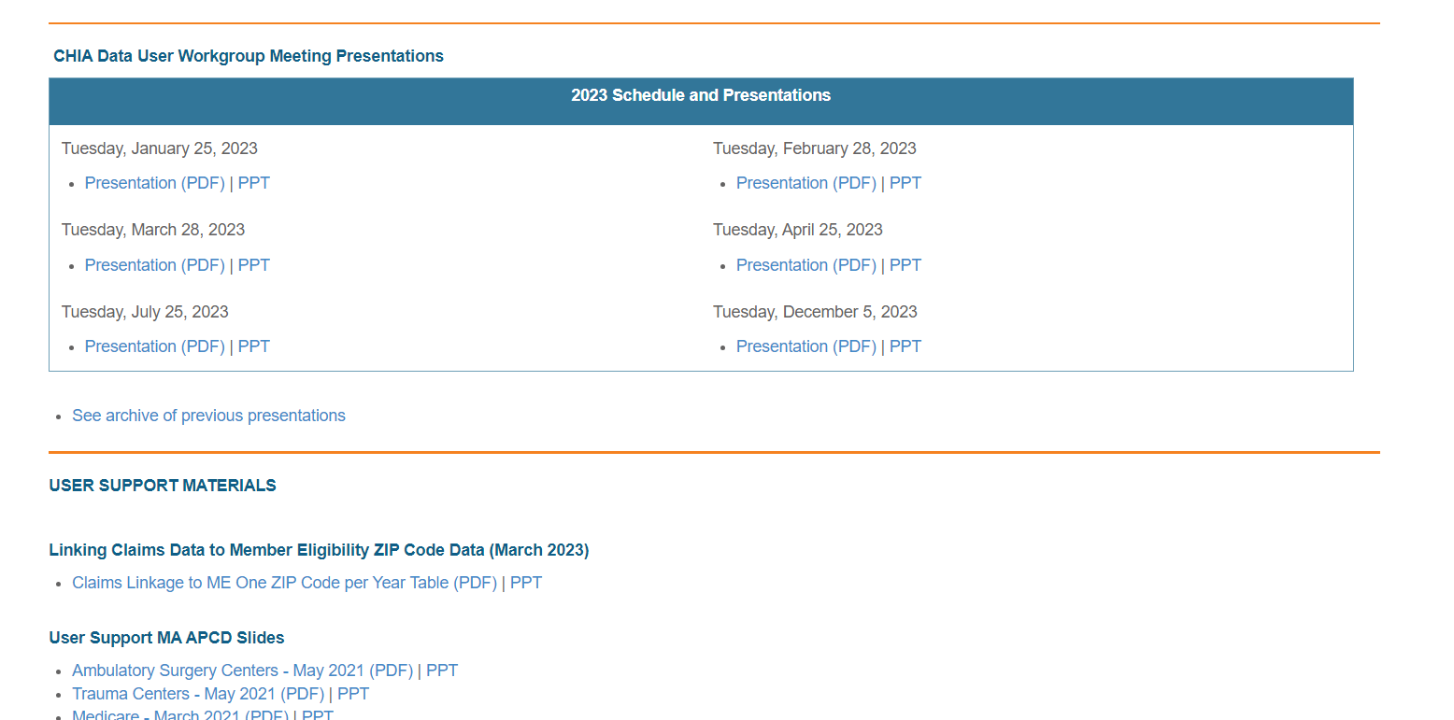
Where can I find past User Workgroup Presentations?
http://www.chiamass.gov/ma-apcd-and-case-mix-user-workgroup-information/

Slide 23
When is the next User Group meeting?
The next User Group will meet Tuesday March 26, 2024.
http://www.chiamass.gov/ma-apcd-and-case-mix-user-workgroup-information/

Slide 24
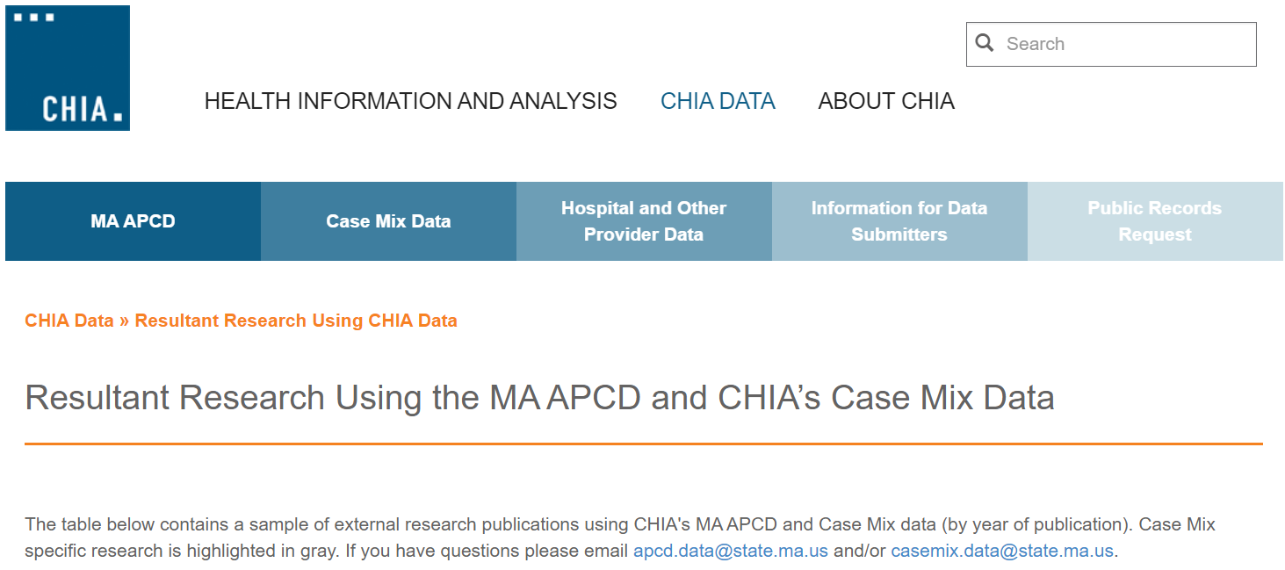
Resultant Research Using CHIA Data
https://www.chiamass.gov/resultant-research-using-chia-data

Slide 25
Questions?
Questions related to MA APCD:
apcd.data@chiamass.gov
Questions related to Case Mix:
casemix.data@chiamass.gov
REMINDER
CHIA still receives a high volume of email from data users who do not include their IRBNet ID. If you are in the process of or have already submitted a data application to CHIA through IRBNet https://www.irbnet.org/release/home.html, due to the volume of email CHIA receives, please remember to always include your IRBNET ID# in the subject line of your email. Doing so facilitates tracking your application and expediting responses to any questions.

