Slide 1
Monthly MA APCD / Case Mix User Workgroup Webinar
December 22, 2015

Slide 2
Agenda
Pharmacy Versioning in MA APCD
2013 MA APCD Profile Reports
User Questions
Q&A

Slide 3
Pharmacy Versioning
Rx versioning previously implemented for large submitters in MA APCD Releases 3.0 and 4.0:
MassHealth
Blue Cross Blue Shield of MA
Tufts Health Plan (commercial claims only)
Harvard Pilgrim Health Plan

Slide 4
Pharmacy Versioning
CHIA is working with other carriers to develop methods for versioning Rx claims, where possible.
Some of the carriers CHIA is currently working with:
Anthem, United Healthcare, Fallon, Neighborhood Health Plan, Boston Medical Center, Network Health, Health New England, Aetna, CIGNA, Celticare, Health Plans Inc., Connecticare, Minuteman Health Inc.

Slide 5
Pharmacy Versioning Method
CHIA profiles a sample of the data (one month of data from calendar years 2011, 2012, 2013, 2014, 2015)
CHIA and carrier review profile report together and develop business rules for versioning
CHIA applies business rules to sample data and shares results with carrier
Carrier approves method for release purposed or suggests changes
Once business rules are finalized with carrier, CHIA applies method to production data for release purposes (where possible)

Slide 6
Pharmacy Versioning Challenges
Variation among adjudication patterns
Pharmacy-Benefit-Manager (PBM) contracts change and carrier platforms change which result in submission pattern differences
Sometimes difficult for carriers to interpret the PBM’s data
Sometimes difficult for carriers to review older transaction data.

Slide 7
Pharmacy Versioning Findings
The majority of data does not require versioning because there’s only one version of the claim within MA APCD.
There’s variation in the submission pattern of critical data elements* for versioning.
For example, some carriers are incrementing the version number for each new version of the claim. Others are submitting zero for every version of the claim.
Some carriers are submitting back-outs every time a claim is replaced. Others are not.
Some carriers are submitting negative values in the backed-out claims. Others are not.
* See next slide for list of critical data elements.

Slide 8
Pharmacy Versioning
Critical Data Elements for Rx Versioning
Submitter ID (HD002) | Drug Code (PC026)
Carrier Specific Unique Member ID (PC107) | New Prescription or Refill (PC028)
Payer Claim Control Number (PC004) | Date Prescription Filled (PC032)
Claim Line Type (O, V, R, B, A) (PC110) | Script Number (PC058)
Line Counter (PC005) | Paid Date (PC063)
Version Number (PC005A) | Submission Year and Month
Pharmacy Number (PC018) | Currency Data Elements (for some carriers)

Slide 9
Pharmacy Versioning
Squish Method Explained:
Some carriers suggested a method called ‘Squish’ where the currency fields are added together for multiple versions of the same claim. When the NET AMOUNT of the currency values equals zero, the transaction is considered voided.

Slide 10
Rx Versioning: Squish!
Notes:
This chart shows the impact of versioning across incurred years within carriers. The blue portion of the bar represents original claim lines. The red portion of the bar represents duplicates, voids, and originals that were adjusted.
Couple observations:
Well over 95% of the claims are originals. However, the process of identifying duplicates and voids is critical to the integrity of the data.
The amount of squish varies by carrier.

Slide 11
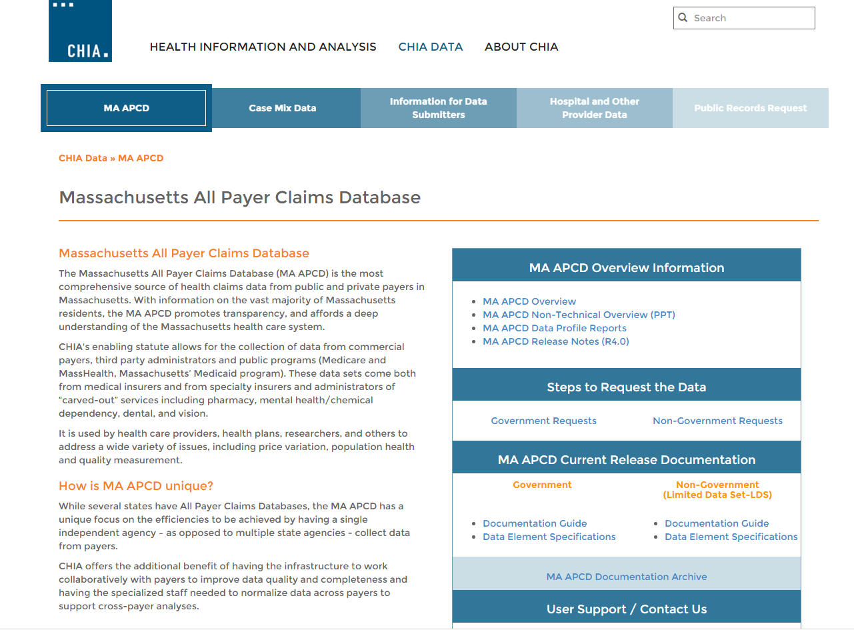
MA APCD Profiles
www.chiamass.gov/ma-apcd
Link to MA APCD Data Profile Reports

Slide 12
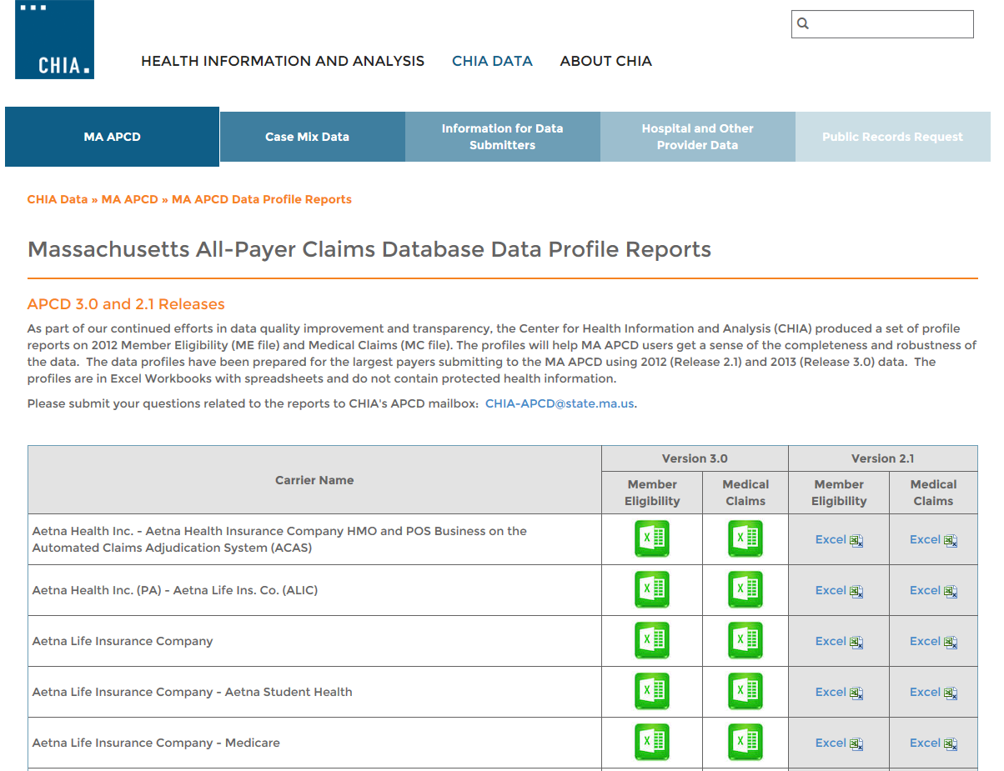
MA APCD Profiles
http://www.chiamass.gov/individual-apcd-data-profile-reports/

Slide 13
User Questions

Slide 14
Question: What is the leading reason for casemix application requiring revisions before proceeding to review?
Answer: Seventy-Five percent of applicants for Casemix Data overlook Section III’s request to provide justification for requesting the chosen level. Please remember to complete Section III before uploading your application to IRBNet.
CASE MIX | Levels 1 – 6 | Fiscal Years Requested
Inpatient Discharge | ☐Level 1 – No Identifiable Data Elements ☐Level 2 – Unique Physician Number (UPN) ☐Level 3 – Unique Health Information Number (UHIN) ☐Level 4 – UHIN and UPN ☐Level 5 – Date(s) of Admission; Discharge; Significant Procedures ☐Level 6 – Date of Birth; Medical Record Number; Billing Number PLEASE PROVIDE JUSTIFICATION BELOW FOR REQUESTING THE CHOSEN LEVEL: | 1998 – 2014 Available (limited data 1989-1997)
Outpatient Observation | ☐Level 1 – No Identifiable Data Elements ☐Level 2 – Unique Physician Number (UPN) ☐Level 3 – Unique Health Information Number (UHIN) ☐Level 4 – UHIN and UPN ☐Level 5 – Date(s) of Admission; Discharge; Significant Procedures ☐Level 6 – Date of Birth; Medical Record Number; Billing Number PLEASE PROVIDE JUSTIFICATION BELOW FOR REQUESTING THE CHOSEN LEVEL: | 2002 – 2014 Available
Emergency Department | ☐Level 1 – No Identifiable Data Elements ☐Level 2 – Unique Physician Number (UPN) ☐Level 3 – Unique Health Information Number (UHIN) ☐Level 4 – UHIN and UPN ☐Level 5 – Date(s) of Admission; Discharge; Significant Procedures ☐Level 6 – Date of Birth; Medical Record Number; Billing Number PLEASE PROVIDE JUSTIFICATION BELOW FOR REQUESTING THE CHOSEN LEVEL: | 2000 – 2014 Available

Slide 15
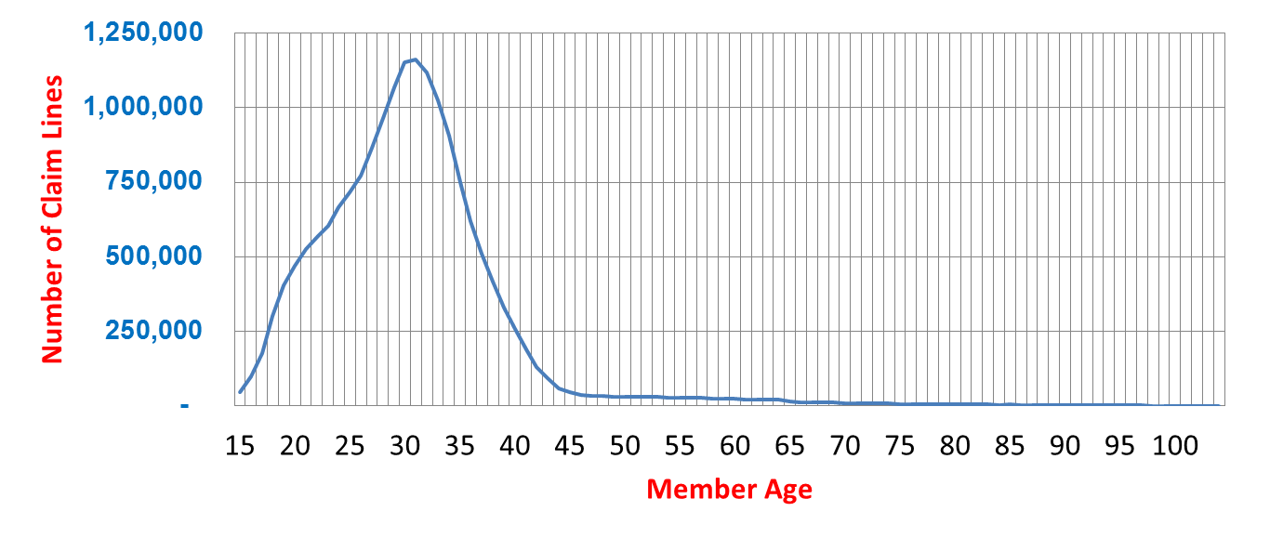
Question: The APCD data has women age 60+ with codes indicating pregnancy and live delivery in hospital even though we know from MA Vital Records that the 2010 oldest maternal age for a live birth was 54. We are applying for the 2013 and 2014 data. How can we be confident in the accuracy of the birth data for all other ages?
Answer: All years of Release 4.0 MA APCD contain 17.6 million claim lines for pregnancies and live deliveries. In profiling the age distribution of those claim lines, less than 1% were found for those 60 and older (see Table 1 below). This anomaly was mainly limited to one carrier, with approximately 90% of claim lines having a paid amount of less than one dollar, with half of the claim lines appearing in one year of data and decrease to less than 0.3% in subsequent years . This anomaly is mostly limited to one payer’s claim lines.
Table 1. Age Distribution of Pregnancies and Live Deliveries in APCD Release 4.0 (All Years)

Slide 16
Question: I can’t decide whether to use APCD or Casemix. What proportion of Massachusetts residents seek care in surrounding States?
Answer: In a count of distinct MA MEIDs for Medical Claims by Service Provider State , 8.5% of MA residents get care in surrounding states (see Table 1 ).
Table 1. Proportion of Distinct MEIDs for MA residents by Service Provider State
SERVICE PROVIDER STATE | 2014
MA | 79.3%
Out of NE Region | 9.6%
Blank | 2.6%
New England Region/Bordering States
RI | 2.1%
ME | 2.0%
NH | 1.8%
CT | 1.3%
NY | 1.1%
VT | 0.2%
Total Proportion New England | 8.5%

Slide 17
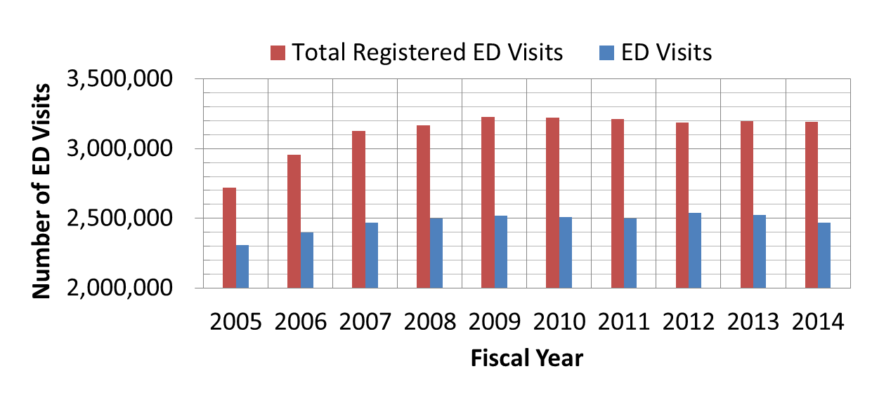
Question: The Emergency Department (ED) datasets for the years 2011-2013 have about 2.5 million patient visits per year, but the report recently published by CHIA quotes 3,062,912 ED visits in FY2013. I am trying to make sense of the differences, but I cannot find a good explanation.
Answer: The ED Visit data includes only routine departures, transfers, dead on arrivals or deaths in the ED which over the past 10 years averaged 2.5 million visits per year. Hospitals also submit data on patients who entered observation stay through the ED and who are admitted for inpatient care through the ED. The total registered in the ED over 10 years has averaged 3.1 million visits per year.
Table 1. Comparison of ED Visits in ED File to Total Registered in ED

Slide 18
Question: Should I be only looking at claim line type “Original” since the others (Void, Amendment, Replacement, Back Out) do not seem to fit into what looks right?
Answer: For financial and service access analysis purposes, after benefits adjudication by
the carrier, the original claim line is not always the line paid. In MA-APCD Release 4.0, which contains 1.7 billion medical claim lines, 67% of original claim lines were the highest version paid (see Table 1 below).
Table 1. Claim Line Type Percent by Version Indicator Flag
CLAIM LINE TYPE | Not Highest Version Paid | Highest Version Paid | Versioning Not Applied
Amendment | 0.45% | 1.56% | 0.18%
Backout | 1.74% | 0.00% | 0.13%
Original | 13.67% | 67.04% | 9.39%
Replacement | 1.07% | 3.85% | 0.23%
Void | 0.67% | 0.00% | 0.04%
Blank | 0.00% | 0.00% | 0.01%

Slide 19
Question: I find the “Highest Version Paid Indicator Flag” and the “Highest Version Indicator Flag” confusing. What is the difference between the two?
Answer: The Highest Version Paid Indicator is intended only to designate the highest version of a claim line that was PAID. This is the version indicator approved by carriers through discussions with CHIA for MA APCD release and financial analysis purposes (See Table 1.)
The Highest Version Indicator indicates that the claim line is the highest version claim line, which can include paid or denied claim claims (See Table 2). Comparing the frequency distributions of Table 1 and Table 2, show how closely the highest version of claims align with claim lines paid.
Table 1. Claim Line Type Percent by Version Indicator Flag
CLAIM LINE TYPE | Not Highest Version Paid | Highest Version Paid | Versioning Not Applied
Amendment | 0.45% | 1.56% | 0.18%
Backout | 1.74% | 0.00% | 0.13%
Original | 13.67% | 67.04% | 9.39%
Replacement | 1.07% | 3.85% | 0.23%
Void | 0.67% | 0.00% | 0.04%
Blank | 0.00% | 0.00% | 0.01%
Table 2. Claim Line Type Percent by Highest Version Indicator Flag
CLAIM LINE TYPE | Not Highest Version Claim Line | Highest Version Claim Line | Versioning Not Applied
Amendment | 0.2% | 1.9% | 0.2%
Backout | 1.7% | 0.0% | 0.1%
Original | 4.8% | 75.9% | 9.4%
Replacement | 0.4% | 4.5% | 0.2%
Void | 0.7% | 0.0% | 0.0%
Blank | 0.0% | 0.0% | 0.0%

Slide 20
Calendar
January 26 – User Workgroup Webinar
January 28 – Data Release Committee Meeting

Slide 21
Questions?
General questions about the APCD:
(CHIA-APCD@state.ma.us)
Questions related to APCD applications: (apcd.data@state.ma.us)
Questions related to Case Mix: (casemix.data@state.ma.us)
REMINDER: Please include your IRBNet ID#, if you currently have a project using CHIA data

