Slide 1
CaseMIx user workgroup
Amy Wyeth (Special Projects Analyst)
Don Kirkwood (Manager of Data Release and Procurement)
Sylvia Hobbs (Manager of User Support)
Scott Curley (Manager Privacy & Compliance)
April 28, 2020
CENTER FOR HEALTH INFORMATION AND ANALYSIS

Slide 2
Agenda
Announcements:
APCD Release 8.0 Updates
FY19 Case Mix Release Projections
Data Release and Application Update
Website Updates
Application Reminders
User Support Questions
Grouping Outpatient ED Visits
Transfer IDs
Filling Out Data Linkage on Application for Data
Differences between Case Mix and MA APCD
Q&A

Slide 3
MA APCD Release 7.0
Available NOW
Encompasses data on services from January 2013 – December 2017 with six months of claim runout (includes paid claims through 6/30/18)
Release Documentation and Data Specifications have been posted to the website: http://www.chiamass.gov/ma-apcd/
Apply now by listing 2017 (and any other years you want from Release 7.0) in the “Years Requested” section of the current application form available here: http://www.chiamass.gov/application-documents

Slide 4
MA APCD Release 8.0
Available NOW
Applicants with approved projects that require updated APCD data (Release 8.0) should submit to CHIA a completed Exhibit B (Certificate of Continued Need and Compliance) of the Data Use Agreement. After submitting a completed Exhibit B you will receive an invoice (if applicable) for the requested data. Upon payment of the invoice the order for the data will be placed.
Release 8.0 includes data on services from January 2014 – December 2018 with six months of claim runout (includes paid claims through 6/30/19).
Will be linkable to Release 7.0 via crosswalk
Additional information on highlights and enhancements will be presented in future APCD User Workgroups.

Slide 5

Case Mix FY19 Release
*CURRENT* RELEASE TIMEFRAMES FOR EACH FILE:
Inpatient (HIDD)
July 2020
Emergency Department (ED)
August 2020
Outpatient Observation (OOD)
October 2020
Applicants with approved projects that require newly available year(s) of Case Mix Data (e.g., FY 19) should submit to CHIA a completed Exhibit B (Certificate of Continued Need and Compliance) of the Data Use Agreement. After submitting a completed Exhibit B you will receive an invoice (if applicable) for the requested data. Upon payment of the invoice the order for the data will be placed.

Slide 6
Data Release and Application Updates
Due to Governor Baker’s emergency actions to limit the spread of COVID-19 CHIA’s workforce will be remote, for now. This arrangement will limit CHIA’s ability to produce and deliver data extracts. At this time it is unknown when CHIA will be able to fulfill data requests but CHIA is exploring alternative data delivery options in order to maintain business as usual. CHIA will continue to do its best to limit the impact of our energy response to data requestors.
During this time, CHIA will continue to accept and review data applications for both Case Mix and All-Payer Claims Database (MA APCD) datasets. Review committees, DRC and DPC, will continue their meetings remotely as necessary.
Due to CHIA’s physical office being closed, applications will be accepted without a fee. After receipt of the application, CHIA will issue an invoice which will allow applicants to remit payment online.
If you are a Data User that has a CHIA hard drive in your possession, please keep the hard drive at this time while CHIA’s physical office is closed.

Slide 7
Website Release Updates
Updates on the production of APCD and Case Mix databases and status of data requests are now posted to CHIA’s website!
Aim #1 is to provide weekly or bi-weekly status update on CHIA data products as they are in development.
Aim #2 is to provide applicants with information about expected fulfillment status for individual data requests.
Request IDs will be communicated to Data Requestors via email.
Please visit http://www.chiamass.gov/status-of-data-requests/ to see the current status of releases.

Slide 8
Application reminders

Slide 9
Fee Waiver Request Reminders
If you’re submitting a request for a fee waiver, remember to include the fee remittance form in your application package on IRBNet.
Remember to submit supporting documentation (if required).
If you’re requesting a financial hardship waiver, remember to submit information detailing your project’s financial situation (examples: project budget, grant funding, organizational / departmental funding). Also request to pay a specific price that you reasonably believe you’re able to afford to contribute.
CHIA generally does not offer full financial hardship fee waivers. We expect all applicants to have made an attempt to find funding to cover the full cost of the data fees.
Fee waiver requests can take some time to process – especially financial hardship requests.

Slide 10
USER questions

Slide 11

Question: I am using FY2016 - 2018 emergency department (ED) data. Due to the specificity and volume of ICD-10-CM diagnosis and procedure codes, I need a meaningful way of grouping and ranking outpatient ED visits. CHIA provides DRGs to group inpatient hospital discharge data. Is there a way of grouping for outpatient ED data?
CLINICAL
GROUPING
Answer: Yes, the Agency for Healthcare Quality and Research’s (AHRQ) Health Care Cost and Utilization Project (H-CUP) provides a free publicly available Clinical Classifications Software Refined (CCSR)* for aggregating ICD-10-CM diagnosis codes into a manageable number of clinically meaningful categories across 21 body systems, with a second classification for grouping external causes and a separate beta classification for grouping ICD-10-PCS procedure codes.
H-CUP Analytic Tools for Clinically Grouping ICD-10-CM Codes
and Prevention Indicators (as of April 29, 2020)
Clinical Classifications Software Refined for ICD-10-CM Diagnosis Codes
Clinical Classifications Software Refined for ICD-10-PCS Procedure Codes (Beta Version)
Chronic Condition Indicator (CCI) for ICD-10-CM (Beta Version)
Elixhauser Comorbidity Software for ICD-10-CM (Beta Version)
Utilization Flags for ICD-10-PCS (Beta Version)
Prevention Quality Indicators for ICD-10-CM
Inpatient Quality Indicators for ICD-10-CM
Patient Safety Indicators for ICD-10-CM
Pediatric Quality Indicators for ICD-10-CM
Answer Continued
* See the CCSR Reference File for a complete list of categories in the CCSR. The CCSR Reference File is only available on the CCSR page of the HCUP U-St website (www.hcup-us.ahrq.gov/toolssoftware/ccsr/ccs_refined.jsp)

Slide 12
Answer (continued): The Clinical Classifications Software Refined (CCSR)* groupings are downloadable from the AHRQ HCUP website in EXCEL, csv text, or SAS format. As of April 29, 2020, the most recent release of the CCSR groupings for ICD-10-CM diagnosis codes was version 2020.2, released February 2020. These codes allow data users to rank ED visits into mutually exclusive groups by principal (or first-listed) diagnosis code which are assigned to a single CCSR category allowing each ED visit to be counted just once.
For example, below are mortality rankings using CCSR for adult (Table 1) and pediatric (Table 2) in FY2018 Massachusetts outpatient ED data, with mortality defined as a departure status code of ‘0’ (died during ED Visit) or ‘9’ (Dead on Arrival (with or without resuscitative efforts in the ED).
CLINICAL
GROUPING
Table 1. FY2018 ED Visit Top 10 CCSR Mortality Ranking for Adults (Age > 18 years) |  |  | Table 2. FY2018 ED Visit Top 10 CCSR Mortality Ranking for Children (Age < 19 years)
RANK | CCSR Category Description |  | RANK | CCSR Category Description
1 | Cardiac arrest and ventricular fibrillation |  | 1 | Cardiac arrest and ventricular fibrillation
2 | Respiratory failure; insufficiency; arrest |  | 2 | Other specified and unspecified perinatal conditions
3 | Acute myocardial infarction |  | 3 | Suicidal ideation/attempt/intentional self-harm
4 | Poisoning by drugs, initial encounter |  | 4 | Respiratory failure; insufficiency; arrest
5 | Cardiac dysrhythmias |  | 5 | Open wounds of trunk, initial encounter
6 | Septicemia |  | 6 | Short gestation; low birth weight; and fetal growth retardation
7 | Acute hemorrhagic cerebrovascular disease |  | 7 | Internal organ injury, initial encounter
8 | Open wounds of trunk, initial encounter |  | 8 | Other general signs and symptoms
9 | Traumatic brain injury (TBI); concussion, initial encounter |  | 9 | Traumatic brain injury (TBI); concussion, initial encounter
10 | Respiratory signs and symptoms |  | 10 | Acute post-hemorrhagic anemia
* See the CCSR Reference File for a complete list of categories in the CCSR. The CCSR Reference File is only available on the CCSR page of the HCUP U-St website (www.hcup-us.ahrq.gov/toolssoftware/ccsr/ccs_refined.jsp)

Slide 13

Completing Section VII. DATA LINKAGE of the CHIA Data application
A common problem on applications for CHIA data is incomplete information in
Section VII Data Linkage. Whenever CHIA data is linked or merged or run
through a software program (such as a GIS), detailed information must be provided
on the data elements added to CHIA data. For example, the previous slide demonstrated how diagnosis codes in CHIA outpatient ED data could be used in AHRQ H-CUP Clinical Classifications Software Refined
VII. DATA LINKAGE
Data linkage involves combining CHIA Data with other data to create a more extensive database for analysis. Data linkage is typically used to link multiple events or characteristics within one database that refer to a single person within CHIA Data.
Do you intend to link or merge CHIA Data to other data?
Yes
2. If yes, please indicate below the types of data to which CHIA Data will be linked. [Check all that apply]
☐ Individual Patient Level Data (e.g. disease registries, death data)
☐ Individual Provider Level Data (e.g., American Medical Association Physician Masterfile)
☐ Individual Facility Level Data (e.g., American Hospital Association data)
☐ Aggregate Data (e.g., Census data)
■ Other (please describe): AHRQ H-CUP Clinical Classifications Software Refined (CCSR) ICD-10-CM Diagnosis Codes
3. If yes, describe the dataset(s) to which the CHIA Data will be linked, indicate which CHIA Data elements will be linked and the purpose for each linkage. AHRQ H-CUP CCSR will use CHIA ICD-10-CM Principal Diagnosis Codes for grouping the large number of Pregnancy, childbirth and the puerperium diagnosis codes into the 34 CCSR categories for utilization analysis.
4. If yes, for each proposed linkage above, please describe your method or selected algorithm (e.g., deterministic or probabilistic) for linking each dataset. If you intend to develop a unique algorithm, please describe how it will link each dataset. Deterministic
5. If yes, attach complete listing of the variables from all sources to be included in the final linked analytic file. Data elements are available at the following link: https://www.hcup-us.ahrq.gov/toolssoftware/ccsr/DXCCSR-vs-Beta-CCS-Comparison.xlsx
6. If yes, please identify the specific steps you will take to prevent the identification of individual patients in the linked dataset. The unit of analysis is a larger aggregated CCSR category without direct patient identifiers and aggregation will include cell suppression.
Answer Continued

Slide 14

Completing Section VII. DATA LINKAGE of the CHIA Data application
Section VII Data Linkage, Question 4, asks that for each proposed linkage, the applicant
describe the method or selected algorithm (e.g., deterministic or probabilistic) for linking
each dataset. If you intend to develop a unique algorithm, please describe how it will link each dataset. To complete this section, it is important to understand what the linkage algorithms are and how they differ.
DETERMINISTIC LINKAGE
Exact matching on a key unique identifier. For example, the physician’s license number in CHIA case mix data can be deterministically linked to Massachusetts Board of Registration of Medicine Physician Profile data to obtain the physician’s area of specialty.
Linking a common variable or a group of common variables across databases and a link is made if they all agree. Example: The Permanent Patient 5-digit ZIP code in CHIA data can be used to deterministically link to the Census Bureau data via 5-digit ZIP Code Tabulation Area (ZCTA). This type of linkage might be used to obtain area Census measures such as median household income level by ZCTA.
You can use a combination of variables such as the Permanent Patient 5-digit ZIP code in CHIA data and patient sex to link to Census data to further refine ZCTA area measures by sex.
NOTE: Remember using CHIA data in analytic software tools such as a GIS is a form of linkage. The case mix data geographic data are linked to census/demographic data layers to provide additional attributes not included in CHIA data.
Answer Continued

Slide 15
Completing Section VII. DATA LINKAGE of the CHIA Data application
PROBABILISTIC LINKAGE
Probabilistic record linking is based on the assumption that no single match between variables common to the source database and target database uniquely match with complete reliability. When there is no single unique identifier shared between source and target database records, a set of methods known as probabilistic record linkage are used.
A probabilistic linkage method calculates the probability that two records belong to the same individual by using multiple variables, such as, Unique Health Information Number (UHIN), Sex, Age, and Permanent Patient ZIP Code.
NOTE: Remember the Limited Data Sets (LDS) by default does not include certain identifiable information like Unique Health Information Number (UHIN), Race and Ethnicity, Physician ID, and Permanent Patient 5-Digit ZIP Code, but they can be requested as options when appropriate justification, correct completion of linkage information, and privacy protection measures are provided.

Slide 16

Question: In the inpatient hospital discharge data and outpatient ED data, I am having difficulty interpreting the IdOrgTransfer field. What does it mean and when should it be populated?
Answer: The IdOrgTransfer is the facility from which the patient is transferred. This ID should not be the same as ID for the hospital service site provider (IdOrgSite). The lookup values for IdOrgTransfer are provided in a separate organization table which accompanies the patient level record data. The lookup values provided in the organization table are the only valid transfer ID codes that can be used. Populating the IdOrgTransfer field is based on whether the record has the following primary or secondary source of admission codes:
The IdOrgTransfer must be populated if Primary or Secondary Source of Admission are:
4-Transfer from an Acute Hospital,
7-Outside Hospital Emergency Room Transfer,
5- Transfer from an SNF Facility or
6- Intermediate Care Facility and the provider from which the transfer occurred is in Massachusetts.
If in any of the above instances, the provider from which the transfer occurred is outside Massachusetts, the IdOrgTransfer must be 9999999.
9 – Other (to include Level 4 Nursing Facility) and the transfer facility is a Level 4 Nursing Facility/Rest Home and the provider from which the transfer occurred is in Massachusetts.
If Level 4 Nursing Facility provider from which the transfer occurred is outside Massachusetts, the transfer OrgID must be 9999999. If the Primary or Secondary Source of Admission is 9 and the admission is from anything other than a Level 4 Nursing Facility the Transfer Organization ID must be blank.

Slide 17
Reminder of the Differences between Casemix and MA APCD in Financial Data
MA APCD
Paid Amount
Prepaid Amount
Other Insurance Paid Amount
Drug Ingredient Cost/List Price
Postage Amount Claimed
Co-Pay Amount
Coinsurance Amount
Deductible Amount
Claim Status
Capitated Encounter Flag
Claim Line Type
Allowed Amount
Authorization Needed
Coordination of Benefits/
TPL Liability Amount
Denial Flag
Denial Reason
Excluded Expenses
Annual Per Family Deductible
Annual Per Person Deductible
Drug Single Multiple Source Indicator
Medical and Pharmacy Deductible
Global Payment Flag
In Network Indicator
Non-Covered Amount
Payer Claim Control Number
Payment Arrangement Type
Reason for Adjustment
Withhold Amount
Behavioral Health Deductible
Medical Deductible
Member Deductible Used
Pharmacy Deductible
Vision Deductible
Medicare Paid Amount
Pharmacy Self Pay Amount
Rebate Indicator
State Sales Tax
Casemix
Shared
Total Charges Ancillaries
Total Charges Special
Total Charges Routine
Revenue Codes
Units of Service
Charge Amount

Slide 18
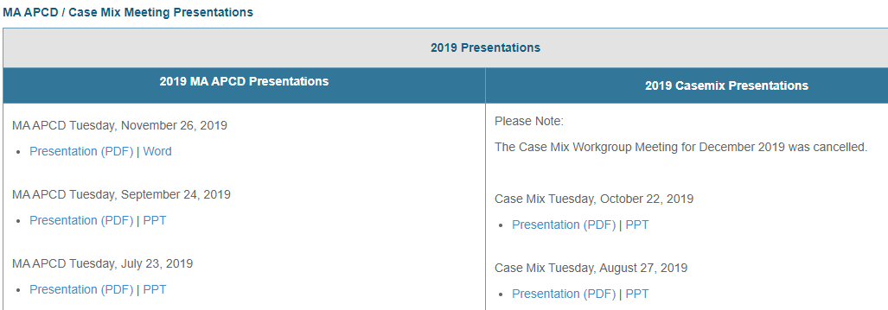
Where can I find past User Workgroup Presentations?
http://www.chiamass.gov/ma-apcd-and-case-mix-user-workgroup-information/

Slide 19
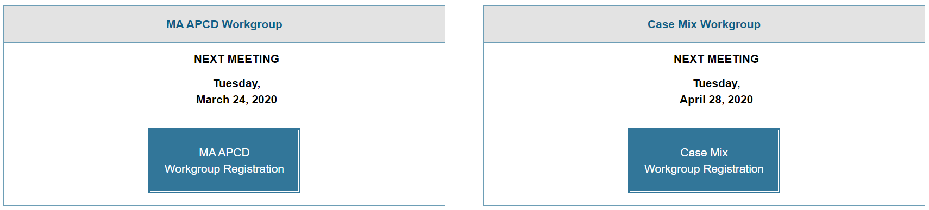
When is the next User Group meeting?
The next User Group will meet Tuesday, May 26.
http://www.chiamass.gov/ma-apcd-and-case-mix-user-workgroup-information/

Slide 20
Questions?
Questions related to MA APCD:
apcd.data@state.ma.us
Questions related to Case Mix:
casemix.data@state.ma.us
REMINDER: Please include your IRBNet ID#, if you currently have a project using CHIA data.

Slide 21
Call for Topics and Presenters
If there is a TOPIC that you would like to see discussed at an MA APCD or Case Mix workgroup in 2020, contact Amy Wyeth [amy.wyeth@state.ma.us]
If you are interested in PRESENTING at a MA APCD or Case Mix workgroup in 2020, contact Amy Wyeth [amy.wyeth@state.ma.us]
You can present remotely, or in-person at CHIA
We may be reaching out to some data users with invitations to present, and hope you will consider this!

