Slide 1
MA Center for Health Information & Analysis
Case Mix User Workgroup
September 27, 2016

Slide 2
Agenda
Announcements
  Update on the status of Case Mix FY15 readiness
Application Reminders
CHIA Answers to User Questions
Q&A

Slide 3
Case Mix FY15 Release Update
We are accepting applications for all FY15 Case Mix files now.
  *CURRENT* RELEASE TIMEFRAMES FOR EACH FILE:
  [Applies to Non-Gov’t Requests Only]
  Fixed Inpatient (HIDD) File with 5-digit zip codes for “neighboring states”
    END OF SEPTEMBER
  Emergency Department (ED) ready
    END OF OCTOBER
  Outpatient Observation (OOD) ready
    TBD

Slide 4
Case Mix FY15 Release Update
Apply for all files now and we will fulfill them as they become available.
FY15 Case Mix data in LDS format
FY04-FY14 available in old “Levels” format (can request on the same application form)
FY15 Release Documentation should be posted soon

Slide 5
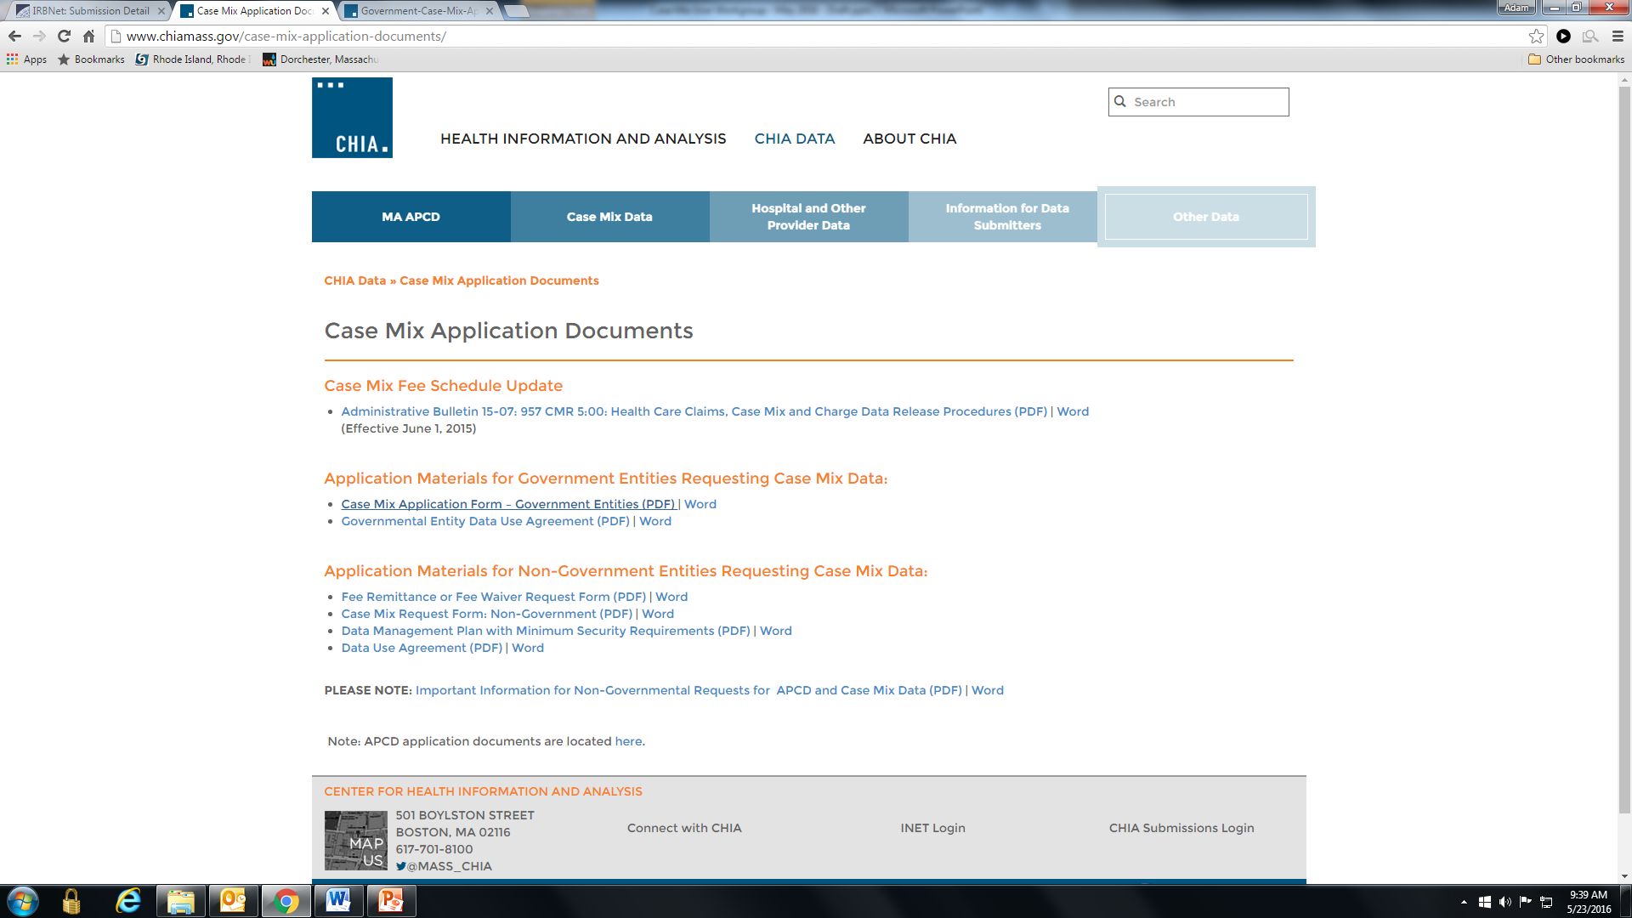
Revised Application Forms
Posted here: http://www.chiamass.gov/case-mix-application-documents/

Slide 6
MA APCD Release 5.0
Timeline:
Apply for data NOW – application forms are posted on the APCD website: http://www.chiamass.gov/application-documents\
Data is ready for release now
Release documentation (including full data specifications and release documentation) has been posted to the APCD website: http://www.chiamass.gov/ma-apcd/
No change in fees or fee waiver provisions with this release

Slide 7
Application Reminders
Don’t forget to upload CVs/Resumes for the “core project team” (even if you’ve previously been approved for data)
Don’t forget to upload your Research Methodology
Don’t forget to upload IRB documentation (even if it’s been determined that you are not subject to IRB review)
If you’re uploading new/revised forms after your initial submission, don’t forget to re-lock your project so we know that new materials are ready for review

Slide 8
QUESTIONS?

Slide 9
QUESTIONS SUBMITTED BY USERS

Slide 10

Question: Both CHIA and AHRQ HCUP State Inpatient Data Administrators have been asked whether the numeric order of associated diagnosis and procedure codes in Hospital Inpatient Discharge Data (HIDD) ranks medical relevancy?
Answer: Diagnosis and procedure codes hospitals collect in administrative data are primarily for billing based on the Centers for Medicare & Medicaid Services (CMS) and the National Uniform Billing Committee approved UB-04 (also known as the CMS-1450) claim form data elements. States have collected additional data elements not on the UB-04, such as race and ethnicity, to serve the needs of Government agencies and researchers. The Federal Agency for Health Research and Quality (AHRQ) has advised users of State HIDD that, unlike a clinical registry, no broad statement can be made about the medical relevancy of the ordering of billing data diagnosis codes for secondary use. Payers have specific billing rules which vary. For example, a Medicare rule in the use of diagnosis codes is that the sign/symptoms that prompt the ordering of diagnostic tests should be used in the absence of a diagnosis. Payers may also have specific types of code edits associated with medical necessity or changes in those edits associated with different payment models, such as bundled payments.

Slide 11
Question: In comparison to FY2014 HIDD, what percentage of discharge records in FY2015 of had 15 or more diagnosis codes?
Answer: In FY2015, 165,087 records (20.7%) have at least 15 diagnosis codes.
(cell suppression at 11 discharges)

Slide 12

Question: FY2015 HIDD contains principal, admitting diagnosis and discharge diagnosis. Are these diagnosis fields populated for all records and are the diagnosis fields ever populated with the same diagnosis codes?
Answer: No, the fields are not populated for all records. The FY2015 HIDD contains 796,835 discharge records, 0.01% do not have a principal or admitting diagnosis and 10.6% do not have a discharge diagnosis. Yes, there are instances when the principal diagnosis field matches the other diagnosis fields with the highest match (87.6%) with the discharge diagnosis.
Percent Completeness of Diagnosis Codes
Percent Match Between Principal DX and other DX Codes
99.9%
Principal Diagnosis 796,766 Records
99.9%
Admitting Diagnosis 712,486 Records
89.4%
Discharge Diagnosis 712,486 Records
73.9%
At Least 5 Associated Diagnosis 589,588
Principal DX Match
87.6% of Discharge DX
52.1% of Admitting DX
42.1% of Discharge and Admitting DXs
Note: Data anomaly 1.9% of Associated DXs

Slide 13

Question: With the lifting of the limit on diagnosis codes, did E-Code information increase on the types of activities performed while injured?
Answer: Yes, injuries of 792 different types of activities and mechanisms
appear in the FY2015 data. Below is an example of how specific these activities are.
American flag or touch football | Racquet and hand sports | Rough housing and horseplay
American tackle football | Rappelling | Spectator at an event
Baseball | Residential relocation | Civilian activity done for income or pay
Basketball | Roller skating (inline) and skateboarding | Military activity
Bike riding | Rowing, canoeing, kayaking, rafting and tubing | Animal care
Bowling | Rugby | Climbing, rappelling and jumping off
Boxing | Running | Computer technology and electronic devices
Building and construction | Snow (alpine) (downhill) skiing, snowboarding | Other cooking and grilling
Cheerleading | Soccer | Dancing and other rhythmic movements
Climbing base jumping | Surfing, windsurfing and boogie boarding | External motion
Cooking and baking | Swimming | Ice and snow
Cross country skiing | Trampoline | Cardiorespiratory exercise
Digging, shoveling and raking | Underwater diving and snorkeling | Muscle strengthening exercises
Floor mopping and cleaning | Vacuuming | Sports and athletics played as a team or group
Food preparation and clean up | Walking an animal | Sports and athletics played individually
Frisbee | Walking, marching and hiking | Person providing caregiving
Gardening and landscaping | Water skiing and wake boarding | Property/land maintenance
Golf | Water sliding | Water and watercraft
Grilling and smoking food | Wrestling | External cause status
Grooming and shearing an animal | Yoga | Specified sports and athletics activities
Gymnastics | Aerobic and step exercise | Free weights
Horseback riding | Calisthenics | Other household maintenance
Ice hockey | Caregiving involving bathing | Other personal hygiene activity
Ice skating | Caregiving involving lifting | Pilates
Lacrosse and field hockey | Exercise machines for cardiorespiratory conditioning | Push-ups, pull-ups, sit-ups
Laundry | Exercise machines for muscle strengthening | Personal bathing and showering
Mountain/rock/wall climbing | Martial arts | Physical games generally associated with school recess

Slide 14

Question: After the Institute of Medicine Report on Dying in America, Medicare proposed paying providers for time spent counseling do-no-resuscitate (DNR) and palliative care patients. In FY2015, was any change seen in data on DNR and comfort care patients?
Answer: Yes, there was an 18.5% increase in use of the flag for DNR patients and 15% increase in comfort care patients. Also, the quality of data improved. Blanks decreased by 8% and confirmation that the patient did not have DNR or comfort care improved by 27%
Please Take Important Note
The Flag fields (such as DNR status and Homelessness status) should not be used alone when there are also V-Codes to describe conditions and circumstances. For example, in FY2015, using V4986 you will find 60,387 distinct discharges (mostly Medicare patients) coded as Do Not Resuscitate.

Slide 15
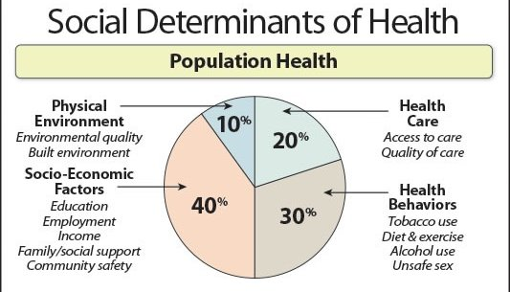
Question: Aside from gender, race/ethnicity, and ZIP Code, are there other data in the FY2015 that can be used to analyze the social determinants of health?
Answer : The lifting of diagnosis codes increased the availability of V-Codes related to the social determinants of health. Aside from child birth related codes and other medical conditions, below are some of the top V-Codes from men and women in FY2015 related to the social determinants of health.
V- Code | Description | Females | Males
V1582 | Personal history of tobacco use, presenting hazards to health | 51234 | 59067
V4986 | Do not resuscitate status | 37231 | 25134
V6284 | Suicidal ideation | 10654 | 11388
V667 | Encounter for palliative care | 10283 | 9582
V8541 | Body Mass Index 400-449, adult | 10799 | 5930
V600 | Lack of housing | 3587 | 7846
V8542 | Body Mass Index 450-499, adult | 5728 | 2641
V620 | Unemployment | 2570 | 4157
V8543 | Body Mass Index 500-599, adult | 4288 | 2086
V603 | Person living alone | 3244 | 2146
V463 | Wheelchair dependence | 2544 | 2163
V8539 | Body Mass Index 390-399, adult | 1917 | 1167
V8530 | Body Mass Index 300-309, adult | 1530 | 1404
V8531 | Body Mass Index 310-319, adult | 1472 | 1388
V8525 | Body Mass Index 290-299, adult | 918 | 939
V4984 | Bed confinement status | 941 | 735
V8544 | Body Mass Index 600-699, adult | 989 | 536
V1584 | Personal history of contact with and (suspected) exposure to asbestos | 86 | 1133
V6285 | Homicidal ideation | 361 | 839
V1542 | Personal history of emotional abuse, presenting hazards to health | 794 | 372

Slide 16
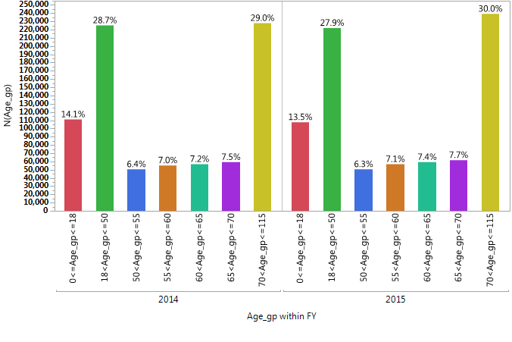
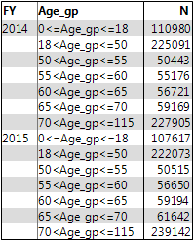
Number of Discharges by Patients' Age Groups Comparison for FY 2014 (N=785,485) and FY 2015 (796,835)
Question: Was there a decrease in inpatient discharges by any specific age group?
Answer: The largest decrease was for the age group 18 years old and younger.
Notes:
* According to the CHIA cell suppression policy of not publishing or presenting tables with cell sizes less than
11 to anyone who is not an authorized user of the data, the discharge number that fall in “others” are not included in the analysis result.

Slide 17
Questions?
Questions related to APCD : (apcd.data@state.ma.us)
Questions related to Case Mix: (casemix.data@state.ma.us)
REMINDER: Please include your IRBNet ID#, if you currently have a project using CHIA data

Slide 18
Call for Topics and Presenters
If there is a TOPIC that you would like to see discussed at an MA APCD or Case Mix workgroup, contact Adam Tapply [adam.tapply@state.ma.us]
If you are interested in PRESENTING at an MA APCD or Case Mix workgroup, contact Adam Tapply [adam.tapply@state.ma.us]
  You can present remotely from your own office, or in-person at CHIA.

