Slide 1
Case Mix user workgroup
Adam Tapply (Manager of Accounts)
Scott Curley (Manager of Privacy & Compliance)
Sylvia Hobbs (Manager of User Support)
October 22, 2019
CENTER FOR HEALTH INFORMATION AND ANALYSIS

Slide 2
Agenda
FY18 Case Mix Release Updates
Website Updates
October Data Audits
Answered User Questions
Q&A

Slide 3

Case Mix FY18 Release
*CURRENT* RELEASE TIMEFRAMES FOR EACH FILE:
Inpatient (HIDD)
September [DONE]
Emergency Department (ED)
Early-Mid October [ALMOST DONE]
Outpatient Observation (OOD)
Late October

Slide 4

COMING SOON: Weekly Case Mix Release Updates
Release updates on current FY Case Mix data release will soon be on the CHIA website.
Aiming to provide updates weekly or bi-weekly (“off-season”).
New web page will likely show:
Release status of each Case Mix file
Status notes, including information on delays
Updated fulfillment queue, with unique IDs for each data request
Very possible we will do this for upcoming APCD releases as well.

Slide 5
Case Mix FY18 Release
REPEAT APPLICANTS:
For those applicants with previously approved projects who indicated they would like to receive data annually, we are currently accepting Certificates of Continued Need and Compliance (Exhibit B of your DUA)
After receiving this, we will send you an invoice for the FY18 data and release data to you once payment is received and the data is ready.
If you are making any changes to your project, you must go through the amendment process first.

Slide 6
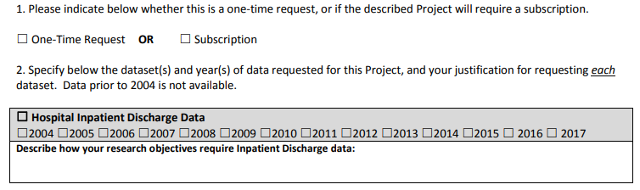
Case Mix FY18 Release
NEW APPLICANTS / NEW PROJECTS:
We will continue to accept new applications on a rolling basis.
If you are requesting FY18 data, just click the box for “Subscription” on p. 3 of the application form:

Slide 7
MA APCD Release 8.0
Available Winter 2019/2020
**Please hold off on submitting Release 8.0 requests for now**
Will encompasses data from January 2014 – December 2018 with six months of claim runout (includes paid claims through 6/30/19)
Will be linkable to Release 7.0 via crosswalk
Additional information on highlights and enhancements will be presented in future APCD User Workgroups.

Slide 8
October Data Audits
ALL academic institutions possessing CHIA data for an approved project should have received an email from CHIA last week with instructions for complying with our data audit.
This includes academic institutions that have been previously audited by CHIA.
Emails were sent to all projects’ Primary Investigators.
Please complete and return the Data Audit Response, with supporting documents, within ten (10) business days and make sure you give yourself plenty of time to get the required signatures.
If we do not receive your response within 20 days, we will contact your institution’s appropriate research office.
If you are having any difficulty in completing this Data Audit Response or have any questions, we encourage you to contact CHIA and we will do our best to assist you.

Slide 9
October Data Audits
Failure to reply to the audit in a timely manner could have major impacts on your (and your institution’s) continued use of the data, including but not limited to:
Being required to delete the data in your possession
Being barred from receiving CHIA data in the future
All other organizations possessing CHIA data for approved projects will be audited next Spring.

Slide 10
USER questions

Slide 11
ICD-10-CM vs ICD-9-CM
Diagnosis Coding
and Cannabis
Question: What is the magnitude of increase from ICD-9-CM to ICD-10-CM in diagnosis coding of outpatient ED visits for patterns of cannabis dependence, nondependent use and exposure? Are all of the new ICD-10-CM cannabis codes being used? Has there been an increase in ED visits associated with cannabis use or exposure?
Table 1. ICD-9-CM Cannabis Diagnosis Codes
Answer: ICD-9-CM cannabis diagnosis codes used prior to October 2015 are comprised of 8 diagnosis codes to distinguish dependent patterns of cannabis use from nondependent patterns of abuse (see Table 1). While all 8 cannabis diagnosis codes have been in the case mix ED data, over 80% of pre-October 2015 cannabis-related ED visits were coded as ICD-9-CM 30520 for nondependent cannabis abuse with an unspecified pattern of use (see Figure 1 below) and therefore lacked specificity on the pattern of use.

Slide 12
ICD-10-CM vs ICD-9-CM
Diagnosis Coding
and Cannabis
Answer (continued): ICD-10-CM cannabis diagnosis codes used after September 2015 contain 78 codes to describe patterns of cannabis use, cannabis abuse, cannabis dependence, occupational exposure to hemp, newborn affected by maternal use of cannabis, poisoning by cannabis derivatives, adverse effects of cannabis derivatives, and underdosing of cannabis derivatives (see Table 2 below). The concept of underdosing in ICD-10-CM is intended to describe the effects of unintentional underdosing of a medication regimen.
Table 2. ICD-10-CM Cannabis Diagnosis Codes

Slide 13
ICD-10-CM vs ICD-9-CM
Diagnosis Coding
and Cannabis
Answer (continued): Of the 78 ICD-10-CM cannabis diagnosis codes, to date 41 of the codes have been used in Massachusetts ED visit data. While the top ranking diagnosis are related to uncomplicated cannabis use (see Table 3 below), ICD-10-CM coding has provided additional information on cannabis induced mental disorders. In the past 8 years the number of cannabis related ED visits has increased from a low of 376 per in December 2011, to a high of 2,624 per month in May 2018 (see Figure 2 below).
Table 3. Ranking of ICD-10-CM Cannabis Diagnosis Codes used in Massachusetts ED Visit Data from FY2016 through FY2018
Figure 2. FY2012 through FY2018 Monthly Cannabis related Massachusetts ED Visit Volume

Slide 14
Question: I am interested in using the Case Mix data to analyze ED visits that result from tobacco related vaping? What codes should I use?
Diagnosis Coding
and Tobacco
Answer: New information is now available from the Centers for Disease Control and Prevention (CDC) on coding and analysis of vaping related injuries and disorders. Last week (October 17, 2019), the CDC issued official “ICD-10-CM Coding Guidance Vaping related disorders” available online at:
https://www.cdc.gov/nchs/data/icd/Vapingcodingguidance2019_10_17_2019.pdf
The guidance outlines and describes all of the specific ICD-10-CM codes to use for assigning codes covering diagnoses in the categories of:
Lung-related complications
Poisoning and toxicity
Substance use, abuse, and dependence
Signs and symptoms
The guidance advices to assign as many codes, as appropriate. Examples:
Cannabis related disorders: F12.---
Nicotine related disorders: F17.----
Specifically, for vaping of nicotine, assign code:
F17.29-, Nicotine dependence, other tobacco products. Electronic nicotine delivery systems (ENDS) are non-combustible tobacco products.

Slide 15

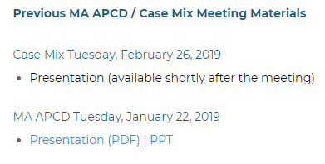
Where can I find old User Workgroup Presentations?
http://www.chiamass.gov/ma-apcd-and-case-mix-user-workgroup-information/

Slide 16
Questions?
Questions related to MA APCD:
apcd.data@state.ma.us
Questions related to Case Mix:
casemix.data@state.ma.us
REMINDER: Please include your IRBNet ID#, if you currently have a project using CHIA data.

Slide 17
Call for Topics and Presenters
If there is a TOPIC that you would like to see discussed at an MA APCD or Case Mix workgroup in 2019, contact Adam Tapply [adam.tapply@state.ma.us]
If you are interested in PRESENTING at an MA APCD or Case Mix workgroup in 2019, contact Adam Tapply [adam.tapply@state.ma.us]
You can present remotely, or in-person at CHIA.

