Slide 1
MA Center for Health Information & Analysis
Case Mix User Workgroup
November 28, 2017

Slide 2
Agenda
Announcements
  Expected timeframes for FY17
  Updates on MA APCD Release 6.0
Summarized Data Reports
Application Reminders
User Questions
Q&A

Slide 3
Case Mix FY16 Release Calendar
  *CURRENT* RELEASE TIMEFRAMES FOR EACH FILE:
  Inpatient (HIDD)
  READY NOW
  Emergency Department (ED)
    READY NOW
  Outpatient Observation (OOD)
    READY NOW

Slide 4
Case Mix FY17 Release Calendar
  *CURRENT* RELEASE TIMEFRAMES FOR EACH FILE:
  Inpatient (HIDD)
  JUNE
  Emergency Department (ED)
    AUGUST
  Outpatient Observation (OOD)
    SEPTEMBER

Slide 5
Case Mix Application Process
Recap of Changes for 2017:
Now charge per year of data requested
Can now request future years of data
  Future years require no DRC review, absent major changes to the project or data being requested
Can request to use data for one project for a subsequent project
Comprehensive DUAs for each organization (will cover all projects instead of multiple DUAs for each specific project)
Not expecting any major changes in 2018

Slide 6
MA APCD Release 6.0
Will encompass data from January 2012 – December 2016 with six months of claim runout
Target release timeframe is still late Fall 2017
Application form has been updated
Available here: http://www.chiamass.gov/application-documents
Make sure you’re signed up for CHIA’s email list to receive important announcements:
Sign Up Here

Slide 7
MA APCD Release 6.0 Highlights
Additional Pharmacy Claims versioning
4 carriers added to the Pharmacy versioning:
  (P1) 301 - Health New England
  (P2) 12226 - Minuteman Health
  (P3) 10632 - Anthem
  (P4) 302 - Health Plans Inc.

Slide 8
MA APCD Release 6.0 Highlights
New and improved Member Enterprise ID (MEID)
Master Data Management (MDM) approach updated to work with hashed patient information
Added Nickname processing for first names (Joe, Joseph)
Added NYSIIS phonetic processing for last names (Smith, Smyth)
Removed the Pharmacy Benefit Manager data from the MDM process to decrease the duplication of member data by upwards of 40%
CHIA is testing the newly created MEIDs and finding significant improvement in the match rates and removal of ‘orphan’ records

Slide 9
Summarized Data Reports
CHIA is proposing to revise our Data Release Regulations to allow for Summarized Data Reports
Notice of Public Hearing: http://www.chiamass.gov/regulations/#publiccomments
[Proposed effective 12/29 – comments due 12/8]
Will contain only aggregate data (data summaries) and De-identified Data, sourced from APCD and Case Mix data
  Examples of Summarized Data Reports include: counts; totals; rates per thousand; index values; and other standardized metrics.
  Will be subject to CHIA’s cell suppression policy (no cell less than 11 will be displayed)

Slide 10
Summarized Data Reports
In determining whether to compile such a report, CHIA will consider the public interest served, the availability of its resources, the complexity of the request, and privacy concerns (i.e. that there is no more than a minimal risk to individual privacy in the public release of the report)
Submit the request via a new form (to be published after the revised regulation goes into effect)
The Executive Director (or his/her designee) will approve or deny such requests. Such approval/denial is final and not subject to further review or appeal.
A support/production fee of $140/hour will be charged

Slide 11
Application Reminders
Financial Hardship Fee Waiver Requests – We expect applicants to have made an attempt to find some kind of institutional or grant funding. 100% fee waiver requests are extremely unlikely to be granted.
If your project requires IRB approval, please ensure you have approval BEFORE submitting your data request to CHIA

Slide 12
QUESTIONS?

Slide 13
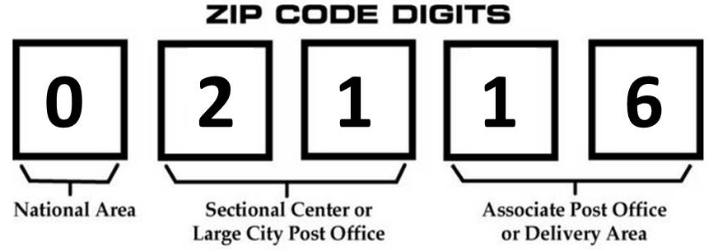
Question: Section VII of the CHIA application form has the option of requesting 3-digit ZIP Code, but what volume distribution and geographic distribution can we expect when using 3-digit ZIP Code boundaries?
Answer: Massachusetts has approximately six hundred and eighty-five 5-digit ZIP codes assigned by the United States Postal Service for mail delivery. These ZIP codes are subject to change and can overlap. The first 3-digits of the 5-digits are a larger grouping with the first digit representing a National Area ranging from zero (for states in far Northeast) to nine (for states in the far West), the second and third digits representing local central post office coverage area, and the remaining digits are for mail service delivery routes. When the data are aggregated at the 3-digit ZIP code level, approximately six hundred and eighty-five 5-digit Massachusetts ZIP codes are reduced eighteen 3-digit ZIP codes.

Slide 14
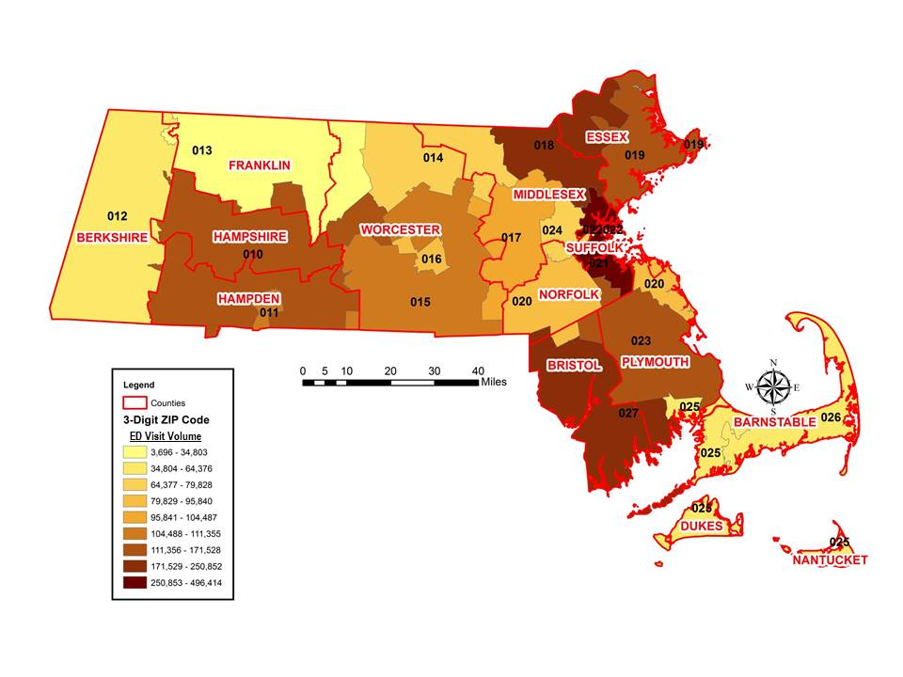
Question: Section VII of the CHIA application form has the option of requesting 3-digit ZIP Code, but what volume distribution and geographic distribution can we expect when using 3-digit ZIP Code boundaries? (continued)
Answer: The map below shows the FY2016 Massachusetts ED Visit volume by 3-digit ZIP Code and County. The eighteen 3-digit ZIP Code boundaries represent a smaller aggregation than the 12 Massachusetts Counties. Geographic coverage in larger less urban 3-digit ZIP Code areas of the Cape, Berkshire and part of Franklin County have lower ED Visit volume. Several small counties on the Cape share the same 3-digit ZIP Code. The Suffolk County 3-digit ZIP Code areas have the highest ED Visit volume.
FY2016 Massachusetts Outpatient Emergency Department
Visit Volume by
3-digit ZIP Code and County

Slide 15
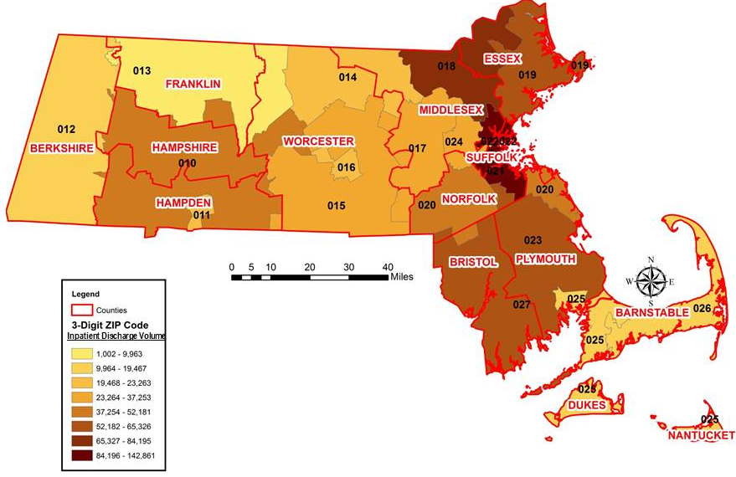
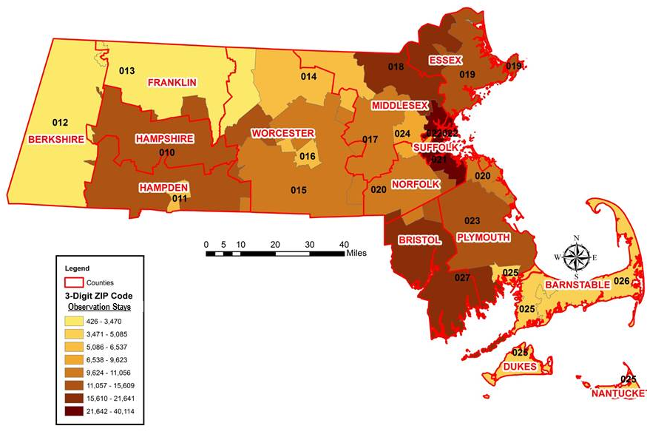
Question: Section VII of the CHIA application form has the option of requesting 3-digit ZIP Code, but what volume distribution and geographic distribution can we expect when using 3-digit ZIP Code boundaries? (continued)
Answer: Both FY2016 Hospital Inpatient Discharge Volume and FY2016 Observation Stay 3-digit ZIP volume mirror a geographic distribution of the FY2016 ED Visit data with less volume from the Cape, Berkshire and a part of Franklin County. When using 3-digit ZIP codes, it is important to keep in mind, while they roughly align some political boundaries, you will see more shared overlapping between ZIP code boundaries and political boundaries. Compare county and ZIP code boundaries in maps below.
FY2016 Inpatient Hospital Discharge Volume by 3-digit ZIP Code and County
FY2016 Outpatient Observation Stay Volume by 3-digit ZIP Code and County

Slide 16
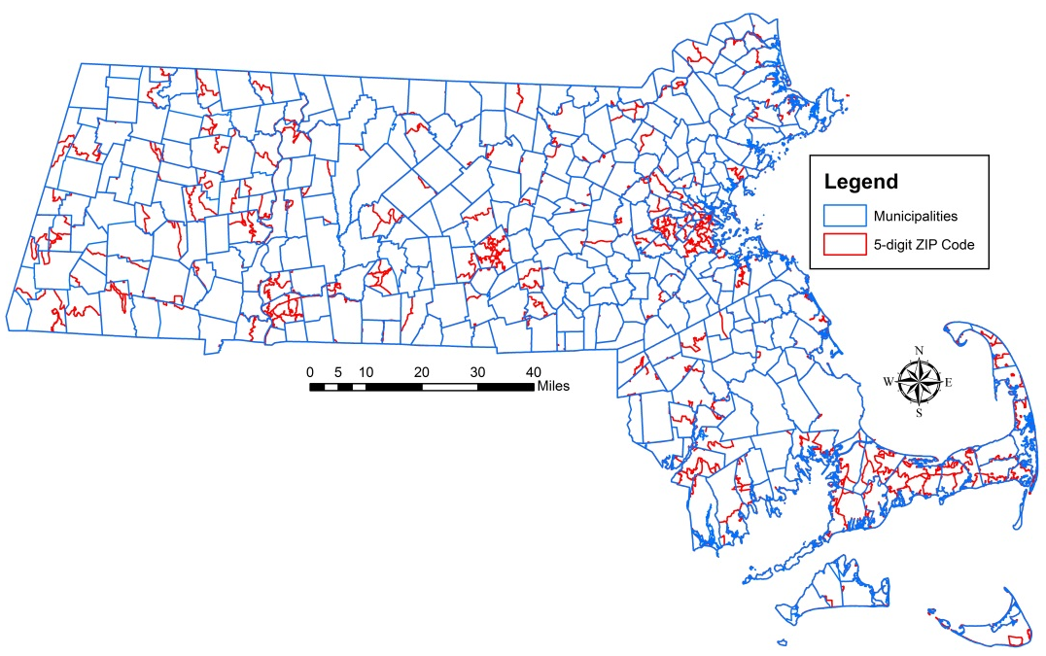
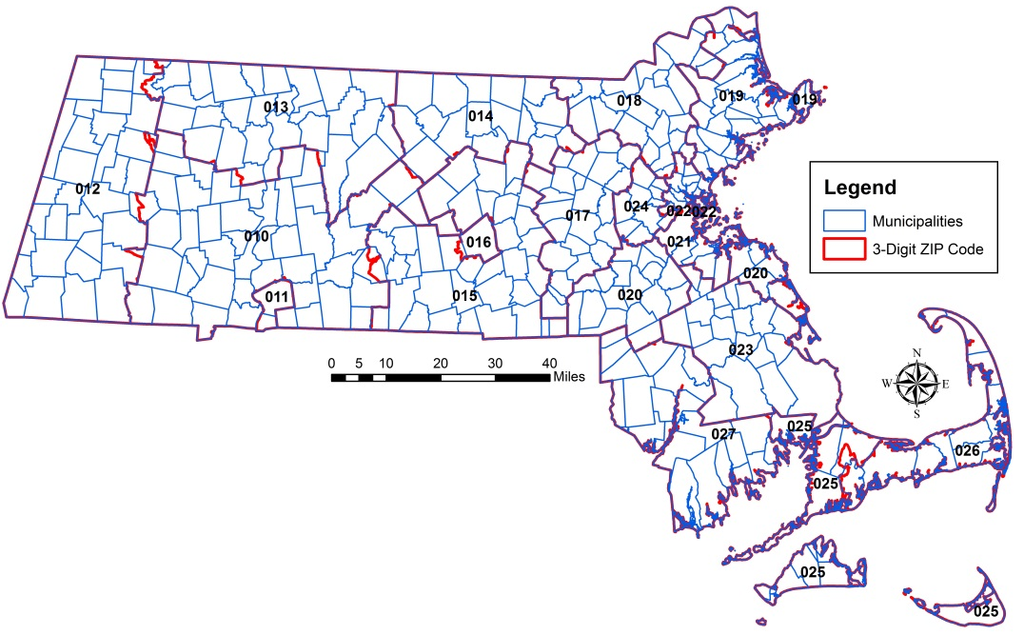
Question: Section VII of the CHIA application form has the option of requesting 3-digit ZIP Code, but what volume distribution and geographic distribution can we expect when using 3-digit ZIP Code boundaries? (continued)
Answer: As with 3-digit ZIP Codes, 5-digit ZIP Codes cut across multiple political boundaries. ZIP Codes generally do not show any respect for state, municipal, county, or census statistical area boundaries. They are administrative units for mail carrier routes that intertwine across political geographic boundaries like spaghetti, and are subject to continuous alteration or elimination based on mail volume. In the 5-digit ZIP code map below, the visible red lines indicate 5-digit ZIP code boundaries which cross Municipal and are shared. In the 3-digit ZIP Code map, there is a closer alignment with Municipal boundaries but sharing still visible in Western Massachusetts, Central Massachusetts and on the Cape.
Massachusetts
5-digit ZIP Code Boundary
overlaid on Municipal Boundaries
Massachusetts
3-digit ZIP Code Boundary
overlaid on Municipal Boundaries

Slide 17
Question: Now that the ICD-10-CM external cause codes are no longer limited to injuries (S00-T88), what types of non-injury diagnoses are accompanied by cause codes in the FY2016 data?
Answer: In the FY2016 outpatient ED data, approximately 12% of ED visits with an ICD-10-CM external cause code (V00-Y99) are non-injury principal diagnosis. The top ranking diagnoses include pains, follow-up examinations, alcohol abuse and depression. Some of the cause codes includes new information not previously available in ICD-9-CM such as blood alcohol test level results.
Top 15 non-Injury Diagnosis with External Cause Codes
ICD-10-CM Blood Alcohol Levels
Rank | ICD-10-CM | Full Description
1 | M545 | Low back pain
2 | M542 | Cervicalgia
3 | F10129 | Alcohol abuse with intoxication, unspecified
4 | R55 | Syncope and collapse
5 | R51 | Headache
6 | Z041 | Encounter for examination and observation following transport accident
7 | Z043 | Encounter for examination and observation following other accident
8 | R0789 | Other chest pain
9 | M549 | Dorsalgia, unspecified
10 | F10120 | Alcohol abuse with intoxication, uncomplicated
11 | M25511 | Pain in right shoulder
12 | M25561 | Pain in right knee
13 | M25512 | Pain in left shoulder
14 | F329 | Major depressive disorder, single episode, unspecified
15 | M546 | Pain in thoracic spine
Code Description
Y900 less than 20 mg/100 ml
Y901 20-39 mg/100 ml
Y902 40-59 mg/100 ml
Y903 60-79 mg/100 ml
Y904 80-99 mg/100 ml
Y905 100-119 mg/100 ml
Y906 120-199 mg/100 ml
Y907 200-239 mg/100 ml
Y908 240 mg/100 ml or more

Slide 18
Question: The largest increase in ICD-10-CM codes are for injury diagnoses. What are the specific changes and enhancements to ICD-10-CM injury data?
ICD-9-CM | ICD-10-CM
Code range 800-959 | “S” and “T” codes
Primary axis is nature of injury | Primary axis is body region
No character to indicate laterality | Characters to indicate left, right, bilateral, unspecified
Limited detail on type of fracture | Detailed info on type of fracture
Lacerations only | Lacerations with and without foreign body
Limited information superficial injuries | Detailed information on superficial injuries
Poisoning & adverse drug effect codes | Poisoning, adverse effects & drug underdosing codes
Poisoning: Both diagnosis code and external cause code | Poisoning: diagnosis code only (T code) with character to specify intent
Asphyxiation: 994.7 | 40 diagnosis codes for asphyxiation/ strangulation by different mechanisms & intent
Child/adult abuse | New codes to distinguish between suspected vs confirmed abuse
No designation of initial vs subsequent encounter | Most codes have 7th character indicating initial vs subsequent encounter
Limited late effect codes | Most codes have 7th character indicating sequelae (late effects)
Source: CDC National Center for Health Statistics

Slide 19
Question: I plan on applying for multiple years of Case Mix data dating back to 2004. Are there specific changes in the data I should pay attention to?
Answer: Prior to 2007 the following data elements were not collected:
    Ethnicity1
    Ethnicity2
    Other Ethnicity
    Hispanic Indicator
    Race 2
    Other Race
    Permanent and Temporary City
    Permanent and Temporary State
    Temporary ZIP Code
    Country
    Condition Present on Admission Codes
Hispanic origin was c as a race. ZIP code data was collected without indication of whether it was temporary or permanent.
After 2007, with the increase in geographic data elements, there was a large increase in the completeness of data on Massachusetts residency.

Slide 20
Change in Massachusetts Inpatient Hospitals Discharges by Age and Diagnosis from FY2005 to FY2007
 | 2,005 | 2,006 | 2,007 | 2005 to 2007 Percent Increase
Total Discharges | 836,811 | 843,167 | 849,290 | 1.49%
Massachusetts Residents | 789,523 | 795,962 | 803,337 | 1.75%
Non-Massachusetts Residents | 42,291 | 42,901 | 42,715 | 1.00%
Residency Unknown | 4,997 | 4,304 | 752 | -84.91%
Total Discharges by Age
0-17 years | 122,726 | 123,470 | 124,560 | 1.49%
18-24 years | 38,805 | 40,482 | 41,282 | 6.38%
25-34 years | 81,824 | 81,144 | 81,693 | -0.16%
35-44 years | 85,392 | 84,239 | 82,298 | -3.62%
45-64 years | 186,132 | 191,574 | 197,276 | 5.99%
65 years and older | 321,932 | 322,258 | 322,181 | 0.08%
Births
Single Births | 73,682 | 74,300 | 74,419 | 1.00%
Twin Births | 3,347 | 3,282 | 3,232 | -3.44%
Multiple Births | 205 | 160 | 122 | -40.49%
Total Fiscal Year Inpatient Charges | $ 15,375,483,473 | $ 16,359,408,778 | $17,377,587,963 | 13.02%
Increases in Selected Inpatient Services
Semi-Private 2-Bed Detoxification Services | $ 2,056,363 | $ 4,613,100 | $ 8,486,951 | 312.72%
Transitional Care Unit Services | $ 9,081,169 | $ 18,890,764 | $ 24,146,910 | 165.90%
Pharmacy: Other | $ 2,353,752 | $ 8,737,928 | $ 21,197,540 | 800.59%
Organ Acquisition | $ 25,033,565 | $ 29,734,122 | $ 35,050,354 | 40.01%
Organ Acquisition: Cadaver Donor | $ 1,593,494 | $ 2,513,272 | $ 2,256,350 | 41.60%
Organ Acquisition: Unknown Donor | $ 496,628 | $ 1,104,418 | $ 1,416,732 | 185.27%
Professional Fees | $ 16,342,722 | $ 18,327,224 | $ 31,092,177 | 90.25%

Slide 21
Questions?
Questions related to APCD : (apcd.data@state.ma.us)
Questions related to Case Mix: (casemix.data@state.ma.us)
REMINDER: Please include your IRBNet ID#, if you currently have a project using CHIA data

Slide 22
Coming Soon
Next Case Mix User Workgroup – February 27
Presentation by Urbano Franca from Children’s Hospital on Pediatric Hospital Care
No APCD Workgroup in December – next one will be in January
Gallery of Publications Using CHIA Data
Web page should go live within the next few weeks
Send us your publications (or at least your citations) to make sure you are included!

Slide 23
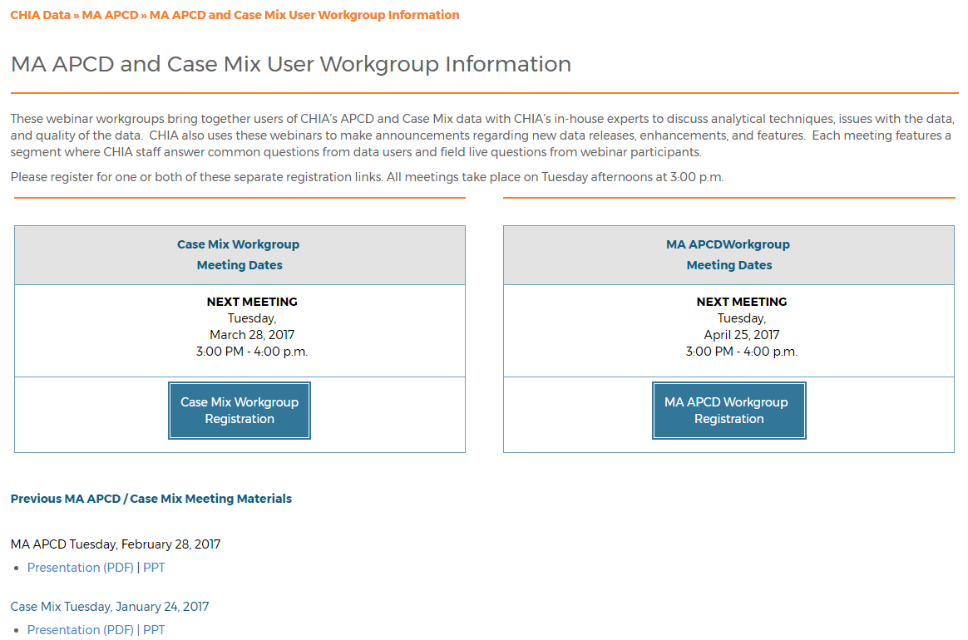
Where can I find old User Workgroup presentations?
http://www.chiamass.gov/ma-apcd-and-case-mix-user-workgroup-information/

Slide 24
Call for Topics and Presenters
If there is a TOPIC that you would like to see discussed at an MA APCD or Case Mix workgroup, contact Adam Tapply [adam.tapply@state.ma.us]
If you are interested in PRESENTING at an MA APCD or Case Mix workgroup, contact Adam Tapply [adam.tapply@state.ma.us]
  You can present remotely from your own office, or in-person at CHIA.

