Slide 1
MA Center for Health Information & Analysis Case Mix User Workgroup
May 24, 2016

Slide 2
Agenda
Announcements:
Slides from Previous Workgroups Now Posted
FY2015 Release Information
Overview of Revised Application Forms
Presentation: Acute Hospital Profiles – CHIA’s Health Analytics & Finance Team
Q&A

Slide 3
User Group Slides Posted [http://www.chiamass.gov/ma-apcd-and-case-mix-user-workgroup-information/]
Based on feedback, grouped by topic and not date of meeting
Three categories:
Application Questions (“When do fees need to be paid?”)
Questions from Users – one PDF containing multiple questions (mostly short questions/answers with 1 or 2 slides each)
Tutorials – PDFs for each tutorial – hyperlink on the website will say what each tutorial is (Example: “How to Count Patients Admitted from the Emergency Dept. in the HDD file”)

Slide 4
Case Mix FY15 Release
We are accepting applications for FY15 Case Mix data NOW
Inpatient Data is scheduled to be ready for release on 6/30
Outpatient Observation ready in August
Emergency Department ready in September
Apply for all files now and we will fulfill them as they become available.
FY15 Case Mix data in LDS format
FY04-FY14 available in old “Levels” format (can request on the same application form)
FY15 Release Documentation will be posted next month

Slide 5
Case Mix Limited Dataset (LDS)
Goal: Protect patient privacy
Starting with FY2015
Applies to non-government users only; government users may request additional elements
Revised application form is available now
Changes are not retroactive to prior years of data
DUAs and Data Management Plans are still required
No changes in fees

Slide 6
CHIA Methodology
Determined what must be excluded, including HIPAA-defined direct identifiers
Investigated elements that potentially should be excluded due to patient privacy concerns (example: free text fields)
Exclude certain quasi-identifiers, which make individuals unique in the population and thus could possibly be used for indirect re-identification
Ended up with a “Core” LDS available to all applicants and offer “buy-up” options for date granularity, geographic granularity, and physician ID#

Slide 7
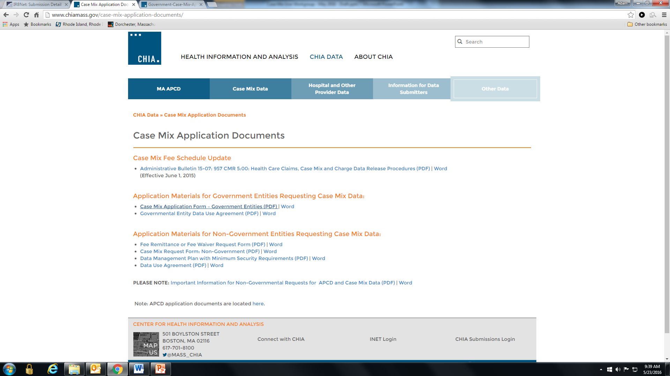
Revised Application Forms
Posted here: http://www.chiamass.gov/case-mix-application-documents/

Slide 8
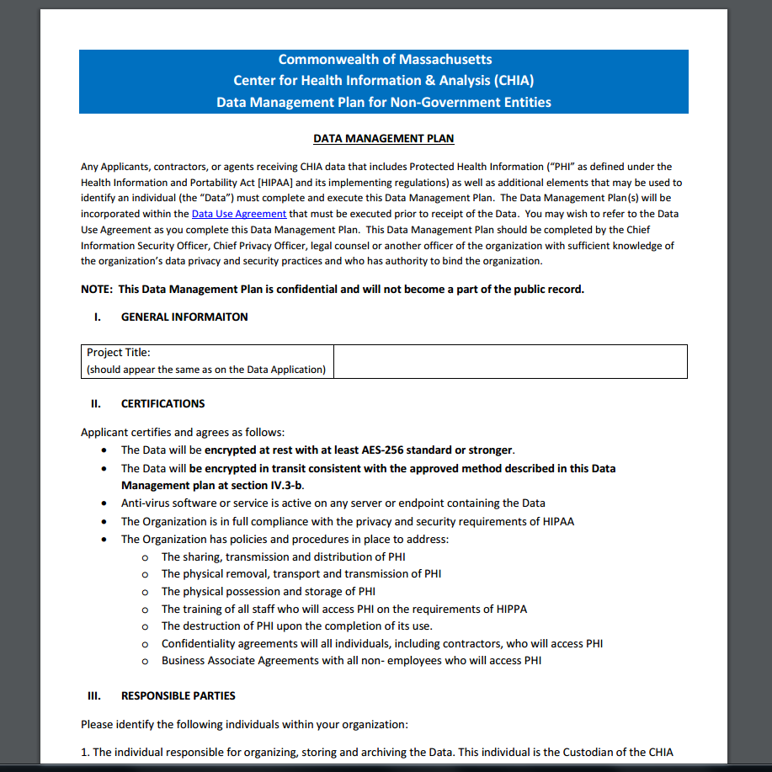
Revised Data Management Plan
Posted here: http://www.chiamass.gov/assets/Uploads/data-apps/Data-Managment-Plan-for-Non-Government-Entities.docx

Slide 9
QUESTIONS?

Slide 10

Acute Hospital Profiles
Health Analytics and finance (HAF)
Case Mix User Workgroup | May 2016

Slide 11
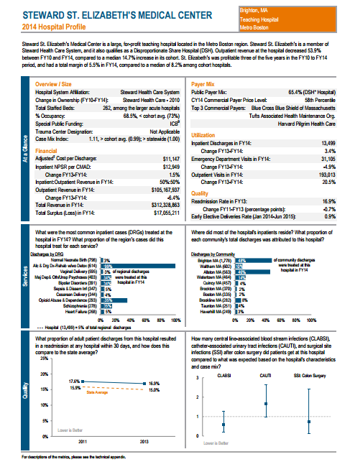
Acute Hospital Profiles
Uses various CHIA data resources to “profile” each acute hospital (n= 65)
Utilization, services, quality, revenue trends and financial performance are all included
Published annually

Slide 12
Acute Hospital Profiles: Case Mix uses
Case Mix data was aggregated at the organization level
Case Mix Index (CMI) and Case Mix Adjusted Discharges (CMAD)
Readmissions
Top DRGs: Most frequently seen inpatient cases
Top Communities: Where a hospital draws its patients

Slide 13
Acute Hospital Profiles: Case Mix uses
CMI – APR DRG v.30; MA specific weights
CMADs – Multiplied CMI to the hospital’s discharges as reported in their hospital cost report.
Gives an idea of “apples to apples” discharges
Cost report discharges used for consistency

Slide 14
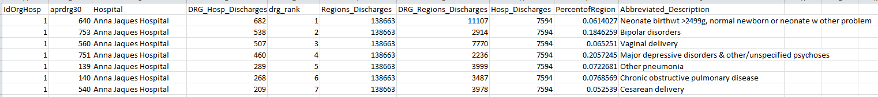
Most Frequent DRGs
Acute Hospital Profiles: Case Mix uses
Used SAS to pull DRG codes with highest number of discharges at each hospital, ranked in ascending order
Also tallied percentage of region each DRG represented
Total hospital discharges compared to region total

Slide 15
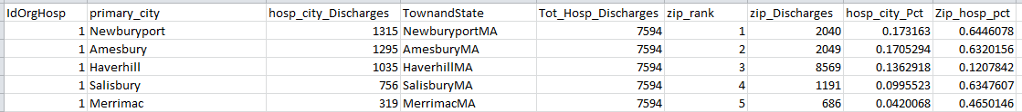
Top Communities
Acute Hospital Profiles: Case Mix uses
Cross-walked zip codes to community names using U.S. Postal Service data
Calculated what percentage of the hospital’s discharges came from each community
Also looked at what percentage of each community were discharged from each acute hospital

Slide 16
Challenges:
Discrepancies between Case Mix and other data sources
Varying DRG code use
e.g., Athol had 100% of Central MA’s rehab discharges
Hospital Mergers

Slide 17
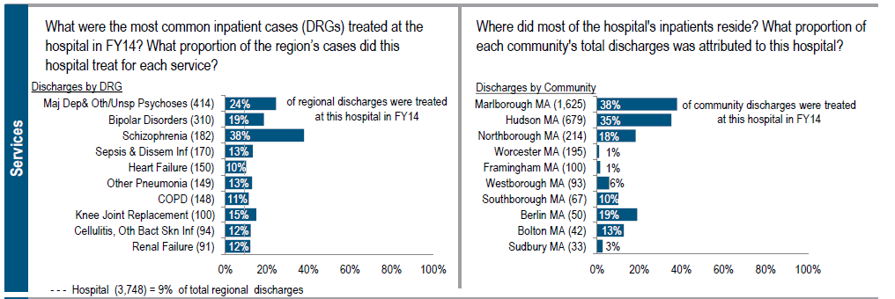
Questions?

Slide 18
Questions?
Questions related to APCD : (apcd.data@state.ma.us)
Questions related to Case Mix: (casemix.data@state.ma.us)
REMINDER: Please include your IRBNet ID#, if you currently have a project using CHIA data

Slide 19
Call for Topics and Presenters
If there is a TOPIC that you would like to see discussed at an MA APCD or Case Mix workgroup, contact Adam Tapply [adam.tapply@state.ma.us]
If you are interested in PRESENTING at an MA APCD or Case Mix workgroup, contact Adam Tapply [adam.tapply@state.ma.us]
You can present remotely from your own office, or in-person at CHIA.

