Slide 1
MA Center for Health Information & Analysis
Case Mix User Workgroup
July 26, 2016

Slide 2
Agenda
Announcements
Presentation: Why did CHIA lift the limit on number of diagnosis and procedure codes in FY15 Case Mix?
Q&A

Slide 3
Announcement
New CHIA Executive Director – Ray Campbell
  Commissioner (Acting E.D.) at the GIC and former CEO of MA Health Data Consortium
  Will be starting August 1st
Steve McCabe, CHIA’s current Deputy Executive Director of Health Analytics and Finance has been the Interim Executive Director since Aron Boros left in June

Slide 4
Case Mix FY15 Release
We are accepting applications for FY15 Case Mix data NOW
Inpatient Data is available NOW
  Emergency Department ready in late August
  Outpatient Observation ready in early September
Apply for all files now and we will fulfill them as they become available.
FY15 Case Mix data in LDS format
FY04-FY14 available in old “Levels” format (can request on the same application form)
FY15 Release Documentation should be posted soon

Slide 5
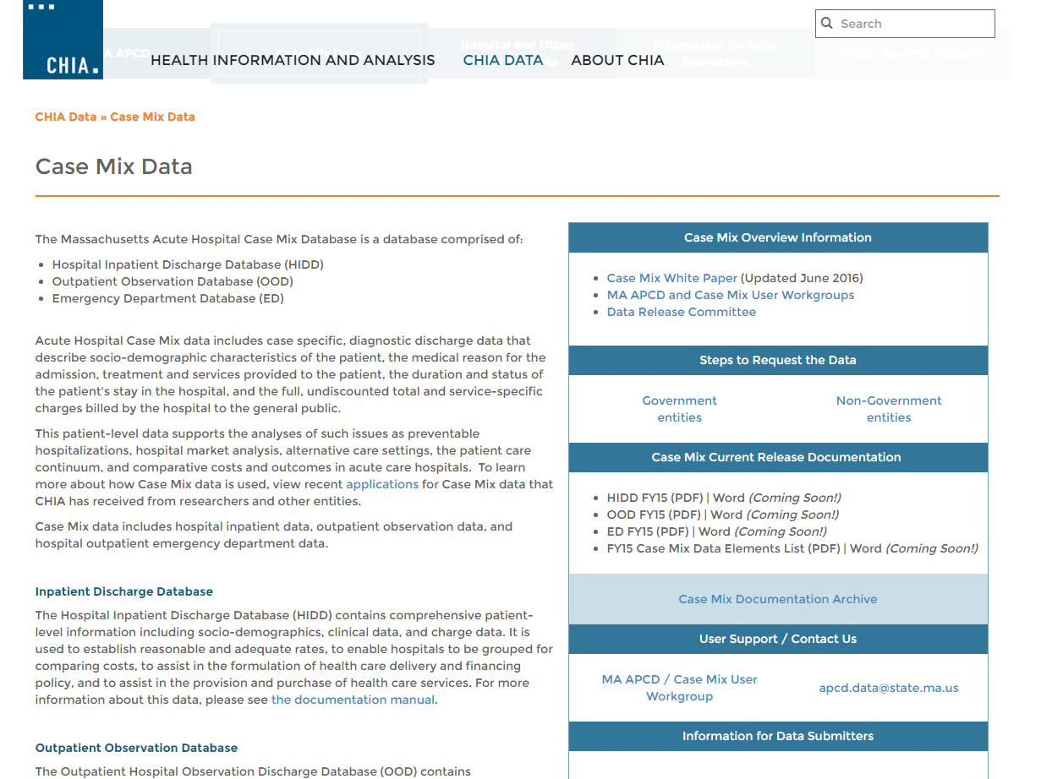
Case Mix Webpage
http://www.chiamass.gov/case-mix-data/

Slide 6
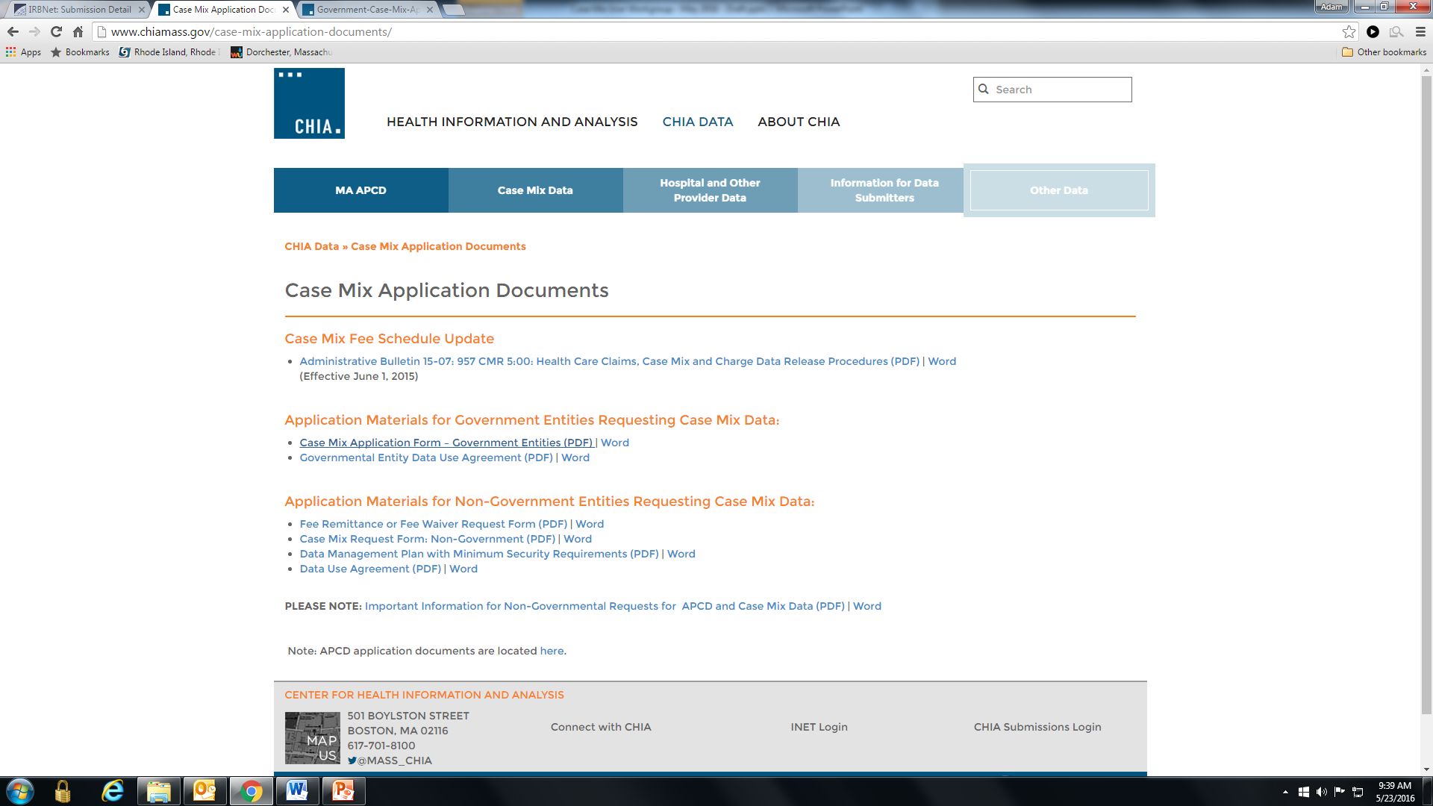
Revised Application Forms
Posted here: http://www.chiamass.gov/case-mix-application-documents/

Slide 7
MA APCD Release 5.0
Apply for data NOW – application forms are posted on the APCD website: http://www.chiamass.gov/application-documents\
Data should be ready to go out the door by July 31st
Release documentation (release notes, full data specifications, etc.) will be posted over the next couple of weeks)
No change in fees or fee waiver provisions with this release

Slide 8
MA APCD Release 5.0
Highlights of Release 5.0 Include:
Data is available for dates of service from January 1, 2011 to December 31, 2015 as paid through March 31, 2016.
  Data submitted to CHIA after March 2016 is not included in the files
Comprehensive and recently updated data, including resubmissions from several large carriers
Versioning for additional carriers beyond those carriers from APCD Release 4.0 (Blue Cross Blue Shield of Massachusetts, Tufts Health Plan, Harvard Pilgrim, and MassHealth)
  A full list of Carriers versioned will be available closer to release implementation

Slide 9
MA APCD Release 5.0
Additional Highlights of Release 5.0:
Government users may request both Level 2 and Level 3 elements, including MassHealth Enhanced Eligibility file and Benefit Plan file data
Non-Government users may request groups of Level 2 data elements, as curated by CHIA into Limited Data Sets (same as Release 4.0).
Some data elements have been derived by CHIA from submission data elements or have been added to the database to aid in versioning and identifying claims (e.g. Unique Record IDs and status flags).
  More information will be available in the MA APCD Data Elements Reference Guide closer to the release date (will be posted with release documentation on the APCD website

Slide 10
QUESTIONS?

Slide 11
QUESTIONS SUBMITTED BY USERS

Slide 12
QUESTION:
In FY2015, why did CHIA lift the limit on number of diagnosis and procedure codes?

Slide 13
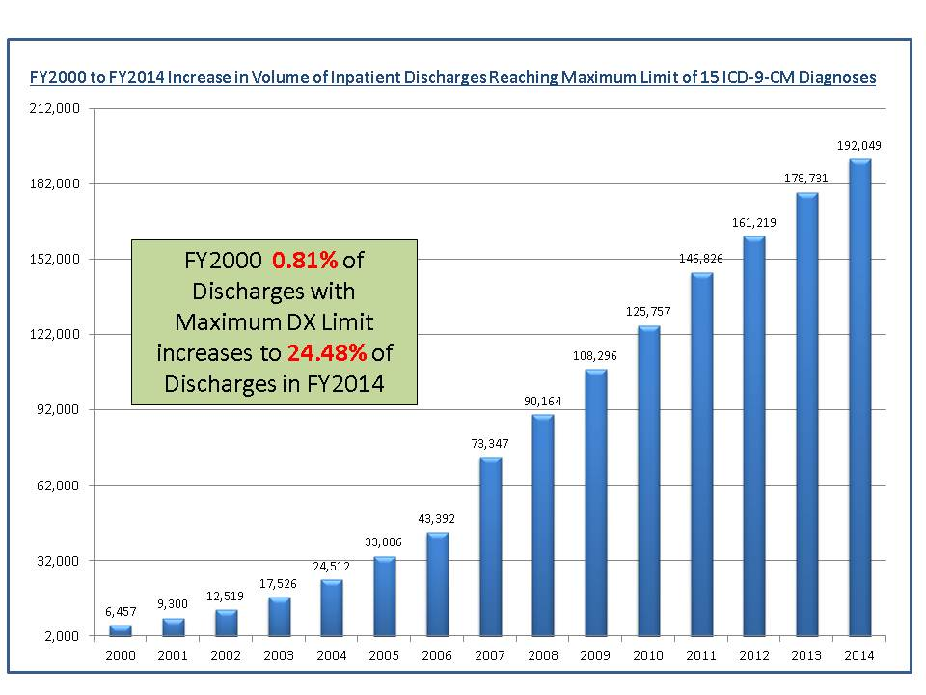
ANSWER: After reviewing a 15-year trend in percent of inpatient discharge records reaching the maximum limit, CHIA saw that in FY2014 (last year’s data release), 24% of records reached the maximum limit.

Slide 14
CHIA also reviewed the Variation in the Number of Diagnoses Codes Collected by States as Evidenced from Hospital Inpatient Discharge Data in AHQR HCUP Data
Some States collect as few as 9 diagnoses and others as many
as 77 diagnoses
Number of Diagnoses Collected by in State Hospital Inpatient Discharge Data

Slide 15
QUESTION: In FY2015, why did CHIA lift the limit on number of diagnosis and procedure codes? (continued)
Comparison of ICD-9-CM to ICD-10-CM Code Volume
ANSWER (continued):
Even though the FY2015 data does not include ICD-10-CM data, next year’s FY2016 release will.
The ICD-10-CM coding rubric includes significantly more codes than ICD-9-CM. ICD-9-CM has approximately 14,000 diagnosis codes and 3,000 procedure codes in comparison to ICD-10-CM’s 68,000 diagnosis codes and 87,000 procedure codes. This increase substantiated the need to lift the limit on diagnosis and procedure codes.

Slide 16
QUESTION: As a result of lifting the limit, did the volume of diagnosis codes in FY2015 data actually increase?
ANSWER: Yes, there was a 24.1% increase in diagnosis codes and a 23.9%
increase in additional E-Codes not recorded in the dedicated E-Code Field.
 | FY2014 | FY2015 | Percent Change
Number of Discharges | 785,485 | 796,835 | 1.4%
Number of Total Diagnosis Codes | 7,105,076 | 9,360,020 | 24.1%
Number of E-Codes in Dedicated and DX Fields | 138,058 | 149,956 | 7.9%
Number of Additional E-Codes in DX Fields | 61,806 | 81,192 | 23.9%

Slide 17
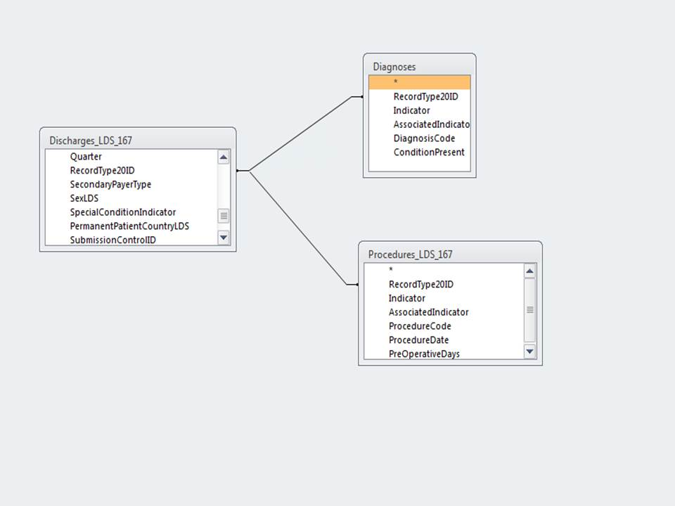
QUESTION: As a result of lifting the limit, has the release data file structure changed?
ANSWER: Yes, many of you are use to linking the main discharge data file by RecordType20ID as a one-to-many relationship to the DRG files and revenue code services files by RecordType20ID. The diagnosis codes file and procedure code file can also be linked to the main discharge data by RecordType20ID. See Example Below…

Slide 18
QUESTION: If I am applying for Inpatient Hospital Discharge Data to study septicemia, do you recommend that I also apply for observation stay data or are the observation stay cases not serious?
Inpatient Hospital Discharge Volume
ANSWER: Yes, the decrease in inpatient discharges has been paralleled by an increase in observation stay utilization and observation stay deaths. Some of those deaths do include septicemia cases.
Observation Stay Volume

Slide 19
Questions?
Questions related to APCD : (apcd.data@state.ma.us)
Questions related to Case Mix: (casemix.data@state.ma.us)
REMINDER: Please include your IRBNet ID#, if you currently have a project using CHIA data

Slide 20
Call for Topics and Presenters
If there is a TOPIC that you would like to see discussed at an MA APCD or Case Mix workgroup, contact Adam Tapply [adam.tapply@state.ma.us]
If you are interested in PRESENTING at an MA APCD or Case Mix workgroup, contact Adam Tapply [adam.tapply@state.ma.us]
  You can present remotely from your own office, or in-person at CHIA.

