Slide 1
MA Center for Health Information & Analysis
Case Mix User Workgroup
August 28, 2018

Slide 2
Agenda
Announcements
  Updates on FY17 Case Mix Data Release
  Updates to Prior Releases (FY2015-2017)
Additional Info on Summarized Data Reports
User Questions:
  Patient Disposition in Outpatient Emergency Department (ED) Data
  Changes in ICU Utilization
Website Updates
Q&A

Slide 3
Case Mix FY17 Release Calendar
  *CURRENT* RELEASE TIMEFRAMES FOR EACH FILE:
  Inpatient (HIDD)
  JUNE [Completed]
  Emergency Department (ED)
    SEPTEMBER
  Outpatient Observation (OOD)
    OCTOBER

Slide 4
Case Mix FY17 Data Release
REPEAT APPLICANTS
For those applicants with previously approved projects who indicated they would like to receive data annually, we began accepting Certificates of Continued Need and Compliance (Exhibit B of your DUA) starting on May 1st.
After receiving this, we will send you an invoice for the FY17 data and release data to you once payment is received and the data is ready
If you are making any changes to your project, you must go through the amendment process first

Slide 5
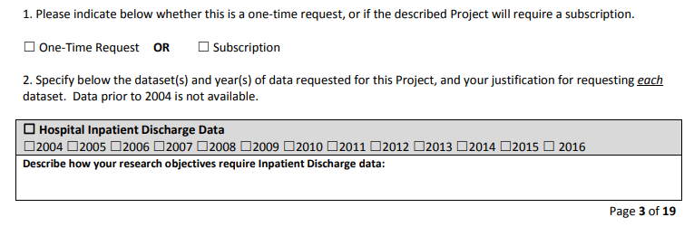
Case Mix FY17 Data Release
NEW APPLICANTS / NEW PROJECTS
We will continue to accept new applications on a rolling basis.
If you are requesting FY17 data, just click the box for “Subscription” on p. 3 of the application form:

Slide 6
Updates to Prior Releases
FY2015 - One hospital has resubmitted data due to approximately 3400 missing birth discharges.
FY2016 – Two hospitals resubmitted data to include approximately 700 missing behavioral health inpatient discharges.
FY2017 – (A) One hospital had a data conversion issue, where Zip Code was reported as ‘00000’ for approximately 5400 discharges. The data was resubmitted; (B) An anomaly was discovered in the Payer Source Code and Payer Type Code data where values were erroneously removed from the released data. This is being corrected.

Slide 7
Updates to Prior Releases
Further details will be provided here as we update each Release.
Changes will be documented in the Case Mix Release documentation (can be found on the Case Mix website)
FY2017 will be updated first and is expected to be ready in September.
We will likely reach out to affected users to see if they would like an updated data extract.

Slide 8
Summarized Data Reports
CHIA has updated our Data Release Regulations to allow for Summarized Data Reports
Will contain only aggregate data (data summaries) and De-identified Data, sourced from MA APCD and Case Mix data
  Examples of Summarized Data Reports include: counts; totals; rates per thousand; index values; and other standardized metrics.
  Will be subject to CHIA’s cell suppression policy (no cell less than 11 will be displayed)
Request form can be found on the MA APCD Application Documents page: http://www.chiamass.gov/application-documents

Slide 9
Summarized Data Reports
In determining whether to compile such a report, CHIA will consider the public interest served, the availability of its resources, the complexity of the request, and privacy concerns (i.e. that there is no more than a minimal risk to individual privacy in the public release of the report)
Submit the request via the new form – please provide as much information as you can, including mock-ups of what you expect the reports to look like
  Data Use Agreement and Data Management Plan not required
The Executive Director (or his/her designee) will approve or deny such requests. Such approval/denial is final and not subject to further review or appeal.
A support/production fee of $140/hour will be charged

Slide 10
What goes into creating a report?
Summarized Data Reports take, on average, 10 hours of CHIA resource time to complete.
Steps include:
Initial review to determine feasibility and spot potential issues
Additional review and revisions with applicant to determine final specifications
Final review and Approval to proceed with the report request
Create documentation, including code, on steps to complete request
Independent code review and QA of results
Create documentation for the recipient
Produce final cut of data / report results

Slide 11
QUESTIONS?

Slide 12

Question: I have a question about patient disposition in the FY2016 Outpatient Emergency Department data. The value for code ‘6’ (eloped) has a frequency of 2% which seems high; it is higher than code ‘4’ (against medical advice). Can you confirm that this is expected or provide any insight?
On Patients who elope
Answer: The volume of patients who elope from the ED has always been been higher than the volume of patients who leave against medical advice (See Table 1 below). In evaluating year-to-year fluctuations in the frequency of patients who elope, 2% is not a wild variance from the 10-year median of 1.9% (See Table 2 below). Over the past 10 years, there have been three instances where the year-to-year percent increase in the frequency of elopes exceeded the percent increase seen from FY2015 to FY2016. The Joint Commission defines elopement as, “When a patient wanders away, walks away, runs away, escapes, or otherwise leaves the hospital unsupervised, unnoticed, and/or prior to their scheduled discharge”. The FY2016 increase is mainly attributable to an increase in patients ages 20 to 30 with “unspecified pain” who elope.
Table 1: Ten-Year Comparison of Massachusetts Outpatient ED Visit Volume by Departure Status
Departure Status (Code) | 2007 | 2008 | 2009 | 2010 | 2011 | 2012 | 2013 | 2014 | 2015 | 2016
Blank/Invalid | 197 | 244 | 250 | 172 | 228 | 163 | 258 | 170 | 97 | 92
Died during ED Visit (0) | 7,746 | 4,398 | 4,467 | 4,311 | 4,283 | 4,970 | 5,057 | 5,995 | 5,490 | 4,626
Routine (1) | 2,295,575 | 2,315,335 | 2,340,666 | 2,329,370 | 2,314,423 | 2,355,704 | 2,331,584 | 2,276,715 | 2,283,450 | 2,316,438
Transferred to another facility (3) | 89,116 | 96,554 | 96,955 | 100,025 | 103,304 | 106,757 | 112,882 | 116,532 | 108,612 | 108,601
Against Medical Advice (4) | 25,155 | 26,067 | 24,514 | 22,670 | 22,635 | 24,122 | 24,865 | 27,018 | 24,553 | 23,918
Eloped (6) | 46,864 | 52,266 | 47,320 | 47,534 | 48,974 | 42,027 | 44,919 | 42,689 | 49,694 | 52,735
Within Hospital Clinic Referral (8) | 2,572 | 2,629 | 3,164 | 3,821 | 3,439 | 1,744 | 1,539 | 1,414 | 1,355 | 1,020
Dead on Arrival (9) | 394 | 498 | 363 | 375 | 392 | 374 | 508 | 458 | 551 | 887
Met with Personal Physician( P) | 1,676 | 2,078 | 2,934 | 1,410 | 1,308 | 2,922 | 258 | 204 | 152 | 97
TOTAL ED VISIT VOLUME | 2,469,295 | 2,500,069 | 2,520,633 | 2,509,688 | 2,498,986 | 2,538,783 | 2,521,870 | 2,471,195 | 2,473,954 | 2,508,414
Table 2: Ten-Year Comparison of Massachusetts Outpatient ED Visit Frequency by Departure Status
Departure Status (Code) | 2007 | 2008 | 2009 | 2010 | 2011 | 2012 | 2013 | 2014 | 2015 | 2016
Blank/Invalid | 0.01% | 0.01% | 0.01% | 0.01% | 0.01% | 0.01% | 0.01% | 0.01% | 0.00% | 0.00%
Died during ED Visit (0) | 0.31% | 0.18% | 0.18% | 0.17% | 0.17% | 0.20% | 0.20% | 0.24% | 0.22% | 0.18%
Routine (1) | 92.96% | 92.61% | 92.86% | 92.82% | 92.61% | 92.79% | 92.45% | 92.13% | 92.30% | 92.35%
Transferred to another facility (3) | 3.61% | 3.86% | 3.85% | 3.99% | 4.13% | 4.21% | 4.48% | 4.72% | 4.39% | 4.33%
Against Medical Advice (4) | 1.02% | 1.04% | 0.97% | 0.90% | 0.91% | 0.95% | 0.99% | 1.09% | 0.99% | 0.95%
Eloped (6) | 1.90% | 2.09% | 1.88% | 1.89% | 1.96% | 1.66% | 1.78% | 1.73% | 2.01% | 2.10%
Within Hospital Clinic Referral (8) | 0.10% | 0.11% | 0.13% | 0.15% | 0.14% | 0.07% | 0.06% | 0.06% | 0.05% | 0.04%
Dead on Arrival (9) | 0.02% | 0.02% | 0.01% | 0.01% | 0.02% | 0.01% | 0.02% | 0.02% | 0.02% | 0.04%
Met with Personal Physician( P) | 0.07% | 0.08% | 0.12% | 0.06% | 0.05% | 0.12% | 0.01% | 0.01% | 0.01% | 0.00%

Slide 13
Question: I am studying changes in ICU utilization and costs and see that, even though inpatient hospitalizations are trending downward, ICU utilization is trending upward. Can you confirm that this is true and provide any insight?
Intensive
Care
Unit
Answer: Yes, while inpatient discharges trended downward, patients requiring ICU services have incrementally been trending upward (see Figures 1 and 2 below). The increases are not across all types of ICU services but the days of services and number of patients requiring those services are higher for intermediate ICU and other intensive care (See Table 3 below).
Fig 1. FY2009 to FY2017 Total Discharges by ICU and Non-ICU Use
Fig 2. FY2009 to FY2017 Percent Discharges by ICU and Non-ICU Use
Table 3. FY2009 to FY2017 ICU Days of Service by ICU Service Type (Note: Asterix (*) for cell suppression for number of days can be used to impute a patient volume less than 11)
Revenue Code | Description | 2009 | 2010 | 2011 | 2012 | 2013 | 2014 | 2015 | 2016 | 2017
0200 | INTENSIVE CARE UNIT-GENERAL CLASSIFICATION | 293,097 | 290,031 | 286,971 | 278,458 | 289,256 | 290,043 | 283,360 | 278,851 | 280,534
0201 | INTENSIVE CARE UNIT-SURGICAL | * | * | * | * | * | * | * | * | *
0202 | INTENSIVE CARE UNIT-MEDICAL | * | * | * | * | 276 | 260 | * | * | *
0203 | INTENSIVE CARE UNIT-PEDIATRIC | 9,204 | 9,404 | 8,688 | 8,325 | 6,851 | 7,113 | 7,371 | 7,888 | 7,403
0204 | INTENSIVE CARE UNIT-PSYCHIATRIC | 3,980 | 4,133 | 3,885 | 4,118 | 4,023 | 3,710 | 3,832 | 4,073 | 3,793
0206 | INTENSIVE CARE UNIT-INTERMEDIATE ICU | 125,042 | 131,933 | 137,678 | 131,866 | 158,668 | 165,852 | 147,078 | 155,050 | 164,421
0207 | INTENSIVE CARE UNIT-BURNCARE | 4,233 | 3,576 | 4,645 | 4,442 | 5,001 | 3,962 | 4,100 | 3,911 | 3,154
0209 | INTENSIVE CARE UNIT-OTHER INTENSIVE CARE | 3,555 | 3,405 | 3,524 | 3,287 | 3,301 | 3,484 | 5,587 | 6,863 | 5,500

Slide 14
Question (continued): I am studying changes in ICU utilization and costs and see that, even though inpatient hospitalizations are trending downward, ICU utilization is trending upward. Can you confirm that this is true and provide any insight?
Intensive
Care
Unit
Answer (continued): Please keep in mind that, unlike the MA APCD, the only currency information contained in Case Mix data is charges not costs. However, in FY2015, the limit was lifted on the number of diagnosis codes that can be submitted in Case Mix, which allows the researcher to have a larger depth of data for comorbidity analysis on patients requiring ICU services. For example, in Table 4 below, you will see that the increase in patients requiring intermediate ICU services was paralleled by an increase in the number of recorded comorbid diagnosis.
Table 4. FY2009 to FY2017 Patient Volume by Type of ICU Services and Number of Diagnosis Codes
Revenue Code | Description | Number of Diagnosis Codes | 2009 | 2010 | 2011 | 2012 | 2013 | 2014 | 2015 | 2016 | 2017
0200 | INTENSIVE CARE UNIT - GENERAL CLASSIFICATION | less than 16 | 76814 | 76308 | 76466 | 75824 | 75670 | 74432 | 28407 | 29380 | 26244
0200 | INTENSIVE CARE UNIT - GENERAL CLASSIFICATION | 16 to 44 |  |  |  |  |  |  | 45357 | 44771 | 48404
0200 | INTENSIVE CARE UNIT - GENERAL CLASSIFICATION | 45 and greater |  |  |  |  |  |  | 594 | 504 | 800
0201 | INTENSIVE CARE UNIT - SURGICAL | less than 16 | * | * | * | * | * | * | * | * | *
0202 | INTENSIVE CARE UNIT - MEDICAL | less than 16 | * | * | * | * | 146 | 138 | * | * | *
0203 | INTENSIVE CARE UNIT - PEDIATRIC | less than 16 | 2634 | 2780 | 2720 | 2518 | 2345 | 2289 | 1922 | 1874 | 1798
0203 | INTENSIVE CARE UNIT - PEDIATRIC | 16 to 44 |  |  |  |  |  |  | 283 | 273 | 375
0204 | INTENSIVE CARE UNIT - PSYCHIATRIC | less than 16 | 491 | 518 | 588 | 635 | 546 | 567 | 125 | 232 | 380
0204 | INTENSIVE CARE UNIT - PSYCHIATRIC | 16 to 44 |  |  |  |  |  |  | 452 | 400 | 240
0204 | INTENSIVE CARE UNIT - PSYCHIATRIC | 45 and greater |  |  |  |  |  |  | * | * | *
0206 | INTENSIVE CARE UNIT - INTERMEDIATE ICU | less than 16 | 30175 | 32085 | 36902 | 35843 | 37408 | 38352 | 18503 | 22059 | 21839
0206 | INTENSIVE CARE UNIT - INTERMEDIATE ICU | 16 to 44 |  |  |  |  |  |  | 21365 | 23260 | 25537
0206 | INTENSIVE CARE UNIT - INTERMEDIATE ICU | 45 and greater |  |  |  |  |  |  | 105 | 96 | 139
0207 | INTENSIVE CARE UNIT - BURN CARE | less than 16 | 676 | 650 | 921 | 870 | 878 | 854 | 381 | 287 | 222
0207 | INTENSIVE CARE UNIT - BURN CARE | 16 to 44 |  |  |  |  |  |  | 419 | 461 | 498
0207 | INTENSIVE CARE UNIT - BURN CARE | 45 and greater |  |  |  |  |  |  | * | * | *
0209 | INTENSIVE CARE UNIT - OTHER INTENSIVE CARE | less than 16 | 196 | 202 | 205 | 202 | 222 | 241 | 133 | 190 | 164
0209 | INTENSIVE CARE UNIT - OTHER INTENSIVE CARE | 16 to 44 |  |  |  |  |  |  | 170 | 181 | 86
0209 | INTENSIVE CARE UNIT - OTHER INTENSIVE CARE | 45 and greater |  |  |  |  |  |  | * | * | *

Slide 15
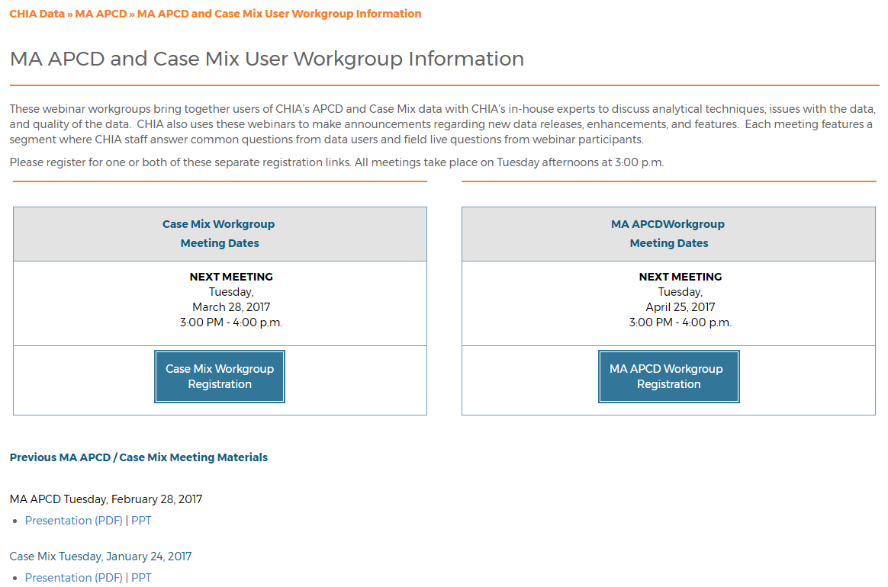
Where can I find old User Workgroup presentations?
http://www.chiamass.gov/ma-apcd-and-case-mix-user-workgroup-information/

Slide 16
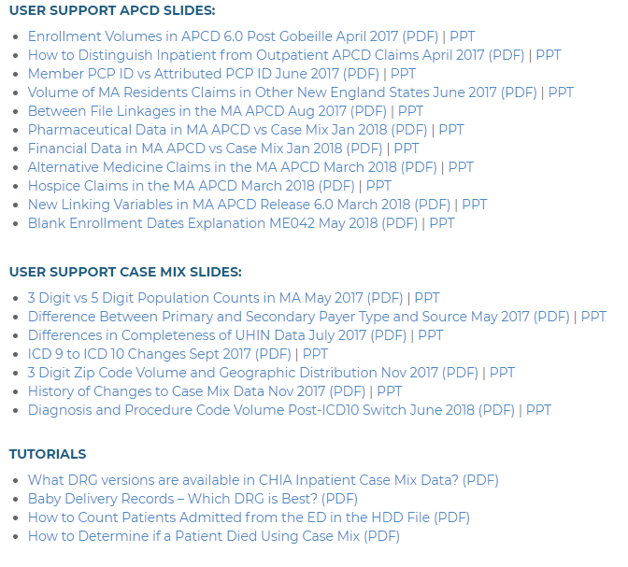
NEW! Updates to the User Workgroup Webpage
User Support slides and tutorials are now available to view and download separately from the presentations.
We will continue to update this page as new presentations happen from month to month.
Link: http://www.chiamass.gov/ma-apcd-and-case-mix-user-workgroup-information/

Slide 17

Updated Case Mix White Paper
Our white paper containing an updated overview of the Case Mix data base was posted last June.
Available on the Case Mix website or via this link: http://www.chiamass.gov/assets/Uploads/casemix/Case-Mix-Whitepaper.pdf

Slide 18
Questions?
Questions related to APCD : (apcd.data@state.ma.us)
Questions related to Case Mix: (casemix.data@state.ma.us)
REMINDER: Please include your IRBNet ID#, if you currently have a project using CHIA data

Slide 19
Call for Topics and Presenters
If there is a TOPIC that you would like to see discussed at an MA APCD or Case Mix workgroup, contact Adam Tapply [adam.tapply@state.ma.us]
If you are interested in PRESENTING at an MA APCD or Case Mix workgroup, contact Adam Tapply [adam.tapply@state.ma.us]
  You can present remotely from your own office, or in-person at CHIA.

