Slide 1
CHIA user workgroup
Don Kirkwood (Manager of Data Release and Procurement)
Sylvia Hobbs (Associate Director of Data Strategy and User Support)
Scott Curley (Manager Privacy & Compliance)
July 25, 2023
CENTER FOR HEALTH INFORMATION AND ANALYSIS

Slide 2
Agenda
Announcements:
APCD Release CY 2021 Updates
FY22 Case Mix Release Projections
Website Updates
User Support Questions
Urgent Care Centers
Data Integration
ED Visit Volume
Newborns
Q&A

Slide 3
MA APCD CY 2021
Available for request
Applicants with approved projects that require updated APCD data (CY 2021 Data) should submit to CHIA a completed Exhibit B (Certificate of Continued Need and Compliance) of the Data Use Agreement. After submitting a completed Exhibit B you will receive an invoice (if applicable) for the requested data. Upon payment of the invoice the order for the data will be placed.
CY 2021 Data includes data on services from January 2019 – December 2021 with six months of claim runout through June 2022.

Slide 4

Case Mix FY22 Release
*CURRENT* RELEASE TIMEFRAMES FOR EACH FILE:
Inpatient (HIDD)
Available for request
Emergency Department (ED)
Available for request
Outpatient Observation (OOD)
Fall
Applicants with approved projects that require newly available year(s) of Case Mix Data (e.g., FY 19) should submit to CHIA a completed Exhibit B (Certificate of Continued Need and Compliance) of the Data Use Agreement. After submitting a completed Exhibit B you will receive an invoice (if applicable) for the requested data. Upon payment of the invoice the order for the data will be placed.

Slide 5
Website Release Updates
Updates on the production of APCD and Case Mix databases and status of data requests are now posted to CHIA’s website!
Aim #1 is to provide weekly or bi-weekly status update on CHIA data products as they are in development.
Aim #2 is to provide applicants with information about expected fulfillment status for individual data requests.
Request IDs will be communicated to Data Requestors via email.
Please visit http://www.chiamass.gov/status-of-data-requests/ to see the current status of releases.

Slide 6
USER questions

Slide 7
Urgent Care Centers
Question: I am applying for the MA APCD medical claims data to study the impact of the surge in urgent care centers on access to non-emergent medical care in Massachusetts. I am concerned about the quality of indicators for identifying urgent care centers. How complete are the site of service codes?
Answer: The field Site of Service on NSF/CMS 1500 Claims (MC037) has a 100% filing threshold. The field must be populated when Type of Claim (MC094) equals ‘001’ for professional claim. The MA APCD CY2021 Release contains 682,078,306 medical claim lines where the Type of Claim is professional. For professional claim lines from Massachusetts service providers, the Site of Service field is 99.99% populated. There is one site of service coding option to urgent care centers:
Site of Service Code Site of Service Name Description
20 Urgent Care Center Location, distinct from a hospital emergency room, an office, or a clinic, whose purpose is to
diagnose and treat illness or injury for unscheduled, ambulatory patients seeking immediate
medical attention.
From January 2018 through December 2021, there has been a significant upward trend in the medical claim lines coded as site of service ’20’ for urgent care centers with the highest surge in claim line volume occurring during the winter months. See Figure 1 below.
Figure 1. January 2018 through December 2021 Urgent Care Center MA APCD Medical Claim Line Volume
continued

Slide 8
Urgent Care Centers
Answer (continued): In addition to the site of service field, the Service Provider Taxonomy
field (MC032) In the medical claims can be used to identify urgent care providers. In this field,
insurance carriers report the standard taxonomy code that defines the provider specialty for
the line of service. This field has a 98% filing threshold.
The Taxonomy code for Urgent Care is 261QU0200X
The taxonomy code ‘261QU0200X’ code can be used by medical groups or individual providers. In MA APCD CY2021 Release medical claims, the number of distinct rendering providers who use the urgent care taxonomy count has more than doubled from calendar 2018 to calendar year 2021. See Table 1 below. It is important to note that many of the top billing providers who use the urgent care taxonomy code are also community health centers and multigroup specialties. See Table 2 below.
Table 1.Rendering Provider Volume with Urgent Care Taxonomy by County
Table 2. Top 15 Billing Providers with Urgent Care Taxonomy
COUNTY | CY2018 | CY2019 | CY2020 | CY2021
BARNSTABLE | 64 | 102 | 106 | 118
BERKSHIRE | * | * | * | 12
BRISTOL | 24 | 99 | 46 | 36
DUKES | * | * | * | *
ESSEX | 62 | 155 | 166 | 146
FRANKLIN | * | * | * | *
HAMPDEN | 52 | 90 | 84 | 93
HAMPSHIRE | 13 | 29 | 28 | 29
MIDDLESEX | 148 | 302 | 275 | 320
NANTUCKET | * | * | * | *
NORFOLK | 119 | 246 | 263 | 295
PLYMOUTH | 34 | 54 | 50 | 60
SUFFOLK | 104 | 207 | 283 | 253
WORCESTER | 49 | 103 | 95 | 131
EAST BOSTON CHC
CONVENIENT MD LLC
EAST BOSTON NEIGHBORHOOD HEALTH CENTER
PATRIOT URGENT CARE
CAREWELL URGENT CARE
AFC URGENT CARE
MGH-CHELSEA HEALTHCARE CENTER
DOCTORS EXPRESS
PARTNERS URGENT CARE LLC
MEDEXPRESS URGENT CARE PC MASSACHUSETTS
SOUTH SHORE HEALTHEXPRESS
CODMAN SQUARE CHC
DORCHESTER HOUSE CHC
CAMBRIDGE HEALTH ALLIANCE
URGENT CARE BOSTON MEDICAL CENTER

Slide 9

Question: I requested the decrypted National Provider Identifier (NPI) in the MA APCD medical claims to link to the CMS National Plan and Provider Enumeration System (NPPES) NPI Registry. I am now also considering applying for the MA APCD’s provider table which I understand can be linked to the medical claims via provider linkage IDs and carrier organization IDs. If I wanted to link the decrypted NPI in the MA APCD provider table to the CMS registry, I first wanted to know whether CHIA had run any integration tests to determine that the same NPIs in the medical claims data can consistently be found in the MA APCD provider table.
Data Integration
Answer: Yes, CHIA routinely conducts data integration tests between all the MA APCD tables. The NPIs in the MA APCD CY2021 medical claims have an over 99% integration with the NPIs in the provider table. See integration test results in Table 1 below. The less than 1% of records by year when the NPIs do not link are mostly attributable instances where an NPI was submitted with a missing digit.
Table 1. Integration Test Results between Medical Claims NPIs and Provider Table NPIs
Volume of Distinct NPIs in Medical Claims CY2021 Release
Calendar Year | 2018 | 2019 | 2020 | 2021
Billing Provider NPIs | 50,117 | 68,594 | 69,166 | 72,038
Service Provider NPIs | 70,820 | 95,084 | 98,733 | 104,743
Rendering Provider NPIs | 71,770 | 96,169 | 99,765 | 106,612
Integration of Medical Claims NPIs with Provider Table NPIs
Billing Provider NPIs | 99.87% | 99.70% | 99.74% | 99.69%
Service Provider NPIs | 99.90% | 99.65% | 99.69% | 99.57%
Rendering Provider NPIs | 99.82% | 99.55% | 99.61% | 99.53%
continued

Slide 10

Question: During the pandemic, the Massachusetts ED visit volume dropped significantly. I understand the latest release of the outpatient ED visit data is now available. Have ED visits continued to trend downward in Massachusetts?
ED Visit Volume
Answer: No, even though the Massachusetts ED visit volume decreased by 18% from FY2019 to FY2020, and continued to trend downward in FY2021, the latest FY2022 release shows ED visits trending upward by 11% from FY2021 to FY2022. See Figure 1 below. The most pronounced FY2022 increase in visit volume was among the pediatric population age 17 years old and younger. See Figure 2 below.
continued

Slide 11
ED Visit Volume
Answer (continued): Historically, the pediatric population has a higher ED visit volume. While the pediatric (age 17 and younger) increased from 279,500 visits in FY2021 to 395,173 visits in FY2022, when the FY2022 ED visit volume is stratified both by age group and sex, the large FY2022 pediatric increase is mainly attributable to males. See Figure 3 below.
Fig 3. FY2016 through FY2022 ED Visit Volume by Age Group and Sex
Pediatric male increase

Slide 12

Newborns
Question: Have newborns continued to trend downward in Massachusetts?
Answer: Also, in the most recent inpatient data, over the past six years there has been a continuous downward trend in newborns in Massachusetts. The most recent FY2022 hospital inpatient discharge data has revealed as surprising reverse in the trend. From FY2021 to FY2022, there was a 1.8% increase in Massachusetts newborns. See Figure 4 below.

Slide 13
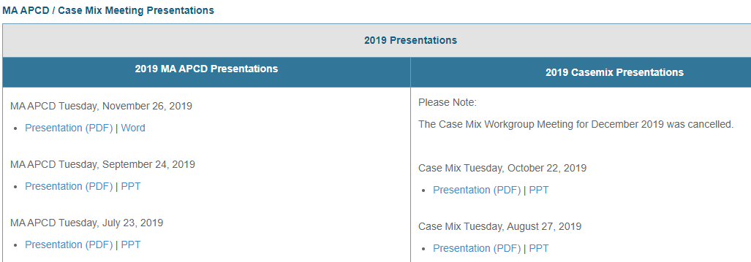
Where can I find past User Workgroup Presentations?
http://www.chiamass.gov/ma-apcd-and-case-mix-user-workgroup-information/

Slide 14
When is the next User Group meeting?
The next User Group will meet Tuesday August 22.
http://www.chiamass.gov/ma-apcd-and-case-mix-user-workgroup-information/

Slide 15
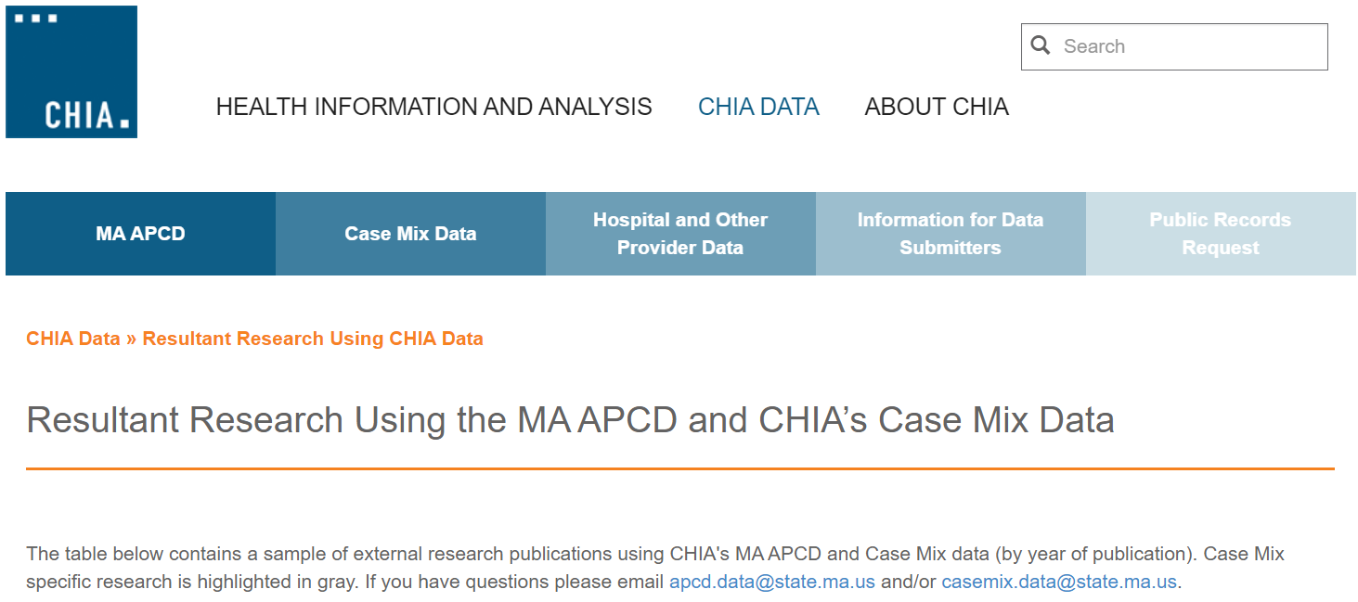
Resultant Research Using CHIA Data
https://www.chiamass.gov/resultant-research-using-chia-data

Slide 16
Questions?
Questions related to MA APCD:
apcd.data@chiamass.gov
Questions related to Case Mix:
casemix.data@chiamass.gov
REMINDER: Please include your IRBNet ID#, if you currently have a project using CHIA data.

