Slide 1
CHIA user workgroup
Don Kirkwood (Manager of Data Release and Procurement)
Sylvia Hobbs (Associate Director of Data Strategy and User Support)
Scott Curley (Manager Privacy & Compliance)
February 22, 2023
CENTER FOR HEALTH INFORMATION AND ANALYSIS

Slide 2
Agenda
Announcements:
  APCD Release CY 2021 Updates
  FY21 Case Mix Release Projections
Website Updates
User Support Questions
  The use of occurrence codes to determine place of injury risk
  The completeness of Unique Identifiers in case mix data before and after the pandemic
Q&A

Slide 3
MA APCD CY 2021
  Available for request
  Applicants with approved projects that require updated APCD data (CY 2021 Data) should submit to CHIA a completed Exhibit B (Certificate of Continued Need and Compliance) of the Data Use Agreement. After submitting a completed Exhibit B you will receive an invoice (if applicable) for the requested data. Upon payment of the invoice the order for the data will be placed.
  CY 2021 Data includes data on services from January 2017 – December 2021 with six months of claim runout.

Slide 4

Case Mix FY21 Release
*CURRENT* RELEASE TIMEFRAMES FOR EACH FILE:
  Inpatient (HIDD)
  Available for request
  Emergency Department (ED)
  Available for request
  Outpatient Observation (OOD)
  Available for request
  Applicants with approved projects that require newly available year(s) of Case Mix Data (e.g., FY 19) should submit to CHIA a completed Exhibit B (Certificate of Continued Need and Compliance) of the Data Use Agreement. After submitting a completed Exhibit B you will receive an invoice (if applicable) for the requested data. Upon payment of the invoice the order for the data will be placed.

Slide 5
Website Release Updates
  Updates on the production of APCD and Case Mix databases and status of data requests are now posted to CHIA’s website!
    Aim #1 is to provide weekly or bi-weekly status update on CHIA data products as they are in development.
    Aim #2 is to provide applicants with information about expected fulfillment status for individual data requests.
    Request IDs will be communicated to Data Requestors via email.
  Please visit http://www.chiamass.gov/status-of-data-requests/ to see the current status of releases.

Slide 6
USER questions

Slide 7
Question: I am conducting prevention research categorizing types of anatomic injuries (ICD-10-CM ‘S-Codes’) most likely to occur in different activity settings. I want to maximize the utility of ICD-10-CM ‘Y92’ and ‘Y93’ occurrence codes intended to measure this . What is the completeness of occurrence code reporting in case mix data whenever the principal diagnosis is an ICD-10-CM ‘S-code’ anatomic injury?
ICD-10-CM Occurrence Codes
Answer: During the six-year period from FY2016 through FY2021, there were a total of 13,797,588 outpatient emergency department (ED) visits at Massachusetts acute care hospitals. Patients with an ICD-10-CM ‘S-code’ principal diagnosis of injury accounted for 20% of ED visits (n=2,732,703) and 80% of those patients had an accompanying occurrence code in the ICD-10-CM range Y92 through Y93 (n=2,182,302). Many of the ‘Y92’ and ‘Y93’ codes used in the patient records lack specificity with regards to the activity associated with the injury. See Table 1 below of Top 25 activity codes used.
Table 1. FY2016 through FY2021 Top 25 Settings for Outpatient ED Injury Visits
Y-Code | Description
Y9289 | Other specified places as the place of occurrence of the external cause
Y9389 | Activity, other specified
Y929 | Unspecified place or not applicable
Y92009 | Unspecified place in unspecified non-institutional (private) residence as the place of occurrence of the external cause
Y92410 | Unspecified street and highway as the place of occurrence of the external cause
Y939 | Activity, unspecified
Y9301 | Activity, walking, marching and hiking
Y9367 | Activity, basketball
Y9302 | Activity, running
Y92219 | Unspecified school as the place of occurrence of the external cause
Y9366 | Activity, soccer
Y92414 | Local residential or business street as the place of occurrence of the external cause
Y92008 | Other place in unspecified non-institutional (private) residence as the place of occurrence of the external cause
Y9355 | Activity, bike riding
Y9269 | Other specified industrial and construction area as the place of occurrence of the external cause
Y9361 | Activity, american tackle football
Y92003 | Bedroom of unspecified non-institutional (private) residence as the place of occurrence of the external cause
Y93G1 | Activity, food preparation and clean up
Y92002 | Bathroom of unspecified non-institutional (private) residence as the place of occurrence of the external cause
Y92480 | Sidewalk as the place of occurrence of the external cause
Y9239 | Other specified sports and athletic area as the place of occurrence of the external cause
Y92000 | Kitchen of unspecified non-institutional (private) residence as the place of occurrence of the external cause
Y92098 | Other place in other non-institutional residence as the place of occurrence of the external cause
Y92007 | Garden or yard of unspecified non-institutional (private) residence as the place of occurrence of the external cause
Y92129 | Unspecified place in nursing home as the place of occurrence of the external cause
continued

Slide 8
Answer (continued): More specificity in occurrence setting injury risk is gained by stratifying the ED data by demographic populations of interest. For example, for infants under 1 year old, the top injury settings were in the kitchen and bedroom (See Table 2 below) . For teenagers ages 13 to 19, school and different sporting activity settings are in the top 10. While the emergency department data has a high volume of injury data with a high rate of completeness for Y-codes, the ‘Y-codes’ are less complete in the inpatient data. The inpatient coding average rate of completeness is 42% versus the ED rate of 80%.
ICD-10-CM Occurrence Codes
Table 2. Top 10 Settings for Outpatient ED Injury Visits for Infants Age ‘0’
Y-code | Description
Y92000 | Kitchen of unspecified non-institutional (private) residence as the place of occurrence of the external cause
Y92003 | Bedroom of unspecified non-institutional (private) residence as the place of occurrence of the external cause
Y92008 | Other place in unspecified non-institutional (private) residence as the place of occurrence of the external cause
Y92009 | Unspecified place in unspecified non-institutional (private) residence as the place of occurrence of the external cause
Y92098 | Other place in other non-institutional residence as the place of occurrence of the external cause
Y9289 | Other specified places as the place of occurrence of the external cause
Y929 | Unspecified place or not applicable
Y9301 | Activity, walking, marching and hiking
Y9389 | Activity, other specified
Y939 | Activity, unspecified
Table 2. Top 10 Settings for Outpatient ED Injury Visits for Teenagers Ages 13 to 19
Y-Code | Description
Y92009 | Unspecified place in unspecified non-institutional (private) residence as the place of occurrence of the external cause
Y92219 | Unspecified school as the place of occurrence of the external cause
Y92410 | Unspecified street and highway as the place of occurrence of the external cause
Y9289 | Other specified places as the place of occurrence of the external cause
Y929 | Unspecified place or not applicable
Y9361 | Activity, american tackle football
Y9366 | Activity, soccer
Y9367 | Activity, basketball
Y9389 | Activity, other specified
Y939 | Activity, unspecified

Slide 9
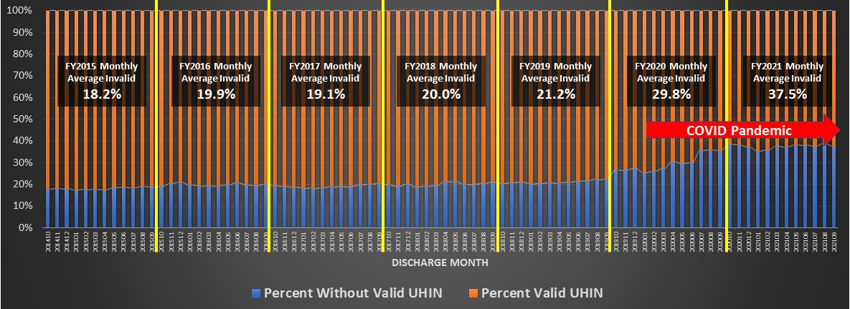
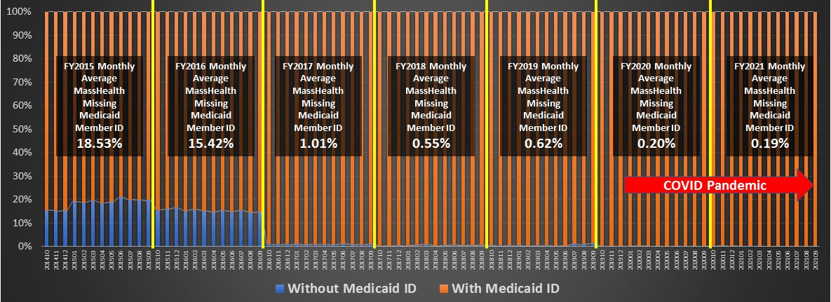

Question: I am conducting readmissions analysis. In prior years, I noticed a deterioration in the completeness of inpatient UHINs. What is the current quality of the UHIN and of the Medicaid IDs in the inpatient case mix data?
Unique Identifiers
Answer: The inpatient UHINs have generally been 80% complete. During the pandemic, there was a deterioration in valid data necessary to create a UHINs (see Table 1 below). However, the completeness of valid Medicaid IDs has improved significantly, over 99% f the inpatient discharge records which list MassHealth as the payer have submitted a Medicaid ID (See Table 2 below).
Table 1. FY2014 through FY2021 Average Percent Invalid UHIN Data by Inpatient Discharge Month
Table 1. FY2014 through FY2021 Average Percent Missing Medicaid ID by Inpatient Discharge Month

Slide 10
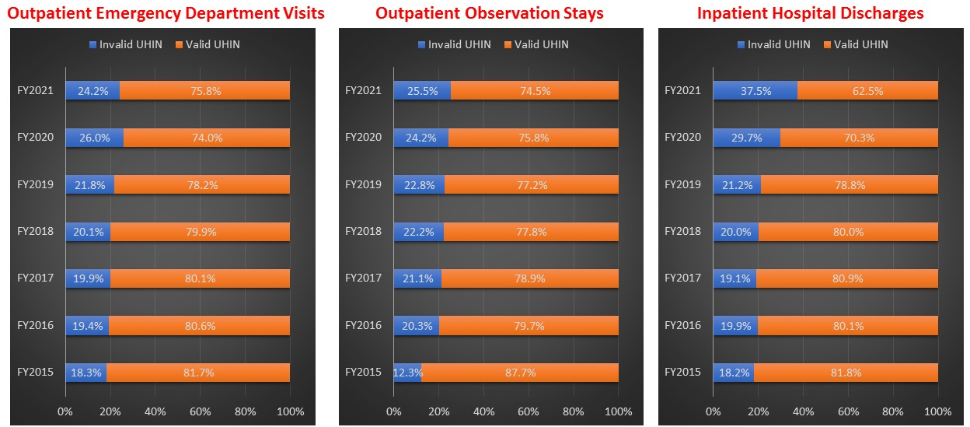
Answer (continued): Even though the outpatient emergency department has a higher volume of patient data, the deterioration of UHINs during in the ED and observation stay data was not as pronounced as the inpatient discharge data . In fact, following the first year of the pandemic, there was an 1.8% improvement in valid UHINs in the ED data (See Table 1 below). Moreover, a hospital submitting poor quality inpatient UHIN data was not a predictor of poor ED UHIN data. For example, in FY2021, one hospital had 28% invalid UHINs for 16,654 inpatient discharges. However, for that same period, the hospital had only 11% invalid UHINs on 40,798 emergency department patients.
Unique Identifiers
Table 1. Comparison of Person Invalid UHINs in Case Mix Data for FY2015 through FY2021

Slide 11
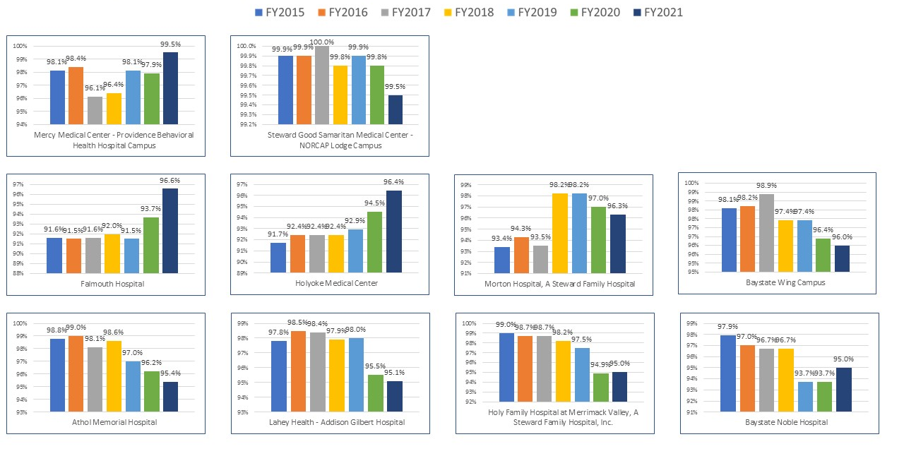
Unique Identifiers
Figure 1. High Quality Inpatient UHINs submitted FY2015 through FY2021
Answer (continued): The lack of availability of data necessary to create a valid UHIN is not pervasive in at all hospitals submitted inpatient data. It is important to note that over the past six years, some hospitals have consistently submitted over 90% valid UHIN data. With some hospitals not only collecting over 90% valid UHINs but improving from collecting 91% UHINs to collecting 96%.

Slide 12
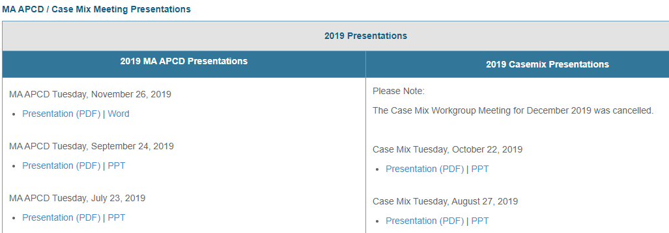
Where can I find past User Workgroup Presentations?
http://www.chiamass.gov/ma-apcd-and-case-mix-user-workgroup-information/

Slide 13
When is the next User Group meeting?
The next User Group will meet Tuesday March, 28.
http://www.chiamass.gov/ma-apcd-and-case-mix-user-workgroup-information/

Slide 14
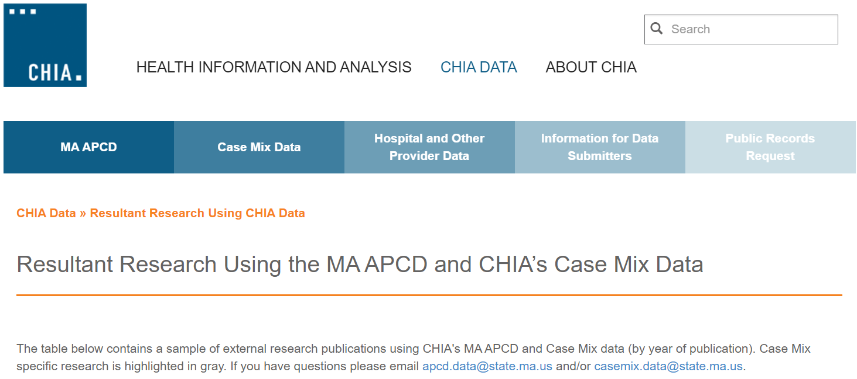
Resultant Research Using CHIA Data
https://www.chiamass.gov/resultant-research-using-chia-data

Slide 15
Questions?
Questions related to MA APCD:
apcd.data@chiamass.gov
Questions related to Case Mix:
casemix.data@chiamass.gov
REMINDER: Please include your IRBNet ID#, if you currently have a project using CHIA data.

