Slide 1
CHIA Data User Workgroup
Donald Kirkwood, Manager of Data Release and Procurement
Anne Medinus, Senior Research Account Specialist
Sylvia Hobbs, Associate Director of Data Strategy and User Support
November 25, 2024

Slide 2
Agenda
Announcements:
  All FY2023 Case Mix Releases Now Available
  Case Mix Documentation and Release Notes
  MA APCD Releases CY2021 and CY2022
  ZIP Code Data in MA APCD Application
Website Updates
  Instructions for Linking One Zip Code per Year
Data User Support Questions
  Zoonotic Diseases and Injuries
  MassHealth Claim Type
  Record Linkage Revisited
  Derived Fields
Q&A

Slide 3
Announcements

Slide 4
All Case Mix FY2023 Releases Now Available
ALL RELEASES AVAILABLE FOR THE FOLLOWING FILE:
  Hospital Inpatient Discharge Data FY2023 (HIDD)
  Outpatient Emergency Department Visit Data FY2023 (EDD)
  Outpatient Observation Stay Data FY2023(OSD)
  Applicants with approved projects using previous years data that require newly available year 2023 case mix data should submit to CHIA a completed Exhibit B (Certificate of Continued Need and Compliance) of the Data Use Agreement. After submitting a completed Exhibit B you will receive an invoice (if applicable) for the requested data. Upon payment of the invoice the order for the data will be placed.

Slide 5
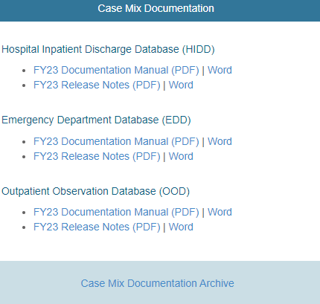

Case Mix Release Documentation
Review Documentation and Release Notes
Data users are advised to review CHIA’s comprehensive case mix documentation manuals and release notes which provide information on data quality issues connected with certain data elements and includes background on the database’s development and the DRG Groupers. The release notes also contains hospital-reported discrepancies received in response to the data verification process. Also, twenty-four years of historical documentation are available online on the documentation archive website
https://www.chiamass.gov/case-mix-data/
https://www.chiamass.gov/case-mix-data-documentation-archive/
The documentation archive contains outpatient emergency department, outpatient observation stay, and hospital inpatient discharges documents dating back to fiscal year 2000.
Link to Archive

Slide 6

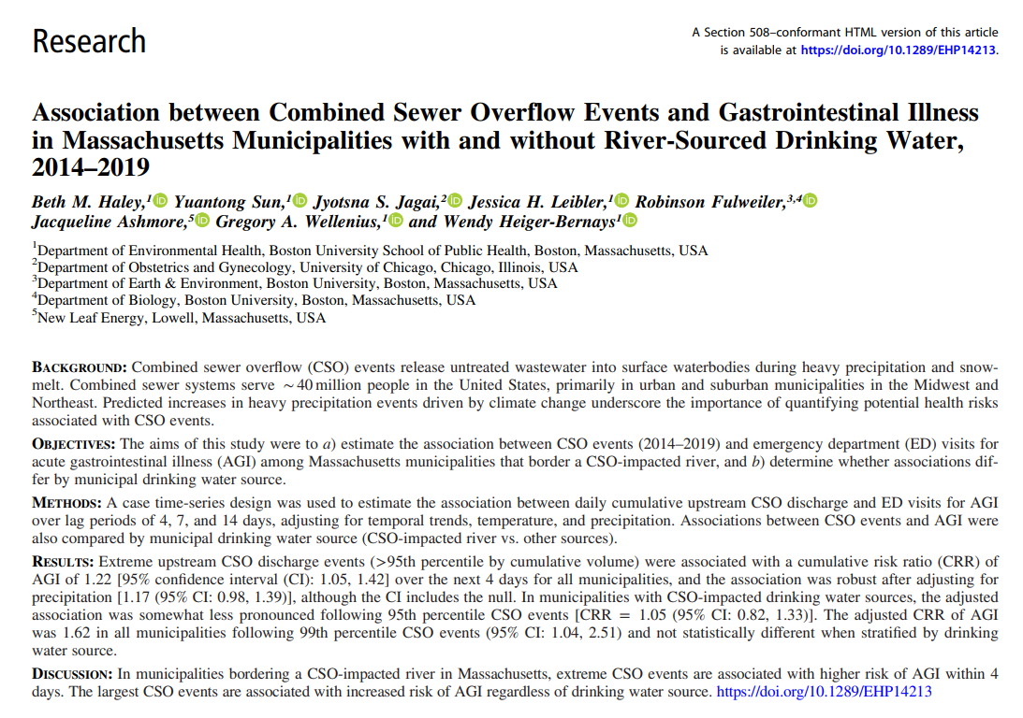
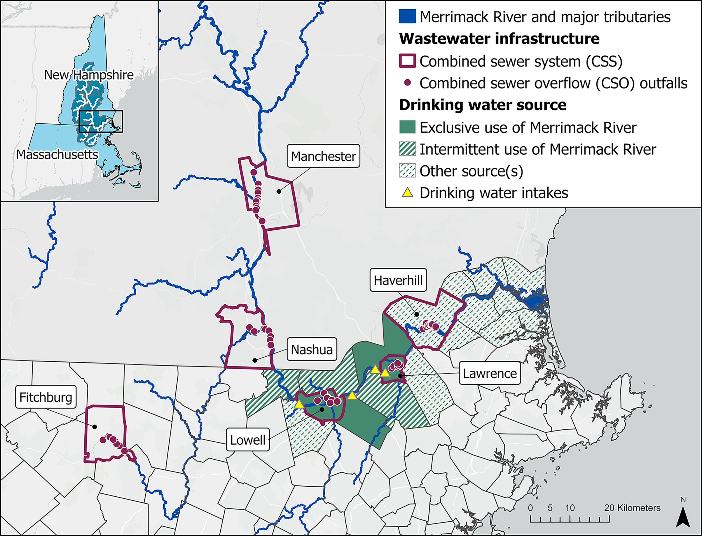
Alert: New Open Access Publication Using Case Mix ED Data
Map of study area in the lower
reaches of the Merrimack River
Source: Haley BM, Sun Y, Jagai JS, Leibler JH, Fulweiler R, Ashmore J, Wellenius GA, Heiger-Bernays W. Association between combined sewer overflow events and gastrointestinal illness in Massachusetts municipalities with and without river-sourced drinking water, 2014–2019. Environmental Health Perspectives. 2024 May 22;132(5):057008.

Slide 7


MA APCD CY2021 and CY2022 Releases
CY2021 and CY2022 Now Available for Request
  CY 2021 Data which includes medical, pharmacy, and dental claims incurred between January 1, 2017, and December 31, 2021, and it includes six (6) months of run-out (paid claims through June 30, 2022) and the new CY 2022 Data which includes claims incurred from January 1, 2018, through December 31, 2022, and includes six (6) months of run-out (paid claims through June 30, 2023) are available for request. Applicants with approved projects that require updated MA APCD data (CY 2021 Data or CY2022) should submit to CHIA a completed Exhibit B (Certificate of Continued Need and Compliance) of the Data Use Agreement. After submitting a completed Exhibit B, you will receive an invoice (if applicable) for the requested data. Upon payment of the invoice the order for the data will be placed. Before accessing the data remember to review documentation on the releases available at: https://www.chiamass.gov/ma-apcd/
New MA APCD CY2023 Release will be Available for Request in January 2025

Slide 8
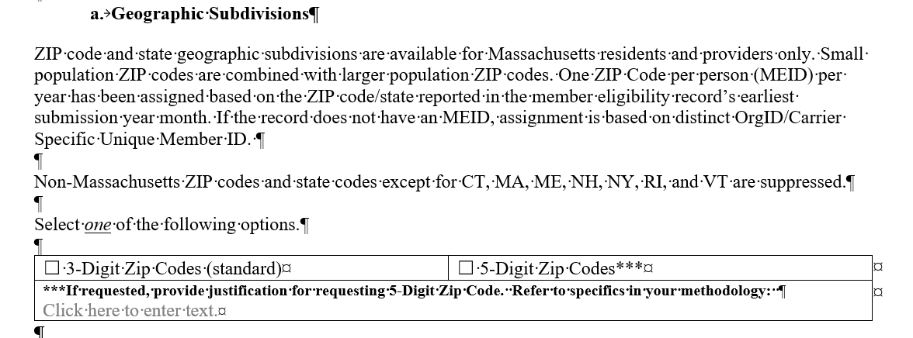
ZIP Code Data in the MA APCD Application
The December 2023 revision to MA APCD application specifies that the member ZIP code geographic data is now only released at the level of one ZIP code per person per year based on the member’s ZIP code reported in the member’s earliest submission year month.
See application excerpt below.

Slide 9
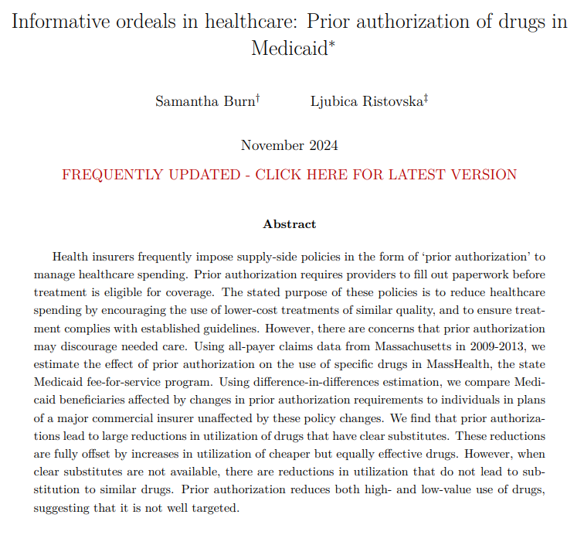
Alert: New Publicly Available White Paper Using MA APCD
Burn S, Ristovska L. Informative ordeals in healthcare: Prior authorization of drugs in Medicaid.
Please note: This is a living white paper using the MA APCD designed to be continuously revised and expanded as new information, data, or insights become available, ensuring that it remains current and relevant over time.
The latest version is available at the following link:
https://ljristovska.com/assets/docs/masshealth_pa_paper.pdf

Slide 10
Website Updates

Slide 11
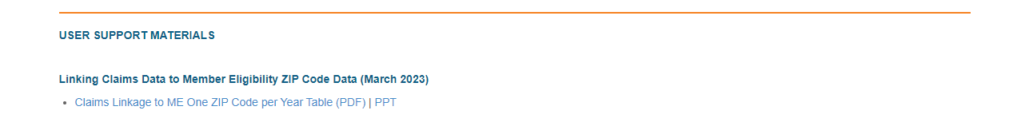
Instructions for Linking One ZIP Table to Claims
Researchers and data users are advised that ZIP code-level information is stored in a distinct table, which is included on the Massachusetts All-Payer Claims Database (MA APCD) hard drive provided upon distribution. Access to the ‘Member Eligibility One ZIP’ table is available as an additional purchase (buy-up) for data applicants specifically requesting member-level ZIP code data. This specialized dataset comprises six key variables: ‘orgid’ (organization identifier), ‘chiacarrierspecificuniqueid’ (carrier-specific unique member identifier), ‘calendaryear’ (year of eligibility), ‘submissionyearmonth’ (the month and year of data submission), ‘zipcode’ (member’s ZIP code), and ‘state’ (member’s state of residence). These variables are available upon request for approved users.
Instructions for linking the data are available on the CHIA website at: https://www.chiamass.gov/chia-data-user-workgroup-information/

Slide 12
Data User Support Questions

Slide 13
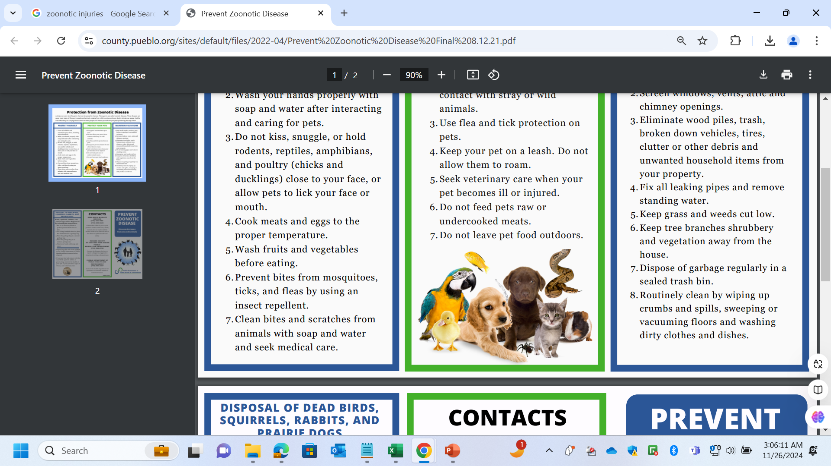
Question: I previously utilized outpatient emergency department case mix data to conduct a geographic analysis, stratified by county, on the prevalence of animal-related bites, injuries, and diseases. I am now exploring the potential application of the Massachusetts All Payer Claims Data (MA APCD) to investigate the spectrum of animal-related conditions managed across healthcare settings beyond the emergency department. Does the MA APCD contain a sufficiently robust volume of claims pertaining to animal-related medical conditions treated in other care settings beyond the emergency to warrant applying for the data to conduct further analysis?
Zoonotic Injuries and Diseases
Answer: While the outpatient emergency department data within the case mix dataset captures an average of approximately 30,000 episodes of care for zoonotic injuries annually, the MA APCD encompasses a broader scope, averaging over 100,000 episodes of care per year across 24 distinct care settings. Among these, the physician’s office consistently ranks as the predominant care setting (See Table 1).
Additionally, the MA APCD documents an average of 15,000 episodes of care annually for zoonotic diseases, with the physician’s office again serving as the primary site of care. Notably, independent laboratories—critical for providing diagnostic services essential to the identification and monitoring of zoonotic diseases—also rank among the top care settings within this dataset (See Table 2).
Table 1. Top 5 Service Sites for Zoonotic Injuries
Physician's Office
Urgent Care Facility
Emergency Room Hospital
Outpatient Hospital
Inpatient Hospital
Table 2. Top 5 Service Sites for Zoonotic Diseases
Physician's Office
Inpatient Hospital
Independent Laboratory
Outpatient Hospital
Home Health Care Provider

Slide 14
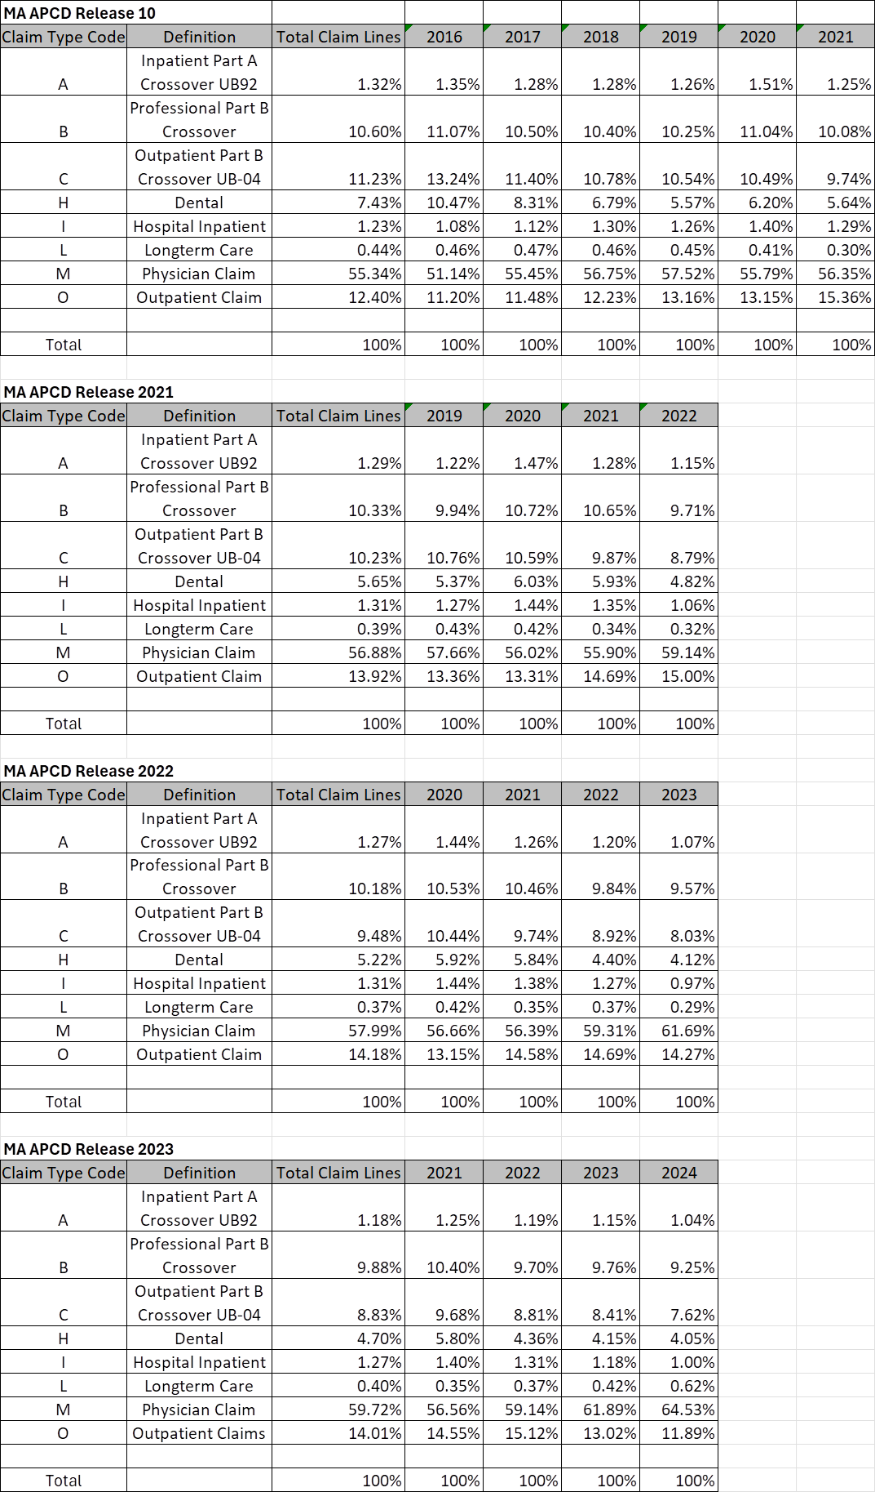
MassHealth Claim Type
Question: The MA APCD medical claims table has a field called MassHealth Claim Type. Do you have any insight into how reliable that field might be?
Answer: The field has been reliably populated without any extraordinary outliers in all releases of the MA APCD. In looking at MA APCD Release 10, Release 2021, 2022, and Release 2023 for the use of MassHealth Claim by OrgID 3156 (MassHealth), the frequency trends by claim type appear consistent from 2016 through 2024.
continued

Slide 15
MassHealth Claim Type
Answer (continued): There are also two noteworthy trends.
Increase in Physician Claims (Code M):
Physician claims consistently dominate the dataset, with a general upward trend in their proportion.
Notable increases include:
Release 2021: from 56.02% (2021) to 59.14% (2022).
Release 2022: from 56.39% (2022) to 61.69% (2023).
Release 2023: from 61.89% (2023) to 64.53% (2024).
2. Decline in Dental Claims (Code H):
A consistent drop in the share of dental claims over time:
From 10.47% (2017, Release 10) to 4.05% (2024, Release 2023).
This reduction might indicate changes in seeking dental care outside the dental care setting where, for example, a patient might appear in the emergency department.

Slide 16

Question: The medical claims, dental claims, and pharmacy claims contain an OrgID field, and three fields called LINKORGIDME, LINKORGIDPV, and LINKORGIDPR. What is the difference between the OrgID field and the latter three fields? Also, I see lots of fields in the MA APCD with the words “Linkage ID” as part of their name and am confused about which fields should used for between file linkage?
Answer: The three fields LINKORGIDME, LINKORGIDPV, and LINKORGIDPR were added to the claims files to facilitate between-file linkage of claims in instances where specific ORGIDs share eligibility data submitted under only one ORGID. This standardization not only ensures that the claims data will be automatically linked to an ORGID’s correct eligibility, provider or product reference file data, but ensures correct linkage for any point in time – no matter how carrier filing relationships have changed over time.
LINKORGIDME – Links to the ORGID field of the relevant Member Eligibility data in the ME file
LINKORGIDPV – Links to the ORGID field of the relevant Provider data in the PV file
LINKORGIDPR – Links to the ORGID field of the relevant Product data in the PR file
continued

Slide 17
Answer (continued): The linkage field names in the medical claims, dental claims, pharmacy claims, and member eligibility tables are intended to link to the linking field names in provider and product tables according to the diagram listed below.
MEDICAL CLAIMS
Medical Claims (MC) → |  | Provider (PV), Product (PR)
MC |  | PV
SERVICEPROVIDERNUMBER_LINKAGE_ID |  | LINKINGPROVIDERID
BILLINGPROVIDERNUMBER_LINKAGE_ID
REFERRINGPROVIDERID_LINKAGE_ID
ATTENDINGPROVIDER_LINKAGE_ID
PLANRENDERINGPROVIDERIDENTIFIER_LINKAGE_ID
MC |  | PR
PRODUCTIDNUMBER_LINKAGE_ID |  | LINKINGPRODUCTID
MEMBER ELIGIBILITY
Member Eligibility (ME) → |  | Provider (PV), Product (PR)
ME |  | PV
HEALTHCAREHOMENUMBER_LINKAGE_ID |  | LINKINGPROVIDERID
MEMBERPCPID_LINKAGE_ID
ATTRIBUTEDPCPPROVIDERID_LINKAGE_ID
ME |  | PR
PRODUCTIDNUMBER_LINKAGE_ID |  | LINKINGPRODUCTID
DENTAL CLAIMS
Dental Claims (DC) → |  | Provider (PV), Product (PR)
DC |  | PV
SERVICEPROVIDERNUMBER_LINKAGE_ID |  | LINKINGPROVIDERID
DC |  | PR
PRODUCTIDNUMBER_LINKAGE_ID |  | LINKINGPRODUCTID
PHARMACY CLAIMS
Pharmacy Claims (PC) → |  | Provider (PV), Product (PR)
PC |  | PV
PRESCRIBINGPROVIDERID_LINKAGE_ID |  | LINKINGPROVIDERID
RECIPIENTPCPID_LINKAGE_ID
PC |  | PR
PRODUCTIDNUMBER_LINKAGE_ID |  | LINKINGPRODUCTID

Slide 18
Derived Fields
The linking OrgIDs are derived fields created by CHIA. Other derived fields are listed below and described in documentation and release notes.
Derived | Submission Month
Derived | Submission Year
Derived | County of Member
Derived | County of Service Provider
Derived | Medical Claim ID
Derived | Submission Control ID
Derived | CHIA Incurred Full Date
Derived | Highest Version Paid Flag
Derived | Highest Version Denied
Derived | Highest Version Indicator
Derived | Substance Abuse Indicator
Derived | Medicaid/HSN Indicator
Derived | Fully Denied Claim
Derived | Member Link EID
Derived | Member Age At Service
Derived | Linking OrgID Member Eligibility
Derived | Linking OrgID Provider
Derived | Linking OrgID Product

Slide 19
When is the next Data User Group meeting?
  The next User Group will meet Tuesday, January 28, 2025.
  http://www.chiamass.gov/ma-apcd-and-case-mix-user-workgroup-information/

Slide 20
Questions?
Questions related to MA APCD email:
apcd.data@chiamass.gov
Questions related to Case Mix email:
casemix.data@chiamass.gov
REMINDER
CHIA still receives a high volume of email from data users who do not include their IRBNet ID. If you are in the process of or have already submitted a data application to CHIA through IRBNet https://www.irbnet.org/release/home.html, due to the volume of email CHIA receives, please remember to always include your IRBNET ID# in the subject line of your email. Doing so facilitates tracking your application and expediting responses to any questions.

