Slide 1
MA Center for Health Information & Analysis MA APCD User Workgroup
November 27, 2018

Slide 2
Agenda
Announcements / Updates:
MA APCD Release 7.0
FY17 Case Mix
User Support Slide Topics:
Comparison of Procedure Volume in MA APCD vs Case Mix
MA APCD Provider Linkages
National Drug Code (NDC) Conversion
Q&A

Slide 3
MA APCD Release 7.0
Expected to be available December 2018
Sign up for the APCD Eblast list for the official announcement
Encompasses data from January 2013 – December 2017 with six months of claim runout (includes paid claims through 6/30/18)
Release Documentation and Data Specifications will be available on our website soon
Will be posted here: http://www.chiamass.gov/ma-apcd/
Apply now by listing 2017 (and any other years you want from Release 7.0) in the “Years Requested” section of the current application form
Available here: http://www.chiamass.gov/application-documents

Slide 4
New in MA APCD Release 7.0
Updated Master Patient Index, including a MEMBERLINKEID crosswalk to enable users to apply Release 7.0 IDs to prior Release 6.0 (available upon request)
Contains ICD-10-CM procedure and diagnosis codes. ICD indicator flag indicates whether codes are reported in ICD-9 or ICD-10 format.
NOTE: the ICD indicator flag is as reported by carriers and is not 100% accurate.
Accountable Care Partnership Plans will be denoted starting in 2018 as follows:
Insurance Type Code/Product (ME003, MC003, PC003, DC003) use the new value of 30 to denote ACO.

Slide 5
Release 7.0 Carrier Highlights
Several carriers resubmitted data, improving data linkage between their file types.
Three new submitters started providing data to the MA APCD
As a result of the Supreme Court Gobeille ruling, we have carriers that have removed self-insured data from their MA APCD data submissions and you will see a drop in members and claims in 2016 onward. Several carriers actively poll their employer groups for inclusion in MA APCD.
Several small carriers that have stopped submitting due to the Supreme Court Gobeille decision or have otherwise left the MA market. You will continue to see their data for earlier years but CHIA does want to alert you that data will be sporadic for the year they exited the MA APCD (see Last Submission column).

Slide 6
Case Mix FY17 Release Calendar
*CURRENT* RELEASE TIMEFRAMES FOR EACH FILE:
Inpatient (HIDD)
JUNE [COMPLETED]
Emergency Department (ED)
NOVEMBER [COMPLETED]
Outpatient Observation (OOD)
DECEMBER

Slide 7
QUESTIONS?

Slide 8

Question: In order to decide which data repository to request, I need to better understand what is the difference in the volume of specific types of procedures in the MA-APCD and Case Mix data?
Answer: The volume of procedures alone should not dictate your data selection. Care setting of interest, payer and geography might also play a role. If you were only interested in inpatient acute care performed on Massachusetts (MA) residents who, for example, received aortic valve replacement procedures (ICD-10-CM 02RF*, X2RF*) at MA Hospitals in FY2016, as you can see in Figure 1 below, Case Mix has more procedures than the MA APCD. While Case Mix data is limited to MA hospitals, even if you compared the Case Mix volume of patients regardless of state residency with MA APCD aortic valve replacement procedures performed in any state and regardless of patient residency, as you can see in Figure 2, the Case Mix volume is still higher than the MA APCD. Over 80% of the MA APCD claims are for outpatient care. Therefore, if your research focused on procedures performed, for example, during routine primary care or in long term care settings, those and many other care settings are only available in the MA APCD.
Comparison of MA APCD and Case Mix Discharge Volume for Inpatient Aortic Valve Replacement
Figure 1: Volume for MA Residents at MA Hospitals Figure 2: Volume for All Patients regardless of Residency at any Hospital
2,553
3,001*
2,106
2,350
* Note: Case mix volume is limited to MA hospitals where residents from states also receive care.

Slide 9
Question: In order to decide which data repository to request, I need to better understand what is the difference in the volume of specific types of procedures in the MA-APCD and Case Mix data?
Answer (continued): In Figure 1 below, you can see that while the skew of the age distribution for inpatient aortic valve replacement patients in the MA APCD clearly matches that of Case Mix, the higher volume of Case Mix discharges is most pronounced in the population over 65 years old. Therefore, if your procedure of research interest is most likely to be performed on an over 65 year old Medicare population in an inpatient acute care setting, Case Mix data would potentially contain a higher volume of procedures. However, the good news is that the matching skew of the Case Mix and MA APCD age distributions suggests that the MA APCD can also provide a meaningful study sample.

Slide 10

Question: The National Service Provider ID in the MC file is not 100% populated. We need it for linking to specific provider attributes in the AMA’s Physician Masterfile. We had assumed that when the National Service Provider ID is null that linking the MC files’ Service Provider Number Linking ID to the Provider file would allow us to obtain the National Service Provider ID, but are finding that in the Provider file it is also not 100% populated.
NPI
Answer: The National Service Provider ID and Service Provider Number Linking ID are different. National Provider IDs (NPIs) are issued by CMS, while non-CMS carriers submit them with Service Provider Numbers to the MA APCD, the Service Provider Number originates from the carriers. The National Service Provider ID in the Release 6 MC file is 86% populated (See Fig.1). Linking the MC file Service Provider Number to the Provider file to obtain an NPI does not ensure finding additional NPIs (See Fig.2) . However, in the MC file, the National Billing Provider ID is 93% populated (see Fig. 1). There are instances on paid claims where the billing provider and the service provider are the same. On some such claims, the service provider is null but the billing and plan rendering NPIs are populated. In such cases, you have the option of using those NPIs.

Slide 11

Question: I downloaded the FDA’s National Drug Code (NDC) list from FDA.GOV. Those codes are different from the NDCs in the MA APCD Pharmacy Claims (PC) file. The FDA NDCs have 10 digits with two hyphens between the digits and the MA APCD PC NDCs have 11 digits without a hyphen. How can I convert the 10-digit NDCs into a format linkable with 11-digit PC file NDCs?
Answer: The FDA NDC packaging format is 10 digits segmented by hyphens into any of the three following 10-digit configurations:
4-4-2 configuration
5-3-2 configuration
5-4-1 configuration
For pharmacy claims standard billing format, the three variations in 10-digit configurations are normalized into one 11-digit 5-4-2 standard configuration format by strategically placing a lead zero as padding in the segment which requires alignment with the pharmacy claims 5-4-2 billing format (See Table 1 below). After the zero has been added to the segment requiring padding, then the hyphens can be stripped and the file linked with the PC file NDCs.
Table 1. Conversion of 10-Digit NDC to 11 Digit NDC through Strategic Zero Padding
FDA 10-Digit NDC Packaging Format | Example: 10-Digit Format | Pharmacy Claims 11-Digit Format | Example with Zero Padding Conversion: 11-Digit Format
4-4-2 | 9999-9999-99 | 5-4-2 | 09999-9999-99
5-3-2 | 99999-999-99 | 5-4-2 | 99999-0999-99
5-4-1 | 99999-9999-9 | 5-4-2 | 99999-9999-09
* For more background information on the National Drug Codes, see FDA website at: https://www.fda.gov/drugs/developmentapprovalprocess/ucm070829

Slide 12
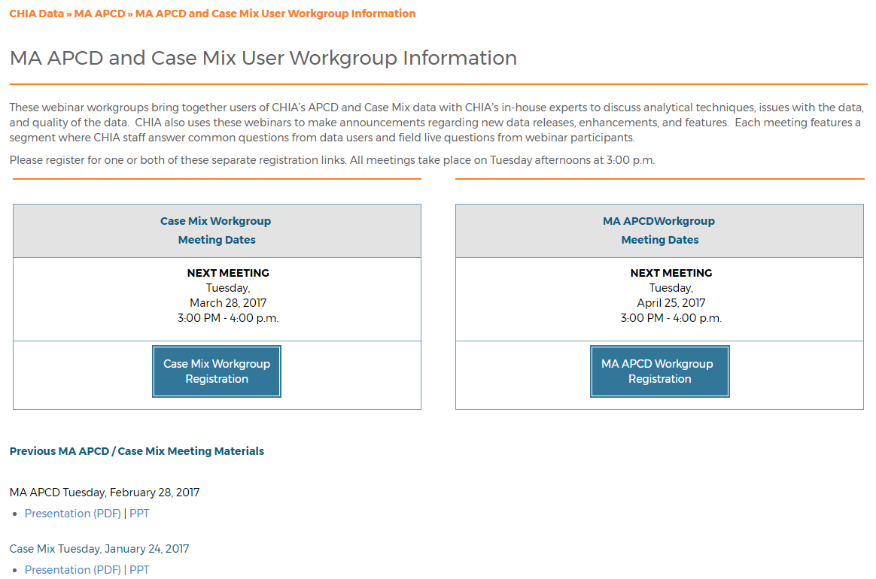
Where can I find old User Workgroup presentations?
http://www.chiamass.gov/ma-apcd-and-case-mix-user-workgroup-information/

Slide 13
Questions?
Questions related to MA APCD: (apcd.data@state.ma.us)
Questions related to Case Mix: (casemix.data@state.ma.us)
REMINDER: Please include your IRBNet ID#, if you currently have a project using CHIA data

Slide 14
Call for Topics and Presenters
If there is a TOPIC that you would like to see discussed at an MA APCD or Case Mix workgroup in 2018, contact Adam Tapply [adam.tapply@state.ma.us]
If you are interested in PRESENTING at an MA APCD or Case Mix workgroup in 2018, contact Adam Tapply [adam.tapply@state.ma.us]
You can present remotely from your own office, or in-person at CHIA.

