Slide 1
MA Center for Health Information & Analysis
MA APCD User Workgroup
May 22, 2018

Slide 2
Agenda
Updates on MA APCD Release 6.0
Announcement regarding APCD Data Release to Market Participants
Summarized Data Reports
User Support Slide Topics:
  % of MA Population with Public Insurance or No Insurance
  SIC Code / NAIC Code Data Quality
  Type of Facility Claim Frequencies
  Blank Product Enrollment End Dates
Q&A

Slide 3
MA APCD Release 6.0
Encompasses data from January 2012 – December 2016 with six months of claim runout
Release Documentation and Data Specifications are now available online
Available here: http://www.chiamass.gov/ma-apcd/
Apply now by listing 2016 (and any other years you want from Release 6.0) in the “Years Requested” section of the current application form
Available here: http://www.chiamass.gov/application-documents

Slide 4
MA APCD Release 6.0 Highlights
4 carriers added to the Pharmacy versioning:
  (P1) 301 - Health New England
  (P2) 12226 - Minuteman Health
  (P3) 10632 - Anthem
  (P4) 302 - Health Plans Inc.
3 new data submitters:
  Catamaran
  Harvard Pilgrim Medicare Advantage
  United Healthcare – Medicare & Retirement - SCO

Slide 5
MA APCD Release 6.0 Highlights
New and improved Member Enterprise ID (MEID)
Allows de-identified linkage of members across plans/products/years – has been retooled and improved
Master Data Management (MDM) approach updated to work with hashed patient information
Added Nickname processing for first names (Joe, Joseph)
Added NYSIIS phonetic processing for last names (Smith, Smyth)
Removed the Pharmacy Benefit Manager data from the MDM process to decrease the duplication of member data by upwards of 40%

Slide 6
Future Years of Data
Applicants can now request FUTURE YEARS OF DATA for both MA APCD and Case Mix.
Initial project requires Data Privacy Committee and Data Release Committee review
Additional years or release versions of data will be released upon availability and the Recipient’s completion of a Certificate of Continued Need (Exhibit B of the DUA)
No additional review required for these additional years of data unless your request changes
Normal data fees still apply

Slide 7
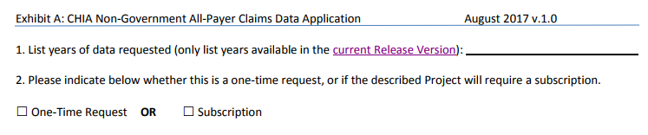
Future Years of Data
In the Data Requested section of the main application form, list the years you would like to request and we will fulfill all years available with the current Release
To request future years of data (no longer limited to the upcoming 5 years), just click the box for “Subscription”

Slide 8
Announcement regarding APCD Data Release to Market Participants
Notice re: APCD Data Release to Market Participants (5/18/18):
CHIA accepts applications from providers, payers, researchers and other government entities for use of the APCD in public policy research. Although infrequent, CHIA has received several applications from market participants requesting the payment data of their competitors.
CHIA is currently developing a transparency agenda that, as envisioned, would make publicly available without application unprecedented levels of procedure pricing data. While developing this transparency agenda in consultation with providers, payers, researchers, and other government agencies, CHIA has acknowledged an open question around how much pricing information can be released without deleterious effects on the Massachusetts health care market.
CHIA will, therefore, temporarily suspend approval of applications for APCD data from market participants requesting the payment data of their competitors while this question is being considered. CHIA will notify the applicant community once a final determination has been made.

Slide 9
Announcement regarding APCD Data Release to Market Participants
Key Points:
Only applications from “market participants” requesting “payment data of their competitors” are affected. Market participants can still request APCD data for other purposes.
Affected applications that are currently pending (and any other affected applications that may be submitted in the meantime) are not being DENIED, they are simply ON-HOLD.
Once CHIA has determined how to proceed, we will contact affected applicants directly, as well as announcing the determination here and on the CHIA website.

Slide 10
Summarized Data Reports
CHIA has updated our Data Release Regulations to allow for Summarized Data Reports
Will contain only aggregate data (data summaries) and De-identified Data, sourced from MA APCD and Case Mix data
  Examples of Summarized Data Reports include: counts; totals; rates per thousand; index values; and other standardized metrics.
  Will be subject to CHIA’s cell suppression policy (no cell less than 11 will be displayed)
Request form can be found on the MA APCD Application Documents page: http://www.chiamass.gov/application-documents
  Data Management Plan and Data Use Agreement are not required.

Slide 11
Summarized Data Reports
In determining whether to compile such a report, CHIA will consider the public interest served, the availability of its resources, the complexity of the request, and privacy concerns (i.e. that there is no more than a minimal risk to individual privacy in the public release of the report)
The Executive Director (or his/her designee) will approve or deny such requests. Such approval/denial is final and not subject to further review or appeal.
A support/production fee of $140/hour will be charged
  **We will let you know the expected number of hours required, as well as when we expect to complete the work, prior to proceeding**

Slide 12
Case Mix FY17 Release Calendar
  *CURRENT* RELEASE TIMEFRAMES FOR EACH FILE:
  Inpatient (HIDD)
  JUNE
  Emergency Department (ED)
    AUGUST
  Outpatient Observation (OOD)
    SEPTEMBER

Slide 13
QUESTIONS?

Slide 14

Question: My MA APCD study is focused on commercial private payer beneficiaries. However, I need an estimate of the excluded Massachusetts population with public insurance and without insurance. Where can I find that information?
Answer: The U.S. Census Bureau collects health insurance data as part of three national surveys: the American Community Survey, Current Population Survey's Annual Social and Economic Supplement, and the Survey of Income and Program Participation. That health Insurance data is available at: https://www.census.gov/topics/health/health-insurance.html. The Census Bureau also has interactive tools at: https://www.census.gov/topics/health/health-insurance/data/data-tools.html for stratifying the data by State geography at broad demographic and insured/uninsured categories (See Figure 1 below) and further stratifying State demographic data by specific coverage status level (See Figure 2 below).
Employment-based
Own Employment-based
Direct-purchase
Government
Medicare
Medicaid
Military
Fig 1. Census Health Insurance Status Categories
Fig 2. Census Health Insurance Specific Coverage Categories
Insured
Sex
Age
Uninsured
Sex
Age

Slide 15
Question: I'm interested in studying health care utilization across industries in Massachusetts. The APCD documentation has an SIC code corresponding to members' type of work. The data quality of this field is indicated as "C", which I interpret as being less reliable than, say "A". Is there a way of telling how much less reliable this variable is?
SIC CODE
Answer: The Member Eligibility file contains the data field ME077 (Member’s NAIC Code) where carriers are instructed to report “the standard code that describes the industry of the subscriber / member. This can be from either the NAICS 6-digit list or the SIC 4-digit list.” For beneficiaries who are over 21 years old, in APCD Release 6.0, this field is populated on average 31% of the time. For those fields that are populated 98% of the codes are SIC Codes. This field is only released to government researchers.
Fig. 2 Percent SIC Codes vs. NAIC codes

Slide 16

Question: I am interested in finding out what is included in facility claims (i.e., MC094 (Type of Claim)= 002) in the Medical Claims file. Specifically, do facility claims include claims from physicians organizations (such as Brigham and Women’s Physicians Organization, MGHs Organization, etc.) in addition to claims from hospitals, nursing facilities, etc.?
Answer: In Figure 1 below, you will see that close to 70% of medical claims where MC094 (Type of Claim) = 002 are general acute care hospitals. The close to 21% of “Other Type of Facilities” include pain centers, surgery centers, rehab centers, reference laboratories, dialysis centers, cataract/laser eye centers, and hospitals.

Slide 17

Question: Why are so many of the Product Enrollment End Dates blank?
Answer: In the Member Eligibility file, for ME042 (Product Enrollment End Date), the filing specifications instruct carriers that “if the member was not disenrolled at the end of the current month, then do not fill with any value”.

Slide 18
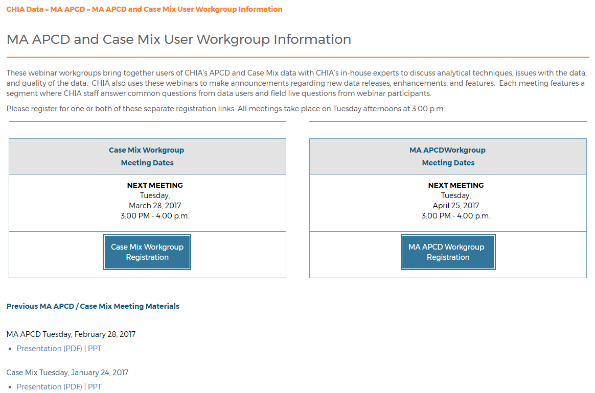
Where can I find old User Workgroup presentations?
http://www.chiamass.gov/ma-apcd-and-case-mix-user-workgroup-information/

Slide 19
Questions?
Questions related to MA APCD: (apcd.data@state.ma.us)
Questions related to Case Mix: (casemix.data@state.ma.us)
REMINDER: Please include your IRBNet ID#, if you currently have a project using CHIA data

Slide 20
Call for Topics and Presenters
If there is a TOPIC that you would like to see discussed at an MA APCD or Case Mix workgroup in 2018, contact Adam Tapply [adam.tapply@state.ma.us]
If you are interested in PRESENTING at an MA APCD or Case Mix workgroup in 2018, contact Adam Tapply [adam.tapply@state.ma.us]
  You can present remotely from your own office, or in-person at CHIA.

