Slide 1
MA Center for Health Information & Analysis
MA APCD User Workgroup
March 27, 2018

Slide 2
Agenda
Updates on MA APCD Release 6.0
Summarized Data Reports
Publications Using CHIA Data – CHIA Website Update
User Support Slide Topics:
  New data linkage elements in Release 6.0
  Alternative medicine claims
  Pharmacy claims drug codes
  Hospice claims
Q&A

Slide 3
MA APCD Release 6.0
Encompasses data from January 2012 – December 2016 with six months of claim runout
Data specifications are now available online
Available here: http://www.chiamass.gov/ma-apcd/
Release documentation should be posted very soon
Apply now by listing 2016 (and any other years you want from Release 6.0) in the “Years Requested” section of the current application form
Available here: http://www.chiamass.gov/application-documents

Slide 4
MA APCD Release 6.0 Highlights
4 carriers added to the Pharmacy versioning:
  (P1) 301 - Health New England
  (P2) 12226 - Minuteman Health
  (P3) 10632 - Anthem
  (P4) 302 - Health Plans Inc.
3 new data submitters:
  Catamaran
  Harvard Pilgrim Medicare Advantage
  United Healthcare – Medicare & Retirement - SCO

Slide 5
MA APCD Release 6.0 Highlights
New and improved Member Enterprise ID (MEID)
Allows de-identified linkage of members across plans/products/years – has been retooled and improved
Master Data Management (MDM) approach updated to work with hashed patient information
Added Nickname processing for first names (Joe, Joseph)
Added NYSIIS phonetic processing for last names (Smith, Smyth)
Removed the Pharmacy Benefit Manager data from the MDM process to decrease the duplication of member data by upwards of 40%

Slide 6
Future Years of Data
Applicants can now request FUTURE YEARS OF DATA for both MA APCD and Case Mix.
Initial project requires Data Privacy Committee and Data Release Committee review
Additional years or release versions of data will be released upon availability and the Recipient’s completion of a Certificate of Continued Need (Exhibit B of the DUA)
No additional review required for these additional years of data unless your request changes
Normal data fees still apply

Slide 7
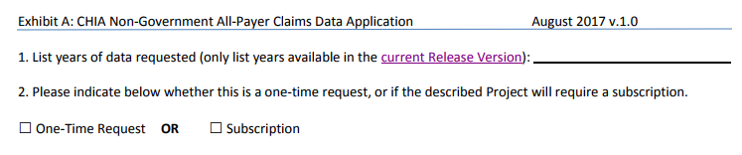
Future Years of Data
In the Data Requested section of the main application form, list the years you would like to request and we will fulfill all years available with the current Release
To request future years of data (no longer limited to the upcoming 5 years), just click the box for “Subscription”

Slide 8
Summarized Data Reports
CHIA has updated our Data Release Regulations to allow for Summarized Data Reports
Will contain only aggregate data (data summaries) and De-identified Data, sourced from MA APCD and Case Mix data
  Examples of Summarized Data Reports include: counts; totals; rates per thousand; index values; and other standardized metrics.
  Will be subject to CHIA’s cell suppression policy (no cell less than 11 will be displayed)
Request form can be found on the MA APCD Application Documents page: http://www.chiamass.gov/application-documents
  Data Management Plan and Data Use Agreement are not required.

Slide 9
Summarized Data Reports
In determining whether to compile such a report, CHIA will consider the public interest served, the availability of its resources, the complexity of the request, and privacy concerns (i.e. that there is no more than a minimal risk to individual privacy in the public release of the report)
The Executive Director (or his/her designee) will approve or deny such requests. Such approval/denial is final and not subject to further review or appeal.
A support/production fee of $140/hour will be charged
  **We will let you know the expected number of hours required, as well as when we expect to complete the work, prior to proceeding**

Slide 10
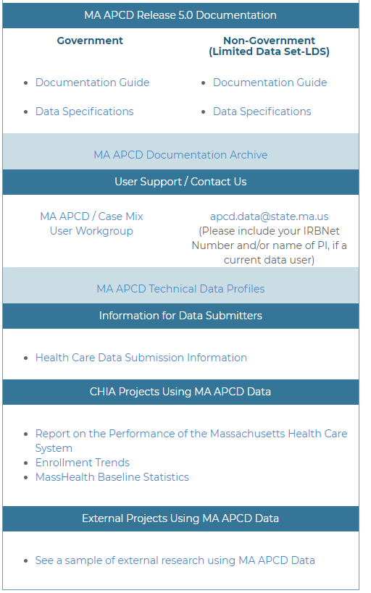
Publications Using CHIA Data
MA APCD and Case Mix websites now have galleries highlighting research completed by previous applicants for CHIA data using MA APCD and Case Mix
If you would like to be included in the list, please send the publication citation and/or hyperlink to the publication to Adam.Tapply@state.ma.us
These lists will be updated continually and will contain links to requestor’s original application form on the public comment page

Slide 11
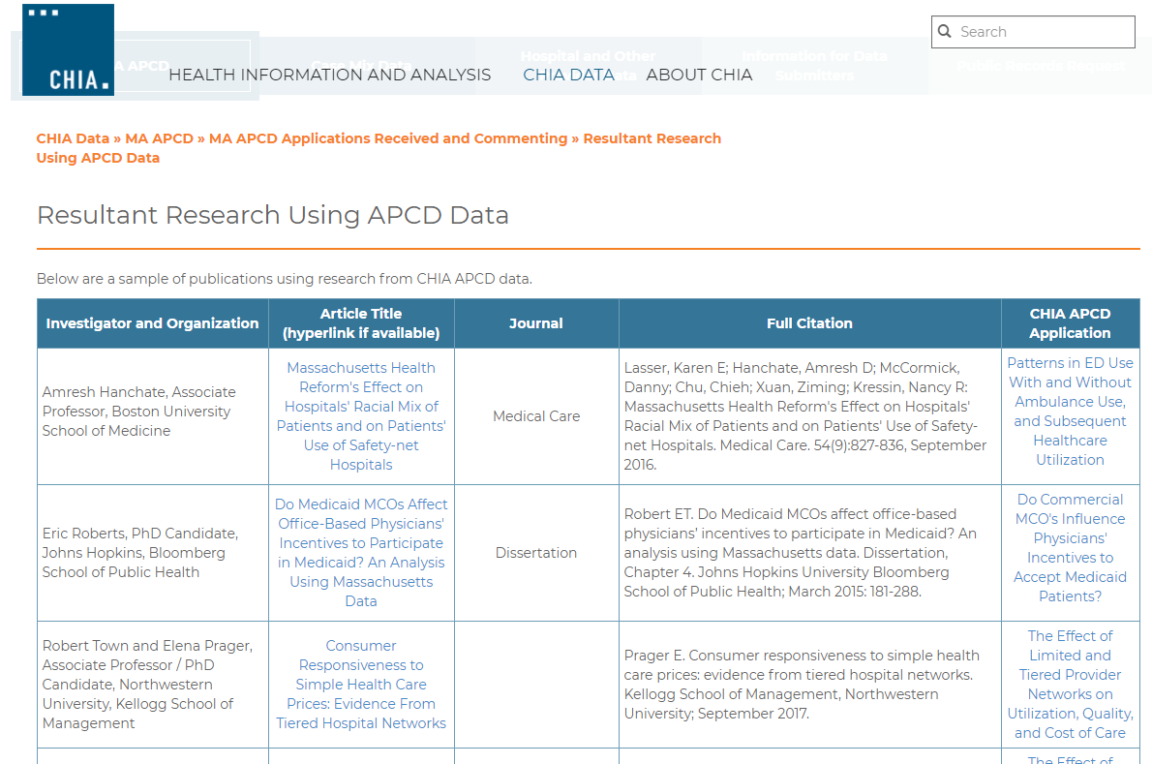
Publications Using CHIA Data
Link to the MA APCD gallery: http://www.chiamass.gov/resultant-research-using-apcd-data/

Slide 12
Case Mix FY17 Release Calendar
  *CURRENT* RELEASE TIMEFRAMES FOR EACH FILE:
  Inpatient (HIDD)
  JUNE
  Emergency Department (ED)
    AUGUST
  Outpatient Observation (OOD)
    SEPTEMBER

Slide 13
QUESTIONS?

Slide 14

Question: What is the purpose and use of the three new linking variables (LINKORGIDME, LINKORGIDPV, LINKORGIDPR) that appear in MA APCD Release 6.0 and to what fields do they link?
Answer: These three new standard link-reference variables were added to the claims files to facilitate between-file linkage of claims to the correct carrier data without, for example, having to worry about untangling the intricacies of ORGIDs that share eligibility data submitted under only one ORGID. This standardization not only ensures that the claims data will be automatically linked to an ORGID’s correct eligibility, provider or product reference file data, but ensures correct linkage for any point in time – no matter how carrier filing relationships have changed over time.
LINKORGIDME – Links to the ORGID field of the relevant Member Eligibility data in the ME file
LINKORGIDPV – Links to the ORGID field of the relevant Provider data in the PV file
LINKORGIDPR – Links to the ORGID field of the relevant Product data in the PR file
Example
Both ORGID 3156 and ORGID 10187 each submit medical claims under their ORGIDS in their MC file. However, they share eligibility data submitted under one ORGID (3156) in the ME file. The LINKORGIDME in the MC file ensures linkage to shared eligibility data.
Medical Claims File
ORGID 3156
Medical Claims File
LINKORGIDME 3156
Member Eligibility File
ORGID 3156
Medical Claims File
LINKORGIDME 3156
Medical Claims File
ORGID 10187
Note: Also remember to use the MC file MemberLinkEID linked to the ME file MemberLinkEID

Slide 15
Question: Does the MA APCD contain medical claims for alternative medical procedures like acupuncture?
Answer: Yes, there are alternative medical procedures in the MA APCD. Since calendar year 2012, the number of acupuncture medical claim lines have more than doubled. The acupuncture procedure codes include '97780', '97781', '97810', '97811', '97813', '97814‘. The top three acupuncture procedure codes in the medical claims are ‘97810’, ‘97811’, and ‘97814’ described as follows:
The MA APCD Release 6.0 includes paid claims from over 4,000 acupuncture providers in both hospital and community based settings. It is important to note that a portion of the community based alternative care providers in various Wellness Clinics and Holistic Health Centers are reimbursed by carriers even though they do not have a National Billing Provider ID or National Service Provider ID in the medical claims data.
Procedure Code | Description
97810 | Acupuncture, 1 or more needles; without electrical stimulation, initial 15 minutes of personal one-on-one contact with the patient
97811 | Acupuncture, 1 or more needles; without electrical stimulation, each additional 15 minutes of personal one-on-one contact with the patient, with re-insertion of needle(s) (List separately in addition to code for primary procedure)
97814 | Acupuncture, 1 or more needles; with electrical stimulation, each additional 15 minutes of personal one-on-one contact with the patient, with re-insertion of needle(s) (List separately in addition to code for primary procedure)

Slide 16

Question: I am using the Pharmacy Claims. Why do some of the drug codes in the MA APCD Pharmacy Claims have 11 digits, some 10 digits, some 9 digits, some 8 digits?
Answer: The MA APCD Pharmacy Claims specifications require carriers to report the National Drug Code (NDC) as defined by the Food and Drug Administration in an 11 digit format (5-4-2) without hyphenation.
Components in 11 digit NDC Code
First 5 digit labeler code identifies the manufacturer
Second 4 digit product code identifies the drug’s active ingredient and dosage
Third 2 digit package code identifies the packaging size and type
In MA APCD Release 6.0, there are 67,100 distinct NDC codes, only 9 of these distinct codes are not in 11 digit format. The APCD has 805,676,569 pharmacy claim lines. These 9 codes with less than 11 digits appear on only 0.0034% of the pharmacy claim lines. If you are seeing even a half percent of pharmacy claims with less than 11 digits in the NDC code, make sure you are importing the code as a text field so that you do not lose any lead zeroes.
The data user also asked does adding a 1 lead zero padding to a 10 digit code fix? The answer is ‘no’ since for a 5-4-2 NDC code the lead zero could be the lead on any segment of the code:
0XXXX-XXXX-XX
XXXXX-0XXX-XX
XXXXX-XXXX-0X

Slide 17
Question: Are there Hospice Claims in the MA APCD and how do I find them?
HOSPICE
Answer: Hospice claims can be found by using the field MC036 - Type of Bill on Facility Claims Codes:
          ’81’ = Hospice (non-hospital based)
          ‘82’ = Hospice (hospital based)
In MA APCD Release 6.0, the highest volume of hospice claim lines are for non-hospital based hospice care, see figures 1 and 2 below.
Please note that there are specific revenue codes, HCPCS codes, CPT codes, occurrence codes, and patient status codes used to describe hospice care. For example, see patient status codes in Table 1.
Table 1. Patient Status Codes Relevant to Hospice Care
40 Expired at home (hospice claims only)
41 Expired in a medical facility such as hospital, SNF, ICF,
or freestanding hospice. (Hospice claims only)
42 Expired - place unknown (Hospice claims only)
43 Discharged/transferred to a federal hospital
50 Hospice - home
51 Hospice - medical facility

Slide 18
Questions?
Questions related to MA APCD: (apcd.data@state.ma.us)
Questions related to Case Mix: (casemix.data@state.ma.us)
REMINDER: Please include your IRBNet ID#, if you currently have a project using CHIA data

Slide 19
Call for Topics and Presenters
If there is a TOPIC that you would like to see discussed at an MA APCD or Case Mix workgroup in 2018, contact Adam Tapply [adam.tapply@state.ma.us]
If you are interested in PRESENTING at an MA APCD or Case Mix workgroup in 2018, contact Adam Tapply [adam.tapply@state.ma.us]
  You can present remotely from your own office, or in-person at CHIA.

