Slide 1
CHIA Data User Workgroup
Donald Kirkwood, Manager of Data Release and Procurement
Anne Medinus, Senior Research Account Specialist
Sylvia Hobbs, Associate Director of Data Strategy and User Support
July 23, 2024

Slide 2
Agenda
Announcements:
  FY2023 Case Mix Release Update
  Case Mix Documentation and Release Notes
  MA APCD Releases CY2021 and CY2022
  Update to the MA APCD Application
Website Updates
  Check the Status of Releases
  Data Applications Received and Commenting
Data User Support Questions
  Diagnosis Code Counts in CHIA data
  Estimated Time for Non-government Organization Application
  Buy-up of National Provider Identifier (NPI)
  Longitudinal Population Counts in MA APCD
  Quality of ED Flag Field
  Variation in the Use of "Unknown" Race Category
  Updates to ICD-10-CM
Q&A

Slide 3
Announcements

Slide 4

Case Mix FY2023 Release
*NEW* RELEASE AVAILABLE FOR THE FOLLOWING FILE:
  Hospital Inpatient Discharge Data (HIDD)
  Outpatient Emergency Department Visit Data (EDD)
  FY2023 Now Available for Request
  Applicants with approved projects using previous years data (e.g., FY 2022, FY2021) that require newly available year(s) of case mix data (e.g., FY 2023) should submit to CHIA a completed Exhibit B (Certificate of Continued Need and Compliance) of the Data Use Agreement. After submitting a completed Exhibit B you will receive an invoice (if applicable) for the requested data. Upon payment of the invoice the order for the data will be placed.

Slide 5
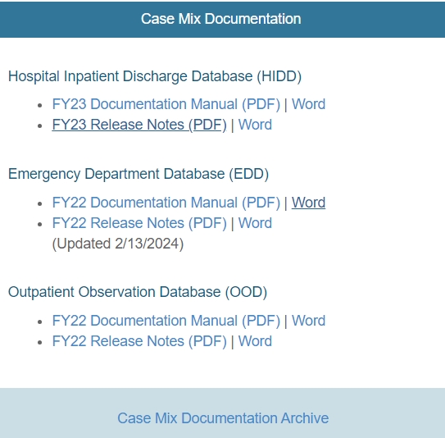

Case Mix Release Documentation
Review Documentation and Release Notes
Data users are advised to review CHIA’s comprehensive case mix documentation manuals and release notes which provide information on data quality issues connected with certain data elements and includes background on the database’s development and the DRG Groupers. The release notes also contains hospital-reported discrepancies received in response to the data verification process. Also, twenty-four years of historical documentation are available online on the documentation archive website
https://www.chiamass.gov/case-mix-data/
https://www.chiamass.gov/case-mix-data-documentation-archive/
The documentation archive contains outpatient emergency department, outpatient observation stay, and hospital inpatient discharges documents dating back to fiscal year 2000.
Link to Archive

Slide 6

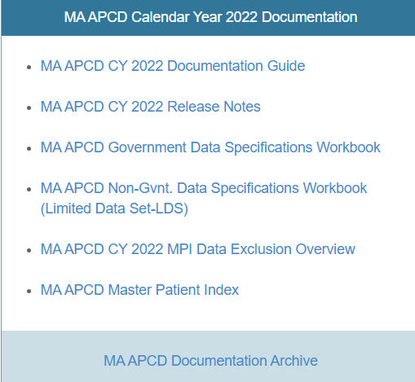
MA APCD CY2021 and CY2022 Releases
CY2021 and CY2022 Available for Request
  CY 2021 Data which includes medical, pharmacy, and dental claims incurred between January 1, 2017, and December 31, 2021, and it includes six (6) months of run-out (paid claims through June 30, 2022) and the new CY 2022 Data which includes claims incurred from January 1, 2018, through December 31, 2022, and includes six (6) months of run-out (paid claims through June 30, 2023) are available for request. In addition to claims data, the releases contain relevant reference files including member eligibility, providers, products, and benefit plans. This data encompasses public and private payers as well as fully-insured and self-insured plans. Keep in mind that due to the Supreme Court decision, Gobeille v. Liberty Mutual, the self-insured plans are severely reduced starting in 2016. The releases also includes MassHealth Medicaid data.
  https://www.chiamass.gov/ma-apcd/
  Applicants with approved projects that require updated MA APCD data (CY 2021 Data or CY2022) should submit to CHIA a completed Exhibit B (Certificate of Continued Need and Compliance) of the Data Use Agreement. After submitting a completed Exhibit B, you will receive an invoice (if applicable) for the requested data. Upon payment of the invoice the order for the data will be placed.
  The new CY 2022 MA APCD Documentation Guide and Release Notes are available on CHIA’s website for your review before using the data. The CY2021 MA APCD Documentation are available online in the documentation archive.

Slide 7
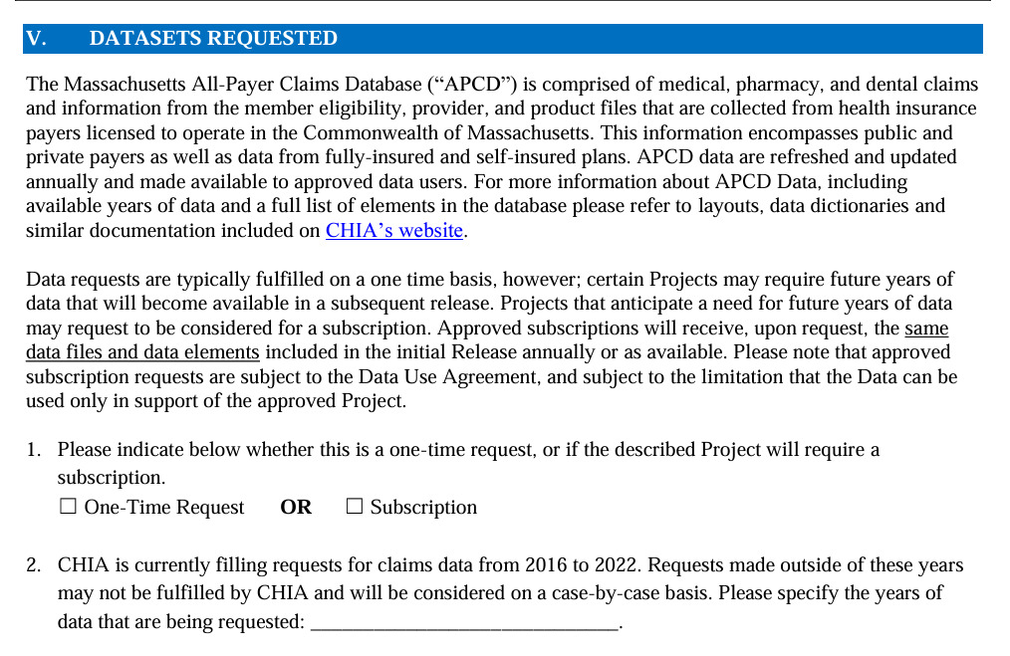
Updates to the MA APCD Application
When applying for CHIA data, always check the website to download and use the most recent version of the data request application. For example, the MA APCD application was last revised in December 2023 to update the full year date ranges available for purchase.
See application excerpt below.

Slide 8
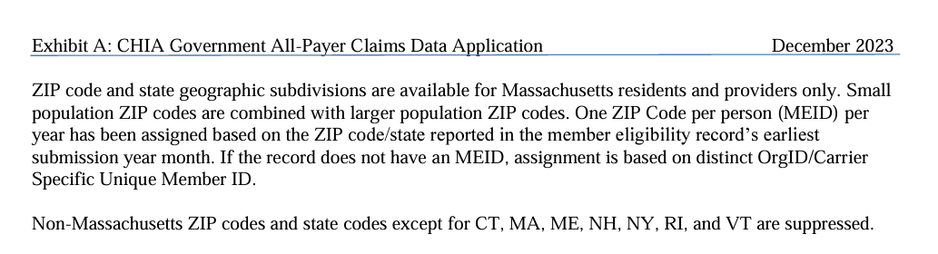
Updates to the MA APCD Application (continued)
In addition, the December 2023 revision to MA APCD application specifies that the member ZIP code geographic data is now only released at the level of one ZIP code per person per year based on the member’s ZIP code reported in the member’s earliest submission year month.
See application excerpt below.

Slide 9
Website Updates

Slide 10
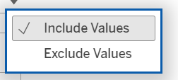
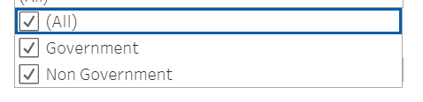
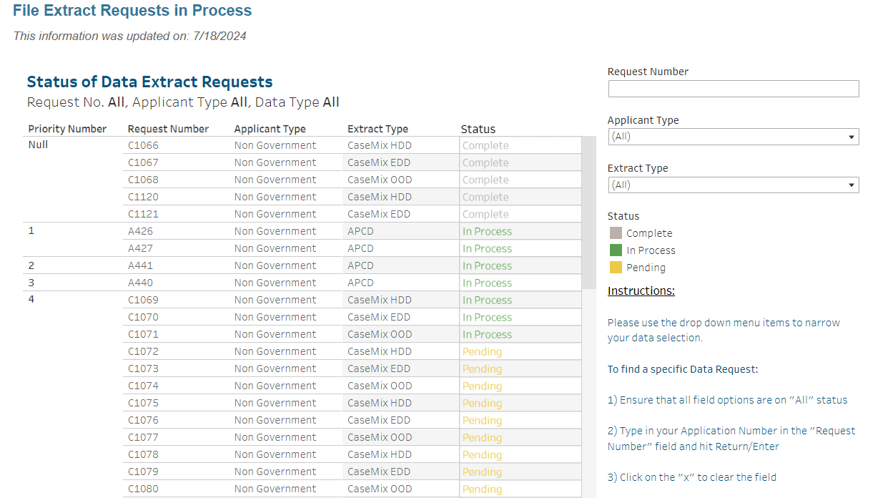
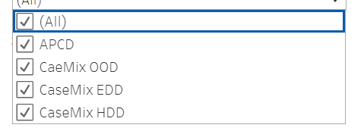
Check the Status of Release Website (Updated 7/18/2024)
  You can visit the CHIA website http://www.chiamass.gov/status-of-data-requests/ to check the status of data extracts and releases. The status website has drop down menus, as shown below, which allow you to narrow your search by request number, applicant type, and extract type.

Slide 11
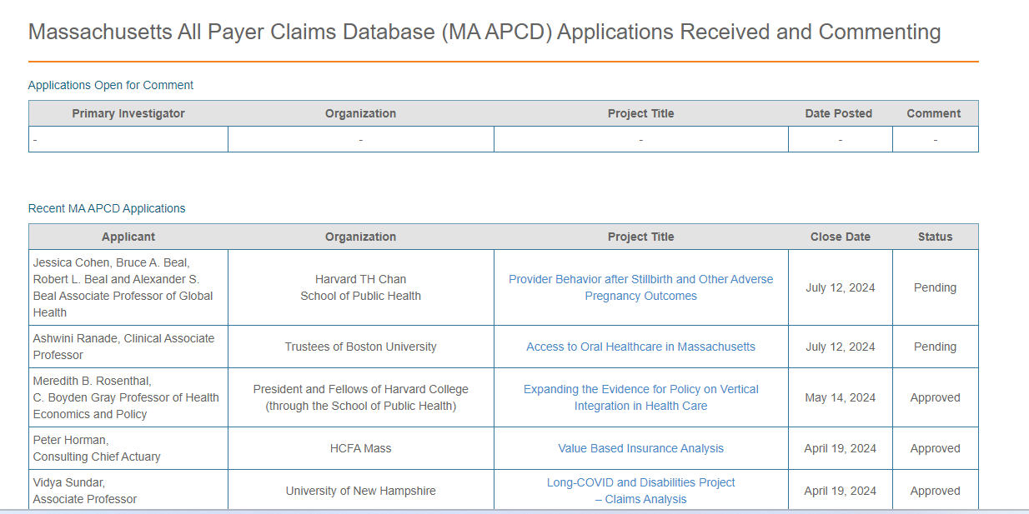
Data Applications Received and Commenting
  You can visit the CHIA website https://www.chiamass.gov/apcd-application-received-and-commenting/
  to check non-government applications received, awaiting public comments, and approved.

Slide 12
Data User Support Questions

Slide 13
Question: Does CHIA’s case mix data or any other dataset contain counts of different diagnosis codes, either ICD-9-CM, ICD-10-CM/PCS or some other category?
Answer: Yes, the main discharge table of Hospital Inpatient Discharge Data (HIDD) has the variable “NumberofDiagnosisCodes”, which gives the total number of diagnosis codes per unique discharge (RecordType20ID); likewise, HIDD contains a variable for “NumberofProcedureCodes.” These are are calculated fields created by CHIA only in HIDD.
The calculation for the NumberofDiagnosisCodes is the PrimaryDiagnosisCode plus a frequency count of the RecordType20IDs in the Diagnosis Code Table. Therefore, if a discharge has eight records in the Diagnosis Code Table, the NumberofDiagnosisCodes for that discharge in the main discharge table would be nine.
The NumberofDiagnosisCodes and NumberofProcedureCodes are core data elements released to both government and non-government data applicants. More information about the core diagnosis code data elements is available at the following website link: https://www.chiamass.gov/assets/docs/r/hdd/FY23-Case-Mix-Hospital-Inpatient-Discharge-Documentation.pdf

Slide 14
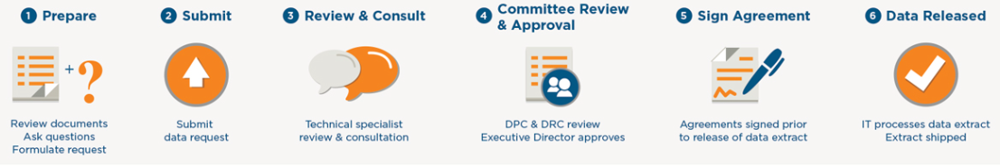
Question: It is my understanding that it takes 6-9 months to get the data for a non-governmental organization. Is this true?
Answer: That is an overall estimated timeframe. The timeframe can be longer or shorter and vary significantly based on several factors. The timeframe is highly dependent on the completeness of the individual’s application, the complexity of the request, the current magnitude of data workload in queue for extraction, and other priorities, including incoming government applications that take priority over non-government applications.
As explained on CHIA’s website, the application process involves:
Tips to improve the efficiency of your application process include ensuring:
  Completeness the necessary application forms. This includes a detailed description of the research project, the intended use of the data, and data security measures. Well-prepared and clearly defined applications can move through the process more quickly.
  Payment of application fees, submission of the application through IRBNet along with any required supporting documents (completed and signed application, CVs, and institutional IRB approval).
  Applicants should familiarize themselves with CHIA’s Regulation 957 CMR 5.00, forms and other background information in the following link: https://www.chiamass.gov/non-government-agency-case-mix-requests

Slide 15
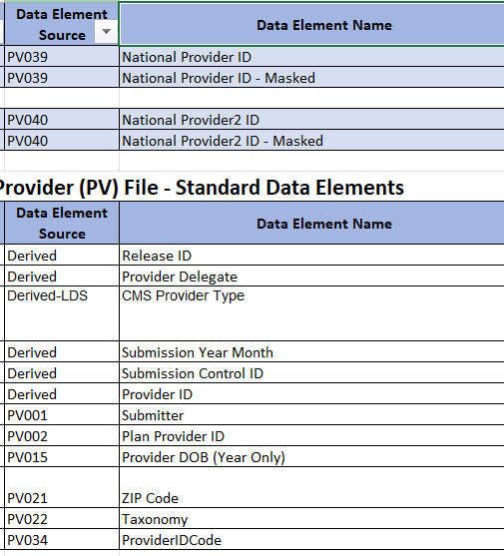
Question: My study involves assessment of provider level behavior. Will the encrypted National Provider ID (NPI) allow the examination of provider level variables such as the type of practice?
Available LDS Provider Table Data Elements
Answer: The encrypted NPI can be associated with provider attributes in the MA APCD LDS Provider Table. This includes Provider Taxonomy, CMS Provider Type (Individual Physician or Non-Individual Entity), Provider ID Code (Person, Facility, Professional Group, Retail Site, E-Site, Financial Parent, Transportation, or Other), Provider ZIP Code, and Provider Birth Year. See table on right of LDS provider table data elements.
The decrypted NPI is a buy-up available to both government and non-government data applicants. All applicants requesting the decrypted NPI are asked on the MA APCD application to a provide justification for requesting decrypted NPIs and to provide the specifics of their research methodology involving use of the NPI. Researchers have used the decrypted NPI to link to the American Medical Association’s Physician’s Masterfile which contains over 100 data elements for each physician, including demographic information, medical education and training, certification and licensure data, professional activities, and other relevant details about the physician's career and practice. The decrypted NPI has also been used to link to the CMS NPI Data Registry which contains over 20 data elements including the provider's name, practice address, taxonomy, and other relevant information.

Slide 16

Question: Are there differences by year between MA APCD releases in population counts using memberlinkeids or the combined OrgID and CHIA carrier specific unique member IDs?
MA APCD
Population Counts
Answer: Yes, insurance carriers submit updates to eligibility data to reflect new enrollments, terminations, or modifications in coverage. The updates ensure that coverage and benefits in eligibility data are aligned with medical claims. The CHIA created memberlinkeid (MEID) approximates a cross-carrier population count, the OrgID in combination with carrier specific unique member ID (CSUMID) can include multiple counts of the same person who may be dually eligible or change carriers within a year.
The table on the right shows the difference in member counts when including those with and without medical coverage. Carrier submitted updates are evident in the difference in year 2021 data compared to other years and other releases. The year 2021 difference in Release 2021 and Release 2022 is attributable to the submission of additional data from three carriers in Release 2022 not in Release 2021.
Comparison of Member Counts with and without Medical Coverage

Slide 17

Admitted Through ED
Question: How reliable is the ED Flag field in the hospital inpatient discharge data for determining the volume of admitted through the emergency department?
Answer: The quality and completeness of data in the ED Flag field varies by hospital. The ED Flag field has three coding options:
Flag 2 has been reliably used by some hospitals to indicate the patient was admitted through the ED, but not all. In fiscal year 2017, CHIA implemented an enhancement to the case mix data to facilitate monitoring patients seen in the ED prior to admission for inpatient care. The fields ED registration date and time were added to HIDD and to observation stay data. Over the years, hospitals have reliably used the Revenue Code 450 to indicate ED utilization in the inpatient discharge record. In FY2018 during the first year of collecting ED Registration Date/Time, 53% of the 809,270 had ED Registration Date/time, 59% Revenue Code 450, and 40% ED Flag Code 2 for Admitted from ED.
ED Flag Code | Admitted ED Patient Status Definition
0 | Not admitted from the ED, no ED visit reflected in this record
1 | Not admitted from the ED, but ED visit(s) reflected in this record; patients not admitted as an inpatient directly from the ED, but a recent ED visit is included in this record because of “payment window” rules
2 | Admitted from the ED
FY2018 HIDD Discharges with ED Information
Total Inpatient Discharges | 809,270
ED Registration Date/Time Present | 53%
Revenue Code 450 Present | 59%
ED Flag Code 2 | 40%

Slide 18
Admitted Through ED
Question: How reliable is the ED Flag field in the hospital inpatient discharge data for determining the volume of admitted through the emergency department?
Answer: The quality and completeness of data in the ED Flag field varies by hospital. The ED Flag field has three coding options:
Flag 2 has been reliably used by some hospitals to indicate the patient was admitted through the ED, but not all. In fiscal year 2017, CHIA implemented an enhancement to the case mix data to facilitate monitoring patients seen in the ED prior to admission for inpatient care. The fields ED registration date and time were added to HIDD and to observation stay data. Over the years, hospitals have reliably used the Revenue Code 450 to indicate ED utilization in the inpatient discharge record. In FY2018 during the first year of collecting ED Registration Date/Time, 53% of the 809,270 had ED Registration Date/time, 59% Revenue Code 450, and 40% ED Flag Code 2 for Admitted from ED.
ED Flag Code | Admitted ED Patient Status Definition
0 | Not admitted from the ED, no ED visit reflected in this record
1 | Not admitted from the ED, but ED visit(s) reflected in this record; patients not admitted as an inpatient directly from the ED, but a recent ED visit is included in this record because of “payment window” rules
2 | Admitted from the ED
FY2018 HIDD Discharges with ED Information
Total Inpatient Discharges | 809,270
ED Registration Date/Time Present | 53%
Revenue Code 450 Present | 59%
ED Flag Code 2 | 40%

Slide 19
Admitted Through ED
Answer (continued): The National Uniform Billing Committee’s UB-04 revenue codes for
emergency department services include:
In the hospital inpatient discharge services data, of all revenue codes including both non-emergency room related, and emergency room related, the third most frequently used revenue code is revenue Code 0450 (Emergency Room).
Also of note, in the past few years, hospitals have also began using codes 0459 (Emergency Room: Other Emergency Room) and 0981 (Professional fees: Emergency Room). The revenue code 0459 is used to capture miscellaneous or unclassified charges associated with emergency room services.
0450 = Emergency Room
0451 = Emergency Room: EM/EMTALA
0452 = Emergency Room: ER/ Beyond EMTALA
0456 = Emergency Room: Urgent care
0459 = Emergency Room: Other emergency room
0981 = Professional fees : Emergency room

Slide 20

Question: I am preparing to apply for case mix data. I understand that ‘Unknown Race’ is a valid coding option in the data. However, its use makes challenging my study analyzing health inequities in the prevalence of certain diseases and in determining which races are receiving inequitable health care. How pervasive is its use in the hospital inpatient discharge data?
Unknown Race
Answer: A high rate of “Unknowns” is not pervasive but limited to a few hospitals. Seventy-four hospitals submit hospital inpatient discharge data (HIDD). In reviewing the frequency of ‘Race1’ coding in FY2018 through FY2023 HIDD for all hospitals and all patients, the average rate of “Unknowns” was 5%, with 91% of submitters have a low rate of “Unknowns” and in fact some hospitals consistently achieving a rate of “Unknowns” below 1%.
For the hospitals that have higher rate than the state average, the explanation for the use of “Unknowns” cannot be attributed to high patient volume since some hospitals, despite their large patient volume, they effectively maintain an "Unknown" rate below the state average. It is also questionable whether the use of “Unknown” is related to the patient’s unwillingness to provide information since there are instances where patients with “Unknown” race are seen at hospitals with a high rate of “Unknowns” and subsequently seen at a hospital with a low rate of “Unknowns” and the latter hospital can obtain the patient’s race.
Using "unknown race" instead of the patient's known race can significantly degrade the quality of healthcare data. CHIA is working to provide ongoing feedback to hospitals to improve the accuracy and completeness of data needed to monitor health inequities.

Slide 21

Reminder of Ongoing ICD-10-CM/PCS Code Updates
Data users are reminded to pay attention to ongoing updates to ICD-10-CM/PCS that impact data definition lookup tables you link to for each year of data. For example, in 2023, there were significant updates ICD-10-CM/PCS code set, including the addition of over 1,000 new codes, 28 revised codes, and 287 deleted codes.
Ongoing updates, past and current are downloadable from CMS at: https://www.cms.gov/medicare/coding-billing/icd-10-codes

Slide 22
When is the next Data User Group meeting?
  The next User Group will meet Tuesday August 27, 2024.
  http://www.chiamass.gov/ma-apcd-and-case-mix-user-workgroup-information/

Slide 23
Questions?
Questions related to MA APCD email:
apcd.data@chiamass.gov
Questions related to Case Mix email:
casemix.data@chiamass.gov
REMINDER
CHIA still receives a high volume of email from data users who do not include their IRBNet ID. If you are in the process of or have already submitted a data application to CHIA through IRBNet https://www.irbnet.org/release/home.html, due to the volume of email CHIA receives, please remember to always include your IRBNET ID# in the subject line of your email. Doing so facilitates tracking your application and expediting responses to any questions.

