Slide 1
MA Center for Health Information & Analysis
MA APCD User Workgroup
July 24, 2018

Slide 2
Agenda
Announcements / Updates
More Info on Summarized Data Reports
Introduction to CompareCare
User Support Slide Topics:
  % of MA Population with Public Insurance or No Insurance
  SIC Code / NAIC Code Data Quality
  Type of Facility Claim Frequencies
  Blank Product Enrollment End Dates
Q&A

Slide 3
MA APCD Release 6.0
Encompasses data from January 2012 – December 2016 with six months of claim runout
Release Documentation and Data Specifications are now available online
Available here: http://www.chiamass.gov/ma-apcd/
Apply now by listing 2016 (and any other years you want from Release 6.0) in the “Years Requested” section of the current application form
Available here: http://www.chiamass.gov/application-documents

Slide 4
Case Mix FY17 Release Calendar
  *CURRENT* RELEASE TIMEFRAMES FOR EACH FILE:
  Inpatient (HIDD)
  JUNE [COMPLETED]
  Emergency Department (ED)
    AUGUST
  Outpatient Observation (OOD)
    SEPTEMBER

Slide 5
Announcement regarding APCD Data Release to Market Participants
Notice re: APCD Data Release to Market Participants (5/18/18):
CHIA accepts applications from providers, payers, researchers and other government entities for use of the APCD in public policy research. Although infrequent, CHIA has received several applications from market participants requesting the payment data of their competitors.
CHIA is currently developing a transparency agenda that, as envisioned, would make publicly available without application unprecedented levels of procedure pricing data. While developing this transparency agenda in consultation with providers, payers, researchers, and other government agencies, CHIA has acknowledged an open question around how much pricing information can be released without deleterious effects on the Massachusetts health care market.
CHIA will, therefore, temporarily suspend approval of applications for APCD data from market participants requesting the payment data of their competitors while this question is being considered. CHIA will notify the applicant community once a final determination has been made.

Slide 6
Announcement regarding APCD Data Release to Market Participants
Key Points:
Only applications from “market participants” requesting “payment data of their competitors” are affected. Market participants can still request APCD data for other purposes.
Affected applications that are currently pending (and any other affected applications that may be submitted in the meantime) are not being DENIED, they are simply ON-HOLD.
On a case by case basis, certain projects from market participants may be allowed to proceed with payment data stripped from their extract.
Once CHIA has determined how to proceed, we will contact affected applicants directly, as well as announcing the determination here and on the CHIA website.

Slide 7
Summarized Data Reports
CHIA has updated our Data Release Regulations to allow for Summarized Data Reports
Will contain only aggregate data (data summaries) and De-identified Data, sourced from MA APCD and Case Mix data
  Examples of Summarized Data Reports include: counts; totals; rates per thousand; index values; and other standardized metrics.
  Will be subject to CHIA’s cell suppression policy (no cell less than 11 will be displayed)
Request form can be found on the MA APCD Application Documents page: http://www.chiamass.gov/application-documents
  Data Management Plan and Data Use Agreement are not required.

Slide 8
Summarized Data Reports
In determining whether to compile such a report, CHIA will consider the public interest served, the availability of its resources, the complexity of the request, and privacy concerns (i.e. that there is no more than a minimal risk to individual privacy in the public release of the report)
The Executive Director (or his/her designee) will approve or deny such requests. Such approval/denial is final and not subject to further review or appeal.
A support/production fee of $140/hour will be charged
  **We will let you know the expected number of hours required, as well as when we expect to complete the work, prior to proceeding**

Slide 9
What goes into creating a report?
Summarized Data Reports take, on average, 10 hours of CHIA resource time to complete.
Steps include:
Initial review to determine feasibility and spot potential issues
Additional review and revisions with applicant to determine final specifications
Final review and Approval to proceed with the report request
Create documentation, including code, on steps to complete request
Independent code review and QA of results
Create documentation for the recipient
Produce final cut of data / report results

Slide 10

Introduction to:
https://masscomparecare.gov/

Slide 11
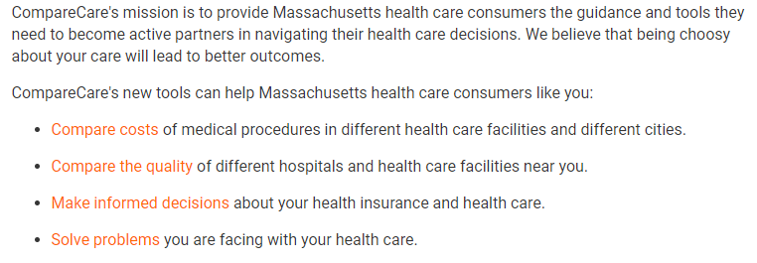
About CompareCare

Slide 12
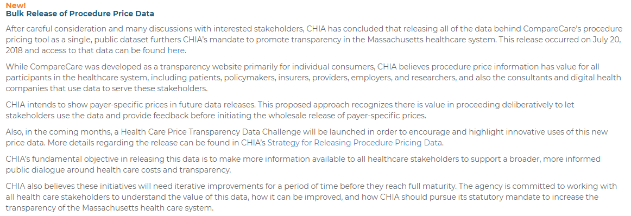
CompareCare Data Available
CompareCare’s underlying data was made available on 7/20/18.
Available as a single, public dataset
More information is available here: http://www.chiamass.gov/transparency-initiatives/
Data can be requested here: http://www.chiamass.gov/procedure-price-data/

Slide 13
QUESTIONS?

Slide 14


Question: I am applying for the APCD to analyze trauma care coordination and understand that medical claims have a lower completeness of external cause coding. Since the transition from ICD-9-CM to ICD-10-CM, has the cause coding for patients with a principal diagnosis of traumatic injury improved in the MA APCD?
Answer: Yes. Calendar year 2014 ICD-9-CM medical claims for patients with a principal diagnosis of traumatic injury where type of claim = 002 (facility), entity type = 2 (non-person entity), and type of bill on facility claims = 11 (Inpatient), 27% of medical claim lines have a cause code (i.e. 22% in the E-code field and 5% in the associated diagnosis fields). However, in calendar year 2016 ICD-10-CM medical claims for patients with the same criteria, 43% of medical claims have a cause code (i.e. 40% in the E-code field and 3% in the associated diagnosis fields).
In addition to the 2016 cause data being more complete, while falls remain the top ranking cause in both 2014 and 2016, the 2016 ICD-10-CM cause codes for falls reveal that the top ranking falls are falls from the same level and that the episode of care is the patient’s initial encounter.

Slide 15

Question: I am currently using the MA APCD to study outpatient Emergency Department (ED) utilization and am considering applying for Case Mix data. What is the difference in insurance payer product types used by those in Case Mix ED data compared to those in MA APCD ED data?
Answer: A comparison of MA APCD Release 6.0 insurance product types by distinct members who used the ED to Case Mix ED distinct patients shows that Case Mix has a higher proportion of Medicare and Worker’s Compensation beneficiaries. Fig 1 (Case Mix) and Fig 2 (APCD) below show the distribution of distinct patients for years 2011 through 2016 by insurance products types in both repositories.
Fig. 1 Case Mix ED Utilization by Payer Product Type
Fig. 2 MA APCD ED Utilization by Payer Product Type

Slide 16

As a Reminder:
Case Mix Contains Some Payers NOT Available in the APCD
Case Mix includes hospital records regardless of payer.
APCD does not include:
  Workers’ Compensation
  Free Care
  TRICARE and the Veterans Health Administration
  Federal Employees Health Benefit Plan
  Private insurers with under 1,000 lives
APCD Medicare data is only released to, upon request, to Government researchers.
APCD MassHealth data is only released after approval by MassHealth.

Slide 17

Question: I am confused about the difference between some of the currency fields in the MA APCD. Where can I find information explaining health insurance currency data?
Answer: The MA APCD has over 20 currency fields. There are a variety of public payer, private payer, and professional organizations with online glossaries, health data boot camp publications, and white papers explaining health insurance claims currency data and providing examples of how currency data fields are used. Below are a few of the public payer sites:
U.S. Health and Human Services
  https://www.healthcare.gov/glossary/
Centers for Medicare & Medicaid
  https://www.cms.gov/CCIIO/Resources/Files/Downloads/uniform-glossary-final.pdf
  https://www.medicare.gov/part-d/costs/copayment-coinsurance/drug-plan-copayments.html
  https://marketplace.cms.gov/technical-assistance-resources/summary-of-benefits-fast-facts.pdf
MassHealth
  https://www.mass.gov/service-details/masshealth-copayments-frequently-asked-questions
  https://www.mass.gov/files/documents/2018/03/01/aca-1-english-mb-lp_03-18_1.pdf
  https://www.sec.state.ma.us/reg_pub/pdf/100/130506.pdf
* Note: The above listed websites were last accessed May 18, 2018 and are subject to change

Slide 18
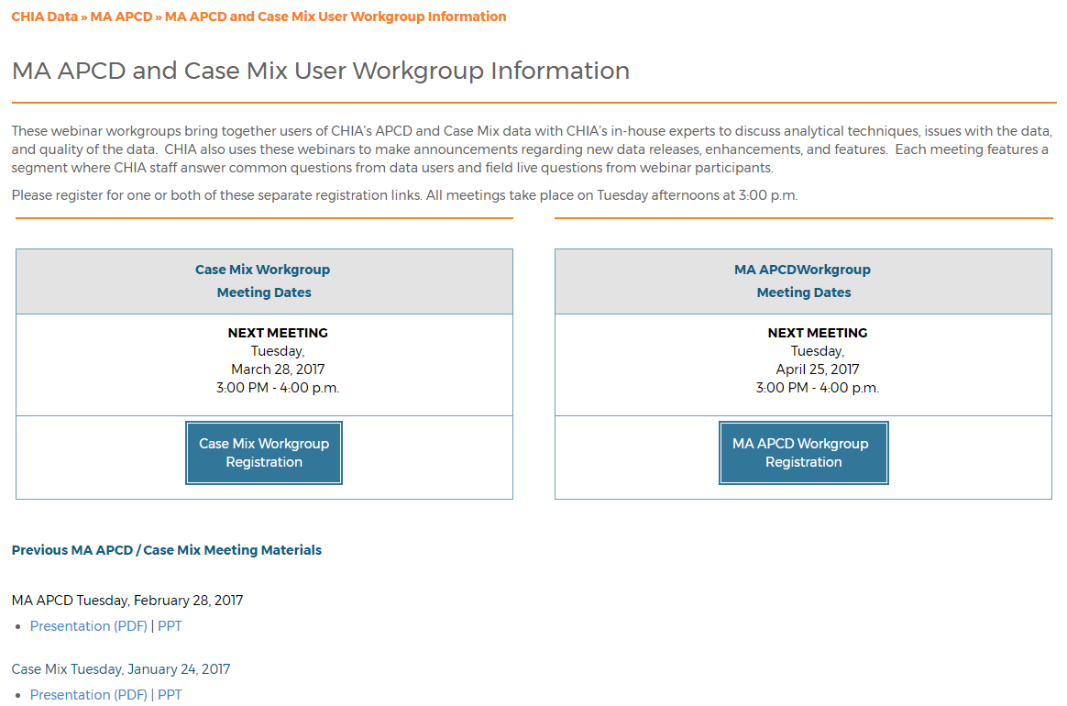
Where can I find old User Workgroup presentations?
http://www.chiamass.gov/ma-apcd-and-case-mix-user-workgroup-information/

Slide 19
Questions?
Questions related to MA APCD: (apcd.data@state.ma.us)
Questions related to Case Mix: (casemix.data@state.ma.us)
REMINDER: Please include your IRBNet ID#, if you currently have a project using CHIA data

Slide 20
Call for Topics and Presenters
If there is a TOPIC that you would like to see discussed at an MA APCD or Case Mix workgroup in 2018, contact Adam Tapply [adam.tapply@state.ma.us]
If you are interested in PRESENTING at an MA APCD or Case Mix workgroup in 2018, contact Adam Tapply [adam.tapply@state.ma.us]
  You can present remotely from your own office, or in-person at CHIA.

