Slide 1
Apcd user workgroup
Amy Wyeth (Special Projects Analyst)
Don Kirkwood (Manager of Data Release and Procurement)
Sylvia Hobbs (Manager of User Support)
Scott Curley (Manager Privacy & Compliance)
January 28, 2020
CENTER FOR HEALTH INFORMATION AND ANALYSIS

Slide 2
Agenda
Announcements:
  APCD Release 8.0 Updates
  FY19 Case Mix Release Projections
Website Updates
Application Reminders
User Support Questions
Q&A

Slide 3
MA APCD Release 7.0
  Available NOW
  Encompasses data on services from January 2013 – December 2017 with six months of claim runout (includes paid claims through 6/30/18)
  Release Documentation and Data Specifications have been posted to the website: http://www.chiamass.gov/ma-apcd/
  Apply now by listing 2017 (and any other years you want from Release 7.0) in the “Years Requested” section of the current application form available here: http://www.chiamass.gov/application-documents

Slide 4
MA APCD Release 8.0
  Available Winter 2019/2020
  Applicants with approved projects that require updated APCD data (Release 8.0) should submit to CHIA a completed Exhibit B (Certificate of Continued Need and Compliance) of the Data Use Agreement. After submitting a completed Exhibit B you will receive an invoice (if applicable) for the requested data. Upon payment of the invoice the order for the data will be placed.
  Release 8.0 includes data on services from January 2014 – December 2018 with six months of claim runout (includes paid claims through 6/30/19).
  Will be linkable to Release 7.0 via crosswalk
  Additional information on highlights and enhancements will be presented in future APCD User Workgroups.

Slide 5

Case Mix FY19 Release
*CURRENT* RELEASE TIMEFRAMES FOR EACH FILE:
  Inpatient (HIDD)
  July 2020
  Emergency Department (ED)
  August 2020
  Outpatient Observation (OOD)
  October 2020

Slide 6
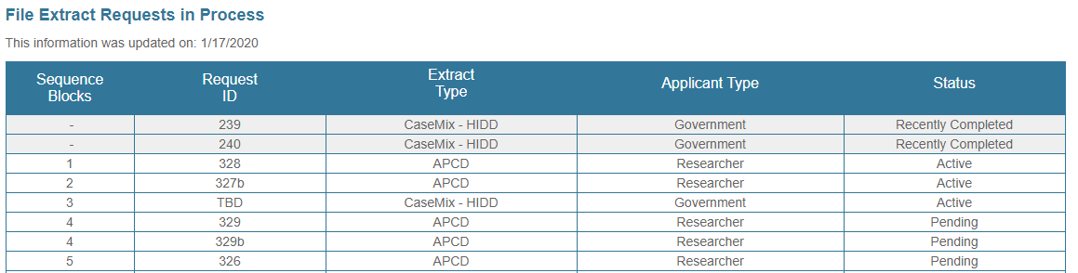
AVAILABLE NOW: Website Release Updates
  Updates on the production of APCD and Case Mix databases and status of data requests are now posted to CHIA’s website!
    Aim #1 is to provide weekly or bi-weekly status update on CHIA data products as they are in development.
    Aim #2 is to provide applicants with information about expected fulfillment status for individual data requests.
    Request IDs will be communicated to Data Requestors via email.
  Have you found the new format helpful?

Slide 7
Application reminders

Slide 8
Fee Waiver Request Reminders
  If you’re submitting a request for a fee waiver, remember to include the fee remittance form in your application package on IRBNet.
  Remember to submit supporting documentation (if required).
  If you’re requesting a financial hardship waiver, remember to submit information detailing your project’s financial situation (examples: project budget, grant funding, organizational / departmental funding). Also request to pay a specific price that you reasonably believe you’re able to afford to contribute.
  CHIA generally does not offer full financial hardship fee waivers. We expect all applicants to have made an attempt to find funding to cover the full cost of the data fees.
  Fee waiver requests can take some time to process – especially financial hardship requests.

Slide 9
USER questions

Slide 10

Question: I am using revenue codes to determine air medical transports and not finding the anticipated volume in the APCD.
Is air medical ambulance data not fully included in the MA APCD?
Answer: Revenue codes are only used for air (or ground) ambulance medical claims if the ambulance provider is billing through an inpatient care provider and such claims account for only a small portion of the ambulance billing. In the MA APCD, 98% of ambulance claims (which are for prehospital outpatient medical care and transport) do not have a revenue code. There are ambulance claims in the MA APCD from providers in all 50 states including the District of Columbia. If you exclude ground transport and filtered by the common HCPCS procedure codes used to identify a rotary wing or fixed wing air medical providers (see Table 1 below), you will still find service providers in all 50 states including DC. The largest volume air medical service provider in Massachusetts and the entire New England region is the non-profit Boston Medflight incorporated as New England Life Flight. Outside of Massachusetts the largest volume provider is the for-profit Air Methods with subsidiaries appearing in the MA APCD as Rocky Mountain Holdings, Native American Air, Mercy Air and LIFENET.
answer continued

Slide 11
Answer: (continued) The MA APCD has a field called “Site of Service - on NSF/CMS 1500 Claims” (MC037) required based on the value in the field “Type of Claim” (MC094). MC094 defines the type of claim for which the payment is submitted based on the following values:
Value Description
            001 Professional
            002 Facility
            003 Reimbursement Form
If the Type of Claim is 001, then Site of Service - on NSF/CMS 1500 Claims is required. The Site of Service field has two coding options related to ground and air ambulance claims:
Value Description
41 Ambulance Land
            42 Ambulance – Air or Water
Additional information on air medical services can be found in DPH’s Massachusetts Ambulance Trip Record Information System (see https://www.mass.gov/info-details/massachusetts-ambulance-trip-record-information-system-matris) and also in the Atlas and Database of Air Medical Services (ADAMS). ADAMS is a national public use database initially funded by National Highway Safety Administration and now funded by the Association of Air Medical Services which provides data on air medical services in each state including Massachusetts. See:
http://www.adamsairmed.org/states/Massachusetts.pdf
answer continued

Slide 12
Answer: (continued) The MA APCD medical claims and provider file contain more detailed Massachusetts data than the ADAMS directory on the level of existing and emerging ambulance medical and transport care providers.
Another researcher asked whether Air Methods/Rocky Mountain Holdings claims are available in the MA APCD, specifically whether one could see claims for services provided in Massachusetts if the provider is based on another state. The answer is yes. Table 1 below shows highest version charge amounts and paid amounts in the medical claims for both ground and air medical services from 2012 to 2016 provided under the Air Methods national billing provider ID by state in the MA APCD, with Massachusetts highlighted.
Table 1: Air and Ground Ambulance Medical Claims Charge Amounts and Paid Amounts in the MA APCD (Years 2012 through 2016) for Air Methods/Rocky Mountain Holdings

Slide 13
Question: Do enough fields exist in the MA APCD to study the magnitude of premature MA NICU infants (gestational age <37 weeks) prescribed inhaled steroids before age 2 and to determine demographic attributes and health status characteristics?
Premature
NICU
Infants
Answer: Yes. ICD-10-CM has a fine gradient of gestational ages by weeks (including preterm and extreme immaturity) which can be mapped to larger age increments in ICD-9-CM to facilitate studying multiple years and avoid the need for cell suppression. See Table 1 below. Medical claims can be linked to pharmacy claims to determine prescriptions before age 2 and ZIP code used to determine demographic attributes. Table 2 below provides a demonstration estimate combining multiple years of MA APCD (Release 6) from years 2012 through 2016.

Slide 14

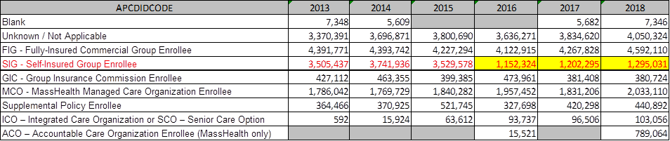
Question: CHIA previously provided information on the impact of Gobeille on medical claims volume. I am applying for dental claims and member eligibility data. Has the volume of data on the self-insured also decreased in those two files?
Answer: There is still some data on the self-insured in the MA APCD. However, the 2015 SCOTUS decision was not limited to medical and pharmacy claims, it also impacted dental claims (see Table 1 below) and eligibility data (see Table 2). When using the MA APCD, you should always remember that while it does contain 100% of the data on the MassHealth population, commercial claims do not contain 100% of the data on the self-insured population.
Table 1: Count of Distinct MEIDs in MA APCD Release 7.0 Dental Claims Data by APCD ID Code
Table 2: Count of Distinct MEIDs in MA APCD Release 7.0 Member Eligibility Data by APCD ID Code

Slide 15

Question: ICD-10-CM has a new diagnosis code ‘Z91120’ for patient's intentional underdosing of medication regimen due to financial. Is this diagnosis code being used in the MA APCD? If yes, what medical conditions and drugs is it associated with?
Answer: Each year, since ICD-10-CM implementation in October 2015, there has been an increase in the use of the code ‘Z91120’. In looking at the use of ‘Z91120’ in all 24 MA APCD medical claims associate diagnosis code fields, the top ranking principal diagnosis code it is associated with is Type 2 diabetes mellitus with hyperglycemia (see Table 1 below). When the medical claims are linked to the pharmacy claims, the top ranking drug code it is associated with is the Proair HFA inhaler used by patients with chronic obstructive pulmonary disease and asthma (see Table 2 below).
Table 1. Top 10 Principal Diagnoses associated with Z91120
Table 2. Top 10 Drug Codes associated with Z91120

Slide 16
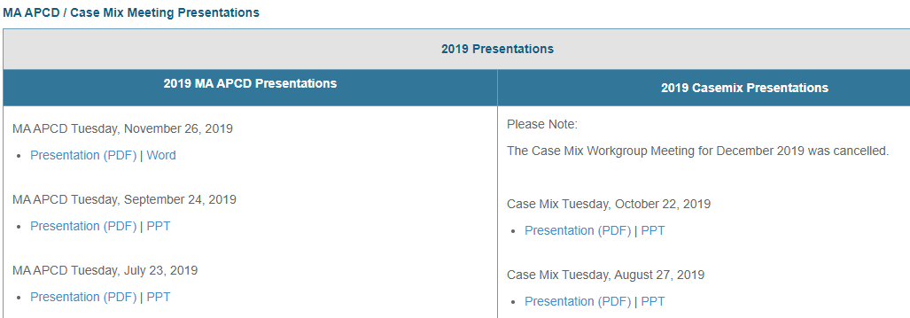
Where can I find past User Workgroup Presentations?
http://www.chiamass.gov/ma-apcd-and-case-mix-user-workgroup-information/

Slide 17
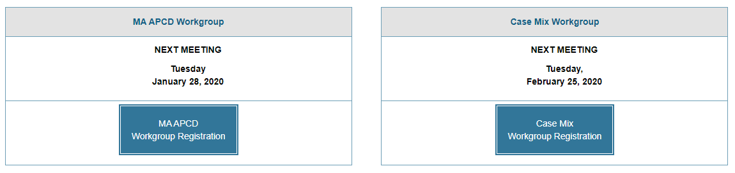
When is the next User Group meeting?
The next APCD User Group will meet Tuesday, March 24. (visual below depicts today’s meeting but will be updated after today)
http://www.chiamass.gov/ma-apcd-and-case-mix-user-workgroup-information/

Slide 18
Questions?
Questions related to MA APCD:
apcd.data@state.ma.us
Questions related to Case Mix:
casemix.data@state.ma.us
REMINDER: Please include your IRBNet ID#, if you currently have a project using CHIA data.

Slide 19
Call for Topics and Presenters
If there is a TOPIC that you would like to see discussed at an MA APCD or Case Mix workgroup in 2020, contact Amy Wyeth [amy.wyeth@state.ma.us]
If you are interested in PRESENTING at a MA APCD or Case Mix workgroup in 2020, contact Amy Wyeth [amy.wyeth@state.ma.us]
You can present remotely, or in-person at CHIA
We may be reaching out to some data users with invitations to present, and hope you will consider this!

