Slide 1
MA Center for Health Information & Analysis
MA APCD User Workgroup
January 23, 2018

Slide 2
Agenda
Updates on MA APCD Release 6.0
Summarized Data Reports
Publications Using CHIA Data – CHIA Website Update
User Support Slide Topics:
  MA APCD Inpatient Deaths in the Medical Claims file
  Difference between Pharmacy data in the MA APCD vs Case Mix
  Unknown Gender in the Member Eligibility file
  Difference between financial data in the MA APCD vs Case Mix
Q&A

Slide 3
MA APCD Release 6.0
Will encompass data from January 2012 – December 2016 with six months of claim runout
Apply now by listing 2016 in the “Years Requested” section of the current application form
Available here: http://www.chiamass.gov/application-documents
Make sure you’re signed up for CHIA’s email list to receive important announcements:
Sign Up Here

Slide 4
MA APCD Release 6.0 Highlights
4 carriers added to the Pharmacy versioning:
  (P1) 301 - Health New England
  (P2) 12226 - Minuteman Health
  (P3) 10632 - Anthem
  (P4) 302 - Health Plans Inc.
3 new data submitters:
  Catamaran
  Harvard Pilgrim Medicare Advantage
  United Healthcare – Medicare & Retirement - SCO

Slide 5
MA APCD Release 6.0 Highlights
New and improved Member Enterprise ID (MEID)
Allows de-identified linkage of members across plans/products/years – has been retooled and improved
Master Data Management (MDM) approach updated to work with hashed patient information
Added Nickname processing for first names (Joe, Joseph)
Added NYSIIS phonetic processing for last names (Smith, Smyth)
Removed the Pharmacy Benefit Manager data from the MDM process to decrease the duplication of member data by upwards of 40%

Slide 6
Other Release 6.0 Notes
Several carriers have stopped submitting data either due to the decision in Gobeille v. Liberty Mutual around self-insured members or because they have left the MA market
These carriers will still be present in Release 6.0, but only limited 2016 data will be available as they only submitted data for a portion of the year
  Most stopped submitting between Jan 2016 and Aug 2016
A full list of the carriers that have stopped submitting will be in the Release 6.0 release documentation, which should be available next month

Slide 7
Data Release Timeframe
CHIA IT expects to start fulfilling requests for MA APCD Release 6.0 in mid-February.
Due to the size of the data and QA required for each extract, they can take around 7 days each to create
Requests from state agencies are always given priority over non-government data requests

Slide 8
Future Years of Data
Applicants can now request FUTURE YEARS OF DATA for both MA APCD and Case Mix.
Initial project requires Data Privacy Committee and Data Release Committee review
Additional years or release versions of data will be released upon availability and the Recipient’s completion of a Certificate of Continued Need (Exhibit B of the DUA)
No additional review required for these additional years of data unless your request changes
Normal data fees still apply

Slide 9
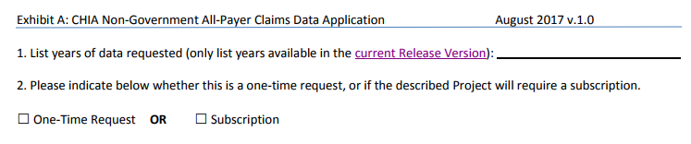
Future Years of Data
No longer required to check any boxes on the application form for future years of data
List the years you would like to request and we will fulfill all years available with the current Release
To request future years of data (no longer limited to the upcoming 5 years), just click the box for “Subscription”

Slide 10
Summarized Data Reports
CHIA has updated our Data Release Regulations to allow for Summarized Data Reports
Will contain only aggregate data (data summaries) and De-identified Data, sourced from MA APCD and Case Mix data
  Examples of Summarized Data Reports include: counts; totals; rates per thousand; index values; and other standardized metrics.
  Will be subject to CHIA’s cell suppression policy (no cell less than 11 will be displayed)
Request form can be found on the MA APCD Application Documents page: http://www.chiamass.gov/application-documents

Slide 11
Summarized Data Reports
In determining whether to compile such a report, CHIA will consider the public interest served, the availability of its resources, the complexity of the request, and privacy concerns (i.e. that there is no more than a minimal risk to individual privacy in the public release of the report)
Submit the request via a new form (to be published after the revised regulation goes into effect.
  Data Use Agreement and Data Management Plan not required
The Executive Director (or his/her designee) will approve or deny such requests. Such approval/denial is final and not subject to further review or appeal.
A support/production fee of $140/hour will be charged

Slide 12
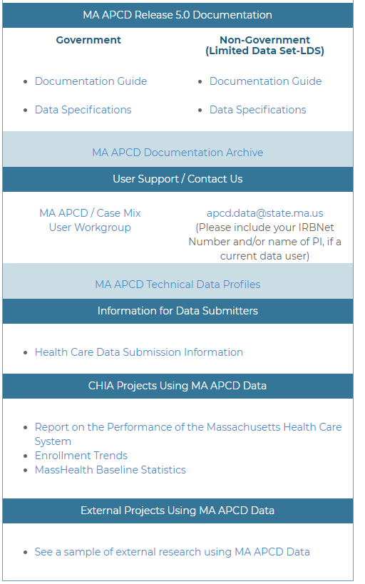
Publications Using CHIA Data
MA APCD and Case Mix websites now have galleries highlighting research completed by previous applicants for CHIA data using MA APCD and Case Mix
If you would like to be included in the list, please send the publication citation and/or hyperlink to the publication to Adam.Tapply@state.ma.us
These lists will be updated continually and will contain links to requestor’s original application form on the public comment page

Slide 13
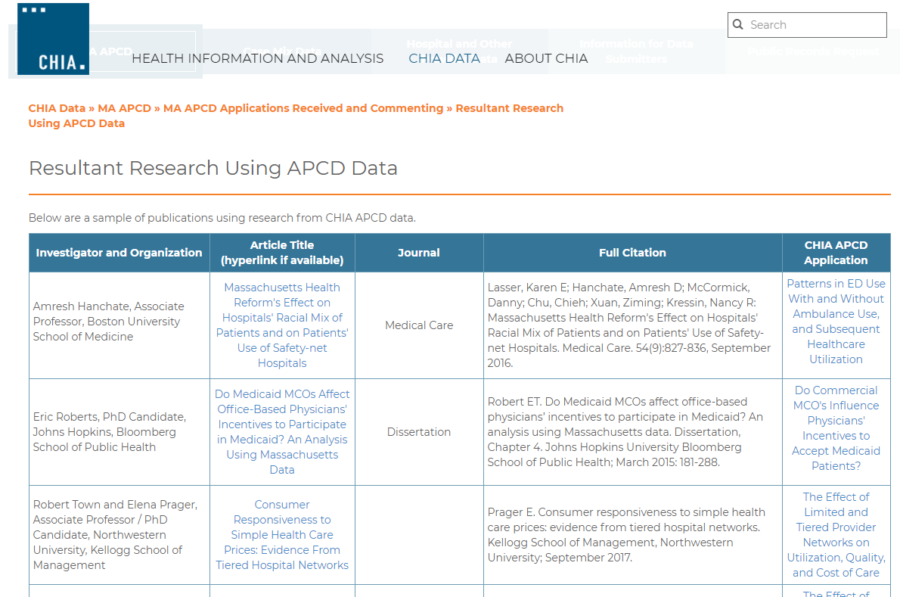
Publications Using CHIA Data
Link to the MA APCD gallery: http://www.chiamass.gov/resultant-research-using-apcd-data/

Slide 14
QUESTIONS?

Slide 15
Question: MC023 (Discharge Status = ’20’ Inpatient death) is a main outcome measure in our research. How do we estimate the magnitude of deaths for the Massachusetts population occurring in other settings not included in the MA APCD and assess how close MA APCD Medical Claims inpatient deaths are to state death records?
Answer: The Centers for Disease Control and Prevention Wide-ranging Online Data for Epidemiologic Research (CDC Wonder) search engine at https://wonder.cdc.gov/ allows the public to conduct customized online queries of state death data by year, state, place of death and other demographic factors . Deaths in an inpatient medical facility setting annually account for approximately 29% of Massachusetts population deaths (See Table 1 below).
Table 1. Massachusetts Annual Death Count by Place of Death from CDC Wonder
Place of Death | 2013 |  | 2014 |  | 2015
 | Total Deaths | Percent | Total Deaths | Percent | Total Deaths | Percent
Decedent's Home | 14,920 | 27.4% | 14,942 | 27.1% | 14,423 | 25.0%
Hospice Facility | 157 | 0.3% | 864 | 1.6% | 2,628 | 4.5%
Medical Facility-Dead on Arrival | 612 | 1.1% | 635 | 1.2% | 597 | 1.0%
Medical Facility-Inpatient | 16,279 | 29.9% | 16,427 | 29.8% | 16,984 | 29.4%
Medical Facility-Outpatient or ER | 4,015 | 7.4% | 4,169 | 7.6% | 4,425 | 7.7%
Nursing Home/Long Term Care | 15,586 | 28.6% | 15,344 | 27.8% | 16,094 | 27.9%
Other | 2,923 | 5.4% | 2,776 | 5.0% | 2,626 | 4.5%
Total Annual Deaths | 54,492 | 100% | 55,157 | 100% | 57,777 | 100%
You can compare CDC Wonder Massachusetts inpatient death distribution by age groups (see Figure 1 below) to Massachusetts resident deaths in MA APCD medical claims by counting distinct Member EIDS with MC023 code of 20 to assess the closeness of deaths reported to the CDC to deaths inpatient deaths in MA APCD claims data (see Figure 2 below).

Slide 16

Question: What is the difference between the information on pharmaceuticals in administrative Case Mix data and the MA APCD?
Answer: The Case Mix data includes revenue codes, CPT codes and HCPCS codes for pharmaceuticals administered in the Massachusetts acute care setting without detailed drug name nor dosage information. The MA APCD includes the revenue codes, CPT codes and HCPCS for all inpatient and outpatient care settings and detail pharmacy claims drug information. See Table Below.
Comparison of Types of Pharmacy Information Contained in Case Mix Data and APCD
Case Mix Pharmacy Information
Inpatient revenue codes on generic, non-generic, take-home, experimental, IV therapeutic and diagnostic pharmaceuticals, charges (Inpatient Acute Care in Massachusetts)
CPT Codes on professionally administered home injectable/infusion, inhalation, therapeutic and diagnostic pharmaceuticals, and charges (ED or Observation Stay in Massachusetts)
HCPCS codes on therapeutic and diagnostic pharmaceuticals, and charges (ED or Observation Stay in Massachusetts)
MA APCD Pharmacy Information
Inpatient revenue codes on generic, non-generic, take-home, experimental, IV therapeutic and diagnostic pharmaceuticals, charges and paid amount (All Inpatient Care Settings including Acute Care, Specialty Hospitals, and Nursing Homes)
CPT Codes on professionally administered home injectable/infusion, inhalation, therapeutic and diagnostic pharmaceuticals, charges and paid amount (All outpatient care settings including home health services)
HCPCS codes on therapeutic and diagnostic pharmaceuticals , charges and paid amount (All outpatient care settings including home health services)
Detailed Pharmaceutical Claims which include drug Codes, units of measure, refills, days supply, quantity dispensed, route of administration, sales tax, rebates, charges and paid amount

Slide 17

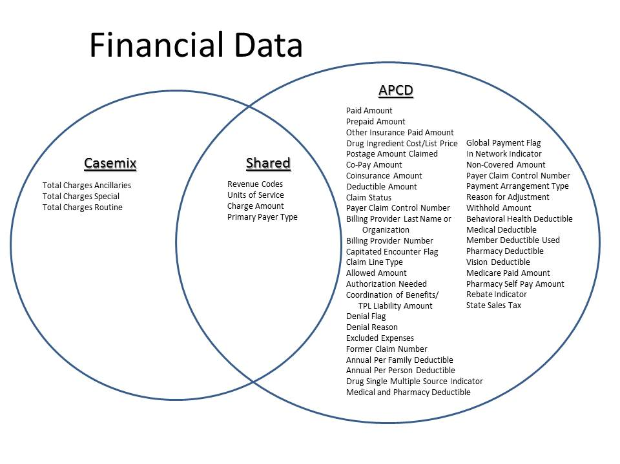
Question: What is the difference between the Financial Data in Case Mix and MA APCD?
Answer: Case Mix data is limited to charges, revenue codes, service units, and payer information. The MA APCD contains all of this information in addition to detail payment amounts by insurer and patient. See Venn Diagram below.

Slide 18

Question: Is there any way to determine the gender for those who have gender listed “unknown” in the eligibility file?
Answer: 96% of Unknown Member Gender Records in Eligibility File* are records belonging to two dental carriers. It is possible to link the ME file MEIDs to their medical claims to obtain consistently reported gender information for approximately 50% of the records.
Given 1,813,943 Distinct MEIDs with Unknown Member Eligibility File Gender Across all Years
1,415,307 Distinct MEIDS with Gender Field Populated in Merged Medical Claims and Dental Claims File
80% of ME File Gender Unknown MEIDs had Gender Populated in the Medical Claims File
Results: of 1,813,943 Unknown Member Eligibility File distinct MEIDs with unknown Gender, 897,880 (49.49%) can be consistently imputed from distinct MEID and populated Gender data from Medical Claims Gender
Table 1. ME Gender Unknown MEIDs linked to Medical Claims file by Consistency of Gender Reporting
Gender | Percent | MC MEIDs
Consistent Single Gender Reported Across All Medical Claims | 61.87% | 897,880
Two Conflicting Genders Reported on Different Medical Claims | 38.13% | 553,427
* Data Source: MA APCD Release 5.0

Slide 19
Questions?
Questions related to MA APCD: (apcd.data@state.ma.us)
Questions related to Case Mix: (casemix.data@state.ma.us)
REMINDER: Please include your IRBNet ID#, if you currently have a project using CHIA data

Slide 20
Call for Topics and Presenters
If there is a TOPIC that you would like to see discussed at an MA APCD or Case Mix workgroup in 2018, contact Adam Tapply [adam.tapply@state.ma.us]
If you are interested in PRESENTING at an MA APCD or Case Mix workgroup in 2018, contact Adam Tapply [adam.tapply@state.ma.us]
  You can present remotely from your own office, or in-person at CHIA.

