Slide 1
MA Center for Health Information & Analysis MA APCD User Workgroup
April 26, 2016

Slide 2
Agenda
Announcements:
Changes to the APCD User Workgroup
MA APCD Release 5.0
New Forms Posted
Presentation: CHIA Enrollment Trends Report
Guest Presentation: Aaron Pervin, Health Policy Commission, “Prices for Pregnancies in Massachusetts Vary Two Fold”
Q&A

Slide 3
Reminder 2016 User Workgroup Changes
Case Mix and APCD User Groups separated
Every other month
More presentations from CHIA’s users and external users
Content from presentations will be categorized by topic and posted to the CHIA website
Easier to find information
Changes to the APCD website will be going live when new application forms / documentation for Release 5.0 are posted

Slide 4
User Group Slides Posted Soon [http://www.chiamass.gov/ma-apcd-and-case-mix-user-workgroup-information/]
Based on feedback, grouped by topic and not date of meeting
Three categories:
Application Questions (“When do fees need to be paid?”)
Questions from Users – one PDF containing multiple questions (mostly short questions/answers with 1 or 2 slides each)
These two sections will be tagged with keywords. The list of keywords will be on the website and those keywords will be footnoted to each slide so people can Ctrl-F in the PDF
Tutorials – PDFs for each tutorial – hyperlink on the website will say what each tutorial is (Example: “What APCD Fields Can be Used to Filter for Medicaid Managed Care Beneficiaries?”)

Slide 5
MA APCD Release 5.0
Important Announcement: MA APCD Release 5.0 will be delayed as we work with carriers on the implications of the recent Supreme Court decision in Gobeille v. Liberty Mutual.
Original release date was June 30th
A new release date has not yet been finalized

Slide 6
New Forms
Posted Now:
Fee Remittance Form / Fee Waiver Request Form: http://www.chiamass.gov/assets/Uploads/data-apps/Fee-Remittance-and-Waiver-Form.docx
Revised Data Management Plan: http://www.chiamass.gov/assets/Uploads/data-apps/Data-Managment-Plan-for-Non-Government-Entities.docx
Government Data Use Agreement Template: http://www.chiamass.gov/assets/Uploads/data-apps/Government-Data-Use-Agreement.docx
Non-Government Data Use Agreement Template: http://www.chiamass.gov/assets/Uploads/data-apps/Non-Government-Data-Use-Agreement.pdf
All forms are also available in the IRBNet “Documents for Researchers” Library.

Slide 7
Application Reminders
We need CVs of the PI(s) and at least the Lead Programmer/Analysts
Please make sure you are authorized to sign the Data Use Agreement on behalf of your organization.
If you’re not sure if you’re an authorized signatory, there’s a good chance you aren’t.
The organization housing the data is the entity being bound in the DUA, not the researcher.
Many institutions (especially universities) have a Research Coordinator that is an authorized signatory and can sign agreements binding the organization.

Slide 8
QUESTIONS?

Slide 9
CHIA Enrollment Trends Verifying Enrollment Counts from the MA APCD Member Eligibility File
Presented by:
Ashley Storms, Senior Health System Policy Analyst
Amy Wyeth, Senior Health System Policy Analyst

Slide 10
Agenda
Enrollment Trends Overview
Verification Process: Private Commercial
Verification Process: Medicare Advantage
Questions

Slide 11
Enrollment Trends Overview
Massachusetts residents with primary, medical insurance from the top 14 commercial payers, MassHealth, and Medicare
Analysis based on MA APCD Member Eligibility data, supplemented as needed
Quarterly enrollment counts (most recently March 2014 – Sept. 2015)
Private commercial enrollment broken out by:
Market sector (employer group size)
Funding type (fully- or self-insured)
Product type (e.g. HMO, PPO, Indemnity)
Public commercial enrollment broken out by program
Commonwealth Care, Medical Security Program (MSP),
MassHealth Managed Care Organization (MCO), One Care,
Senior Care Options, Medicare Advantage
Released semi-annually, most recently in February 2016
3

Slide 12
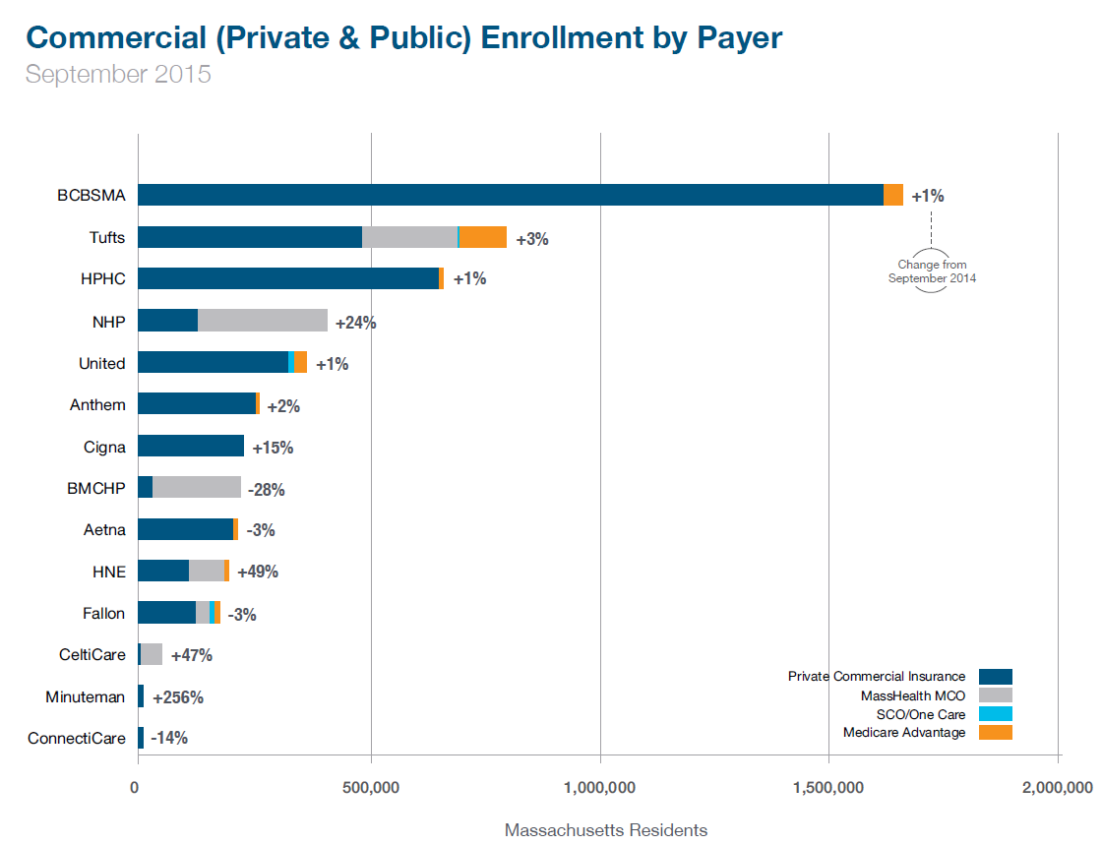

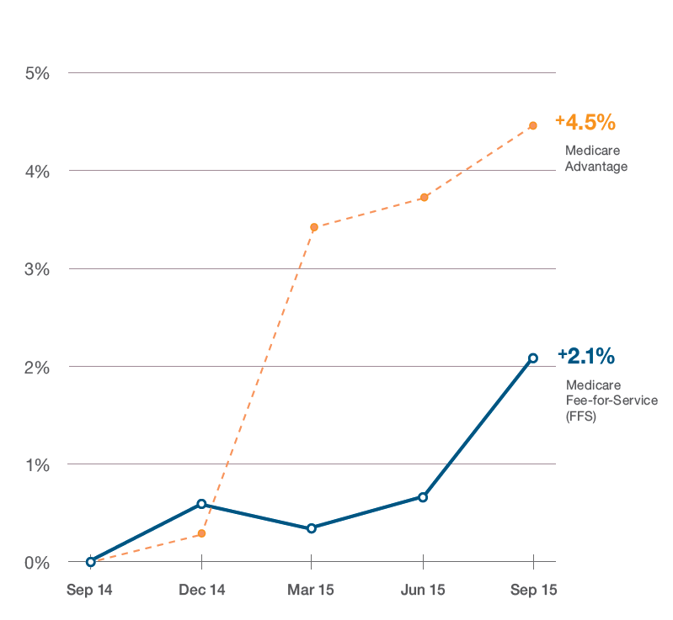
Enrollment Trends Overview
Full report, databook, technical appendix, and programming code available online: http://www.chiamass.gov/enrollment-in-health-insurance/
Complete overview slides, previously presented at July 2015 User Workgroup, available on CHIA’s website: http://www.chiamass.gov/assets/docs/p/apcd/workgroup-meetings/User-Workgroup-July-2015-Final.pdf
5

Slide 13
Verification Process: Private Commercial
Data Assessment
Payers submitted aggregate membership totals to CHIA (“ACA Reports”); these served as both control totals and an early data source
Direct payer totals were compared with enrollment counts sourced from the MA APCD

Slide 14
Verification Process: Private Commercial

Slide 15
Verification Process: Private Commercial
Data Assessment
Payers submitted aggregate membership totals to CHIA (“ACA Reports”); these served as both control totals and an early data source
Direct payer totals were compared with enrollment counts sourced from the MA APCD
Reconciliation
Where data sources diverged, CHIA worked with payers to identify where specifications for the two submissions differed

Slide 16
Verification Process: Private Commercial

Slide 17
Verification Process: Private Commercial
Data Assessment
Payers submitted aggregate membership totals to CHIA (“ACA Reports”); these served as both control totals and an early data source
Direct payer totals were compared with enrollment counts sourced from the MA APCD
Reconciliation
Where data sources diverged, CHIA worked with payers to identify where specifications for the two submissions differed
Resolution Development
A decision was made in conjunction with payers about how to obtain accurate data for reporting
This could include payer-submitted supplemental data, changes to payers’ MA APCD submissions, or alternative logic implemented by Enrollment Trends team

Slide 18
Verification Process: Private Commercial

Slide 19
Verification Process: Private Commercial
Data Assessment
Payers submitted aggregate membership totals to CHIA (“ACA Reports”); these served as both control totals and an early data source
Direct payer totals were compared with enrollment counts sourced from the MA APCD
Reconciliation
Where data sources diverged, CHIA worked with payers to identify where specifications for the two submissions differed
Resolution Development
A decision was made in conjunction with payers about how to obtain accurate data for reporting
This could include payer-submitted supplemental data, changes to payers’ MA APCD submissions, or alternative logic implemented by Enrollment Trends team

Slide 20
Verification Process: Private Commercial
All MA APCD-sourced enrollment counts are shared with payers for confirmation prior to publication. MA APCD counts are reassessed each reporting cycle as new Member Eligibility submissions become available.

Slide 21
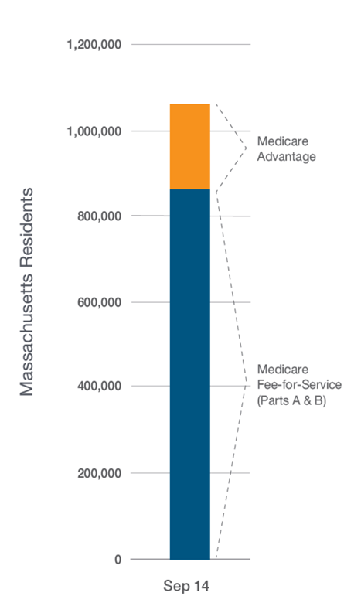
Medicare
Medicare data in Enrollment Trends includes Fee for Service (reported to CHIA directly by CMS) and Medicare Advantage (reported to MA APCD by commercial payers using figures CMS reports to them; separately posted online by CMS);
Of 6 million + unique residents insured, Massachusetts has approximately 1.1 million with primary coverage from Medicare:
197,000 Medicare Advantage
861,000 Medicare FFS
60,000 dual-eligible (Medicare-Medicaid/OneCare, Senior Care Options plans, or PACE)
This presentation focuses on CHIA’s Medicare Advantage data verification
Sep 15

Slide 22
Goal: Source all Medicare Advantage enrollment data from APCD
Why it’s important: The APCD has several hundred data fields in seven file types. Enrollment numbers are the starting point for most analyses. If we know they are accurate, using data in associated files will be very rich.
Verification process:
Assessment
CMS online enrollment data* is “gold standard” – our control
How well do APCD enrollments submitted match CMS? If not close…
Reconciliation
Do the sources have the same data specifications?
What else could account for differences?
Resolution Development
CHIA works with payers to produce enrollment counts that match CMS’ as closely as possible
Does the payer submit the same data to CHIA that it receives from CMS?
So far, resolutions have included supplemental data, requests to payers to adjust their submission processes, and payers newly submitting to the MA APCD
* http://www.cms.gov/Research-Statistics-Data-and-Systems/Statistics-Trends-and-Reports/MCRAdvPartDEnrolData/Monthly-Enrollment-by-Contract-Plan-State-County.html

Slide 23
Verification Process: Medicare
Case Study: Payer A Assessment
Note APCD enrollments are higher, and difference is increasing

Slide 24
Verification Process: Medicare
Case Study: Payer A Reconciliation
Below questions investigated:
Do the sources have the same data specifications?
CHIA ET specifies unique member, primary coverage, medical coverage
CMS data adjusted to remove PDP-only, dual-eligible
Does the payer submit the same data to CHIA that it receives from CMS?
Enrollment numbers compared at plan name level; both sources had submitted virtually all the same plans, but with different enrollments
We considered the possibility that the discrepancy might tie back to CHIA’s “24-month lookback” request. We request payers to refresh each monthly data submission to include the most recent data for the past month as well as the 23 previous months. If a refresh does not occur, members who disenroll remain in its data as an enrollee, artificially inflating the count.

Slide 25
Verification Process: Medicare
Case Study: Payer A Resolution
CHIA Enrollment Trends staff and an agency Payer Liaison conferred with this payer during a biweekly conference call about the possibility that data was not fully refreshed with each monthly submission. It turned out that this was the case.
This payer has agreed to resubmit several months of data to reflect the full 24-month lookback.

Slide 26
Medicare Advantage enrollments: current status
The chart above shows CHIA’s September 2015 comparison of CMS online and APCD-submitted Medicare Advantage enrollments, not counting dual eligible enrollees, for the four payers successfully transitioned as of that date. This data represents approximately 82 percent of Massachusetts Medicare Advantage enrollees. We are optimistic that data from three additional large payers will transition later this year.

Slide 27
Questions?
Ashley Storms
Senior Health System Policy Analyst
CHIA Health System Performance Analytic Team
Ashley.Storms@state.ma.us
Amy Wyeth
Senior Health System Policy Analyst
CHIA Health System Performance Analytic Team
Amy.Wyeth@state.ma.us
http://www.chiamass.gov/enrollment-in-health-insurance/

Slide 28
Price Variation for a Delivery Varies Two Fold in Massachusetts
April 25, 2016

Slide 29
Table of contents
Background
Method
Results
Policy Implications

Slide 30
Price Variation is Extensive in Massachusetts
Academic research and HPC’s Cost and Market Impact Reviews have shown that price variation is typically not related to indicators of higher value, such as quality of care or patient acuity.
Yearly relative price analyses have found that price variation has persisted in the Commonwealth since 2010.
Last year’s Cost Trends Report found that there is large variation in episode-level spending by hospital for both hip and knee replacements and percutaneous coronary intervention.
Maternity care represents 1 in 6 commercial inpatient discharges and is 3.5% of all commercial spending.
This presentation examines hospital-level variation in spending for an episode of maternal care.
Notes:
“Shoppable” services are relatively common services that are planned in advance, where patients have realistic choice of providers, and quality and price information are potentially available

Slide 31
Table of contents
Background
Method
Results
Policy Implications

Slide 32
Research Questions
What is the degree of price variation for low risk births in the Commonwealth?
What is the relationship between price variation and measurable quality in the Commonwealth?
This is the source

Slide 33
Method of Price Analysis
We used the Optum Symmetry Episode Treatment Grouper to group claims into unique episodes of care. Episode Treatment Groups (ETGs) are medically meaningful statistical units representing complete episodes of care. These episodes describe a recipient’s observed mix of diseases and conditions, and any underlying co-morbidities and complications.
The following ETGs were used in our study:
Episode Treatment Group 601100: Pregnancy, with delivery
Patient population and risk adjustments
The study sample was defined according to the following criteria:
Only patients within BCBS, HPHP, THP
Only complete episodes between 2011-2012
Only patients who are between 18 and 35
Only patients who are classified as low severity by the Optum ETG grouper
Only patients whose delivery was during their first hospital stay for the episode
Excludes outliers (all episodes in the top and bottom 2.5% of payments were cut out of the sample)
We calculated an episode price for C-sections, vaginal deliveries, and all deliveries.
This is the source

Slide 34
Calculation of Quality and Volume Measures
Birth Trauma Rate: Calculated using CHIA’s 2012 case mix data. The measure was calculated according to AHRQ’s technical specifications for PSI # 17, Birth Trauma Rate-Injury to Neonates.
Obstetric Trauma Rate: Calculated using CHIA’s 2012 case mix data. The measure was calculated according to AHRQ’s technical specifications for PSI # 19, Obstetric Trauma Rate – Vaginal Delivery without instrument.
C-Section Rate: We used Leapfrog Group’s most recent NTSV C-Section rate for 2015.
http://www.leapfroggroup.org/compare-hospitals
Volume of Discharges: We calculated the total number of discharges for uncomplicated vaginal delivery (DRG 775) and uncomplicated C-sections (DRG 766) for commercial payers from the CHIA’s case mix data for 2012 and 2014
Notes:
Both the birth trauma rate and obstetric trauma rate use the case mix data because the measures were defined for discharge data
C-Section rates were used for 2015 because we wanted to use the most recent data available.
We looked at two years worth of discharges to determine if the share of discharges attributable to each hospital changed significantly. IT did not.

Slide 35
Table of contents
Background
Method
Results
Policy Implications

Slide 36
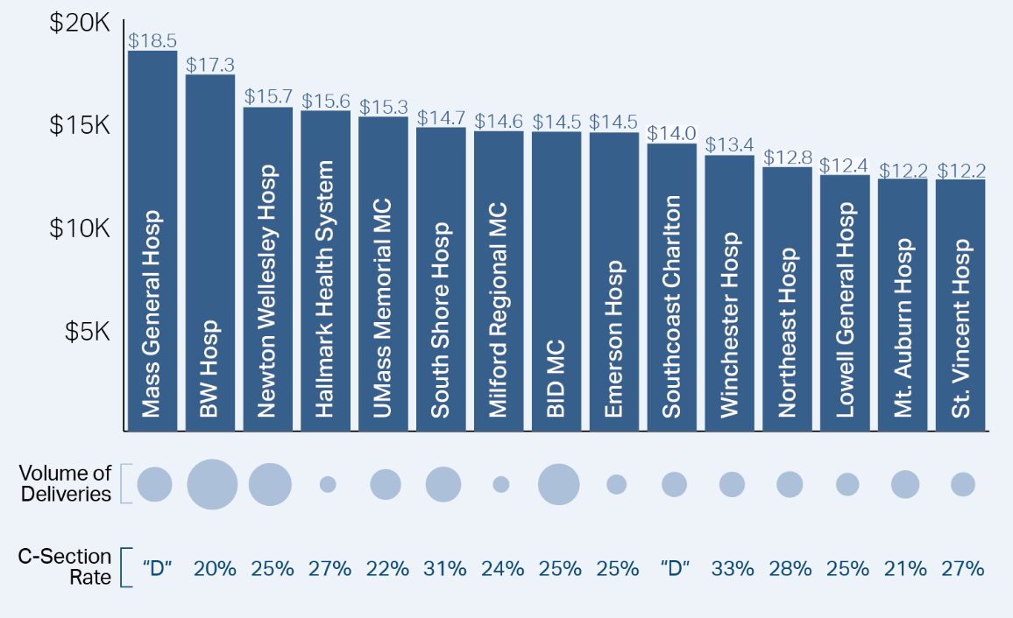
Price varies extensively without any associated variation in quality
Source: HPC Analysis—CHIA, All Payer Claims Database, 2011-2012, CHIA, Hospital Inpatient Discharge Database, 2014, Leapfrog Group, 2015
Notes: C-Section Rate is the NTSV C-Section Rate calculated from the Leapfrog Group, 2015, “D” means the hospital declined to provide the data
Volume of deliveries is all commercial deliveries for 2014

Slide 37
Price is the main driver of episode spending, not differences in quality or C-sections
We found that price was uncorrelated with our quality measures
Patient Safety Indicator 17: Birth Trauma Rate-Injury to Neonates, r=.03, p= .86
Patient Safety Indicator 19: Obstetric Trauma-Vaginal Delivery without instrument, r= -.10, p=.53
~85% of the variation in episode spending was due to the variation in the procedure price of the delivery,* as apposed to the variation in the C section rate.
Source: HPC Analysis—CHIA, All Payer Claims Database, 2011-2012, CHIA, Hospital Inpatient Discharge Database, 20124 Leapfrog Group, 2015
Notes: * this number was produced by looking at the price and quantity of C sections and vaginal deliveries at the hospital level within the APCD
Notes:
85% variation:
The main driver of episode spending was the hospital’s procedure price, not the c section rate within the hospital.
For this analysis we: broke out price and quantity for c sections and vaginal deliveries using the APCD

Slide 38
Table of contents
Background
Method
Results
Policy Implications

Slide 39
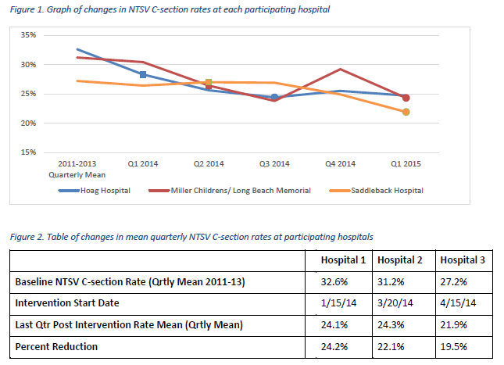
Businesses in California have experimented with blended payments for maternal care
The Pacific Business Group on Health’s members are experimenting with combining a C-section and vaginal delivery payment into a single blended payment
Preliminary results show that the NTSV C-Section rate has dropped since they implemented the program
Pacific Business Group on Health: Maternity Payment and Care Redesign Pilot

Slide 40
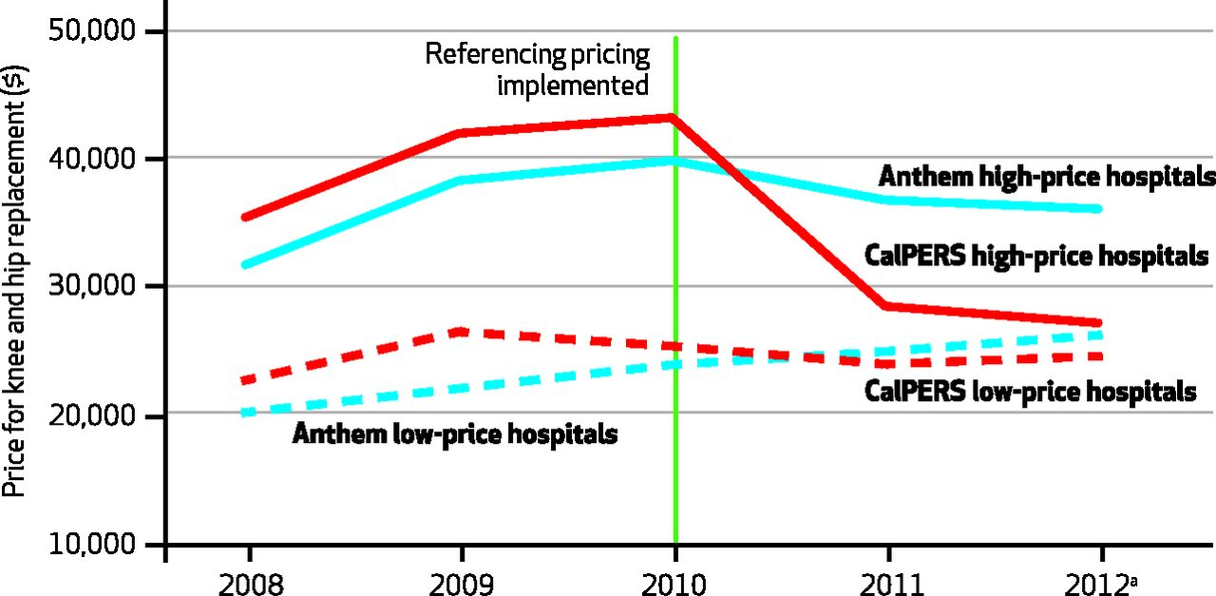

Reference pricing has been shown to lower prices at high priced hospitals
California’s public employee retirement system (CalPERS) initially saw 5-fold variation in prices paid for knee and hip replacements
They identified 41 preferred hospitals and set a maximum price paid ($30,000); enrollees paid full cost above that set price
Reference Price Outcomes:
CA patients chose care in lower cost facilities: ~30% switched to lower-priced facilities
Prices declined ~34% at higher-priced facilities in California
A similar program in MA for maternity might save the payer/purchaser approximately 17% total medical expenditures if Mount Auburn’s price were set as the reference price.
James C. Robinson, and Timothy T. Brown Health Aff 2013;32:1392-1397 ©2013 by Project HOPE - The People-to-People Health Foundation, Inc.
Notes: Mt. Auburn was chosen because it is a low cost and high volume provider.
Notes:
CALPERS (California’s public employee retirement system) saw 5-fold variation in prices paid for hip and knee replacements
They identified 41 preferred hospitals and set a maximum price paid ($30,000)– enrollees paid full cost above that price
No evidence of reduced quality
No evidence of cost-shifting

Slide 41
Questions?
Notes:
“Shoppable” services are relatively common services that are planned in advance, where patients have realistic choice of providers, and quality and price information are potentially available

Slide 42
Questions?
Questions related to APCD : (apcd.data@state.ma.us)
Questions related to Case Mix: (casemix.data@state.ma.us)
REMINDER: Please include your IRBNet ID#, if you currently have a project using CHIA data

Slide 43
Call for Topics and Presenters
If there is a TOPIC that you would like to see discussed at an MA APCD or Case Mix workgroup, contact Adam Tapply [adam.tapply@state.ma.us]
If you are interested in PRESENTING at an MA APCD or Case Mix workgroup, contact Adam Tapply [adam.tapply@state.ma.us]
You can present remotely from your own office, or in-person at CHIA.

