Slide 1

Massachusetts All-Payer Claims Database:
Technical Assistance Group (TAG)
April 12, 2022

Slide 2
Agenda
MA APCD
Enrollment Trends
DOI Reporting
Questions

Slide 3
MA APCD Intake
All APCD submissions through March 2022 are due by April 30^{th.} This includes any re-submissions.
Please work with your liaison in submitting any overdue files and alert them if you expect any delays.
Data will be used for Q1 2022 DOI membership, Mar-2022 bi-annual claims utilization and quarterly Enrollment Trends reporting.
CHIA is revisiting Medical Claim versioning methods with select payers. We’ll reach out when we have examples to share with each company.

Slide 4
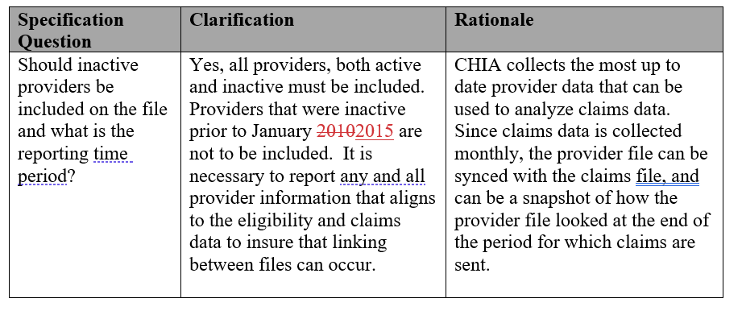
MA APCD – 2022 Provider Submission Guide Update (Page 9)

Slide 5
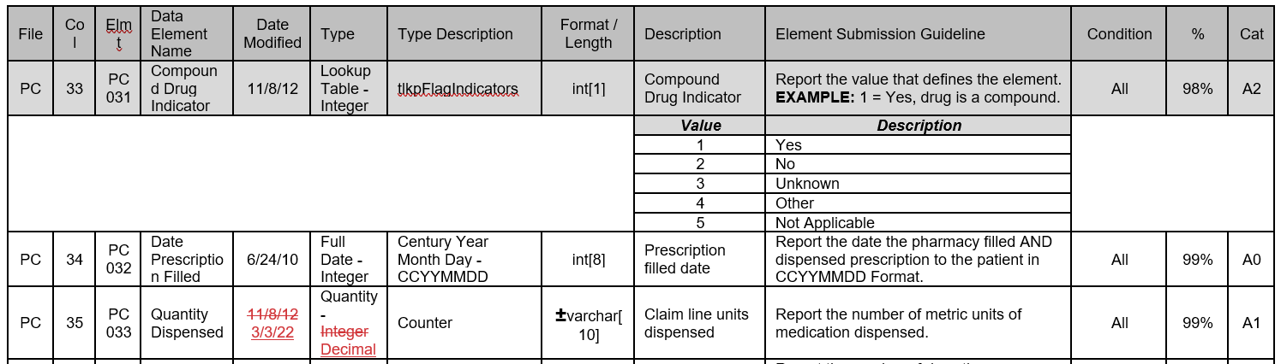
MA APCD – 2022 Pharmacy Claims Submission Guide Update (Page 21)

Slide 6
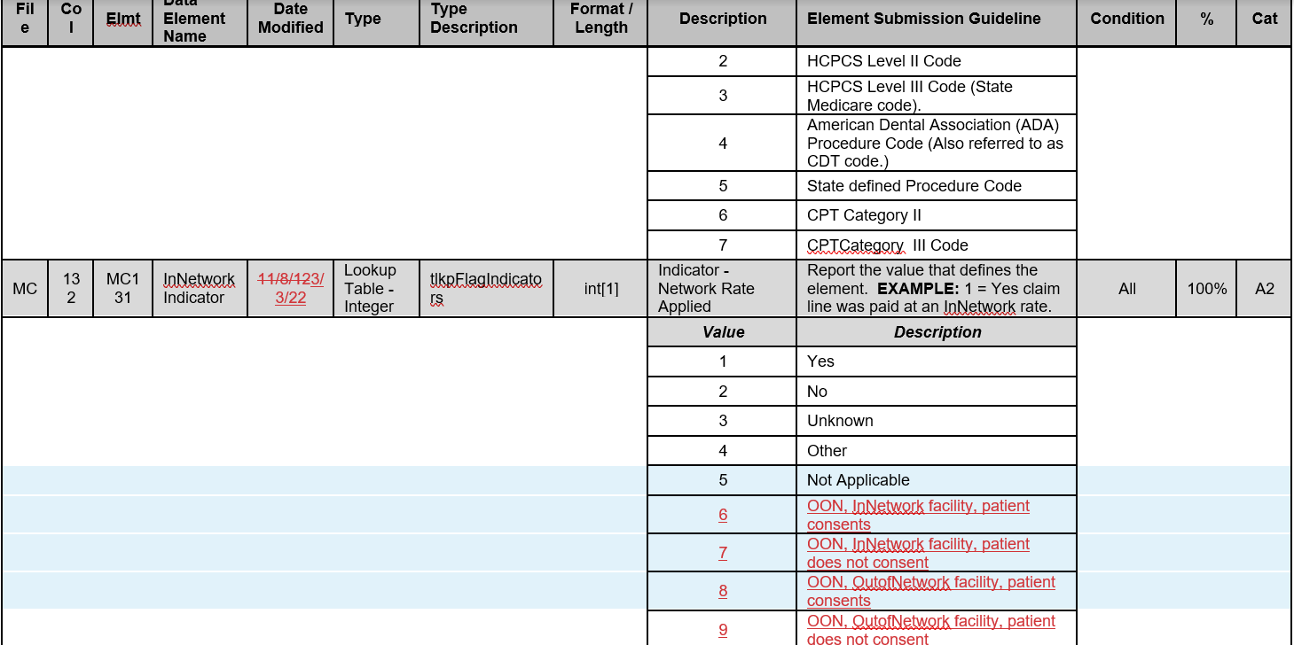
MA APCD – 2022 Medical Claims Submission Guide Update (Page 48)

Slide 7
MA APCD Intake Version 2022
APCD submitters may send test files in July 2022. Please work with your liaison if you want to do this.
Production files with submission guide changes are due by 8/31 for July 2022 data.
There is no change to the version field in the header record – it remains ‘2019’.

Slide 8
Enrollment Trends Update
The next Enrollment Trends reporting cycle will be based on data through March 2022 and is scheduled to be published in August 2022.
CHIA requested Supplemental Data from certain payers last week. The due date for Supplemental Data through March 2022 is May 13, 2022.
Payers will be sent MA APCD-sourced enrollment counts for review in June 2022.
For questions on Enrollment Trends: Contact your CHIA liaison and Lauren Almquist at lauren.almquist@chiamass.gov

Slide 9
Enrollment Trends Timeline
Apr 2022 | May 2022 | Jun 2022 | Jul 2022 | Aug 2022
Payers submit March 2022 MA APCD files
 | Supplemental enrollment reports due (select payers)
 |  | MA APCD enrollment counts sent to payers for review
 |  |  | Reporting

Slide 10
DOI Reporting
Q4 2021 HMO Membership reports were sent on 3/3. Signoff is due by 4/18.
CY2021 Membership reports were sent on 3/16. Signoff is due by 4/29.
Claims/Utilization:
Reports using data through September 2021 were sent on 3/7. Signoff is due by 5/7.
We continue to meet with select payers to reconcile differences in certain report categories.

Slide 11
Next Meetings
May 10, 2022 @ 2:00 pm
June 14, 2022 @ 2:00 pm

Slide 12
Questions?

