Slide 1
Apcd user workgroup
Amy Wyeth (Special Projects Analyst)
Sylvia Hobbs (Manager of User Support)
Scott Curley (Manager Privacy & Compliance)
November 26, 2019
CENTER FOR HEALTH INFORMATION AND ANALYSIS

Slide 2
Agenda
Announcements:
APCD Release 8.0 Updates
FY18 Case Mix Release Updates
Future Website Updates
Application Reminders
User Support Questions
Q&A

Slide 3
MA APCD Release 7.0
Available NOW
Encompasses data on services from January 2013 – December 2017 with six months of claim runout (includes paid claims through 6/30/18)
Release Documentation and Data Specifications have been posted to the website: http://www.chiamass.gov/ma-apcd/
Apply now by listing 2017 (and any other years you want from Release 7.0) in the “Years Requested” section of the current application form available here: http://www.chiamass.gov/application-documents

Slide 4
MA APCD Release 8.0
Available Winter 2019/2020
Applicants with approved projects that require updated APCD data (Release 8.0) should submit to CHIA a completed Exhibit B (Certificate of Continued Need and Compliance) of the Data Use Agreement. After submitting a completed Exhibit B you will receive an invoice (if applicable) for the requested data. Upon payment of the invoice the order for the data will be placed.
Release 8.0 includes data on services from January 2014 – December 2018 with six months of claim runout (includes paid claims through 6/30/19).
Will be linkable to Release 7.0 via crosswalk
Additional information on highlights and enhancements will be presented in future APCD User Workgroups.

Slide 5

Case Mix FY18 Release
*CURRENT* RELEASE TIMEFRAMES FOR EACH FILE:
Inpatient (HIDD)
Mid-September [Available Now]
Emergency Department (ED)
Late September [Available Now]
Outpatient Observation (OOD)
Late September [Available Now]

Slide 6
COMING SOON: Website Release Updates
Coming December 2019
CHIA will make updates on the production of its APCD and Case Mix database releases available on its website.
Aim #1 is to provide weekly or bi-weekly status update on CHIA Data products as they are in development.
Aim #2 is to provide applicants with information about expected fulfillment status for individual data requests.
What kinds of information would users like to see?

Slide 7
Application reminders

Slide 8
Fee Waiver Request Reminders
If you’re submitting a request for a fee waiver, remember to include the fee remittance form in your application package on IRBNet.
Remember to submit supporting documentation (if required).
If you’re requesting a financial hardship waiver, remember to submit information detailing your project’s financial situation (examples: project budget, grant funding, organizational / departmental funding). Also request to pay a specific price that you reasonably believe you’re able to afford to contribute.
CHIA generally does not offer full financial hardship fee waivers. We expect all applicants to have made an attempt to find funding to cover the full cost of the data fees.
Fee waiver requests can take some time to process – especially financial hardship requests.

Slide 9
USER questions

Slide 10
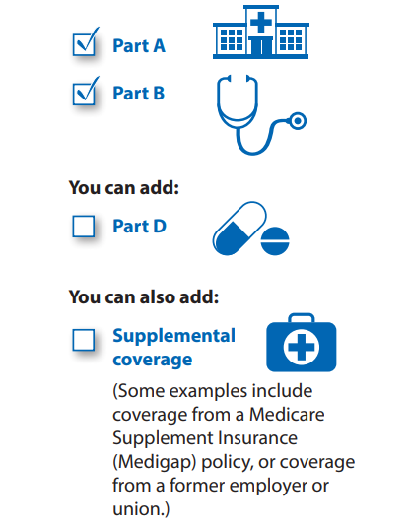
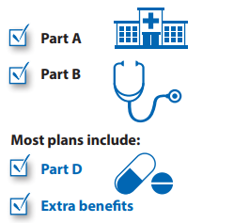
Question: MA APCD release 7.0 documentation indicates Medicare data is released only to government agencies. However, the MA APCD submission guides include product codes for Medicare. Is commercial carrier Medicare data available to non-government applicants? What type of Medicare products are included in the MA APCD and on how many beneficiaries?
MEDICARE
DATA
Answer: CHIA receives Medicare data (“Original Medicare”) from the Centers for Medicare & Medicaid Services (CMS) under a Data Use Agreement (DUA). Under terms of the DUA, CHIA only releases Original Medicare data to government* applicants. Original Medicare beneficiaries can obtain supplemental coverage through commercial carriers and have the option of receiving Medicare through commercial carrier “Medicare Advantage” plans which can include hospital, medical and pharmacy benefits. Claims data from commercial carrier supplemental coverage, pharmacy benefit managers, and Medicare Advantage plans submitted to the MA APCD are available to all applicants. According to CMS’s 2019 product guide **, the difference between Original Medicare and Medicare Advantage products is as follows:
Original Medicare
(separate extract available only to government* applicants)
Medicare Advantage
(included in the MA APCD available to all applicants)
Medicare Part A (Hospital Insurance)
Medicare Part B (Medical Insurance)
Beneficiaries can add Medicare Part D (Drug Coverage).
Beneficiaries can use any doctor or hospital that takes Medicare, anywhere in the U.S.
Medicare Advantage is an “all in one” alternative to Original Medicare. These “bundled” plans include Part A, Part B, and usually Part D.
In most cases, beneficiaries need to use doctors who are in the plan’s network.
Most plans offer extra benefits that Original Medicare doesn’t cover— like vision, hearing, dental, and more.
Note: Supplemental coverage submitted by commercial carriers directly to MA APCD is available to all applicants
Note: * Government agencies are limited Massachusetts state agencies and Federal agencies
** Understanding Medicare Advantage Plans, CMS Product No. 12026, Sept. 2019

Slide 11
Answer (continued): To gauge the number of beneficiaries who have any type of commercial Medicare products in the MA APCD as a proportion of the Massachusetts population, we assessed both medical coverage of the entire population as a proportion of the Census population and coverage for any Medicare product types as a proportion of the population 65 and older.
MEDICARE
DATA
In Table 1 below, MA census population* for 2013 to 2017 (first column) and all MA residents with medical coverage in the APCD (second column) show that data from 2013 to 2015 was close to population-based (over 95%) followed by a drop to 85% in 2016 (due to Gobeille). This drop was corroborated by comparing the Census American Community Survey estimate on insured population** under 65 years old (third column) to APCD beneficiaries under 65 with medical coverage (fourth column). In Table 2, census estimates for MA residents age 65 and over (first column) were compared to 65 and older age group in the APCD with different types of Medicare coverage (columns 2 through 7). Year 2017 showed increases for all products except Medicare Advantage, however the proportion of the population age 65 and over in the MA APCD with Medicare Advantage (26.86%) was closely aligned with CMS historical data on Massachusetts resident year 2017 Medicare Advantage enrollment (26.42%).****
Table 1. 5-Year Comparison of MA Census Population to MA APCD All Insured and Insured Under Age 65
Year | MA Census Population Estimate | MA Residents*** in APCD | MA Census Insured** Population Estimate (Under Age 65) | MA Residents*** APCD (Under Age 65)
2013 | 6,613,654 | 6,637,940 | 5,662,008 | 5,679,004
2014 | 6,668,348 | 6,687,425 | 5,691,319 | 5,676,655
2015 | 6,718,090 | 6,831,678 | 5,712,361 | 5,792,745
2016 | 6,736,017 | 5,694,862 | 5,699,946 | 4,734,582
2017 | 6,785,622 | 5,737,664 | 5,714,204 | 4,732,344
Table 2. 5-Year Comparison of MA Census Population Age 65 and Older to MA APCD
Massachusetts Residents Insured Age 65 and Older by Medicare Coverage Types
Year | MA Census Population Estimate (Age 65 and Older) | Medicare Advantage In MA APCD | Part A Only | Part B Only | Part A and B Only | Part C Only | Part D Only
2013 | 961,031 | 310,441 | 10,304 | 1,787 | 541,639 | 5,679 | 17,574
2014 | 990,097 | 337,182 | 8,579 | 1,784 | 553,741 | 5,234 | 93,269
2015 | 1,015,577 | 347,993 | 9,681 | 1,850 | 562,703 | 4,739 | 116,419
2016 | 1,044,226 | 369,268 | 6,873 | 2,227 | 517,769 | 4,203 | 134,010
2017 | 1,074,425 | 288,602 | 7,590 | 2,431 | 533,251 | 5,159 | 230,360
Notes: * Census American Community Survey Demographic Profile Data, ** Census American Community Survey Insured Population Estimate (Under Age 65) for civilian noninstitutionalized population, *** MA Residents Under 65 with Medical Coverage , **** Centers for Medicare & Medicaid Services, Office of Enterprise Data and Analytics, Data Warehouse

Slide 12

Question: There is an “Insurance Type Code Product” field in claims data (MC003, PC003, DC003) and in eligibility data (ME003). In the product file, there is also a field called “Product Line of Business” (PR004) which appears to have similar coding options to “Insurance Type Code Product.” Are there any differences in the coding options from one MA APCD table to another?
Insurance Type Code Products
Answer: Based on the CHIA 2019 All Payer Claims Data Submission Guides, the Insurance Type Code Product field in the Medical Claims, Pharmacy Claims, Dental Claims and Member Eligibility files contain the same 40 coding options across all four file types. The Product file’s Product Line of Business field contains 36 coding options. The Insurance Type Code Product field and Product Line of Business field have 24 product definitions in common, see Table 1 below)
Table 1. Product Definitions Shared Across all Four Files
Code | Definition
12 | Preferred Provider Organization (PPO) (Note: Code PR used in Product file)
13 | Point of Service (POS)
14 | Exclusive Provider Organization (EPO)
15 | Indemnity Insurance
16 | Health Maintenance Organization (HMO) Medicare Advantage
17 | Dental Maintenance Organization (DMO) (Note: Code DM used in Product File)
20 | Medicare Advantage PPO
21 | Medicare Advantage Private Fee for Service
CH | Champus
DS | Disability
LM | Liability Medical
MC | Medicaid
MO | Medicaid Managed Care Organization
MP | Medicare Primary
MS | Medicare Secondary Plan
OF | Other Federal Program (e.g. Black Lung)
QM | Qualified Medicare Beneficiary
SC | Senior Care Option
SP | Supplemental Policy
TF | HSN Trust Fund
TV | Title V
VA | Veterans Administration Plan
WC | Workers' Compensation
ZZ | Other

Slide 13
Answer (continued): While the claims, eligibility and product files contain 24 shared definitions, the claims and eligibility Insurance Type Code Product field contain 16 definitions not found in the product file’s Product Line of Business field, see Table 2 below. The product file’s Product Line of Business field contains 11 fields not found in the claims and eligibility file, see Table 3 below. Please note that while Product Line of Business contains a Medicare code (MR), the claims and eligibility Insurance Type Code Products contain the more granular definitions of Medicare Part (MA), Part B (MB), and Part D (MD).
Insurance Type Code Products
Table 2. Product Definitions Contained only in Claims (MC003, PC003, DC003) and Eligibility (ME003) Files
Table 3. Product Definitions Contained only in Product Line of Business (PR004)
Code | Definition
09 | Self-pay
10 | Central Certification
11 | Other Non-Federal Programs
30 | Accountable Care Organization (ACO) – MassHealth
AM | Automobile Medical
BL | Blue Cross / Blue Shield
CC | Commonwealth Care
CE | Commonwealth Choice
CI | Commercial Insurance
HM | Health Maintenance Organization
HN | HMO Medicare Risk/Medicare Part C
IC | Integrated Care Organization
LI | Liability
MA | Medicare Part A
MB | Medicare Part B
MD | Medicare Part D
Code | Definition
AC | Accident Only
BH | Basic Hospital
HC | HMO - Closed
HO | HMO - Open
IN | Individual
MR | Medicare
PC | Medicaid Primary Care Clinician Plan
QH | Qualified Health Plan
SA | Self-Administered Group
UN | Unemployment
VS | Vision

Slide 14
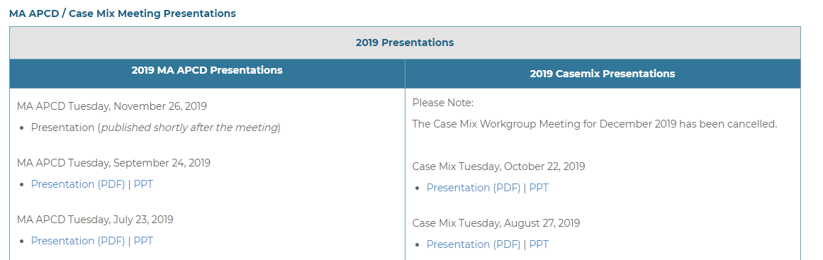
Where can I find old User Workgroup Presentations?
http://www.chiamass.gov/ma-apcd-and-case-mix-user-workgroup-information/

Slide 15
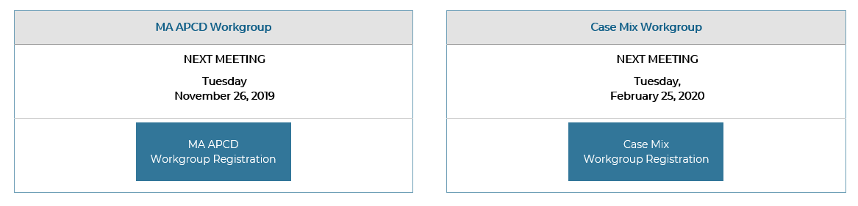
When is the next User Group meeting?
The next meeting is Tuesday, Jan. 28 at 3 p.m. (visual below depicts today’s meeting but will be updated)
http://www.chiamass.gov/ma-apcd-and-case-mix-user-workgroup-information/

Slide 16
Questions?
Questions related to MA APCD:
apcd.data@state.ma.us
Questions related to Case Mix:
casemix.data@state.ma.us
REMINDER: Please include your IRBNet ID#, if you currently have a project using CHIA data.

Slide 17
Call for Topics and Presenters
If there is a TOPIC that you would like to see discussed at an MA APCD or Case Mix workgroup in 2020, contact Amy Wyeth [amy.wyeth@state.ma.us]
If you are interested in PRESENTING at a MA APCD or Case Mix workgroup in 2020, contact Amy Wyeth [amy.wyeth@state.ma.us]
You can present remotely, or in-person at CHIA.

