Slide 1

MASSACHUSETTS
All-Payer Claims Database
Overview
July 2016

Slide 2
MA All-Payer Claims Database (MA APCD)
Intended to simplify the process by which payers submit claims data to various MA state agencies
State agencies required, if feasible to use the MA APCD before requesting data directly from payer
Also intended to benefit carriers by reducing the number of complex, overlapping, and sometimes contradictory requests for data
Contents:
Medical, pharmacy and dental claims data for the majority of Massachusetts residents, and
Details of providers, products, and benefit plans
Member/patient demographics
Available to state agencies, payers, providers, researchers and others
Subject to Federal and State privacy rules and regulations

Slide 3
Administrative Simplification Selected Data Elements in the MA APCD
Connector/Risk Adjustment for ACA Indicator Purchased thru HIX, Actuarial Value, Tobacco
Use
Division of Insurance NAIC Code
Health Policy Commission Total Medical Expense
Group Insurance Commission
GIC ID
CHIA for Total Medical Expense, Cost Trends and Relative Pricing Non Claims Payments, Payment Arrangement Type
Connector and DOI Monthly Premium, Employer ZIP, Family Size
Connector, DOI and GIC
Market Category Code
Connector, CHIA and DOI
Employer Contribution
MA All Payer Claims Database
Private and Public Payers

Slide 4
MA APCD Builds on CHIA’s Expertise and Systems
Case Mix Files – Discharge, Emergency Department, Observation (Acute Care Hospitals)
Health Care Quality and Cost Council
(Payers)
All Payer Claims Database (Payers)
1982
2006
2010
2016

Slide 5
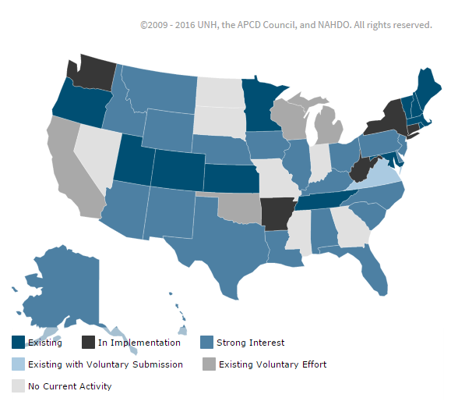
MA APCD is Consistent with a Growing National Trend

Slide 6
The MA APCD is Comprehensive Files and Selected Elements
MA All-Payer Claims Database
Provider File
Member Data
Claims Files (n = 3)
Product File
Benefit Plan
Member File
Patient Demographics Age, gender, relationship to subscriber, address, plan ID (encrypted)
MassHealth Enhanced Eligibility (MHEE)
Type of Product HMO, POS, Indemnity
Type of Contract Single person, family
Coverage Type Self-funded, Individual, Small group
Service/prescribing provider Name, Tax ID, Payer ID, NPI, Specialty code, City, State, Zip code
Billing Provider Name, payer ID, NPI
Medical Claims
Pharmacy Claims
Dental Claims
Service Information
Service and paid dates, paid amount, admission types, diagnosis and procedure information
Actuarial Values and Control Totals for plans subject to ACA Risk Adjustment

Slide 7
Claims Volume Concentration Ratios MA APCD Release 4.0 (CY 2010-14)
 | Medical Claims | Pharmacy Claims | Dental Claims
Top 5 Payers | 75.86% | 59.13% | 84.78%
Top 10 Payers | 89.47% | 83.82% | 96.49%
Top 15 Payers | 94.38% | 94.34% | 98.12%
Top 20 Payers | 96.98% | 96.98% | 99.13%
Top 25 Payers | 98.58% | 98.49% | 99.59%
Total Payers Submitting Data | 73 | 55 | 54

Slide 8
Data Presently Available Release 5.0
Claims with dates of service January 1, 2011 - December 31, 2015
Paid through March 31, 2016
Self-insured plans beginning 2011
Public and private payers
Medicare data available to state agencies
Generally covers all Massachusetts residents*, with the following excluded groups:
Uninsured/self pay
Workers’ Compensation
TriCare/VA
Federal Employees Health Benefit Plan
Small private insurers**
* Includes out of state residents who are GIC members
** CHIA continues to develop regulations concerning minimum data thresholds. Carriers with less than the minimum data threshold would not be required to submit data to the APCD unless they required by DOI or the Connector.

Slide 9
MA APCD Data Release
Data release is subject to CHIA’s data release regulation (957 CMR 5.00) as well as federal and state law
Requests to use MA APCD data are considered through a multi-layer review process that considers: risk to patient privacy, research and project objectives, and the public interest
Data elements are characterized into three levels that determine if they can be released and to whom they can be released:
Level 1 – de-identified data per federal privacy law
Level 2 – elements that pose a risk of re-identification
Level 3 – elements with direct patient identifiers

Slide 10
MA APCD Data Release (Cont’d)
Data is released to Government entities through custom extracts based on detailed specifications developed by the applicant with the support of CHIA staff.
May request data unavailable to Non-Government applicants, including:
All Level 2 and Level 3 data elements
Medicare data
Benefit Plan File data elements
MassHealth Enhanced Eligibility (MHEE) data
Data is released to Non-Government applicants through Limited Data Sets (LDS) that exclude:
All Level 3 data elements
Some Level 2 data (quasi-identifiers, data elements that are missing a significant amount of data or data elements that pose re-identification risk

Slide 11
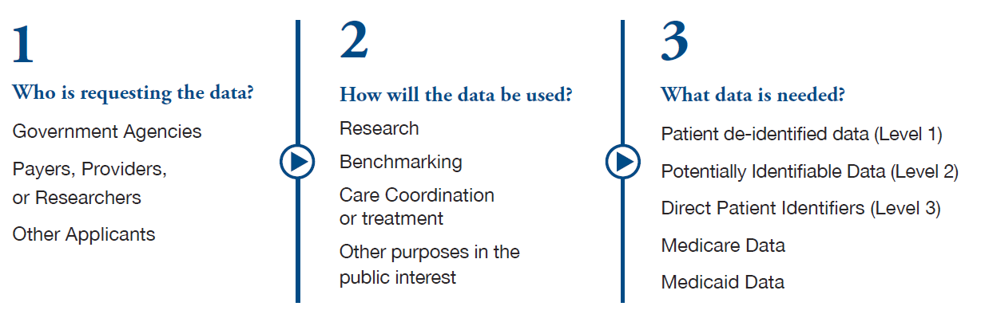
Data Release Policies and Procedures Depend on Several Factors
Consult the CHIA website (chiamass.gov/chia-data) and regulation 957 CMR 5.00
for how these factors apply to your specific circumstances.

Slide 12
Release of Public Payer Data in the MA APCD
MassHealth
Applications for MassHealth data, including data from the Health Safety Net and the Medicaid Managed Care programs, must be approved by MassHealth.
Federal law requires restricts use of protected health information of Medicaid recipients to uses the benefit the Medicaid program.
Medicare
Medicare fee-for-service data may only be shared with state agencies
Medicare Advantage data is contained within the general MA APCD release dataset

Slide 13
Multi-Layer Review Process Transparency and Protection of Patient Privacy
All applications reviewed by the Data Privacy Committee
Chaired by CHIA Chief Privacy Officer
Staffed by CHIA Chief Security Officer and CHIA data specialists
Non-government applications, including those from researchers, consultants and others, are further reviewed by the Data Release Committee
Outside advisory panel of consumers and experts from carriers, providers and research community
Considers public interest
Applications posted on CHIA website for public comment
Final decision rests with CHIA Executive Director based on recommendations of these committees

Slide 14
Research Using MA APCD Data Examples of Approved Applications
“Studying the Impact of Health Policy on Health Outcomes”
“Child Health Care Quality Measurement – Core Measure Set Testing”
“Evaluation of Mass in Motion and the Community Transformation Grants (CTGs)
“Examination of STD, HIV, and Viral Hepatitis Testing, Treatment, and Screening Trends in Massachusetts”
“Utilization of Tobacco Treatment in Massachusetts to Quit Smoking”
“The Effects of Fragmentation in Health Care”
See the CHIA website for a full list of applications.

Slide 15
For more information please contact
apcd.data@state.ma.us
Thank you for your interest in the Massachusetts All Payer Claims Database.

