Slide 1
Task Force on Behavioral Health Data Policies and Long Term Stays Meeting Two
December 18, 2014
Beth Waldman and Megan Burns

Slide 2
Agenda
Welcome
Public comment
Discussion of draft vision and measures
Long term stays
Next Steps

Slide 3
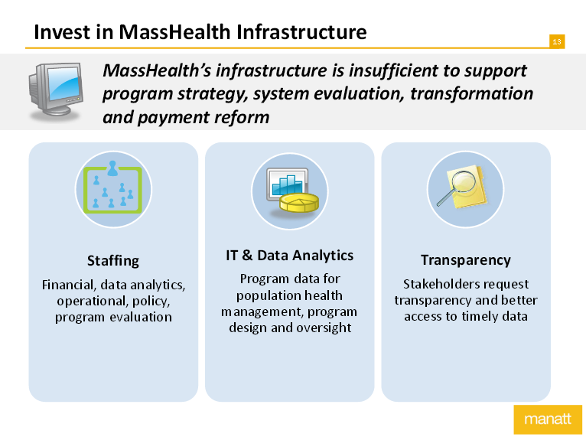
Since We Last Met….
MMPI released 5 priority areas for the new administration including Behavioral Health Integration and Infrastructure Investment
Source: http://bluecrossfoundation.org/sites/default/files/Manatt%20Presentation_FINAL.pdf

Slide 4
Since We Last Met…
MA Health Policy Forum released a report on racial and ethnic disparities in behavioral health

Slide 5
Happening now…
The Health Planning Council is releasing its final report today.

Slide 6
Connecting the Dots….
Current and past work is highlighting the need for data that can tell us more about the MA behavioral health system and its performance.

Slide 7
Connecting the Dots…
Activity Performed by the BH Data Policy and Long Term Stay Task Force
Identify characteristics of high performing BH system
Identify what to measure
Issue report detailing measurement goals and gaps in ability to achieve those goals
Activity Taken by State Agencies or Legislature
State might invest in BH data collection
Laws may be changed
Goal
Public Dashboard on Performance of Behavioral Health System

Slide 8
Draft Vision
Discussion of Draft Vision
Packet includes draft vision
Key topic areas are in red
Looking for feedback on topics:
What is missing?
What shouldn’t be there?

Slide 9
What Measures Can Assess the Behavioral Health System?
Our goal is to develop measures that would help the legislature assess the performance of the behavioral health system and to inform its investments of resources.
When reviewing these measures, we will need to consider:
Are these good measures?
Do they sufficiently assess the performance of the behavioral health system?
Which measures best indicate system performance without needing additional information?

Slide 10
Five Draft Domains
Person Centered
Workforce & Infrastructure
Access
Health & Wellbeing Outcomes
Fair and Reasonable Payment Rates and Financial Alignment

Slide 11
Person Centered Measures
How much improvement perceived in oneself as a result of the care provided*
Percent of patients that agree they had a team of providers working to meet the patient’s needs
Ability to access care when needed
Consumer and family participant in treatment planning, as desired, and agreement with plan of care

Slide 12
Workforce & Infrastructure Measures (1 of 2)
Number of providers in specialty, including:
Hours work
Work setting
Types of insurance accepted
Training
Languages spoken
Types of services provided

Slide 13
Workforce & Infrastructure Measures (2 of 2)
Numbers and types of behavioral health providers with interoperable EHRs and protocols in place to share information with physical health and behavioral health providers.
Number of prescribing providers with ability to review up-to-date behavioral and physical health medical lists prior to issuing new prescriptions

Slide 14
Access Measures (1 of 2)
Number of patients in the ED that are ready to be discharged or admitted but unable to leave ED because they are waiting for available care in either the community or hospital.
Number of individuals with more than six ED visits within a 12 month period with a behavioral health diagnosis
Number of patients in IP psychiatric care that are ready to be discharged to step-down care but unable to leave IP care because they are waiting for available step-down care.

Slide 15
Access Measures (2 of 2)
Unduplicated count of individuals receiving behavioral health services in the state as compared to those expected to need behavioral health services (based on prevalence)
Number of licensed beds and occupancy rates for:
IP psychiatric beds
Free-standing psychiatric facility
DMH Continuing Care facilities
Number of licensed inpatient psychiatric beds compared to number of staffed beds, by region, including nearby out of state facilities
Average time to appointment for outpatient behavioral health care, by service type.

Slide 16
Care Delivery, Health and Wellbeing Outcomes: Behavioral Health Integration
Number of patients with behavioral health issues that are being screened for medical issues (e.g., LDL, BP, BMI, etc. as appropriate)
Number of patients with medical health issues that are being screened for behavioral health issues in the primary care setting (e.g., depression, substance use, etc.)
Number of primary care practices that offer integrated behavioral health services
Number of behavioral health practices that offer integrated primary care services

Slide 17
Care Delivery, Health and Wellbeing Outcomes: Other Measures
Provider performance against evidence-based standards of care
Readmissions to any care setting within 30 days of discharge from IP psychiatric care
Follow-up after hospitalization for mental illness or substance use disorder within 7 days and within 30 days
Follow-up referral and adequate connection to care after discharge
Number of arrests for individuals who have received behavioral health care and for individuals who have received treatment within the past 30 days
Percent of individuals with behavioral health needs who have stable housing

Slide 18
Fair and Reasonable Payment Rates / Financial Alignment
Variation in payment rates across provider types
Total cost of care for individuals receiving behavioral health services
Number of providers that receive payment and / or performance incentives for integration and / or coordination work
Cost of care for individuals receiving behavioral health services in a hospital setting, including ED care
Inclusion / exclusion of behavioral health in alternative payment contracts

Slide 19
Long Term Stays Discussion: A Preview
Chapter 230 asks Task Force to make recommendations to:
reduce the number of long-term patients in DMH Continuing Care Facilities, acute psych units and emergency departments
Suggests potential solutions including:
Increased capacity in Crisis Stabilization Units
Prioritization of individuals in need of re-admission within 30 days of discharge from a DMH Continuing Care Facility

Slide 20
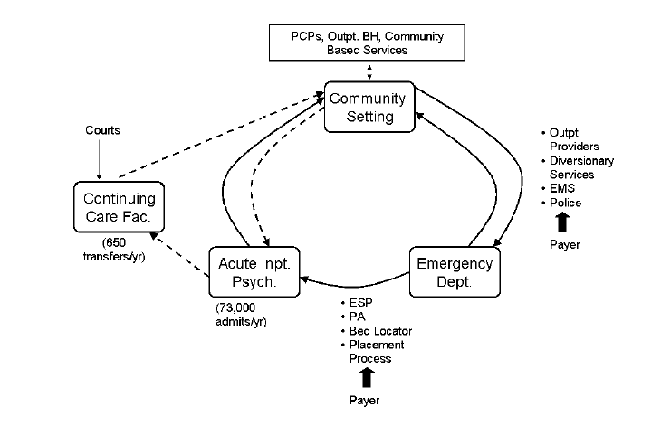
Complex, Interdependent System
Source: ED Length of Stay Issues for Behavioral Health Patients: Update. June 6, 2013. EOHHS

Slide 21
Available Data on Long Term Stays
State collects information on the children who are in specialized services and ready for discharge through the CARD List. This does not measure ED, but does lead to inability to discharge others from the ED
State also collects data on the number of adults who are awaiting placement in DMH Continuing Care Facilities through the DART list.
Hospitals individually track who is “boarding” in the ED, or who is inpatient but awaiting discharge. Required to report to DPH if over 12 hours.

Slide 22
CARD List
Source: http://www.mass.gov/eohhs/gov/commissions-and-initiatives/children-awaiting-resolution-and-disposition.html

Slide 23
Next Steps
Next meeting: January 27th 9:30-noon.
Location TBD
Consider data questions and develop survey for insurers/state purchasers based on today’s conversation
Next meeting will focus on Long Term Stays and potential solutions to recommend

Slide 24
Contact Information
For any questions contact:
Beth Waldman: bwaldman@bailit-health.com or
781-559-4705
Megan Burns: mburns@bailit-health.com or
784-559-4701
Joe Vizard: joseph.vizard@state.ma.us or
617-988-3313

