Slide 1
Task Force on Behavioral Health Data Policies and Long Term Stays Meeting Three
February 26, 2015
Beth Waldman and Megan Burns

Slide 2
Agenda
Welcome 9:30 am – 9:40am
Public Comment 9:40 am – 9:55 am
Long Term Stays: ED Boarding 9:55am – 11:40am
Follow-up Conversation on Data 11:40am – 11:55am
Next Steps 11:55am – noon

Slide 3
Long Term Stays: Our Charge
To make recommendations on how to reduce the number of long-term patients in DMH continuing care facilities, acute psychiatric units and emergency departments.

Slide 4
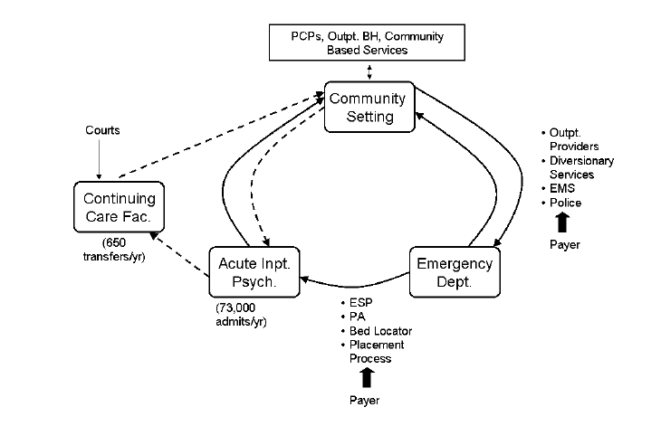
Complex, Interdependent System
Today’s Meeting
March Meeting
Source: ED Length of Stay Issues for Behavioral Health Patients: Update. June 6, 2013. EOHHS

Slide 5
What is the Problem We’re Trying to Solve?
Increase in number of BH visits to the emergency department. (Chang et al, 2012).
Average duration of BH patient stay in ED exceeds non- BH visit by 42%. (Chang et al, 2012)
40% of psychiatric ED visits typically lead to a hospital admission – 2.5 times the rate for other conditions. (Owens et al, 2007)
Boarding contributes to poor quality care for behavioral health patients and contributes to ED overcrowding.
ED Boarding in Massachusetts is ill-defined,

Slide 6
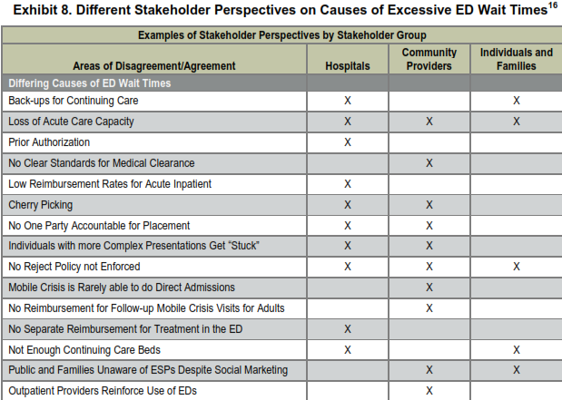
What Do Providers and Families Believe Contributes to ED Boarding?
Source: “Massachusetts General Court Mental Health Advisory Committee Report Phase I and Phase II” June 30, 2014. Abt Associates

Slide 7
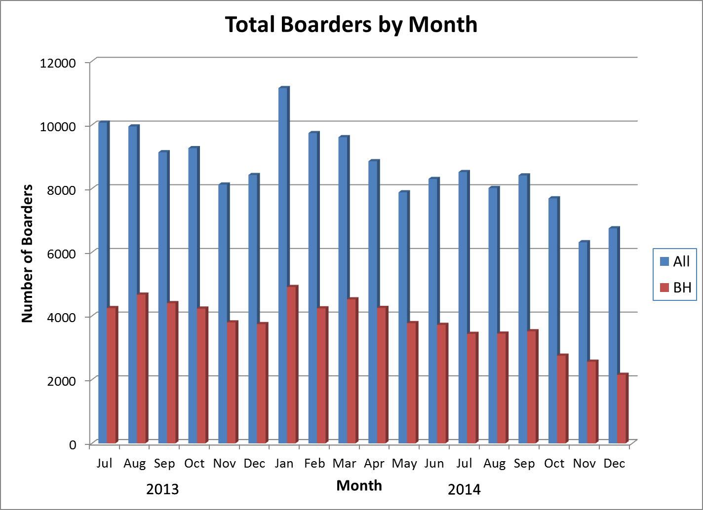
Statewide Total Boarders by Month (July 2013 – Dec 2014) (DPH Report)

Slide 8
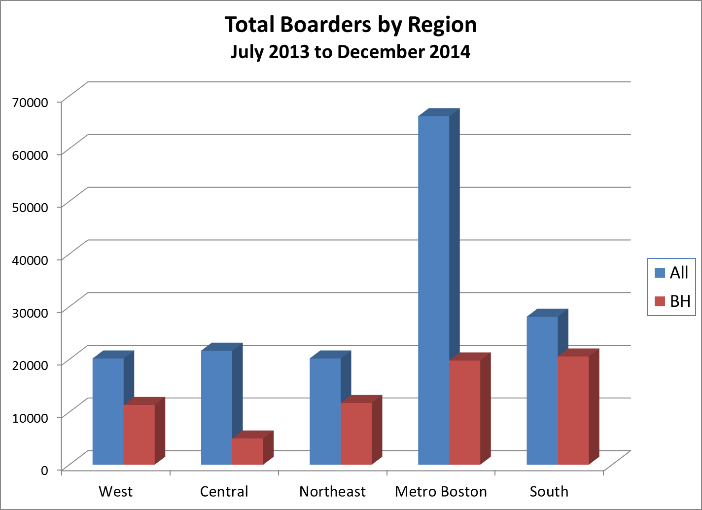
Total Number of 12 Hour Visits (DPH)

Slide 9
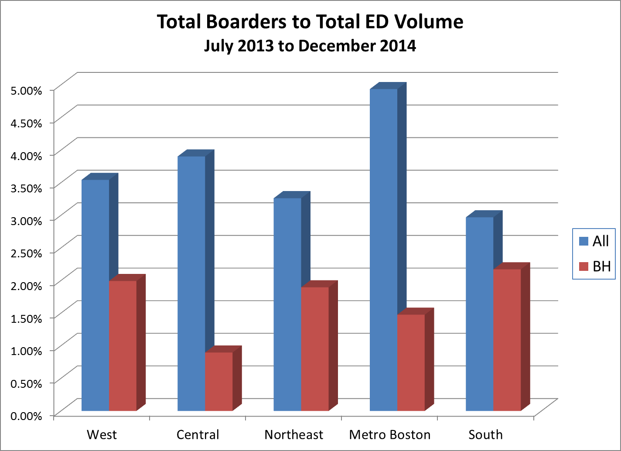
Percentage of ED Visits Lasting 12 Hours or More (DPH)

Slide 10
Mental Health ED Boarding
Mark Pearlmutter, MD, FACEP
Associate Professor Tufts University School of Medicine
VP and Chair, Emergency Network Services
Steward Health Care

Slide 11
Focusing our Discussion
Those patients without pre-arranged beds had mean LOS of 20.1 hours

Slide 12
What Work Has Already Been Done About ED Boarding?
EOHHS
Department of Public Health
Boarding and Patient Flow Task Force (2009-2012)
Department of Mental Health
ED LOS and Psych Bed Access Initiative (2010-2012)
ED Length of Stay Issues for Behavioral Health Patients (2013)
Division of Insurance
Study of differences in plan records between behavioral health and non behavioral health patients in the ED (2014)
Legislatively mandated groups
Mental Health Advisory Committee (2014)
Special Commission examining the “bed finder” tool. (2014)

Slide 13
Identifying Recommendations
We presented to you a subset of 68 different recommendations / suggestions by the various aforementioned Task Forces, Work Groups, Commissions, etc.
Thank you for providing us with feedback on your thoughts about those recommendations.
Today, we will discuss a potential consensus recommendation and then discuss potential additional recommendations through the lens of four component problems that were identified in your feedback.

Slide 14
Consensus Recommendation?
Based on your feedback, we identified a potential consensus recommendation.
Accept the December 2014 report from the Special Commission to Investigate the Expansion and Enhancement of the MABHA Website.
Does everyone agree that bed finder website offered by MBHP is a useful tool and that the recommendations contained within the report should be acted upon by the legislature and the Administration?

Slide 15
Based on Your Feedback, We Identified Several Component Problems of ED Boarding
“Difficult to manage” patients are the hardest to place and have the longest lengths of stay in the ED.
While waiting for an inpatient psychiatric bed in the ED, patients often are not getting the care they need in the ED.
Data on the problem of ED boarding are sparse and inconsistent, and not all stakeholders are aware.
Other components?

Slide 16
Do these recommendations help place “difficult to manage” patients more quickly?
Payment:
Increased reimbursement for psychiatric inpatient admissions to allow for staffing and coordination of individuals with complex needs. (37)
Support legislation (e.g., House Bill 1788 (2013-2014)) which would provide licensure of beds designated for “difficult to manage” patients or medically complex patients. (17)
Increased participation by insurers in bed search and placement and increased reimbursement to the provider who must board the patient in their facility. (22)
Develop pilots for alternative payment models involving multiple providers to reduce the ED LOS of difficult to manage patients, which includes incentives for inpatient psych units to maintain open “difficult to manage” beds. (Revised TFM)

Slide 17
Do these recommendations help place “difficult to manage” patients more quickly, cont.?
Inpatient Service Availability / Capacity:
Establish single authority to make determinations for placement for patients who have extended boarding, been refused admission or whose course of treatment is in dispute. (15)
Establish piloting the use of single rooms / appropriate staffing ratio and other techniques that can help patients with aggressive behavior recover. (Revised 55)
Regulation to provide appropriate staffing levels in all care facilities on the weekend. (19)
DOI to develop standards to ensure plans have adequate BH networks. (14)
Enforce no reject provisions in hospital contracts. (31)

Slide 18
Do these recommendations help “ED boarders” receive the care they need while awaiting an available bed?
ED Processes / ESP Services:
For EDs with no / little psych support at a minimum have telepsych consultations, contract with an ESP or psych consultation service. (55)
ED Alternatives
Consideration of Taunton State hospital or other sites for pilot programs that divert high acuity and dual diagnosis patients away from EDs. (18)
Increase use of separate but adjacent psychiatric EDs within the hospital. (38)
Create post-ED crisis pod that would serve to care for patients needing emergent mental health care pre-inpatient stay or in lieu of inpatient stay. (TFM)

Slide 19
Does this recommendations help stakeholders to define, measure and act upon ED Boarding?
Recommendation:
Improve data collection by EDs on ED boarders, their insurance status, clinical status and reasons for boarding. Share data with DPH and with insurers (for their members) (New)
Potential dashboard measure:
Number of patients in the emergency department that are ready to be discharged or admitted but unable to leave ED because they are waiting for available care in either the community or hospital.

Slide 20
Other Recommendations For Group to Consider?
Are there other specific recommendations that you’d like the group to discuss today?

Slide 21
Before it started snowing….
In December, we discussed our goal to develop measures that would help the legislature assess the performance of the behavioral health system and to inform its investments of resources.
We presented measures for consideration and collected your feedback.

Slide 22
In follow-up to our December Meeting and in Preparation for our 3/10 Meeting
Bailit held a meeting with state agencies on 1/18 to identify issues across state agencies with data sharing.
Attending agencies
Center for Health Information and Analysis (CHIA),
Health Policy Commission (HPC),
MassHealth,
Department of Public Health (DPH - Bureaus of Substance Abuse Services (BSAS) and Health Planning);
Department of Mental Health (DMH),
Division of Insurance (DOI),
Attorney General’s Office (AGO)

Slide 23
Key Findings from State Agencies Meeting
Agencies devote significant resources to data collection and data analysis today
There is a clear recognition of agencies of need to work together on some long standing and difficult to solve issues, including:
Can't follow member through state agencies
Different terms used by different agencies
Privacy constraints: federal state law and agency policy

Slide 24
Discussion Topics for 3/10 Meeting
Revisit measures discussion and tie to specific data needs and priorities
Will produce matrix for your feedback with following columns:
Measures
Data Need/Source
Frequency
Stratification
Priority Level
Discuss potential recommendation to support state agencies in developing solutions to long-standing data issues

Slide 25
March Meetings
March 10th: 9:30-noon: Focus on Data
March 24th: 9:30-noon: Focus on Long Term Stays (inpatient and DMH continuing care facilities)
Location for all remaining meetings:
CHIA
501 Boylston Street
5th Floor, Newbury A & B

Slide 26
Contact Information
For any questions contact:
Beth Waldman: bwaldman@bailit-health.com or
781-559-4705
Megan Burns: mburns@bailit-health.com or
784-559-4701
Joe Vizard: joseph.vizard@state.ma.us or
(new) 617-701-8313

