Slide 1
CHIA user workgroup
Don Kirkwood (Manager of Data Release and Procurement)
Sylvia Hobbs (Manager of User Support)
Scott Curley (Manager Privacy & Compliance)
September 28, 2021
CENTER FOR HEALTH INFORMATION AND ANALYSIS

Slide 2
Agenda
Announcements:
  APCD Release 9.0/10.0 Updates
  FY20 Case Mix Release Projections
  Data Release and Application Update
Website Updates
Application Reminders
User Support Questions
  Prescription Prescriber
  Discharge Date
  Product Enrollment Date
  ED Physician Groups
Q&A

Slide 3
MA APCD Release 9.0/10.0
  Available Late Fall / Early Winter
  Applicants with approved projects that require updated APCD data (Release 9.0/10.0) should submit to CHIA a completed Exhibit B (Certificate of Continued Need and Compliance) of the Data Use Agreement. After submitting a completed Exhibit B you will receive an invoice (if applicable) for the requested data. Upon payment of the invoice the order for the data will be placed.
  Release 9.0/10.0 includes data on services from January 2015 – December 2020 with six months of claim runout.

Slide 4

Case Mix FY20 Release
*CURRENT* RELEASE TIMEFRAMES FOR EACH FILE:
  Inpatient (HIDD)
  Available for request
  Emergency Department (ED)
  Available for request
  Outpatient Observation (OOD)
  Mid-Fall 2021
  Applicants with approved projects that require newly available year(s) of Case Mix Data (e.g., FY 19) should submit to CHIA a completed Exhibit B (Certificate of Continued Need and Compliance) of the Data Use Agreement. After submitting a completed Exhibit B you will receive an invoice (if applicable) for the requested data. Upon payment of the invoice the order for the data will be placed.

Slide 5
Data Release and Application Updates
Due to Governor Baker’s emergency actions to limit the spread of COVID-19 CHIA’s workforce will be remote, for now. This arrangement will limit CHIA’s ability to produce and deliver data extracts. At this time, CHIA is releasing data and providing extracts to requestors.
During this time, CHIA will continue to accept and review data applications for both Case Mix and All-Payer Claims Database (MA APCD) datasets. Review committees, DRC and DPC, will continue their meetings remotely as necessary.
Due to CHIA’s physical office being closed, applications will be accepted without a fee. After receipt of the application, CHIA will issue an invoice which will allow applicants to remit payment online.
If you are a Data User that has a CHIA hard drive in your possession, please keep the hard drive at this time while CHIA’s physical office is closed.

Slide 6
Website Release Updates
  Updates on the production of APCD and Case Mix databases and status of data requests are now posted to CHIA’s website!
    Aim #1 is to provide weekly or bi-weekly status update on CHIA data products as they are in development.
    Aim #2 is to provide applicants with information about expected fulfillment status for individual data requests.
    Request IDs will be communicated to Data Requestors via email.
  Please visit http://www.chiamass.gov/status-of-data-requests/ to see the current status of releases.

Slide 7
Application reminders

Slide 8
Fee Waiver Request Reminders
  If you’re submitting a request for a fee waiver, remember to include the fee remittance form in your application package on IRBNet.
  Remember to submit supporting documentation (if required).
  If you’re requesting a financial hardship waiver, remember to submit information detailing your project’s financial situation (examples: project budget, grant funding, organizational / departmental funding). Also request to pay a specific price that you reasonably believe you’re able to afford to contribute.
  CHIA generally does not offer full financial hardship fee waivers. We expect all applicants to have made an attempt to find funding to cover the full cost of the data fees.
  Fee waiver requests can take some time to process – especially financial hardship requests.

Slide 9
USER questions

Slide 10

DISCHARGE
DATE
Question: A portion of the MA APCD inpatient medical claims are missing the discharge dates. We have used the case mix hospital inpatient discharge data before, and the discharge date is never missing. What accounts for the missing discharge dates in the MA APCD inpatient medical claims?
Answer: In MA APCD Release 8.0 approximately, 95% of the inpatient claims with missing discharge date have the patient discharge status code ‘30’ which, according to CMS, indicates the claim line is interim billing for someone who is still a patient. Remember one difference between the case mix hospital inpatient discharge data and MA APCD inpatient medical claims, is that the MA APCD inpatient claims includes nursing home and long-term care facilities. For this reason, though the discharge date is blank, the “date of service to” is populated indicating a line of service is interim billing for a person who is still a patient. In the Table below, you will see the frequency of specialties for the types of inpatient facilities where the discharge date is missing with the discharge status is ‘still a patient’. Therefore, the missing date is explained by services billed for patients who remain in nursing, long-term or residential treatment.
MA APCD Inpatient Facility Specialty Frequency with Discharge Date Blank
Taxonomy Code | Specialty Description | Frequency
314000000X | Skilled Nursing Facility | 69.8%
282E00000X | Long-term Care Hospital | 18.4%
282N00000X | General Acute Care Hospital | 4.3%
283Q00000X | Psychiatric Hospital | 2.4%
315P00000X | Intellectual Disabilities Intermediate Care Facility | 1.5%
311Z00000X | Custodial Care Facility | 1.5%
283X00000X | Rehabilitation Hospital | 0.4%
320600000X | Residential Treatment Facility | 0.3%
 | All Other Specialties | 1.5%
Continued

Slide 11
DISCHARGE
DATE
Answer (continued): Since 95% of the medical claims with missing
Discharge Date have the patient status code ‘30’, you can find
Additional references from CMS on the meaning of code ‘30’ .
In one patient status guidance document available at:
https://www.hhs.gov/guidance/sites/default/files/hhs-guidance-documents/JA0801.pdf
CMS explains:
Patient Status Code 30 - Still Patient or Expected to Return for Outpatient Services
This code is used when the patient is still within the same facility and is typically used when billing for leave of absence days or interim bills. It can be used for both inpatient or outpatient claims.
It is used for inpatient claims when billing for leave of absence days or interim billing (i.e., the length of stay is longer than 60 days).
On outpatient claims, the primary method to identify that the patient is still receiving care is the bill type frequency code (e.g., Frequency Code 3: Interim - Continuing Claim).
CMS also provides guidance on how the patient status code ‘30’ is used in combination with the Occurrence span code 70 to indicate qualifying hospital stay dates and Occurrence code 22 with date covered SNF care ended.

Slide 12

Question: We are trying to determine if a prescription that was filled was prescribed by a doctor (MD/DO) or physician assistant (PA or NP). What is the best way to determine the credentials the prescriber.
Answer: The limited data set pharmacy claims data available for non-government data
users includes the prescriber’s National Provider ID (PC048). If the data user applies for
and is approved to receive the decrypted NPI, the NPI can be linked to the CMS
National Plan and Provider Enumeration System downloadable data available at:
        https://npiregistry.cms.hhs.gov/
The CMS NPI Registry contains two relevant fields: the provider credential text and the provider other credential text. The MA APCD pharmacy claims table for Release 8.0 contains 716,460 distinct prescribing NPIs. The prescribers are not limited to Massachusetts. When the prescribing NPIs are linked to the CMS NPI Registry, 86.4% have credentials listed in NPI Registry. As you can see in the figure below, the largest proportion (77%) of prescribers are MDs, followed by nurse practitioners, physician assistants, DO’s and RNs.

Slide 13

Question: In MA APCD member eligibility (ME) table, the "product enrollment end date year“ for many rows is populated with the end date year “2299” and many are blank. That year is outside of the conceivable range of human life expectancy. What does the out-of-range year “2299” mean and why are so many end dates blank?
Product End Dates
Answer: The ME specifications for product enrollment end date (ME042) ask
carriers to report the date a member was disenrolled from the product. If a member was not disenrolled at the end of the current month, then the field is left blank. Some carriers, in their ME operations documentation, designate a specific future date for use if the end date is designated “open-ended” (See Figure 1 below). Two carriers specifically use ’12/31/2299’ for an open-ended end date. For such dates, determine which carriers the date is limited and find that their claims and ME operations documentation online. In the example “12/31/2299”, the products were for a public carrier and the designation of the date as open-ended was found in their documents on their website.

Slide 14

Question: A patient seen in the ED may have billing codes from a physician group in another city. We are trying to identify the hospital where the patient received care during their index ED visit. The billing facility fields include various names of institutions and billing entities but does not clearly link to a hospital. Is there a reliable way to link emergency department claims to the unique hospital / ED?
Physician Groups
Answer: In the medical claims table, the field provider location (MC0135), which is linked to the provider table, is intended to report on the geographic site where the medical care was provided. In the filing specifications for provider location, insurance carriers are instructed to: Report the unique code which identifies the location / site of the service provided by the plan rendering provider identified in MC134. The code should link to a provider record in field PV002 (Provider ID) and indicate that the service was performed at a specific location; e.g.: Dr. Jones Pediatrics, 123 Main St, Boston, MA, or Pediatric Associates, or Mass General Hospital, etc. Only the code is needed in this field, and the link to the Provider ID in the field PV002 (Provider ID) will allow the physical address and other identifying information about the service location to be captured. Type of location is an incorrect value.
The provider location in the medical claims release is a large integer field called “providerlocation_linkage_id.” This field is linked to the “linkingproviderid”. To determine whether the NPI associated with the linking provider id in the provider file when linked to the NPI registry reported a hospital or a physician’s group. A query for ED medical claims (i.e., siteofserviceonnsfcms1500claims = ‘23’) for Massachusetts
residents was linked to the provider file and the CMS NPI
registry. In the table to the right, you will see the Top
10 ED Provider Locations obtained through this linkage.
Keep in mind that this ranking will not match case mix due
to the 40% reduction in commercial claims in the MA APCD.
While the ED hospital locations are what you were looking for,
there were nevertheless still physician groups in the search
results. At the next MA APCD webinar, we will compare
geographic results comparing the rendering, service,
and billing provider NPIs.
Top 10 MA ED Provider Sites Through Linkage
Provider Organization Name
CAMBRIDGE PUBLIC HEALTH COMMISSION
BAYSTATE MEDICAL CENTER INC
HOLYOKE MEDICAL CENTER, INC.
MERCY HOSPITAL INC
BERKSHIRE MEDICAL CENTER, INC
BAYSTATE FRANKLIN MEDICAL CENTER
BROCKTON HOSPITAL, INC.
COOLEY DICKINSON HOSPITAL
BAYSTATE WING HOSPITAL CORPORATION
BAYSTATE NOBLE HOSPITAL CORPORATION

Slide 15
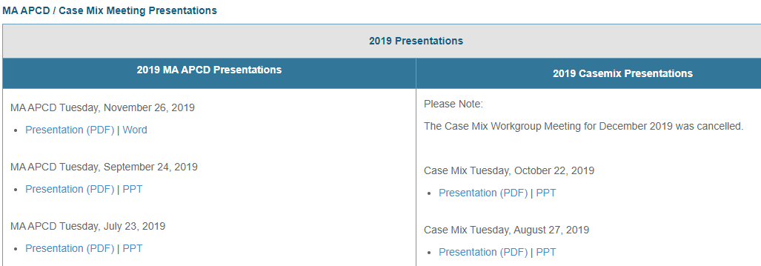
Where can I find past User Workgroup Presentations?
http://www.chiamass.gov/ma-apcd-and-case-mix-user-workgroup-information/

Slide 16
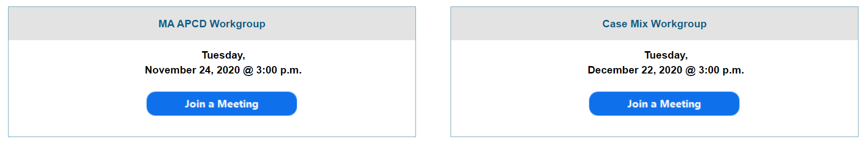
When is the next User Group meeting?
The next User Group will meet Tuesday, October 26.
http://www.chiamass.gov/ma-apcd-and-case-mix-user-workgroup-information/

Slide 17
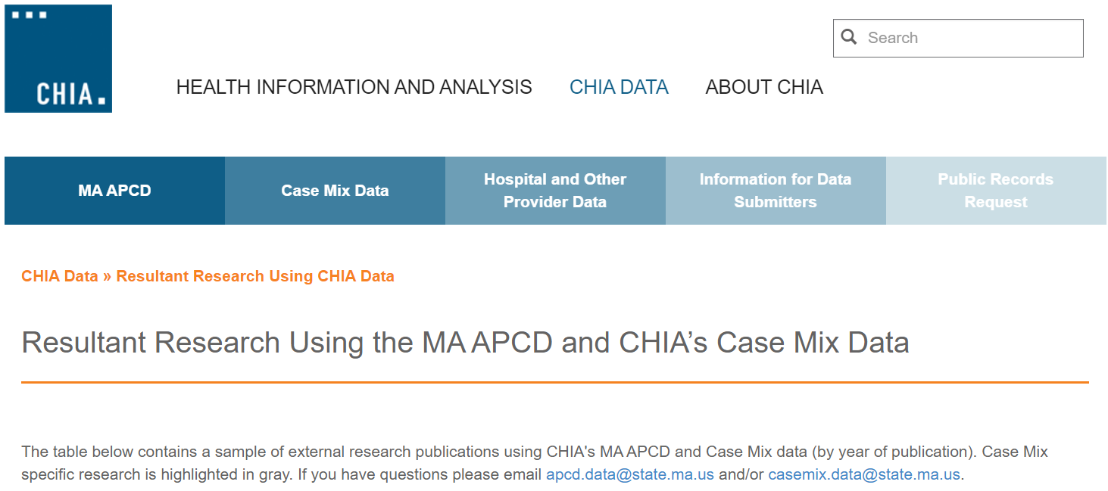
Resultant Research Using CHIA Data
https://www.chiamass.gov/resultant-research-using-chia-data

Slide 18
Questions?
Questions related to MA APCD:
apcd.data@chiamass.gov
Questions related to Case Mix:
casemix.data@chiamass.gov
REMINDER: Please include your IRBNet ID#, if you currently have a project using CHIA data.

Slide 19
Call for Topics and Presenters
If there is a TOPIC that you would like to see discussed at an MA APCD or Case Mix workgroup in 2021, contact Amy Wyeth [amy.wyeth@chiamass.gov]
If you are interested in PRESENTING at a MA APCD or Case Mix workgroup in 2021, contact Amy Wyeth [amy.wyeth@chiamass.gov]
You can present remotely, or in-person at CHIA
We may be reaching out to some data users with invitations to present, and hope you will consider this!

