Slide 1
CHIA user workgroup
Don Kirkwood (Manager of Data Release and Procurement)
Sylvia Hobbs (Manager of User Support)
Scott Curley (Manager Privacy & Compliance)
August 23, 2022
CENTER FOR HEALTH INFORMATION AND ANALYSIS

Slide 2
Agenda
Announcements:
  APCD Release CY 2020 Updates
  FY20 Case Mix Release Projections
Website Updates
User Support Questions
  Types of Provider IDs in MA APCD
  Differences between Types of Provider IDs
  MA APCD Between Table Provider ID Linkage
  National Provider ID (NPI)
  Linking MA APCD NPIs to external repositories
  Discussion of Provider Linkage Quality
Q&A

Slide 3
MA APCD CY 2020 (Release 10.0)
  Available for request
  Applicants with approved projects that require updated APCD data (CY 2020 Data) should submit to CHIA a completed Exhibit B (Certificate of Continued Need and Compliance) of the Data Use Agreement. After submitting a completed Exhibit B you will receive an invoice (if applicable) for the requested data. Upon payment of the invoice the order for the data will be placed.
  CY 2020 Data includes data on services from January 2016 – December 2020 with six months of claim runout.

Slide 4

Case Mix FY21 Release
*CURRENT* RELEASE TIMEFRAMES FOR EACH FILE:
  Inpatient (HIDD)
  Available for request
  Emergency Department (ED)
  Available for request
  Outpatient Observation (OOD)
  Available for request
  Applicants with approved projects that require newly available year(s) of Case Mix Data (e.g., FY 19) should submit to CHIA a completed Exhibit B (Certificate of Continued Need and Compliance) of the Data Use Agreement. After submitting a completed Exhibit B you will receive an invoice (if applicable) for the requested data. Upon payment of the invoice the order for the data will be placed.

Slide 5
Website Release Updates
  Updates on the production of APCD and Case Mix databases and status of data requests are now posted to CHIA’s website!
    Aim #1 is to provide weekly or bi-weekly status update on CHIA data products as they are in development.
    Aim #2 is to provide applicants with information about expected fulfillment status for individual data requests.
    Request IDs will be communicated to Data Requestors via email.
  Please visit http://www.chiamass.gov/status-of-data-requests/ to see the current status of releases.

Slide 6
USER questions

Slide 7

Claims Provider Data
The types of provider data in the member eligibility, medical, pharmacy, and dental claims differ in the magnitude. The four tables all contain a Linking Orgid Provider used in combination with Linking Provider Identifiers to link to each insurance carrier’s provider table data.
Dental Claims Medical Claims Member Eligibility
Data Element | Data Element Name
Derived | Linking OrgID Provider
DC018 | Service Provider Number
DC020 | National Service Provider ID
DC021 | Service Provider Entity Type Qualifier
DC025 | Delegated Benefit Administrator OrgID
DC026 | Service Provider Specialty
DC028 | Service Provider State
DC029 | Service Provider ZIP Code
DC030 | Facility Type - Professional
Data Element | Data Element Name
Derived | Linking OrgID Provider
MC024 | Service Provider Number
MC026 | National Service Provider ID
MC027 | Service Provider Entity Type Qualifier
MC031 | Service Provider Suffix
MC032 | Service Provider Specialty
MC034 | Service Provider State
MC035 | Service Provider ZIP Code
MC076 | Billing Provider Number
MC077 | National Billing Provider ID
MC100 | Delegated Benefit Administrator OrgID
MC112 | Referring Provider ID
MC118 | Referral Indicator
MC119 | PCP Indicator
MC125 | Attending Provider
MC131 | InNetwork Indicator
MC134 | Plan Rendering Provider Identifier
MC135 | Provider Location
MC242 | Plan Rendering National Provider ID
Data Element | Data Element Name
Derived | Linking OrgID Provider
ME036 | Health Care Home Number
ME038 | Health Care Home National Provider ID
ME046 | Member PCP ID
ME124 | Attributed PCP Provider ID
MC125 | TME OrgID - Physician Group of the Member’s PCP
Pharmacy Claims
While the MA APCD has a Master Patient Index (Member Link EID) to analyze distinct patients across carriers, it does not have a Master Provider Index. Although Medicare’s National Provider Identifier (NPI) can be used, which Medicare requires all enrolled individual practitioners and organizational providers to have, atypical providers such as certain transportation providers and respite providers might not have an NPI.
Data Element | Data Element Name
Derived | Linking OrgID Provider
PC024 | Pharmacy ZIP Code
PC055 | Prescribing Physician Zip
PC048 | Prescribing Physician NPI - National Provider ID
PC021 | National Pharmacy ID Number
PC023 | Pharmacy Location State
PC024 | Pharmacy ZIP Code
PC043 | Prescribing Provider ID
PC054 | Prescribing Physician State
PC055 | Prescribing Physician Zip
PC057 | Mail Order pharmacy
PC059 | Recipient PCP ID
PC072 | Delegated Benefit Administrator OrgID

Slide 8

CHIA defines a provider as an entity associated with either: 1. providing services to patients 2. submitting claims for services on behalf of a servicing provider 3. providing business services or contracting arrangements for a servicing provider. All critical fields to use for MA APCD between table linkage with the provider table are embedded with the word linkage_id at the end field name. These fields link to the linkingproviderid (PV002) in the provider table in combination with linkingorgpv which links to orgid in the provider table.
Claims Linking Provider IDs
MEDICAL CLAIMS
linkingorgpv
attendingprovider_linkage_id
billingprovidernumber_linkage_id
planrenderingprovideridentifier_linkage_id
providerlocation_linkage_id
referringproviderid_linkage_id
serviceprovidernumber_linkage_id
linkingorgpv orgid
+
linkage_id linkingproviderid
DENTAL CLAIMS
linkingorgpv
serviceprovidernumber_linkage_id
PROVIDER TABLE
orgid
linkingproviderid (PV002)
provider_affiliation_linkage_id
medicalhealthcarehomeid_linkage_id
PHARMACY CLAIMS
linkingorgpv
prescribingproviderid_linkage_id
recipientpcpid_linkage_id
A record In the MA APCD Provide Table represents a unique instance of a provider entity, and that provider’s affiliation to another entity, or a provider’s affiliation to a specific location.
MEMBER ELIGIBILITY
linkingorgpv
attributedpcpproviderid_linkage_id
healthcarehomenumber_linkage_id
memberpcpid_linkage_id

Slide 9

There are differences in the completeness and quality of provider identifiers . Data
users should carefully review the release documents before proceeding to link data.
For example, a carrier may have reported during one submission month an inadvertent
transposition of a digit that could impact linkage.
For example, for ME046 (Member PCP ID) carriers report the PCP identifier for members
with a corresponding ID in the Provider File, only used for members whose insurance
requires the selection of a primary care physician (e.g., HMO or POS plans).
For ME124 (Attributed PCP ID) carriers report PCPs attributed to the members
whose insurance products do not require the selection of a primary care
physician (e.g., PPO plans or indemnity products). This attribution is based on the carrier’s
own attribution methodology.
Even though there is a high
completeness of the PCP ID in the
member eligibility file (see figure 1),
the missing PCP ids were not
accounted for by the attributed PCP
IDs. Except for calendar
Year 2014, most of the attributed
PCP IDs (see figure 2) had both a
PCP ID and an attributed PCP ID.
Completeness of Provider IDs
Remember both active and inactive are in the provider table. Providers inactive prior to January 2015 are no longer submitted. Carriers are asked to report any and all provider information that aligns to the eligibility and claims data to insure that linking can occur.

Slide 10

The MA APCD LDS Provider Table only contains twelve (12) data elements (see Table below). For this reason, many data applicants request the national provider ID (NPI) for the purposes of linking it to provider to external repositories. CMS provides the following definition and explanation of the NPI.
PROVIDER EXTERNAL LINKAGE DATA
  What is a National Provider Identifier (NPI)
    The Health Insurance Portability and Accountability Act of 1996 (HIPAA) specifies the set of providers that must have NPIs as those that execute HIPAA transactions (i.e., only some Medicaid/CHIP “providers” have NPIs)
    The NPI is a 10-digit national identifier assigned by the National Plan and Provider Enumeration System (NPPES)
    NPPES Type 1 NPI – Individual Practitioners
    NPPES Type 2 NPI – Organizational Providers and their sub-parts
    The same organizational unit (i.e., acute care hospital) can have more than one NPI.
  Organizational provider sub-parts
    “Some organization health care providers are made up of components that function somewhat independently from their ‘parent’ organization. These components may furnish different types of health care or have separate physical locations where health care is furnished. These components and their physical locations are not themselves legal entities but are part of the organization health care provider (which is a legal entity). The NPI Final Rule refers to the components and locations as subparts.” (CMS, Medical Learning Network, December 2016 909434)
    Stores in a pharmacy chains and departments in hospitals are examples of organizational provider sub-parts
    Medicare Durable Medical Equipment (DME) suppliers must have their own NPI (i.e., Pharmacy Chain Stores)
MA APCD LIMITED DATA SET PROVIDER TABLE
Data Element | Data Element Name
Derived | Release ID
Derived | Provider Delegate
Derived | CMS Provider Type
Derived | Submission Year Month
Derived | Submission Control ID
Derived | Provider ID
PV001 | Submitter
PV002 | Plan Provider ID
PV015 | Provider DOB (Year Only)
PV021 | ZIP Code
PV039 | National Provider ID
PV040 | National Provider2 ID

Slide 11
There are many challenges linking and identifying relationships between providers and provider care setting locations in linking within the MA APCD and to external data repositories. CHIA’s linking provider IDs were created to reduce these challenges.
CHALLENGES IN
PROVIDER LINKAGE
  Challenges in identity resolution among providers with multiple affiliations and sharing organizational IDs in determining provider-to-provider relationships, provider-to-organization relationships, large group practices, and multi-state hospital networks.
  Determining the extent to which both historical and current provider data are needed based on the time period of the claims
  Resolving conflicts in provider attributes from multiple data sources
  Determining which data should be cleaned or imputed to resolve inconsistencies and assess patterns in missing data.
CHIA is currently making a conscious decision to collect numerous identifiers that may be associated with a provider:
  PV002 Plan Provider ID
  PV006 License Id
  PV007 Medicaid Id
  PV008 Last Name
  PV009 First Name
  PV036 Medicare Id
  PV039 National Provider ID
  PV040 National Provider2 ID
These identifiers will be used by CHIA in the future to create a Master Provider Data Set for analyzing providers across submitters and help link providers across carriers in the event that the primary linking data elements are not a complete match. The existence of these extra identifying elements will improve the quality of our matching algorithms

Slide 12
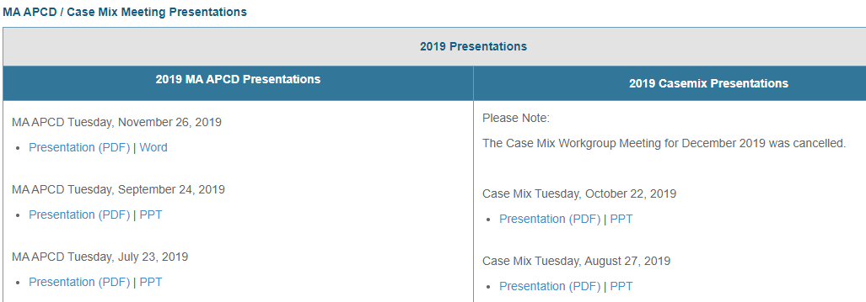
Where can I find past User Workgroup Presentations?
http://www.chiamass.gov/ma-apcd-and-case-mix-user-workgroup-information/

Slide 13

When is the next User Group meeting?
The next User Group will meet Tuesday, September 27.
http://www.chiamass.gov/ma-apcd-and-case-mix-user-workgroup-information/

Slide 14
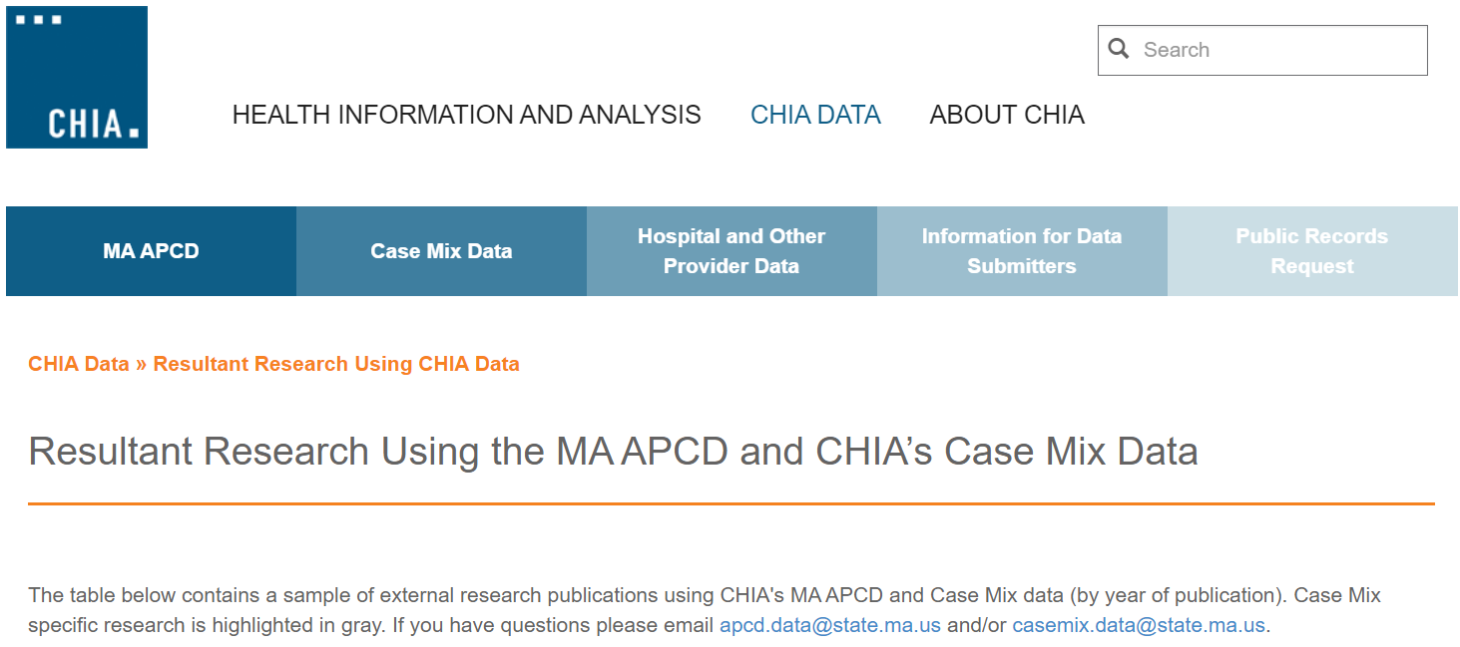
Resultant Research Using CHIA Data
https://www.chiamass.gov/resultant-research-using-chia-data

Slide 15
Questions?
Questions related to MA APCD:
apcd.data@chiamass.gov
Questions related to Case Mix:
casemix.data@chiamass.gov
REMINDER: Please include your IRBNet ID#, if you currently have a project using CHIA data.

